Slide 1
Microservices
FastAPI and Redis

Slide 2
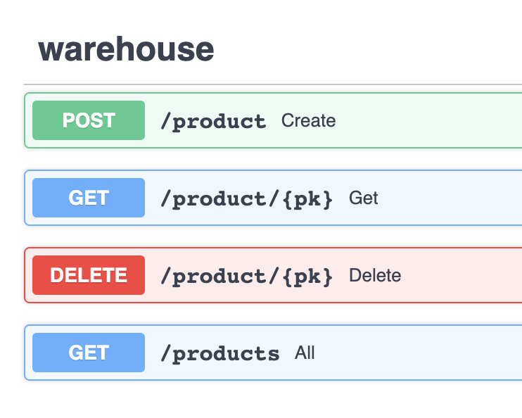
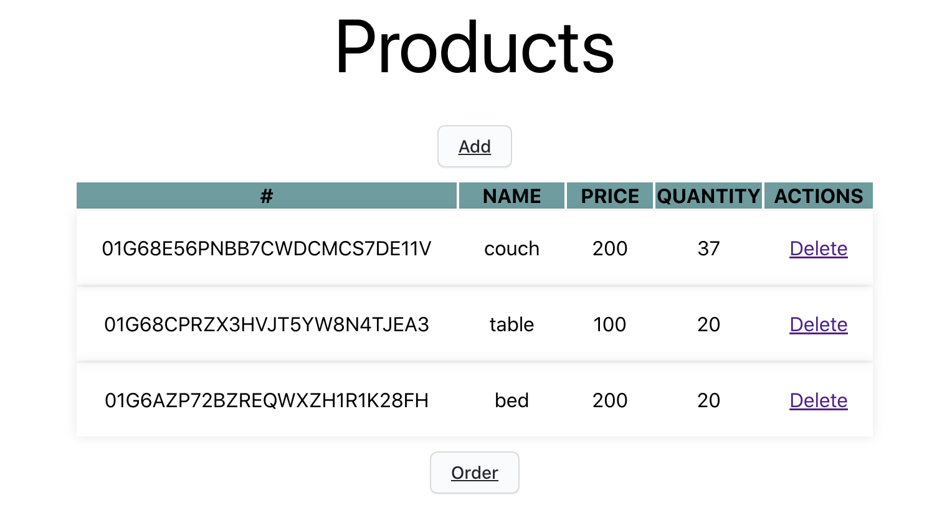

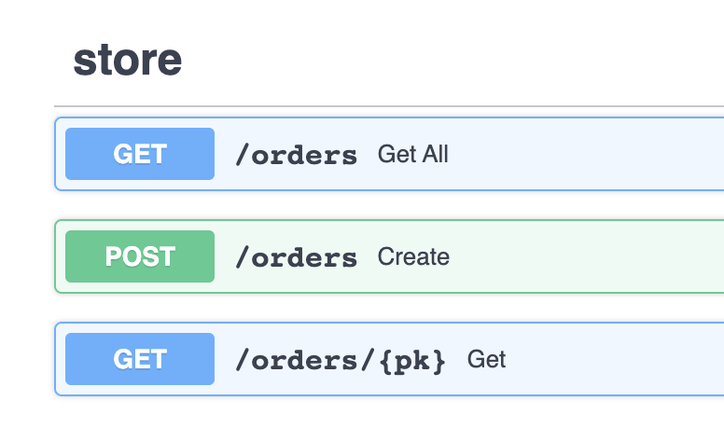
Microservices
Warehouse microservice
FastAPI
Web UI
React JS
Backend server
Redis
Store microservice
FastAPI
- database
- streams

