Slide 1
FastAPI
Relationships

Slide 2
Relationships
Retrieve elements from multiple tables in a single request

Slide 3
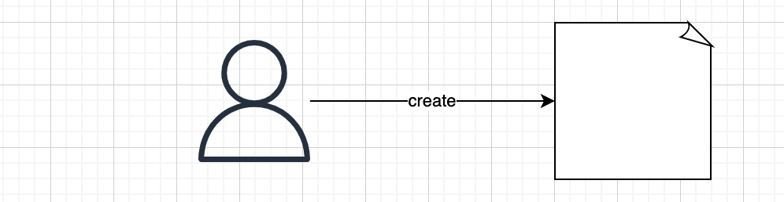
Relationships
Retrieve elements from multiple tables in a single request

Slide 4
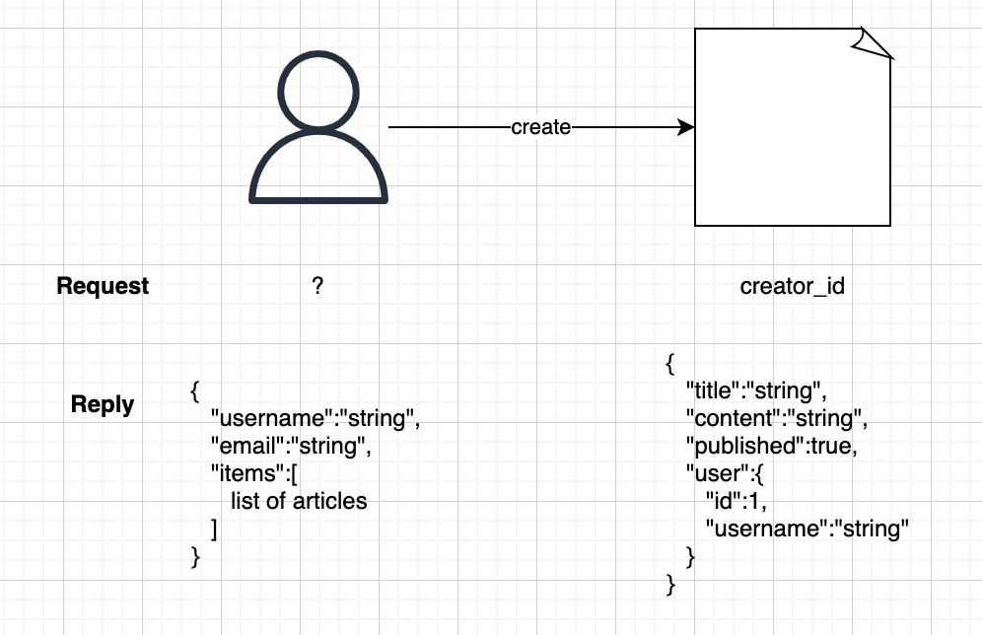
Relationships
Retrieve elements from multiple tables in a single request

Slide 5
Relationships
Define relationship in models

Slide 6
Relationships
Define relationship in models
items = relationship("DbArticle", back_populates="user")

Slide 7
Relationships
Define relationship in models
items = relationship("DbArticle", back_populates="user")
user_id = Column(Integer, ForeignKey("users.id"))
user = relationship("DbUser", back_populates="items")

Slide 8
Relationships
Define relationship in models
Add the elements we want to retrieve in schemas
items = relationship("DbArticle", back_populates="user")
user_id = Column(Integer, ForeignKey("users.id"))
user = relationship("DbUser", back_populates="items")

Slide 9
Relationships
Define relationship in models
Add the elements we want to retrieve in schemas
items = relationship("DbArticle", back_populates="user")
user_id = Column(Integer, ForeignKey("users.id"))
user = relationship("DbUser", back_populates="items")
class UserDisplay(BaseModel):
...
items: List[Article] = []

Slide 10
Relationships
Define relationship in models
Add the elements we want to retrieve in schemas
items = relationship("DbArticle", back_populates="user")
user_id = Column(Integer, ForeignKey("users.id"))
user = relationship("DbUser", back_populates="items")
class UserDisplay(BaseModel):
...
items: List[Article] = []
class ArticleDisplay(BaseModel):
...
user: User

