Slide 1
FastAPI
Exceptions

Slide 2
Exceptions
Notify a client of an error

Slide 3
Exceptions
Notify a client of an error
Raising an exception anywhere stops code from running

Slide 4
Exceptions
Notify a client of an error
Raising an exception anywhere stops code from running
raise HTTPException(status_code=status.HTTP_404_NOT_FOUND,
detail=f"User with id {id} not found")

Slide 5
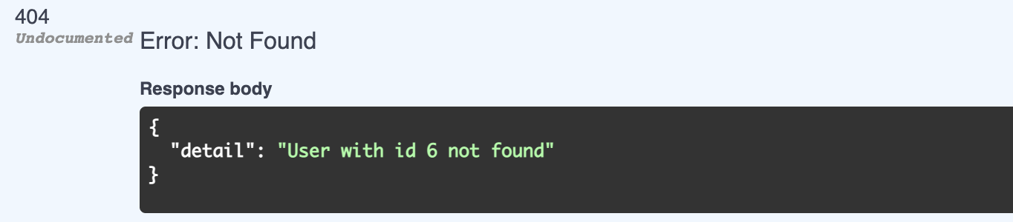
Exceptions
Notify a client of an error
Raising an exception anywhere stops code from running
raise HTTPException(status_code=status.HTTP_404_NOT_FOUND,
detail=f"User with id {id} not found")

Slide 6
Exceptions
Notify a client of an error
Raising an exception anywhere stops code from running
Will contain a status code and exception message
raise HTTPException(status_code=status.HTTP_404_NOT_FOUND,
detail=f"User with id {id} not found")

Slide 7
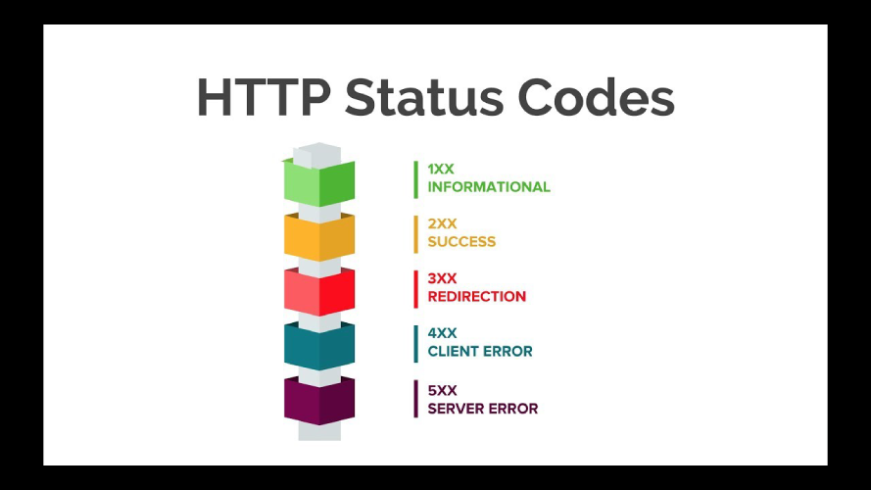
Exceptions

Slide 8
Custom exceptions
Custom exception must inherit from Exception

Slide 9
Custom exceptions
Custom exception must inherit from Exception
Provide exception handler

Slide 10
Custom exceptions
Custom exception must inherit from Exception
Provide exception handler
class StoryException(Exception):
def __init__(self, name: str):
self.name = name

Slide 11
Custom exceptions
Custom exception must inherit from Exception
Provide exception handler
class StoryException(Exception):
def __init__(self, name: str):
self.name = name
@app.exception_handler(StoryException)
def story_exception_handler(request: Request, exc: StoryException):
return JSONResponse(
status_code=418,
content={'detail': exc.name}
)

Slide 12
Custom exception handler
Handle standard HTTPException in a custom way

