Slide 1
Problem Identification
An additional chair lift increases the operating cost by $1,540,000
Goals:
Increase ticket price to at least cover the increased operating cost
Provide some guidance on future facility investment plans
Scope of solution space: build a prediction model based on the number of facilities owned by all the resorts in Big Mountain’s market share
Possible constraints: limited amount of facilities and properties; visitors like to pay more for certain facilities and less for others

Slide 2
Recommendation & Key Findings
While the current ticket price of Big Mountain is $81.00, the model suggests an increased ticket price of $95.87
Recommendation option 1: Increase the vertical drop by adding a run to a point 150 feet lower down, and install an additional chair lift.
Recommendation option 2: Permanently close down one or more of the least used runs. Depending on the operating cost of one run, the suggested number is either 2 or 5.

Slide 3
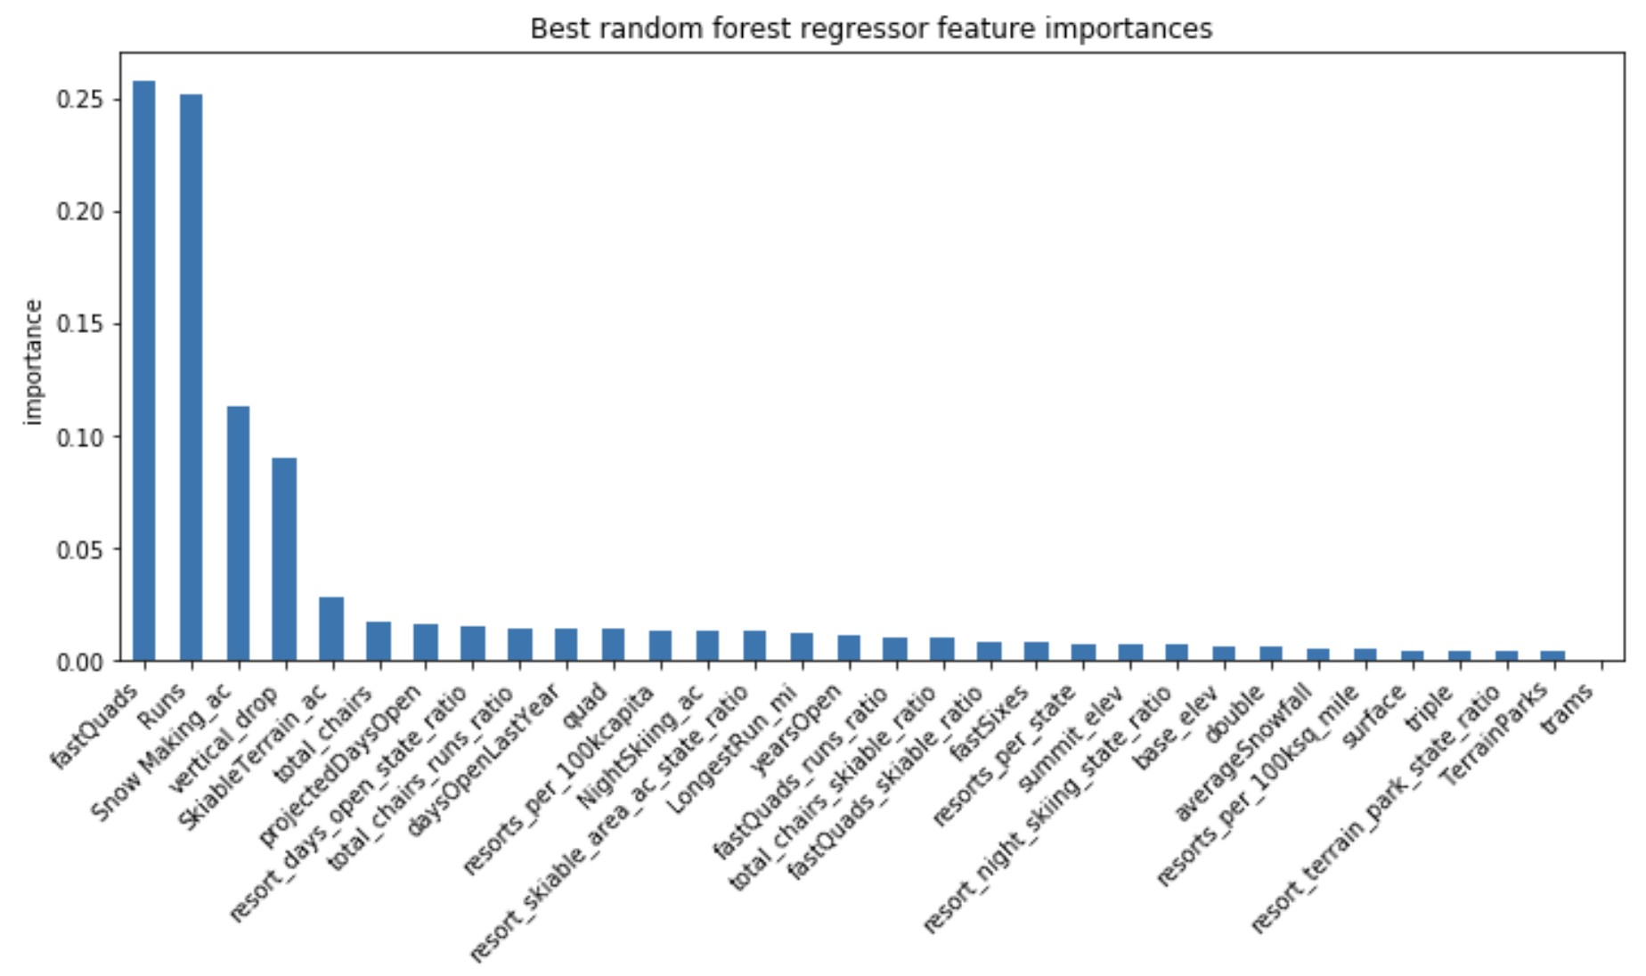
Modeling Results
The most important features in random forest regressor
fastQuads
Runs
Snow Making_ac
vertical_drop
SkiableTerrain_ac
total_chair
…...

Slide 4
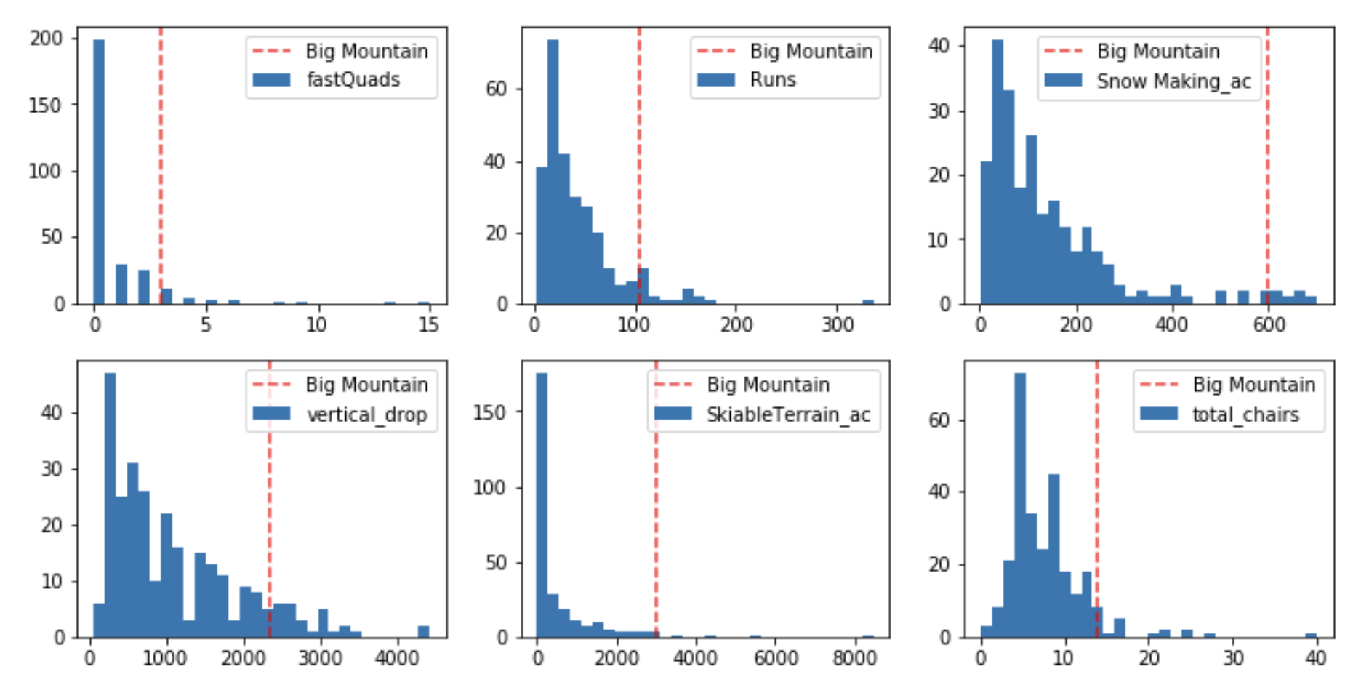
Modeling Results
Distribution of the value of the most important features for all resorts in Big Mountain’s market share

Slide 5
Modeling Results - Scenario 1
Increase the vertical drop by 150 feet, add a run, and install an additional chair lift
Model shows the ticket price can be increased by $1.99, and the total revenue can be increased by $3,474,638

Slide 6
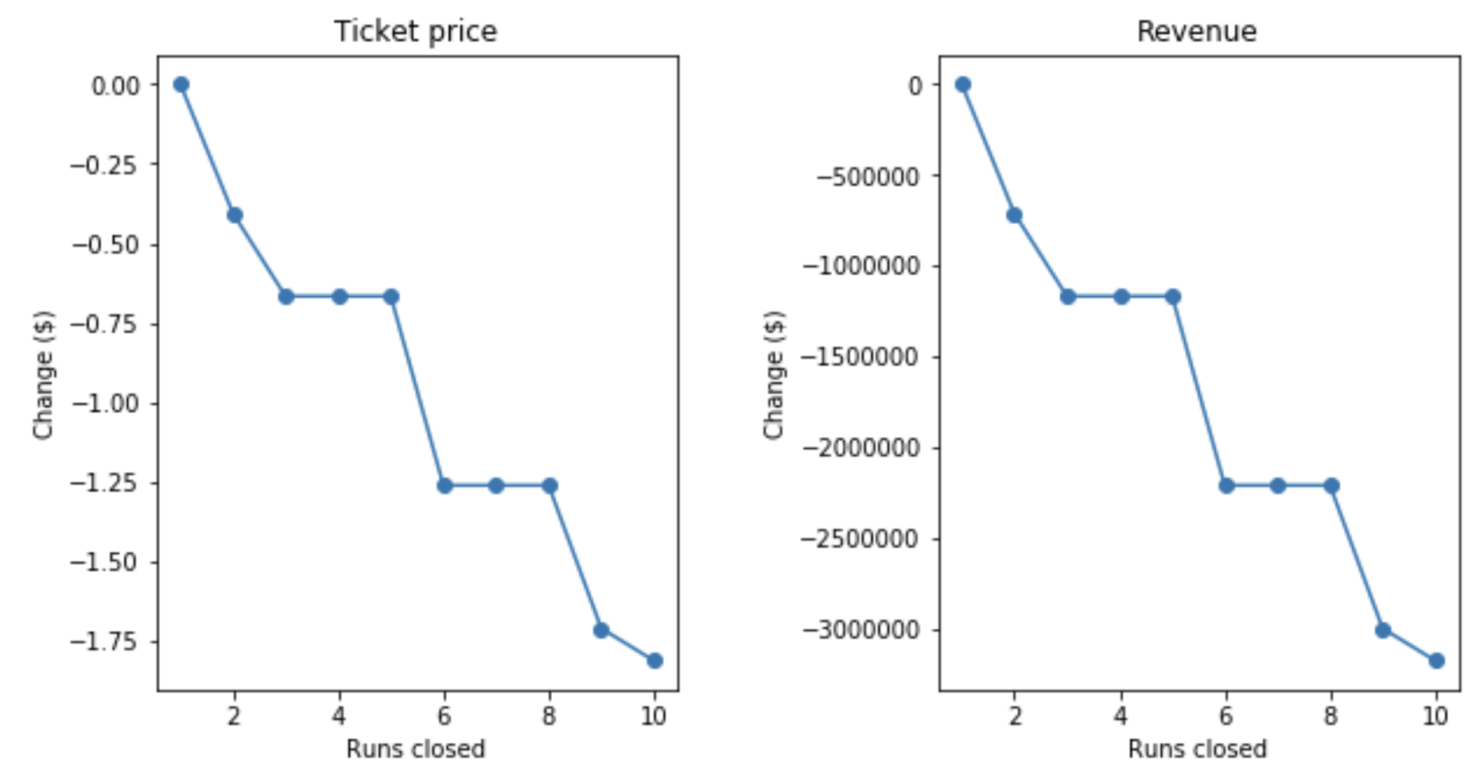
Modeling Results - Scenario 2
Close down some of the least used runs
The operating cost of one run is unknown
Closing down one run will reduce operating cost, while maintaining revenue
Depending on the operating cost, the model suggests closing down either 2 or 5 runs

Slide 7
Summary
Increase the current ticket price to $95.87 based on Big Mountain’s positive in its market share
Future investment option 1: increase the vertical drop by 150 feet, add one run and install another chair lift, increase the ticket price by $1.99
Future investment option 2: close down one of the least used runs, keep the same ticket price
Future investment option 3: close down either 2 or 5 runs, depending on the operating cost of one run, reduce the ticket price accordingly

