Slide 1
Problem Identification
Build a prediction model for ticket price to cover the increased operating cost of $1,540,000
Provide guidance on future facility investment plans
Possible constraints: limited amount of facilities and properties

Slide 2
Recommendation & Key Findings
Current ticket price: $81.00; modeled ticket price: $95.87
Recommendation 1: Increase vertical drop by 150 feet, add a run, install an additional chair lift.
Recommendation 2: Close some of the least used runs. Model suggested closing either 1, 2 or 5 runs.

Slide 3
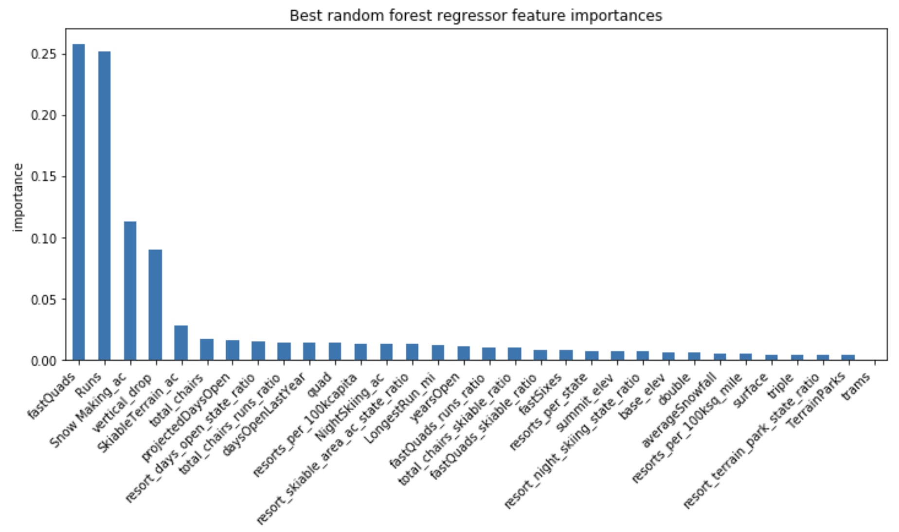
Modeling Results
The most important features in random forest regressor
fastQuads
Runs
Snow Making_ac
vertical_drop
SkiableTerrain_ac
total_chair
…...

Slide 4
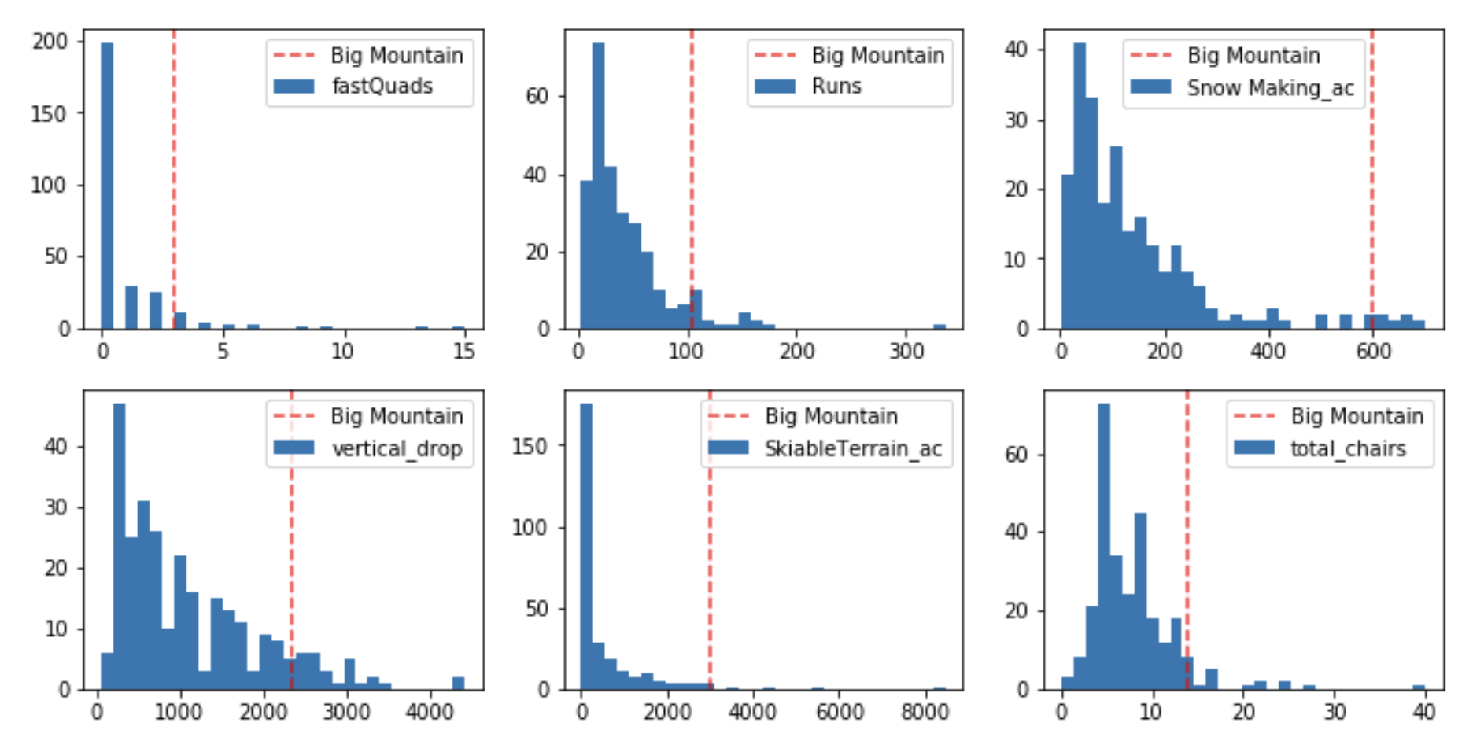
Modeling Results
Distribution of the value of the most important features for all resorts in Big Mountain’s market share

Slide 5
Modeling Results - Scenario 1
Increase the vertical drop by 150 feet, add a run, and install an additional chair lift
Model shows the ticket price can be increased by $1.99, the total revenue can be increased by $3,474,638

Slide 6
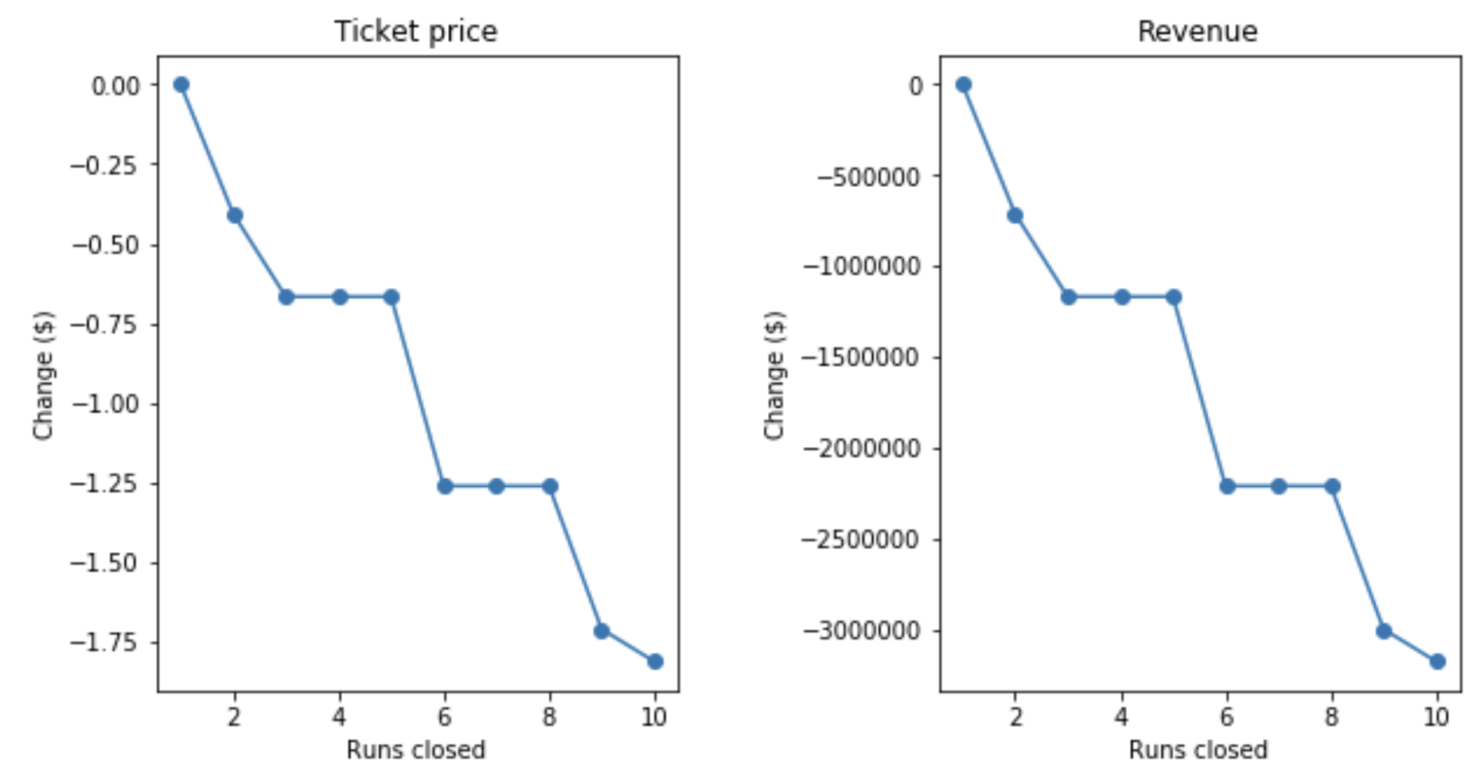
Modeling Results - Scenario 2
Close down some of the least used runs
The operating cost of one run is unknown
Closing down one run reduces operating cost, while maintaining revenue
Depending on the operating cost, the model suggests closing down either 2 or 5 runs

Slide 7
Summary
Model suggests increasing ticket price to $95.87
Option 1: increase vertical drop by 150 feet, add one run and install another chair lift, increase ticket price by $1.99
Option 2: close one of the least used runs, keep the same ticket price
Option 3: close either 2 or 5 runs depending on the operating cost, reduce ticket price accordingly

