Slide 1
KCL 4YYD0003
Macroeconomics Revision: Lectures 1–3 Student-focused trial lesson / 学生向试课
Economic Fluctuations, Fiscal Policy, and the Labour Market
English first, with Chinese support • 2-hour revision class • exam-oriented
What this lesson is for / 这节课要解决什么
Turn three school lectures into exam-ready language, diagrams, and question choices.
Based on KCL Term 2 Weeks 1–3, Problem Sets 1–3, and the 2025 paper.

Slide 2
Today’s promise
今天这节课的目标
You have already seen the content.
你在学校已经见过内容，所以今天是 revision, not re-teaching.
We focus on marks, not just theory.
重点不是“知道概念”，而是“能把概念写成考试分数”.
We will practise the closest tutorial questions.
我会选和 exam 最接近的 tutorial questions 来讲.
Quick question / 先热身
Which of these three lectures feels weakest to you right now?
Economic fluctuations / Fiscal policy
/ Labour market
By the end / 下课前你应该会
see the exam map for Lectures 1–3
explain key diagrams in English
know which questions are safest to revise first

Slide 3
Where Lectures 1–3 appear in the exam
这三讲在考试里主要出现在哪里
Lecture CORE unit Most relevant exam targets
Lecture 1
Lecture 2
Lecture 3
Unit 13
Unit 14
Unit 9
Short Q2: temporary income changes, credit constraints, and why investment is more volatile than consumption Short Q4 and Part B Q2: multiplier, fiscal policy, budget deficit vs debt, paradox of thrift
Short Q5 and Part B Q1 / Q4: wage-setting, price-setting, unemployment, demand shocks
Exam structure / 试卷结构
2 hours. Answer 3 short questions + 1 Part A + 1 Part B.
So for today’s macro revision, the priority is: pickable short questions + one safe Part B route.

Slide 4
Class route for 2 hours
两小时怎么安排
Timing / 节奏
How we keep it interesting / 怎样避免无聊
0–10 min: warm-up + exam map
10–35 min: Lecture 1 revision
35–75 min: Lecture 2 revision + tutorial drill
75–110 min: Lecture 3 revision + tutorial drill
110–120 min: final recap + homework
short predictions
real-life examples
exam-style mini answers
tutorial questions closest to the paper

Slide 5
Warm-up: three quick statements
先来三个判断题
Your turn / 你先判断
For each statement, say True / False / It depends.
1
If GDP grows, unemployment must fall.
If households save more in a recession, the economy becomes safer. If the labour market is in equilibrium, unemployment should be zero.
2
3
Do not worry about full answers yet. We will unpack all three ideas today.

Slide 6
Warm-up answers and the answer template
答案先看方向，同时记住答题模板
1 = It depends (usually negative, not mechanical).
通常增长和失业率变化负相关，但不是 every time / every country 一
样.
2 = False in a recession.
这正是 paradox of thrift: individually rational, collectively harmful.
3 = False in this model.
在 labour discipline model 里，一定程度的 unemployment 是
equilibrium 的一部分.
Exam-safe structure / 考试答题模板
Define the concept
Draw / describe the diagram Explain the mechanism
End with the conclusion
1
2
3
4

Slide 7
Lecture 1
Economic fluctuations and unemployment
You have seen the lecture.
Now we compress it into the ideas that produce marks.
核心抓手：business cycle, GDP, consumption smoothing, investment volatility, inflation

Slide 8
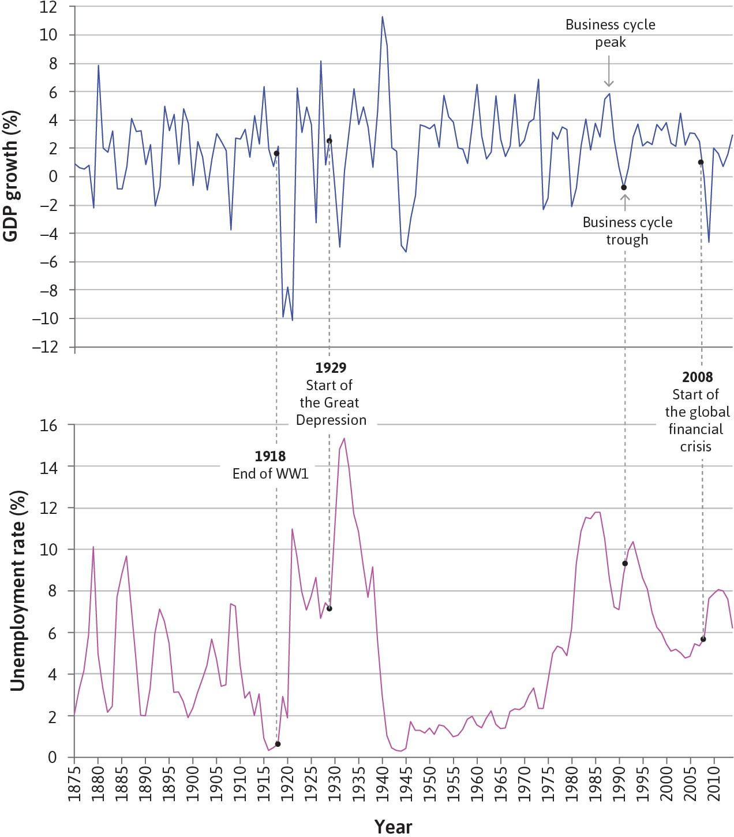
The business cycle: long-run growth, short-run instability
长期增长存在，但短中期波动也真实存在
Over the long run, GDP tends to rise.
长期看经济规模常常增长，这一点不难理解.
Over the short to medium run, growth is uneven.
但短中期有 boom and bust，所以 growth is not
smooth.
What matters for people is not only output, but jobs.
波动会传到 labour market，因此 unemployment 才
是痛点.
Key phrase / 关键表达
A business cycle is an alternating pattern of expansions and contractions.

Slide 9
What exactly is a recession?
recession 到底怎么定义
Definition 1: output is falling.
一种定义是：只要 output 在下降，就叫 recession.
Definition 2: output is below its normal / potential level.
另一种定义是：即使 output 在增长，只要还低于 normal level，也
还没真正走出 recession.
Why it matters: policy depends on the diagnosis.
如果是 temporary demand weakness，政策逻辑和 permanent
supply loss 不一样.
Problem Set 1 hook / 来自 PS1
的引子
A country has relied on oil production, and its oil wells suddenly run out.
Is it in a recession?

Slide 10
How to answer the oil-wells example
oil wells 例子该怎么说才像考试答案
There may be a one-off fall in output, so the country can look recessionary at the moment of decline.
如果从‘output is falling’这个定义出发，下降当下当然可能被描述成 recessionary.
But the deeper point is that potential output itself has fallen.
更重要的是：这个国家的生产能力变差了，它是 permanently poorer, not just temporarily weak.
So policymakers should not treat it as a standard demand slump only.
也就是说，不能只想着用 demand management 去把经济“拉回原来那条线”.
Exam-safe sentence / 可直接写进答案
A permanent supply loss makes the economy poorer and may reduce potential output, so it is different from a purely cyclical recession caused by weak aggregate demand.

Slide 11
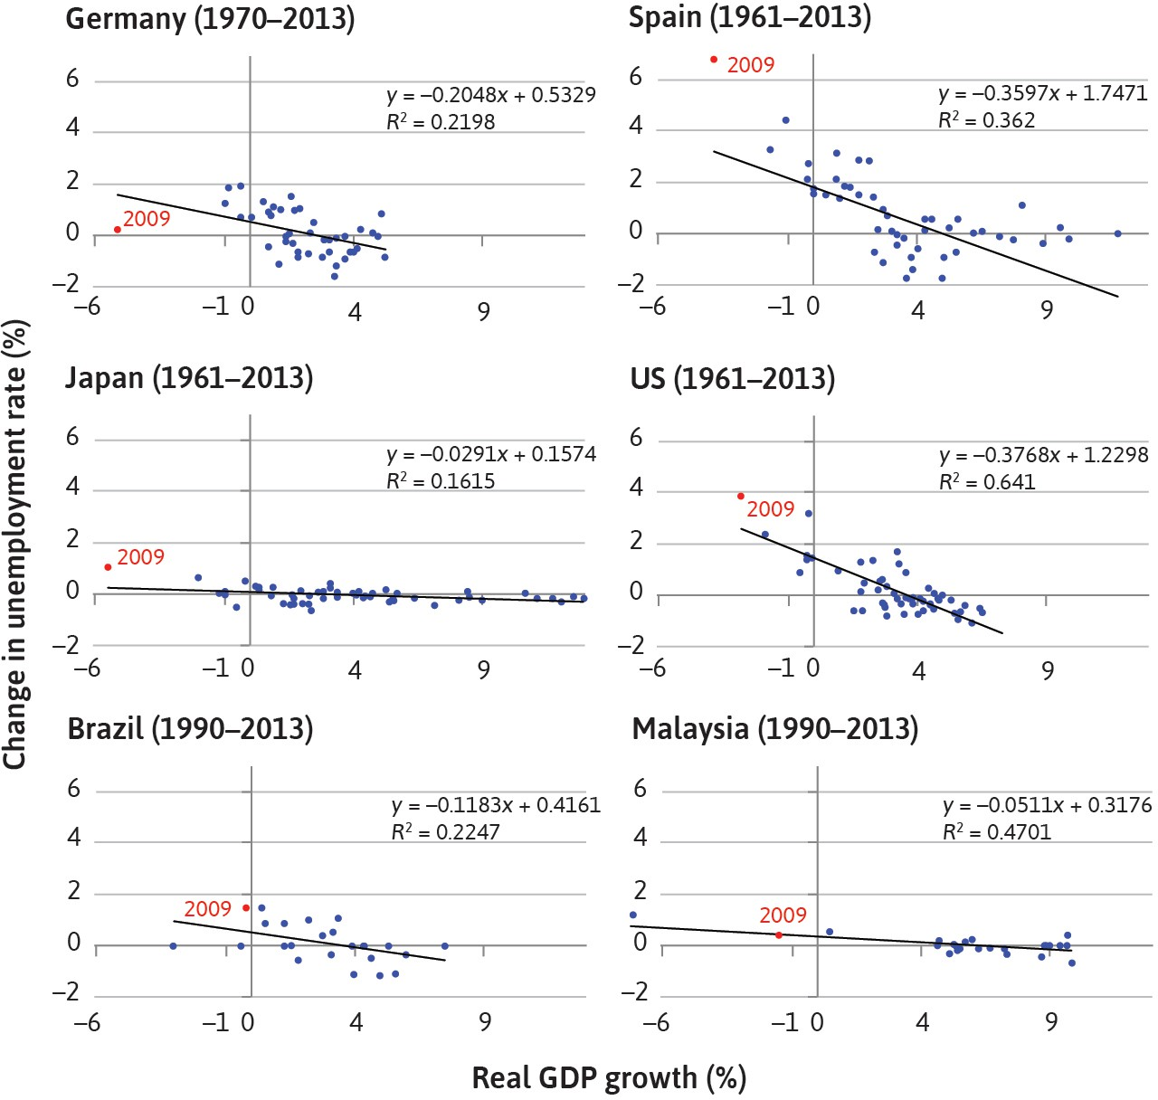
Okun’s Law: why growth and unemployment move in opposite directions
为什么 GDP 增长和失业率变化通常负相关
Okun’s Law is an empirical relationship, not a law of nature.
它是经验规律，不是每个国家完全一样的机械公
式.
When output growth falls, firms usually need fewer workers.
增长变慢时，企业对 labour 的 demand 下降，
失业率就容易上升.
This is one reason recessions hurt well-being so much.
因为 recession 不只是 GDP 变小，更是 jobs
and income 受影响.

Slide 12
Reading the cross-country figure
怎么读 Problem Set 1 里的六国图
The slope is steeper in some countries and flatter in others.
有些国家增长变一点，失业率就动很多；有些国家则没那么敏感.
At zero growth, countries may still show different unemployment changes.
即使 growth = 0，不同国家的 unemployment 变化也不一样.
Possible reasons: labour-force growth, productivity, hours adjustment, institutions.
可以从人口、劳动参与、劳动生产率、工时和制度差异去解释.
Student tip / 学生提醒
If the question says “What else might explain the differences between countries?”, do not
stop at “because the economy is different”. Give named mechanisms.

Slide 13
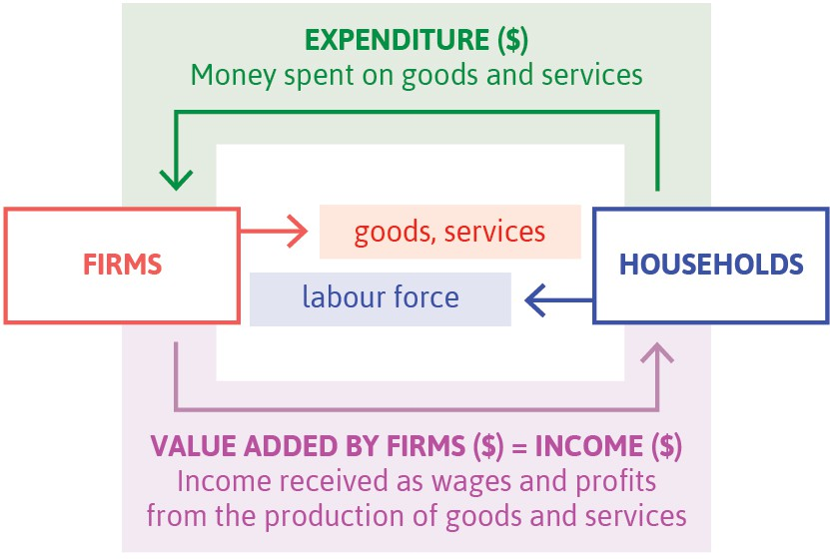
GDP and the circular flow
GDP 以及它和 circular flow 的关系
GDP can be measured through spending, production, or income.
支出法、生产法、收入法本质上是在看同一个 circular flow.
By expenditure:
GDP = C + I + G + X − M.
最常用的是 expenditure identity，这个式子必须会写.
Imports are subtracted; transfers are not part of current production.
imports 要减，transfer payments 不算进当期生产.

Slide 14
Worked example: what counts in GDP?
做题时最容易错的 GDP 细节
Count / 要算进去
Lecture exercise answer /
课堂练习答案
household consumption
capital goods
change in inventories
government goods and services
exports
transfer payments
imports (subtract them)
C = 100, I = 15 + 1, G = 10 + 2, NX = 12 − 10 = 2
GDP = 100 + 16 + 12 + 2 = 130
Transfers are excluded.
Do not count / 不直接算进去

Slide 15
GDP is useful, but GDP is not welfare
GDP 很有用，但它不是 wellbeing
GDP is powerful for size, planning, forecasting, and comparison.
GDP 对 policy 和比较国家经济规模非常有用.
But GDP misses inequality, unpaid work, and environmental damage.
它不直接告诉你分配、公平、家庭劳动和环境成本.
Good exam style: define GDP first, then criticise it briefly.
考试里先定义再批判，不要一上来就说 GDP 没用.
One neat line / 一个好用句子
GDP is a measure of economic activity, not a complete measure of human welfare.

Slide 16
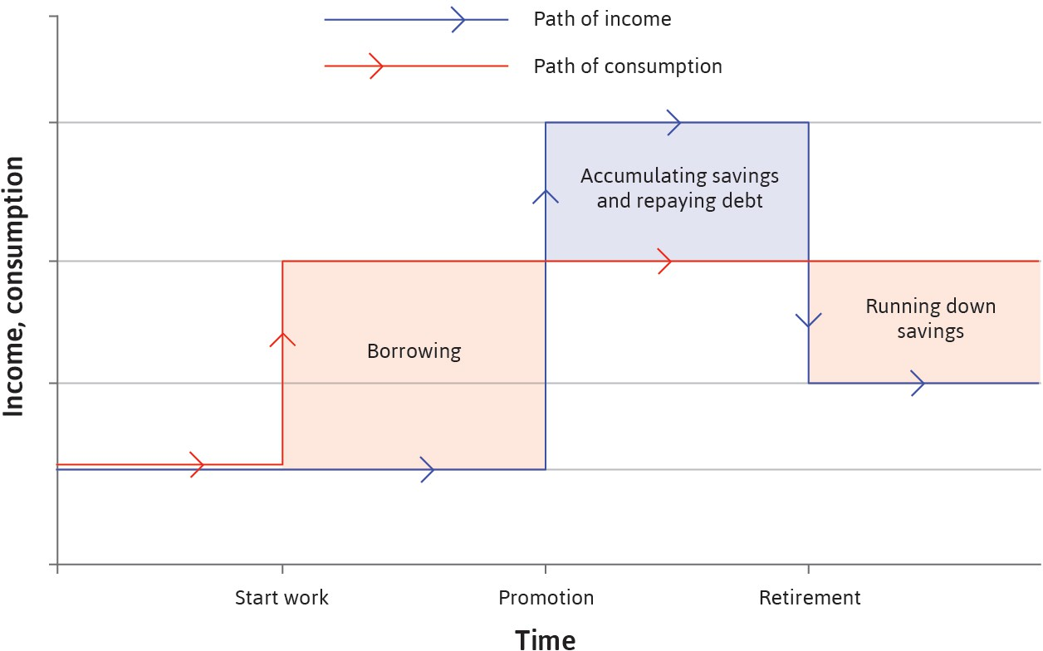
Consumption smoothing
为什么 households 想把消费变平滑
Households usually prefer smoother consumption than income.
收入会波动，但消费如果也大幅波动，福利会更差.
Temporary shock: borrow or save to smooth consumption.
暂时性冲击通常通过 borrowing / saving 去平滑.
Permanent shock: revise long-run consumption.
如果冲击是永久的，就要把长期消费水平重新往下或往上
改.

Slide 17
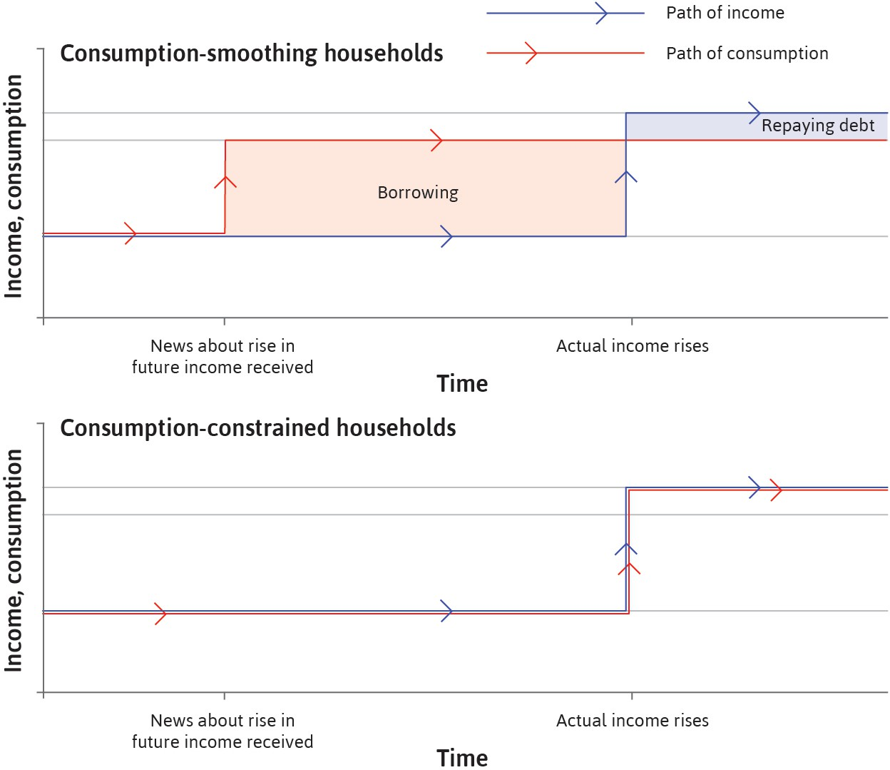
Credit constraints change the story
一旦有 credit constraints，平滑消费就没那么容易
Some households cannot borrow against future income.
有些家庭即使知道以后会赚更多，现在也借不到钱.
Then current consumption becomes more sensitive to current income.
这时当前消费就会更依赖当前收入，而不是长期收入.
This is why temporary shocks can hurt welfare more.
所以同样是 temporary shock，被约束家庭会更难受.

Slide 18
Direct exam link: Short Q2(a)
这就是 2025 试卷 Short Q2(a) 的核心
Unconstrained households treat a temporary income gain as mostly temporary.
所以他们往往只小幅增加 current consumption，更多是 save.
Credit-constrained households use the extra income immediately.
因为之前本来就消费被卡住，收入一来就会马上增加消费或还紧急账
单.
Therefore temporary income changes affect them more strongly.
这就是题目想要的主结论.
Exam-safe sentence / 可直接背
A temporary income change affects credit-constrained households more because they cannot borrow to smooth consumption in advance, so current consumption is tightly linked to current income.
Simple example / 一个学生能秒懂的例子
A student with savings mostly saves a one-month bonus; a cash-strapped student spends much more immediately.

Slide 19
Why investment is more volatile than consumption
为什么 investment 往往比 consumption 波动更大
Firms do not have a preference for smooth investment.
家庭会追求 smooth consumption，但企业不会追求‘平滑投资’本身.
Investment can be postponed.
机器、厂房、扩张计划都可以拖到以后做.
Investment depends heavily on expectations of future demand and profits.
预期一变，investment plan 很容易一起变.
Direct exam link / 对应 2025 Short Q2(b)
The question is not asking for a formula. It is asking for mechanisms: postponability, expectations, and coordination.

Slide 20
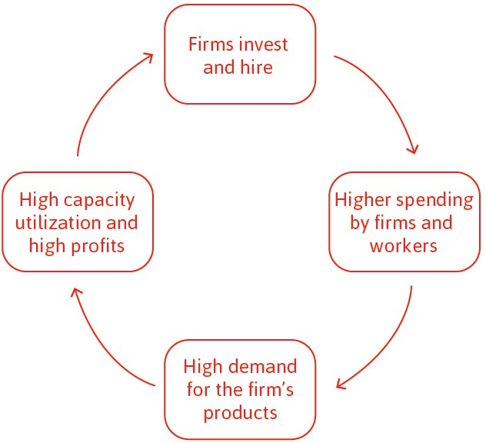
Coordination and business confidence
协调、信心、以及 why booms and busts can reinforce themselves
If one firm invests, workers and suppliers receive more income.
一家企业投资之后，别人收入也会上去.
That raises demand for other firms’goods.
于是别的企业看到 demand 更强，也更愿意 invest.
The reverse is also true in bad times.
坏消息时这种机制会反过来，形成 self-reinforcing
downturn.

Slide 21
Inflation: CPI versus GDP deflator
通胀怎么量，以及为什么不要把两个指标混掉
Inflation means a rise in the general price level.
通胀是 general price level 的上升，不是某一个商品涨价.
CPI tracks the cost of a representative consumption bundle.
CPI 更贴近日常消费和 cost of living.
The GDP deflator tracks prices of domestically produced output.
GDP deflator 关注国内产出价格，所以覆盖面不一样.
One-line distinction / 一句话区别
CPI is consumer-bundle based; the GDP deflator is output-based.
Why this matters / 为什么要会
In later lectures, inflation interacts with unemployment and policy.
For now, you only need the measurement intuition.

Slide 22
Lecture 1 recap: what must survive in memory
Lecture 1 讲完以后你至少要带走这四句
Four lines to remember / 四句最该记住的话
1
A business cycle is long-run growth plus short-run fluctuations.
GDP by expenditure is C + I + G + X − M.
Credit-constrained households react more to temporary income changes.
Investment is more volatile than consumption because it is postponable and expectation-driven.
2
3
4
If a student remembers only these four lines from Lecture 1, they already have the spine of Short Q2.

Slide 23
Lecture 2
Unemployment and fiscal policy
This is where revision turns into policy logic.
multiplier • fiscal stimulus • austerity • deficit vs debt
这一讲既是 short question 高发区，也是 Part B Q2 的主战场

Slide 24
Aggregate demand in one formula
先把 Lecture 2 的主公式抓住
Core equation / 核心公式
What the formula tells you
/ 这个式子在说什么
AD = c₀ + c₁(1 − t)Y + I + G + X − mY
Aggregate demand depends partly on current income, so shocks can be amplified through the circular flow.
c₀: autonomous consumption
不随当前收入变化的消费部分.
c₁: marginal propensity to consume
每增加一单位收入，消费增加多少.
t and m: leakages
tax 和 imports 都会把 multiplier 变小.

Slide 25
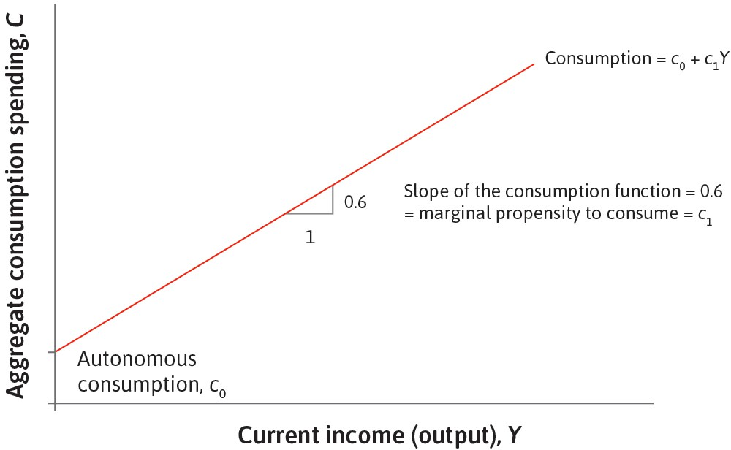
Consumption function and MPC
消费函数和 marginal propensity to consume
Consumption has an autonomous part and an income-related part.
消费函数通常分成 autonomous consumption 和随
收入变化的部分.
The slope is the MPC.
斜率就是 marginal propensity to consume.
Poorer or constrained households often have a higher MPC.
越紧的人，新增收入越容易转成消费.

Slide 26
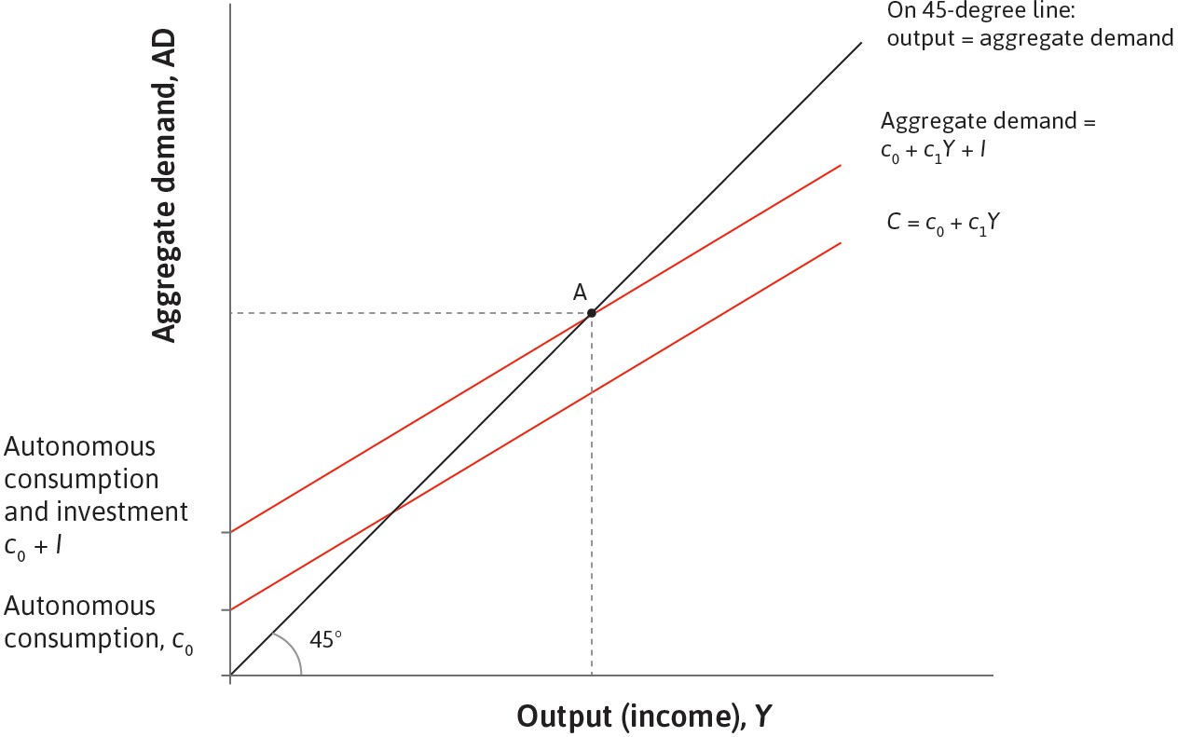
Goods market equilibrium and the 45-degree line
45 度线为什么这么重要
On the 45-degree line, output equals aggregate demand.
45-degree line 上满足 Y = AD.
If AD is below output, inventories rise and firms cut output.
如果需求低于产出，企业会减产.
If AD is above output, firms expand production.
如果需求高于产出，企业会增产.

Slide 27
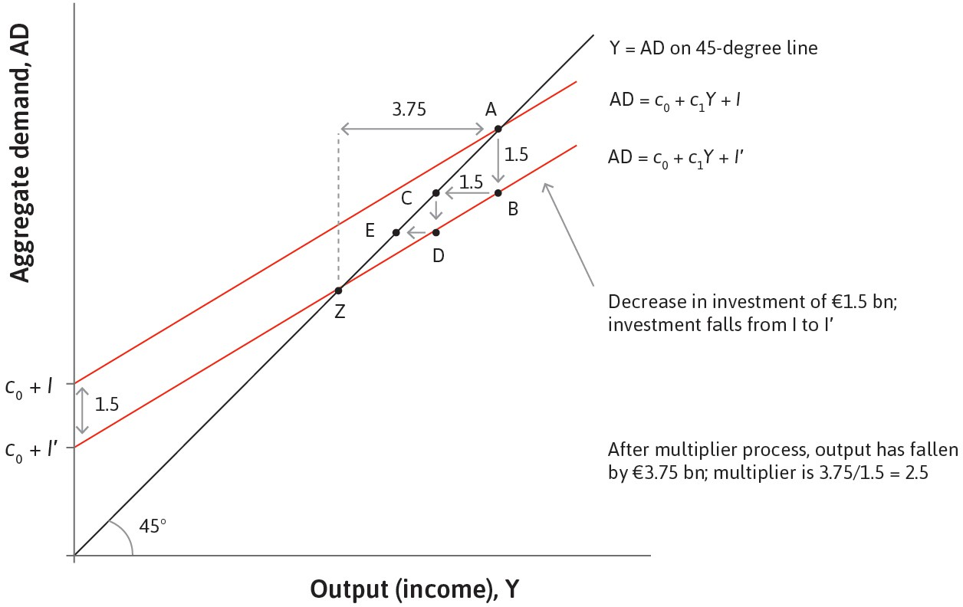
The multiplier process
乘数不是 magic，是 repeated rounds of spending
A fall in investment is the first-round shock.
第一轮只是 investment 自己先掉下去.
Lower output means lower income, which lowers spending again.
但收入下降会带来第二轮、第三轮的 spending
decline.
So total output can fall by more than the initial shock.
这就是为什么最终变化会大于初始冲击.

Slide 28
What makes the multiplier smaller?
什么时候乘数会变小
Saving is a leakage from the circular flow.
收入不是全拿去花，乘数就会被削弱.
Taxation is a leakage too.
一部分收入进政府，私人消费的反馈减弱.
Imports are another leakage.
买外国货不直接增加本国 GDP，所以 multiplier 更小.
Key idea / 核心一句
More leakages ⇒ flatter AD ⇒ smaller multiplier.

Slide 29
Tutorial question closest to the exam #1
Problem Set 2 Q1(a): 哪个经济体的 multiplier 更大
Problem Set 2 / 你先判断
Two economies differ only in the share of credit-constrained households.
Which economy has the larger multiplier? Why?
Try saying it in one sentence / 先试着用一句英文说
The economy with has the larger multiplier because .

Slide 30
Model answer logic for PS2 Q1
把口语答案升级成考试答案
More credit-constrained households usually means a higher MPC.
被约束的人对当前收入更敏感，所以 MPC 更高.
A higher MPC makes AD steeper and the multiplier larger.
MPC 越高，收入反馈越强，乘数越大.
In deep downturns, the multiplier can be especially strong.
资源闲置多、约束强的时候，policy effects 往往更明显.
Exam-safe sentence / 可直接用
The multiplier is larger in the economy with a bigger share of credit-constrained households because more of any extra income is spent rather than saved.

Slide 31
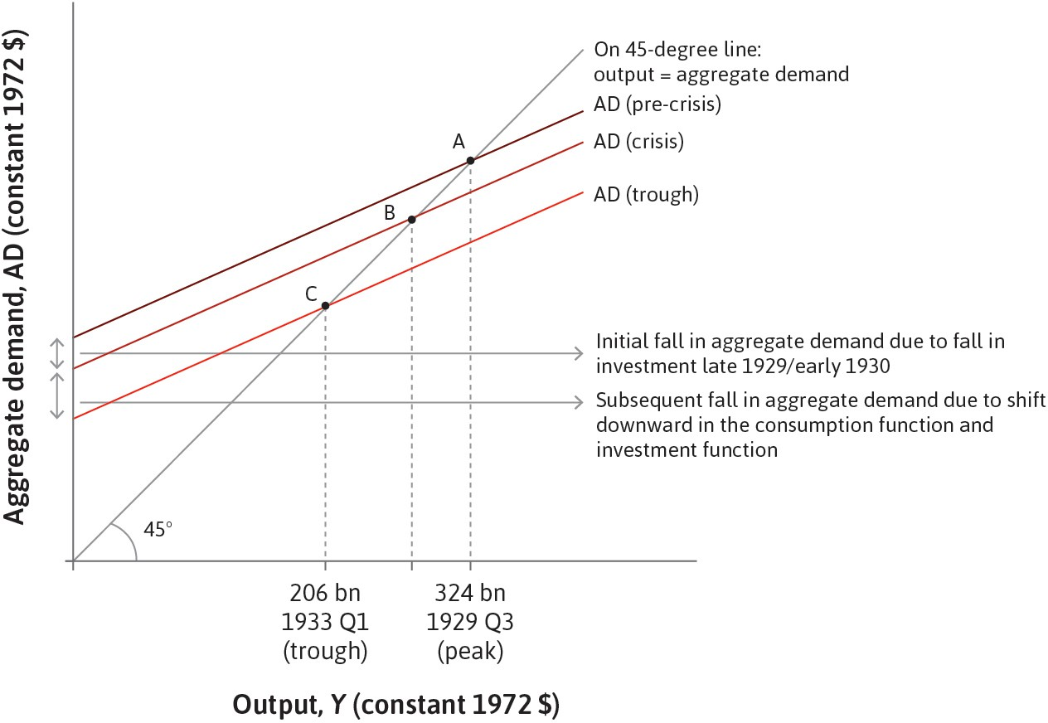
The Great Depression as a multiplier story
Great Depression 为什么是 Lecture 2 的经典例子
The first fall came from investment.
一开始是 investment 下滑.
Then autonomous consumption also fell.
之后因为恐慌、信贷崩塌、悲观预期，消费函数也
往下移.
So multiple parts of AD moved down together.
结果不是单一冲击，而是多重 AD components 一
起向下.

Slide 32
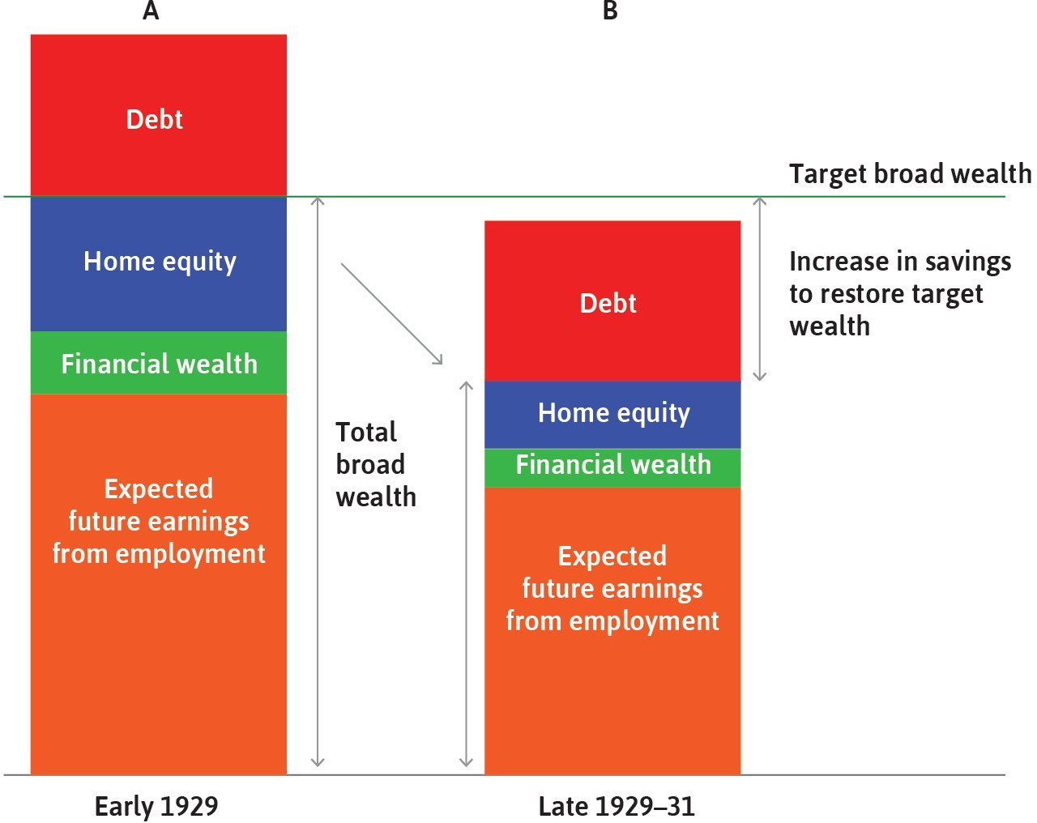
Wealth, target wealth, and precautionary saving
为什么家庭会因为变穷而进一步少花
Households often aim for a target level of wealth.
家庭心里对‘安全资产水平’常常有个目标.
If wealth falls below target, they try to rebuild it by saving more.
财富跌破目标后，会通过 cut spending 来恢复目标
wealth.
That is precautionary saving.
这就是 precautionary saving 的核心逻辑.

Slide 33
House prices and the financial accelerator
房价、借贷约束、和 financial accelerator
If rising house prices increase borrowing capacity, spending rises more.
房价上涨如果能让你更容易借钱，消费就会被进一步放大.
That channel is stronger in places like the US or UK.
在 home equity borrowing 更容易的国家，这个机制更强.
It is weaker where mortgage rules are tighter, such as France or Germany.
首付高、提取房屋净值难的地方，这个放大器会弱很多.
Why it is interesting / 为什么值得讲
This is a nice real-world example of how financial structure changes the strength of aggregate demand.

Slide 34
Automatic stabilisers
automatic stabilisers 为什么很重要
Taxes automatically dampen booms.
收入上涨时税收上升，私人 spending 的放大效应被削弱.
Unemployment benefits support consumption in recessions.
失业时福利会托住部分收入，消费不会掉得那么猛.
They stabilise GDP without a new law each time.
这就是 automatic stabilisers：不需要每次都重新立法.
Two examples / 两个一定会说的例子
proportional or progressive taxation
unemployment insurance

Slide 35
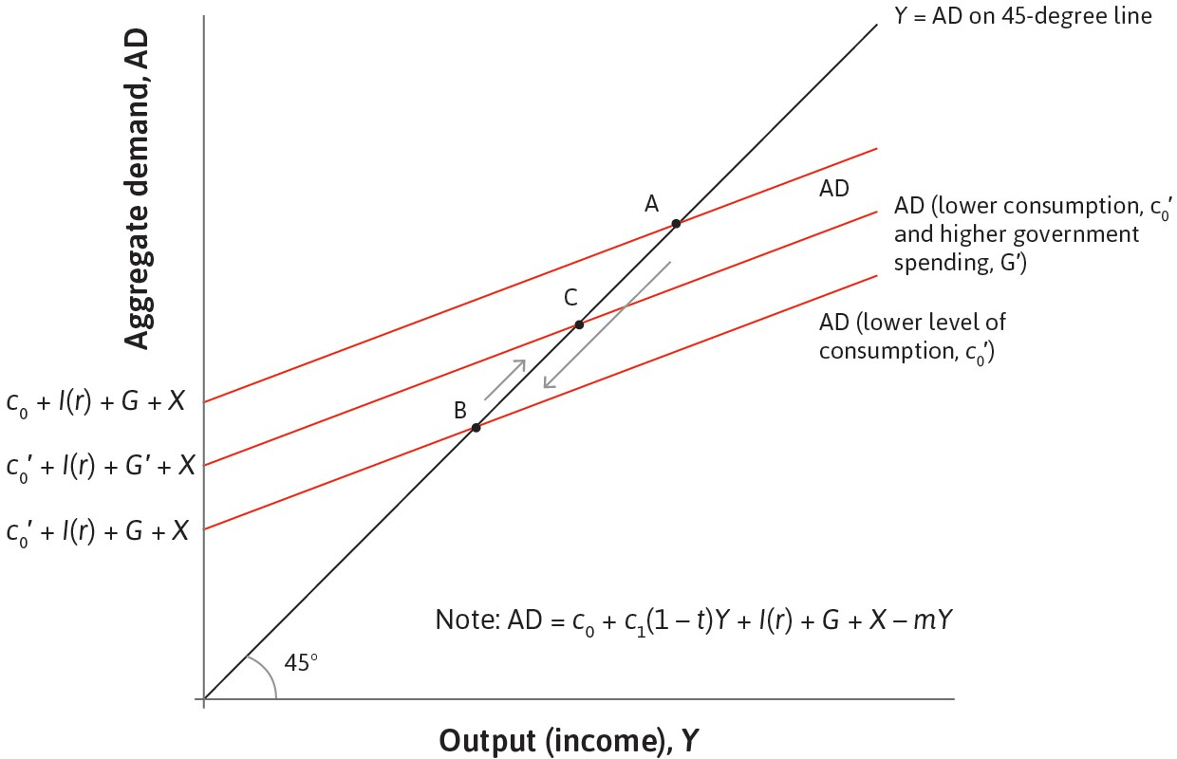
Fiscal stimulus
财政刺激怎么把 output 往上拉
An increase in G shifts AD upward directly.
政府支出增加，aggregate demand 先直接往上移.
Then the multiplier amplifies the effect on Y.
随后收入–支出反馈把效果继续放大.
This is especially useful when private demand is weak.
私人部门 spending 太弱时，政府可以顶上去.

Slide 36
Tutorial question closest to the exam #2
Problem Set 2 Q2: recession 里 cut G，预算会变好吗
Problem Set 2 / 先别急着说“会”
The government starts in budget balance. In a recession, it cuts G to improve the budget.
Does the budget balance improve, deteriorate, or remain unchanged?
Hint: think about tax revenue as well as spending.

Slide 37
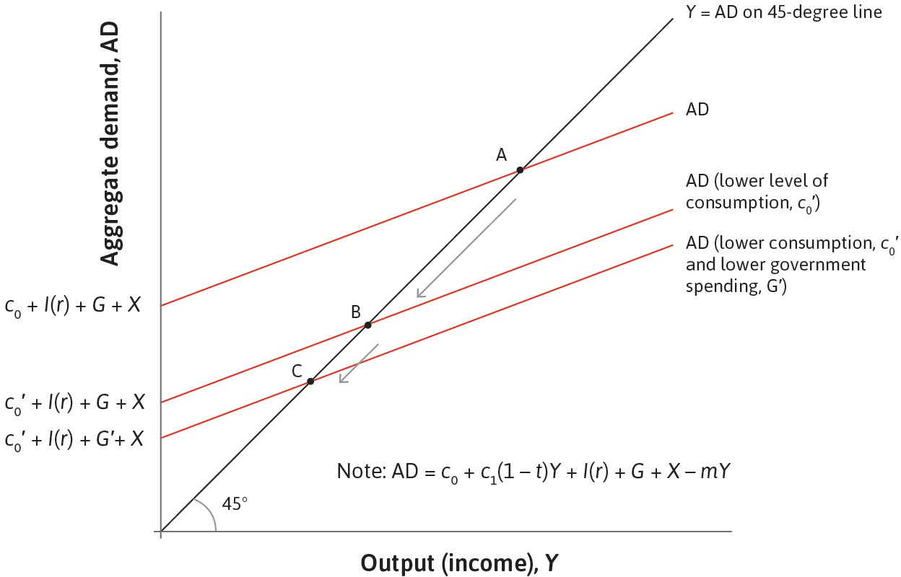
Why austerity can fail in a recession
为什么 recession 里的 austerity 可能适得其反
Cutting G shifts AD down further.
本来需求就弱，再 cut G 等于继续往下踩.
Lower Y means lower tax revenue.
产出和收入下降后，税收也会减少.
So the budget may not improve much, while unemployment rises.
结果可能是 deficit 没改善多少，但 recession 更深
了.
Good closing line / 一个好结尾
Austerity in a recession can be
self-defeating because it reduces output and tax revenue as well as spending.

Slide 38
The paradox of thrift, in words
先用文字把 paradox of thrift 说清楚
For one household, cutting spending may raise saving.
对单个家庭来说，少花钱看上去是合理的.
For the whole economy, one person’s spending is another person’s income.
但在总量层面，大家一起少花，大家收入也会一起少.
So aggregate saving may not rise, because aggregate income falls.
这就是 thrift 的悖论：想多存钱，最后可能并没有存下来更多.
Keyword / 关键词
fallacy of composition
What is true for one part may not be true for the whole.

Slide 39
The paradox of thrift on a multiplier diagram
把文字逻辑翻译成图上的 downward shift
Higher desired saving means lower autonomous consumption.
大家更想存钱，本质上就是 c0 往下掉.
AD shifts downward, so equilibrium output falls.
AD 下移，均衡产出下降.
Lower income may stop actual saving from increasing.
因为收入也掉了，最后aggregate saving 不一定真
的上升.

Slide 40
Exam drill: Part B Q2(a) and (b)
Part B Q2 的计算路线先固定下来
Question setup / 题目给的数据
C = 100 + 0.6Y, I = 400, G = 200, t = 0.1
In this module, once a tax rate is given, rewrite consumption using disposable income:
C = 100 + 0.6(1 − 0.1)Y = 100 + 0.54Y
Then solve:
Y = 100 + 0.54Y + 400 + 200 ⇒ 0.46Y = 700 ⇒ Y∗ ≈ 1521.7
If G rises from 200 to 300:
∆Y = ¹⁰⁰ ≈ 217.4
0.46
Exam warning / 一个容易错的点
Always show how tax enters the consumption function.

Slide 41
Exam drill: Part B Q2(c) and (d)
deficit, debt, and why the government is not a household
Budget balance / 预算平衡
What to say in words / 文字题要说什么
BB = T − G = tY − G
Before the increase in G:
T = 0.1 × 1521.7 ≈ 152.2
BB ≈ 152.2 − 200 = −47.8
After G rises to 300:
Y′ ≈ 1739.1, T′ ≈ 173.9
BB′ ≈ 173.9 − 300 = −126.1
A larger deficit adds to government debt if it persists.
Debt is a stock; deficit is a flow.
Monetary policy affects debt through interest payments, growth, and inflation.
A government is not the same as a household: it can roll over debt.

Slide 42
Lecture 3
The labour market
This is the most diagram-heavy part today.
wage-setting • price-setting • equilibrium unemployment
也是 2025 paper 里最直接可押中的 short-question 板块

Slide 43
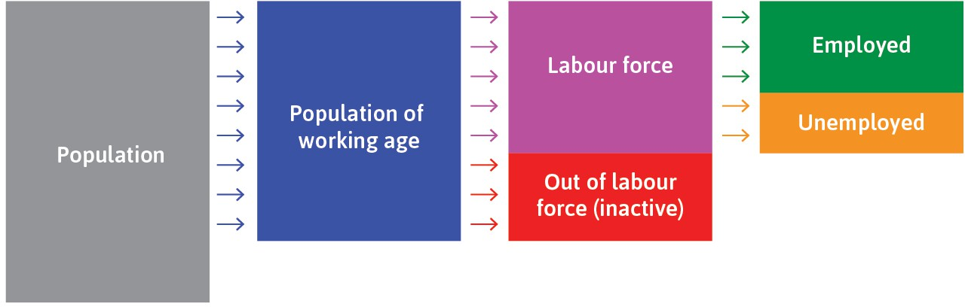
Who counts as unemployed?
先把 labour market 的盒子分清楚
Start with the working-age population.
不是所有人口都在 labour market 里.
Then separate the labour force from the inactive population.
先分成 labour force 和 inactive/out of labour
force.
Inside the labour force, split employed and unemployed.
只有 labour force 里的失业者才计入
unemployment rate.

Slide 44
Three rates you must not confuse
participation / unemployment / employment 三个比率别混
Definitions / 定义
Participation rate = ^{labour force}
working-age population
Unemployment rate = ^{unemployed}
labour force
Employment rate = ^{employed}
working-age population
Fast reminder / 快速提醒
Two countries can have the same unemployment rate but different employment rates if their participation rates differ.

Slide 45
Same unemployment, different employment
为什么失业率一样，就业率也可能不一样
The unemployment rate uses the labour force as the denominator.
所以它不看那些 inactive people.
The employment rate uses the working-age population as the denominator.
所以 participation 的变化会影响 employment rate.
That is why the same unemployment rate can hide different labour-market structures.
这也是 Problem Set 3 Q1 想让你看到的点.
Nice sentence / 好用句子
A low unemployment rate does not automatically mean a high employment rate if participation is low.

Slide 46
Where do wage-setting and price-setting come from?
先把两条曲线背后的部门想象出来
HR decides the wage needed to make workers work hard.
人事部门要想：工资至少给到哪里，员工才不会偷懒.
Marketing chooses the price/markup given demand.
市场部门要想：面对需求曲线，价格和加成怎么定最赚钱.
Together, these decisions determine the real wage and employment.
把企业都加总起来，就得到economy-wide real wage and employment.
Memory trick / 一个记忆法
HR ⇒ wage-setting
Marketing ⇒ price-setting

Slide 47
Real wage and markup
real wage 和企业 markup 是此消彼长的关系
The real wage is the nominal wage divided by the price level, W/P.
这句定义必须会说.
A higher markup means a lower share of output goes to workers.
markup 高，意味着工人拿到的 real wage share 更低.
So price-setting is really about how output is divided between wages and profits.
这也是为什么 PS 曲线决定分配关系.
One useful line / 一个好用句子
For a given productivity level, a higher markup implies a lower real wage.

Slide 48
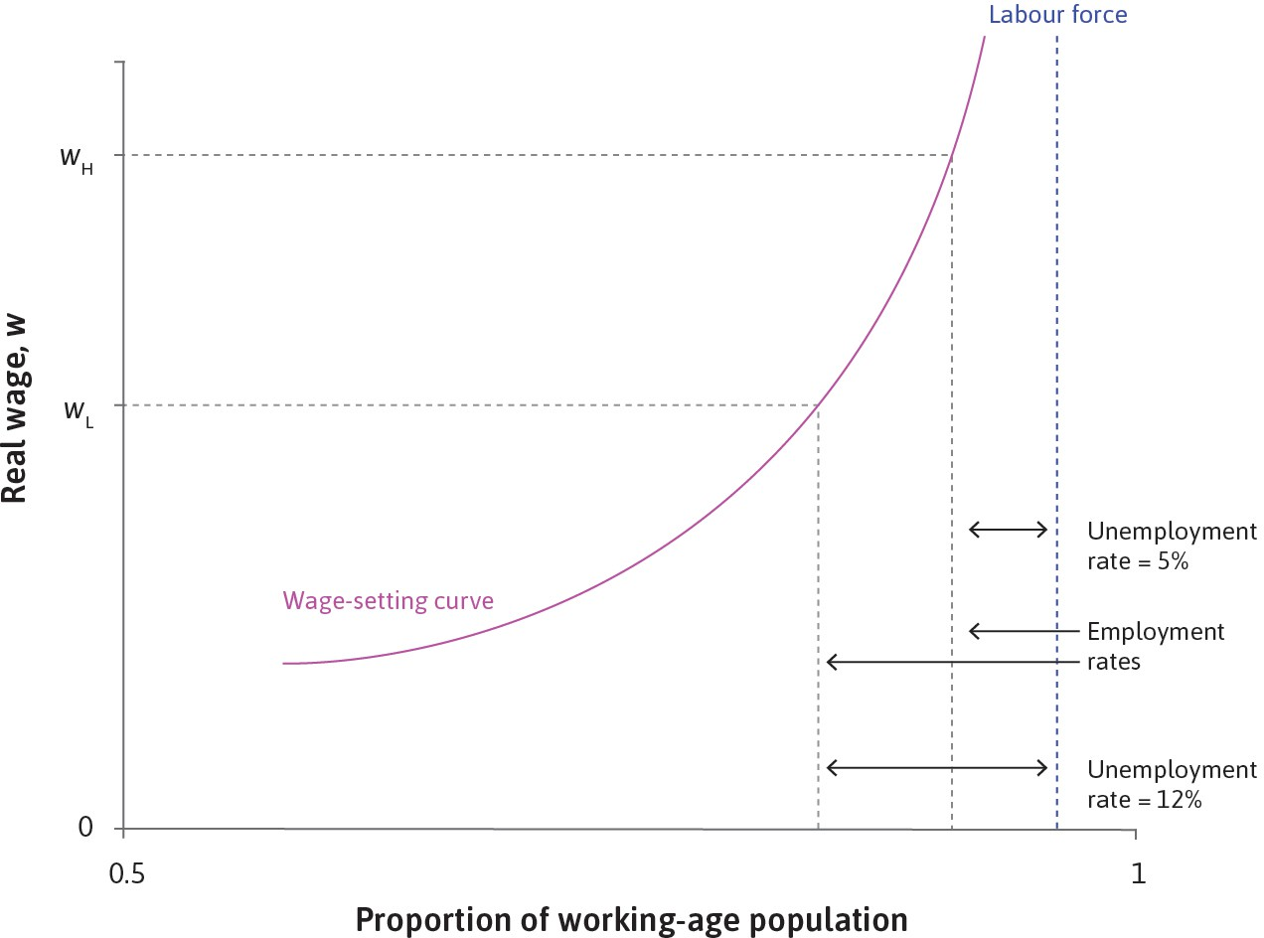
The wage-setting curve
工资设定曲线为什么向上
When employment is high, unemployment is low.
就业高就意味着失业少.
Then losing a job is less painful, so workers need a higher wage to exert effort.
丢工作的威慑变弱，企业就得给更高工资来维持
effort.
That is why the wage-setting curve slopes upward.
因此 employment 越高，所需 real wage 越高.

Slide 49
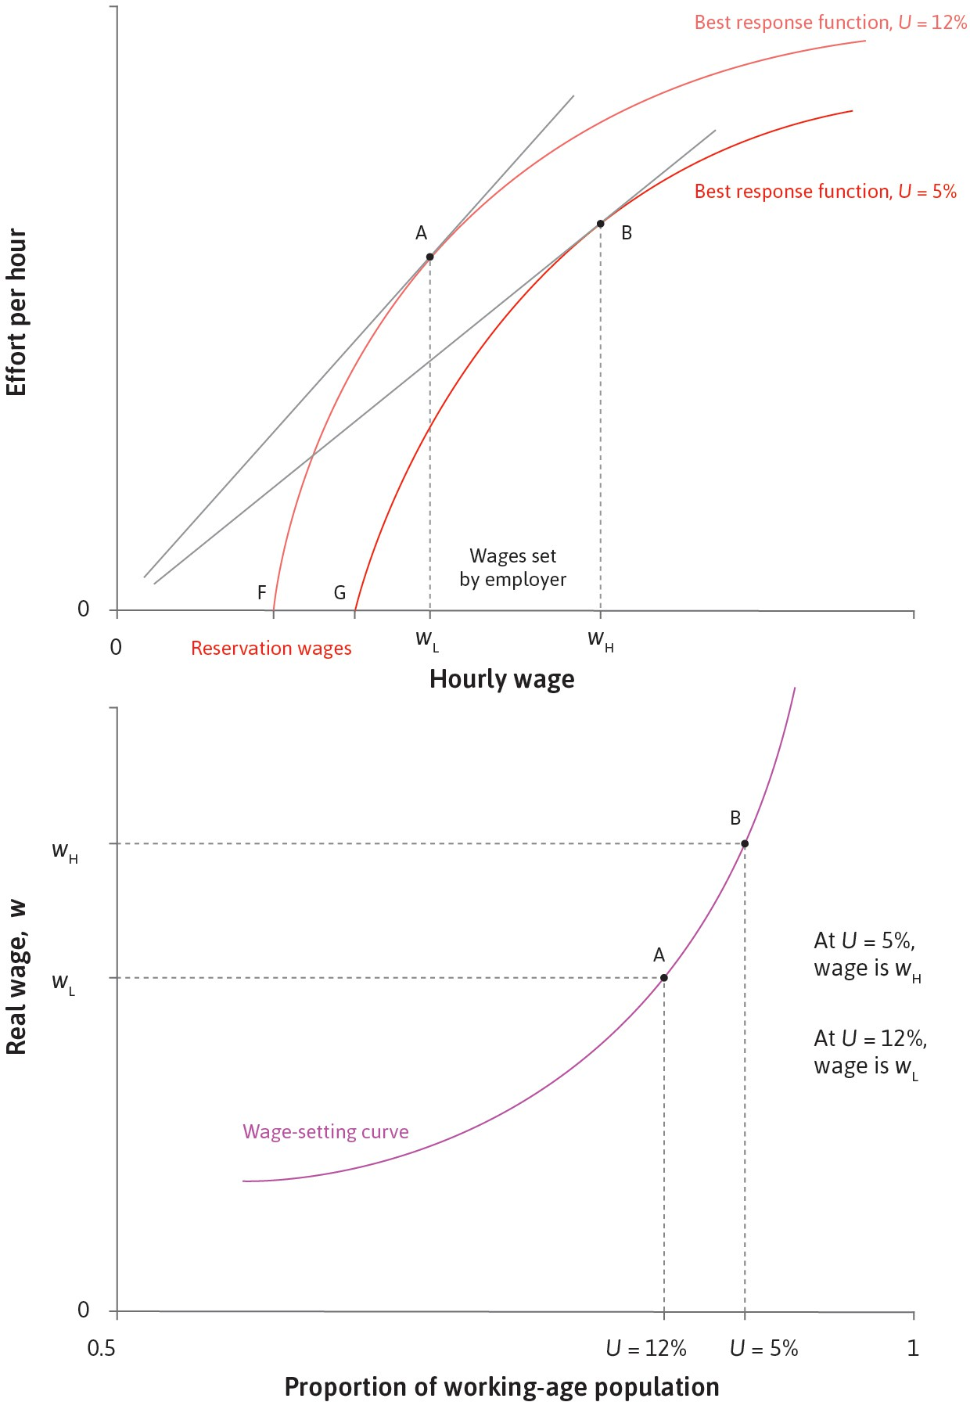
Tutorial question closest to the exam #3
Problem Set 3 Q2 / Short Q5(a): monitoring device
Monitoring makes shirking easier to detect.
监控更强，偷懒更容易被抓到.
So firms need a lower wage to induce effort.
因此维持 effort 所需的效率工资下降.
Best response shifts left/down, and the wage-setting curve shifts down.
在图上就是 BR 左移/下移，WS 整体下移.
Final effect / 最后会怎样
Lower equilibrium wage pressure and higher employment.

Slide 50
Tutorial question closest to the exam #4
Problem Set 3 Q2(c) / Short Q5(b): BR shifts but WS does not?
A rise in unemployment makes job loss more costly.
失业率上升时，丢工作更可怕，reservation wage 下降.
So the worker’s best-response curve shifts.
因此 BR curve 会移动.
But the wage-setting curve itself already maps each employment rate to the required wage, so this is mainly movement along the WS relationship, not a shift of the whole curve.
而 WS 本来就是‘不同就业率对应不同工资’的关系，所以更像沿着 WS 走，而不是整个 WS 外移/内移.
Verdict / 判断
The statement is essentially True in this setup.

Slide 51
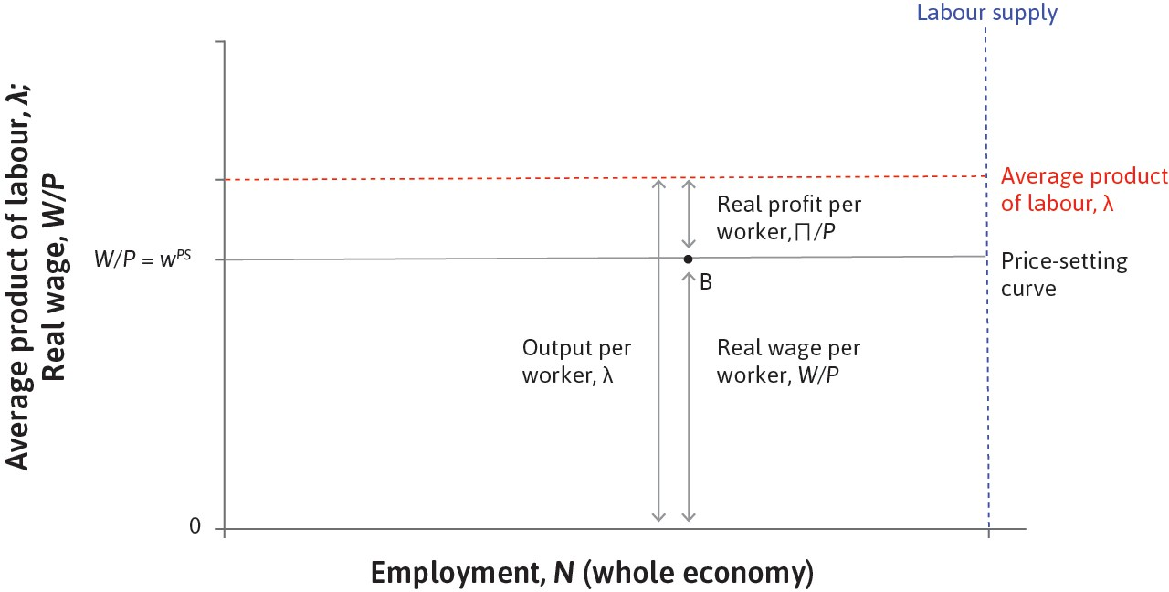
The price-setting curve
为什么 price-setting curve 基本上是水平的
Firms set a price as a markup over cost.
企业定价时要在成本上加 markup.
Given productivity and markup, this pins down the real wage consistent with profit maximisation.
在给定 productivity 和 markup 时，能支付的 real
wage 基本被定住了.
So the price-setting curve is horizontal in this simple model.
因此在简化模型里，PS curve 画成水平线.

Slide 52
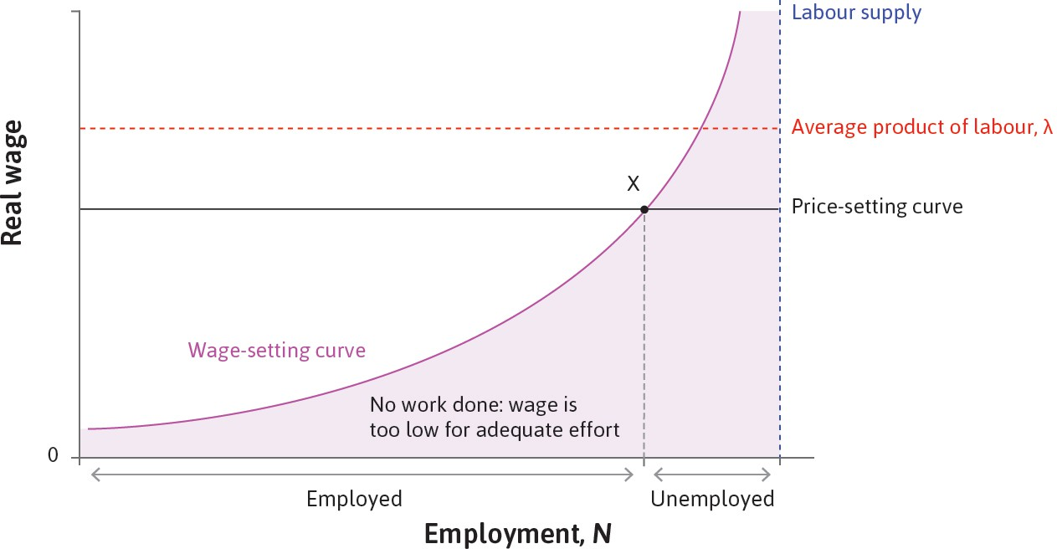
Labour market equilibrium
两条曲线一交，equilibrium 在哪里
The labour market equilibrium is where WS and PS intersect.
交点就是双方都在做最优反应时的均衡.
At that point, the wage is just high enough for effort.
工资刚好高到能维持 effort.
Employment is as high as it can be given that discipline problem.
在 discipline problem 存在时，就业也就只能到这
里.

Slide 53
Why equilibrium unemployment still exists
为什么在均衡里依然会有 involuntary unemployment
If unemployment were zero, job loss would have no cost.
如果失业为零，丢工作就没有威慑.
Then firms would struggle to induce effort.
员工更容易偷懒，企业无法用 job loss discipline workers.
So some unemployment is part of equilibrium in this model.
因此一定程度的 unemployment 是这个模型中的 equilibrium feature.
Key term / 关键词
involuntary unemployment People want jobs, but firms will not hire them at a lower wage because discipline would break down.

Slide 54
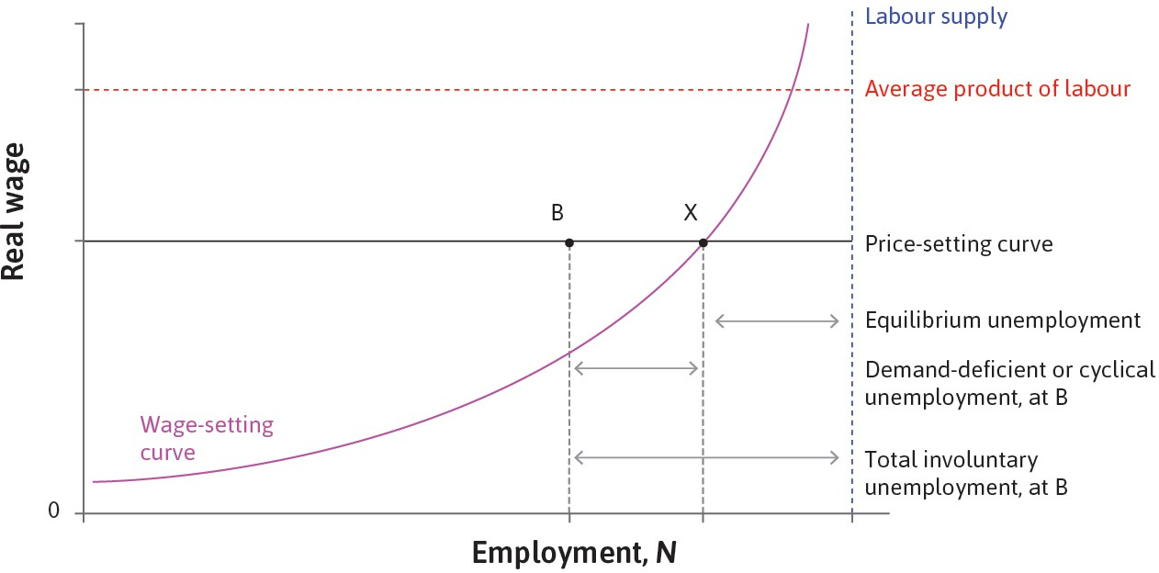
Demand-deficient unemployment
低 aggregate demand 会把失业再往上推
A fall in aggregate demand reduces firms’demand for labour.
需求弱，企业就不需要那么多工人.
Employment falls below the labour-market equilibrium level.
这时经济会落在均衡左边的点.
That extra unemployment is cyclical or demand-deficient unemployment.
多出来的那部分就是 cyclical unemployment.

Slide 55
Why automatic adjustment is slow in real life
书上会自动调，现实里却常常调不快
Workers resist nominal wage cuts.
名义工资下降会伤害 morale，也可能引发冲突.
Lower wages can reduce spending and weaken demand further.
工资降了，消费也可能更弱，反而拖累 AD.
If people expect lower future prices, they may postpone spending.
通缩预期还会让人继续等，进一步压低需求.
Bottom line / 底线
This is why governments may intervene instead of waiting for a painless automatic adjustment.

Slide 56
Government intervention when demand is weak
当 demand 太弱时，政府为什么会出手
If firms would like to sell more at current prices, the economy is demand-constrained.
如果企业愿意多卖，但市场没人买，就是 AD 问题.
Fiscal policy can shift demand outward.
财政政策可以把 demand 推回去.
Monetary policy can also work through investment and spending.
货币政策则更多通过利率、投资和消费来传导.
Bridge to later weeks / 为后面几讲铺路
Lecture 5: inflation and monetary policy
Lecture 6+: banks, money, and credit

Slide 57
Exam drill: Part B Q1 on the energy-price shock
用 2025 paper 的 energy bills 题练回答框架
Answer path / 最稳的答题顺序
If the Bank of England raises rates / 如果央行加息
1
2
3
4
Higher energy prices raise firms’ costs.
The price-setting curve shifts down (firms can afford a lower real wage for a given markup).
Inflation rises: this is cost-push pressure, so the Phillips curve shifts up.
Employment falls and unemployment rises relative to the initial labour-market equilibrium.
aggregate demand weakens
inflation should fall over time
unemployment rises further
investment and consumption may weaken too

Slide 58
Exam drill: Part B Q4 on investment and unionisation
autonomous investment 上升，以及 unionisation 下降时怎么写
Higher autonomous investment raises aggregate demand and labour demand.
投资自发上升会把总需求和 labour demand 往上推.
Employment rises, unemployment falls, and bargaining power strengthens.
就业上升、失业下降，工人议价能力增强.
That puts upward pressure on wages and prices.
工资和价格都会更有上升压力.
If unionisation falls, the wage-setting curve shifts down.
如果工会化程度下降，WS 下移，工资压力更弱.
How to score well / 怎么拿高分
demand shock
bargaining power
wages and prices
then the effect of weaker unions

Slide 59
What to memorise from Lectures 1–3
真正该背的东西没有你想的那么多
Must know / 必背
Common mistakes / 高频错误
GDP = C + I + G + X − M
the AD formula and multiplier logic
credit constraints and temporary income shocks
WS up, PS horizontal, equilibrium unemployment
forgetting imports and taxes in AD
treating deficit and debt as the same
saying GDP = welfare
assuming equilibrium means zero unemployment
Must say well / 必须会说: paradox of thrift
deficit vs debt
equilibrium unemployment

Slide 60
Wrap-up, homework, and what we would do next
收尾：今晚练什么，如果继续上下一节做什么
Tonight’s homework / 今晚最值的三道
If we continue / 如果继续上
inflation and monetary policy
banks, money, and credit
timed exam answers
Problem Set 2 Q1 Problem Set 2 Q2 Problem Set 3 Q2
1
2
3
Final message / 最后一句
You do not need to know everything. You need to know which diagrams and mechanisms turn into marks.

