Slide 1
STAT 598Z – Sorting
Jyotishka Datta

Slide 2
Insertion Sort
If the first few objects are already sorted, an unsorted object can be inserted in the sorted set in proper place. This is called insertion sort.
An algorithm consider the elements one at a time, inserting each in its suitable place among those already considered (keeping them sorted).
Insertion sort is an example of an incremental algorithm; it builds the sorted sequence one number at a time.

Slide 3
Algorithm
It works the way you might sort a hand of playing cards:
We start with an empty left hand [sorted array] and the cards face down on the table [unsorted array].
Then remove one card [key] at a time from the table [unsorted array], and insert it into the correct position in the left hand [sorted array].
To find the correct position for the card, we compare it with each of the cards already in the hand, from right to left.
Note that at all times, the cards held in the left hand are sorted, and these cards were originally the top cards of the pile on the table.

Slide 4
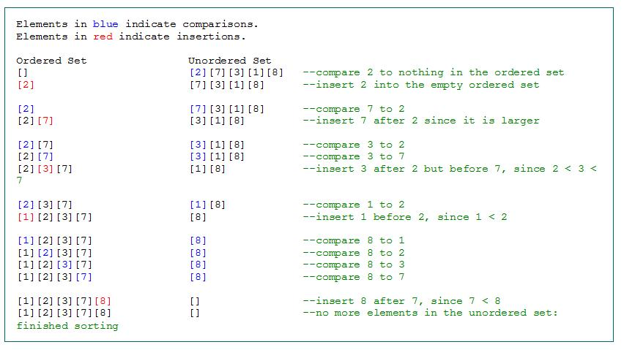

Slide 5
Quicksort – Algorithm
The steps are:
Pick an element, called a pivot, from the list.
Reorder the list so that all elements with values less than the pivot come before the pivot, while all elements with values greater than the pivot come after it (equal values can go either way). After this partitioning, the pivot is in its final position. This is called the partition operation.
Recursively sort the sub-list of lesser elements and the sub-list of greater elements.

Slide 6
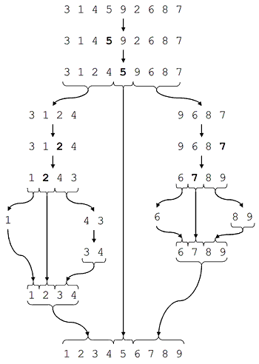
Quicksort - Example

