Slide 1


Analysis of the Relationship between SNP and Heart Disease in 373 Patient Samples Based on microarray DNA
Ziming Huang
From 16/05/2024. progress report

Slide 2
Data Summary
samples | 373 samples (3 missing in raw data)
DNA source | human heart tissue
gender | 256 males, 82 females, 32 inconsistency
Diagnose | 37 Control, 336 Case
def encode phenotype(diagnose):
if diagnose is None or diagnose == '?':
return -9 # Unknown diagnosis, code as -9
elif diagnose == 'N':
return 1 # Control group, code as 1
elif 'DCM' in diagnose.upper():
return 2 # DCM and its subtypes, code as 2
elif diagnose == 'ICM':
return 3 # ICM, code as 3
elif 'HCM' in diagnose or 'HOCM' in diagnose:
return 4 # HCM/HOCM, code as 4
else:
return 5 # Other cardiomyopathies, code as 5
Encoding | Numbers
1 | 37
2 | 177
3 | 90
4 | 10
5 | 50
-9 | 9

Slide 3
Situation: Sex inconsistency
IID | Sex(raw data) | Sex(Record) | Diagnose | PHENO | sex_consistency
D24 | 0 | m | DCM | 2 | False
D27 | 2 | m | DCM | 2 | False
D59 | 0 | m | DCM | 2 | False
D67 | 0 | m | DCM | 2 | False
D87 | 0 | m | ICM | 3 | False
D104-2 | 2 | m | ICM | 3 | False
D106 | 1 |  | N | 1 | Confused
D108 | 1 | w | Marfan Syndrom | 5 | False
… | … | … | … | … | …
D392 | 0 | w | ARVC | 5 | False
D15 | 1 |  | DCM | 2 | Confused
D36 | 2 |  | N | 1 | Confused
D42 | 1 |  | N | 1 | Confused
D46 | 1 |  | N | 1 | Confused
D50 | 1 |  | N | 1 | Confused
D66 | 1 |  | N | 1 | Confused
D184-2 | 0 |  | N | 1 | Confused
D194 | 2 |  | N | 1 | Confused

Slide 4
Input Data Files and Associated Information
Raw data:
M01144_01-04_PLINK_genotypes_GSAv4_hg38_forward.map
M01144_01-04_PLINK_genotypes_GSAv4_hg38_forward.bed
Sample - related Information Files:
M01144_01-04_samplesheet.csv
M01144_01-04_reclustered_summary.xlsx
Phenotype Information File:
Phenotype_Information_HTX_samples_Ziming.csv

Slide 5
Work flow
Transform dataset
Input .map and .ped file. Output .bed files.
Missing data
plink --bfile plink --geno 0.05 --mind 0.1 --make-bed --out qcdata
370 people and 696873 variants loaded
Hardy-Weinberg balance
plink --bfile qcdata --hwe 0.0001 --make-bed --out hwe_filtered
363 people and 651477 variants loaded
plink --file M01144_01-04_PLINK_genotypes_GSAv4_hg38_forward --make-bed --out ./plink
7 people and 45396 variants removed due to missing genotype data
363 people and 651477 variants pass filters
363 people and 650890 variants pass filters and QC
587 variants removed due to Hardy-Weinberg exact test
plink --bfile hwe_filtered --maf 0.05 --make-bed --out maf_filtered
Minor allele
363 people and 274416 variants pass filters and QC
363 people and 650890 variants loaded
376474 variants removed due to minor allele threshold(s)

Slide 6
Work flow
MAF calculating
plink --bfile hwe_filtered --maf 0.05 --make-bed --out maf_filtered
plink --bfile maf_filtered --pheno pheno.txt --covar pca_results.eigenvec --linear --allow-no-sex --out dcm_control_assoc_adjusted
correlation analysis
26 significant SNPs found in the multi-case linear model
363 people and 274416 variants loaded
ANNOVAR annotation

Slide 7
Significant SNPs: Chromosomal Locations, Gene Names and Their Implications
By using the linear algorithm, we can identify the SNPs that are significantly associated with multiple heart diseases.
The significant SNPs listed herein are likely to be of crucial importance in our exploration of the genetic basis underlying heart disease.
Their specific chromosomal locations and corresponding gene names offer valuable perspectives regarding potential genetic markers and pathways implicated in the pathogenesis of heart conditions.

Slide 8
Single Nucleotide Polymorphism | Chromosomal position | Mutation-type | Corresponding gene name
rs6662316 | 1 : 244222912 | intergenic | ZBTB18-to-C1orf100
exm2266124 | 5 : 139378785 | intronic | NRG2
rs11950646 | 5 : 139378785 | intronic | NRG2
rs10063949 | 5 : 139383837 | intronic | NRG2
rs9262134 | 6 : 30650523 | intronic | PPP1R18
GSA-rs73703314 | 7 : 77289437 | ncRNA_intronic | APTR
rs2267705 | 7 : 139996449 | intergenic | KDM7A-DT-to-SLC37A3
rs2721266 | 8 : 2895605 | intronic | CSMD1
rs16907232 | 8 : 137456932 | intergenic | KHDRBS3-to-LINC02055
rs7816962 | 8 : 137504543 | intergenic | KHDRBS3-to-LINC02055
GSA-rs943170 | 9 : 7468664 | intergenic | KDM4C-to-DMAC1
GSA-rs7873050 | 9 : 7512186 | intergenic | KDM4C-to-DMAC1
GSA-rs10967482 | 9 : 26699113 | intergenic | LOC100506422-to-CAAP1
GSA-rs17256298 | 9 : 80489443 | intronic | GNAQ
GSA-rs77695840 | 9 : 80504523 | intronic | GNAQ
rs7071119 | 10 : 127647515 | intronic | FANK1
rs60883840 | 10 : 131319448 | intronic | MGMT
rs4758274 | 11 : 8049276 | intergenic | CASC23-to-TUB
rs11024797 | 11 : 18802768 | intronic | PTPN5
rs1211610 | 12 : 131122509 | intronic | RIMBP2
rs9571875 | 13 : 68284298 | intergenic | LINC00364-to-LINC00550
rs1163881 | 13 : 111532499 | intronic | ANKRD10
GSA-rs35134902 | 16 : 80756584 | intronic | CDYL2
rs566483 | 18 : 4323022 | intronic | DLGAP1
rs8133171 | 21 : 24522616 | intergenic | MIR6130-to-D21S2088E
rs4986503 | 23 : 17369377 | intergenic | NONE-to-NONE

Slide 9
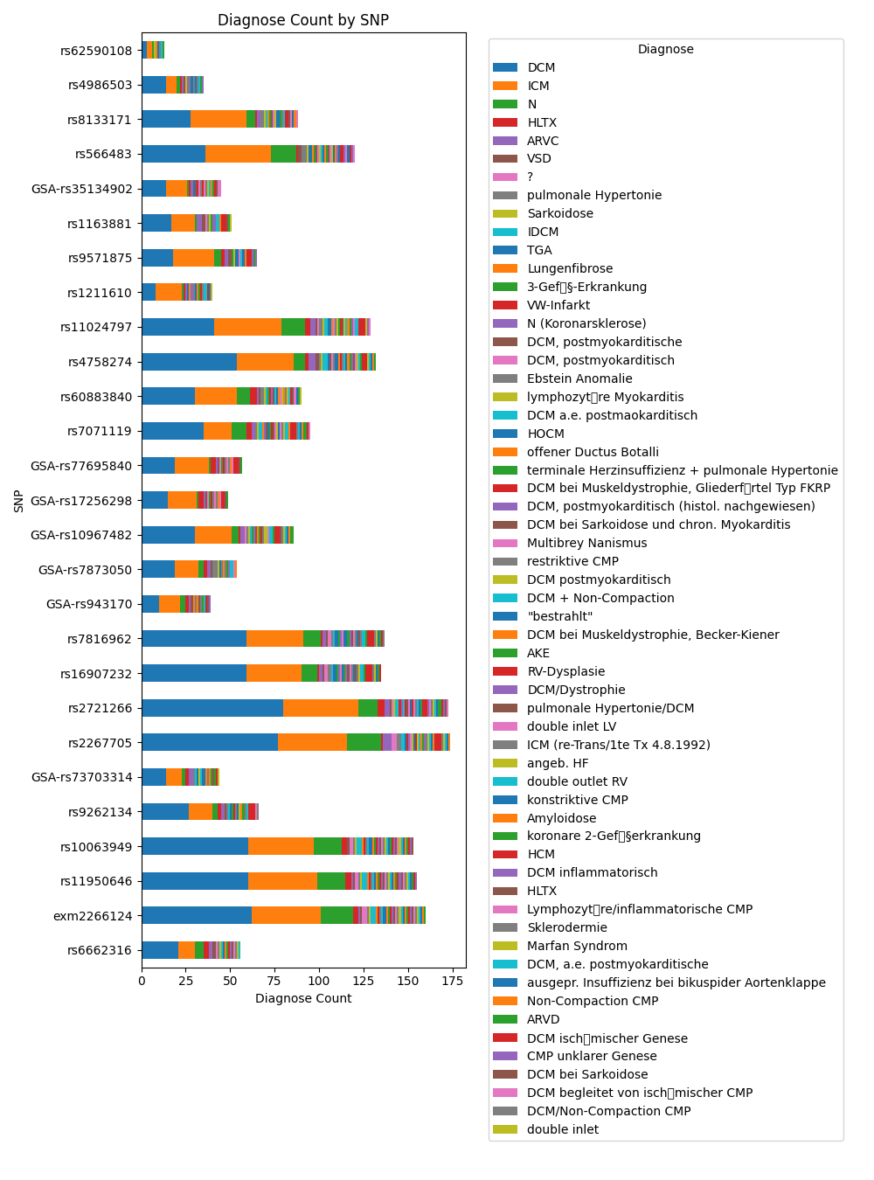

Slide 10
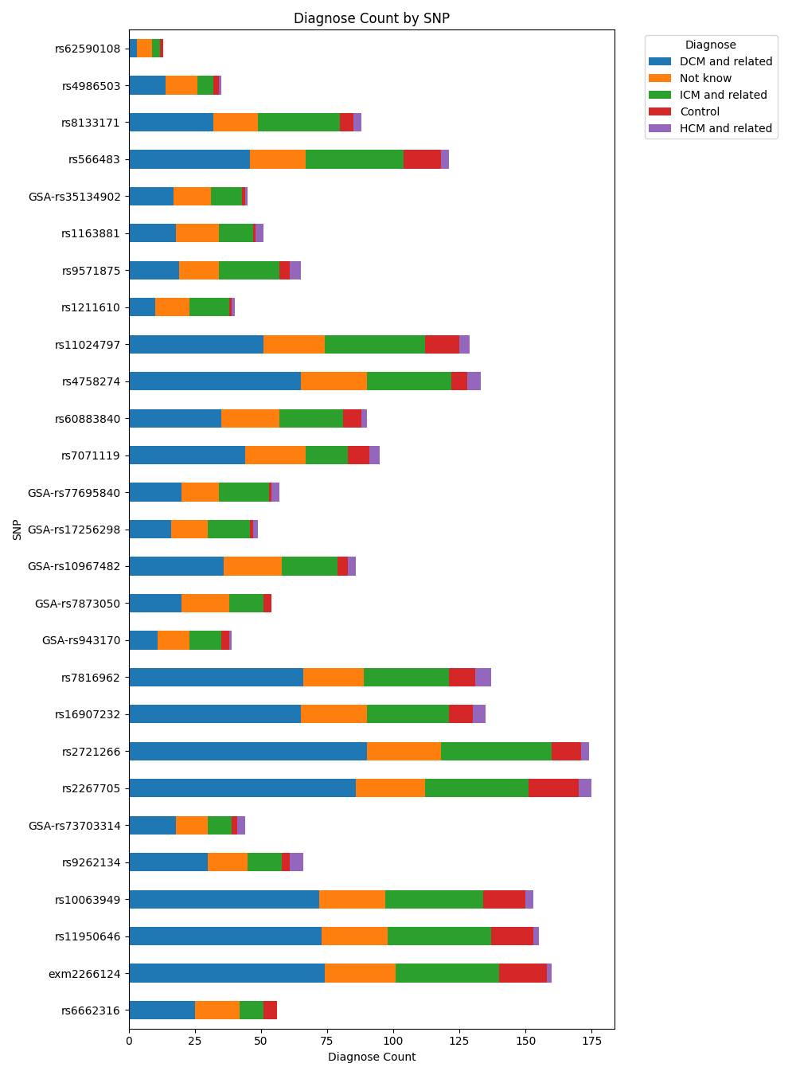

Slide 11
