Slide 1
Flow chat of mutagenesis
1st round mutagenesis
YB1
(wildtype Kitaake )
Tissue culture and transformation
SWEET14 mutant
(5 bp deletion)
TALEN_SWEET14
TALEN_SWEET11
Tissue culture and transformation
2nd round mutagenesis
YB2, YB3, YB4, YB5, YB6, YB7, YB8
Final products for resequencing

Slide 2
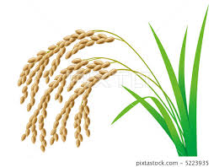
Flow chat of mutagenesis
1st round mutagenesis
Individual embryos were used to generate
2nd round mutagenesis
SWEET14 mutant
(5 bp deletion)
YB1
YB2
YB3
YB8
Individual embryos
YB2, YB3, YB4, YB5, YB6, YB7, YB8 were from independent seed of YB1
Final products for resequencing
One single seed of each line was used to grow plant for DNA extraction and sequencing

