Slide 1
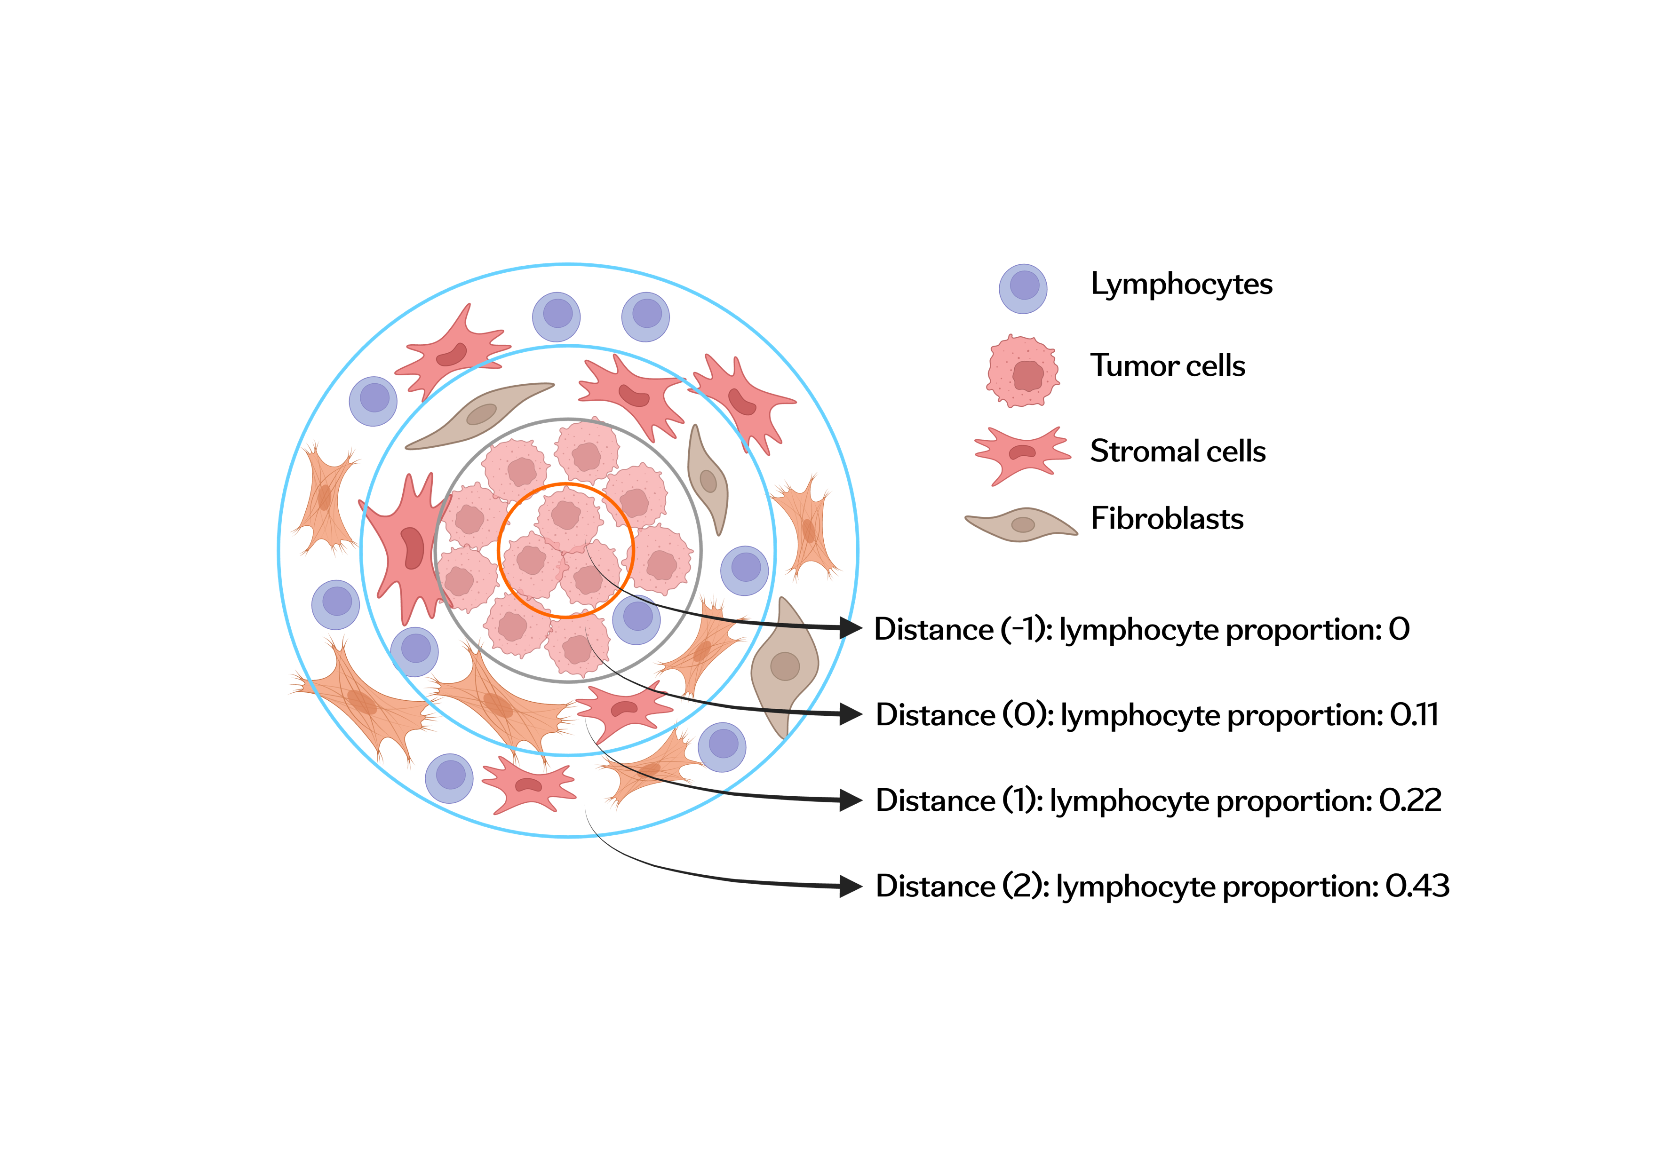
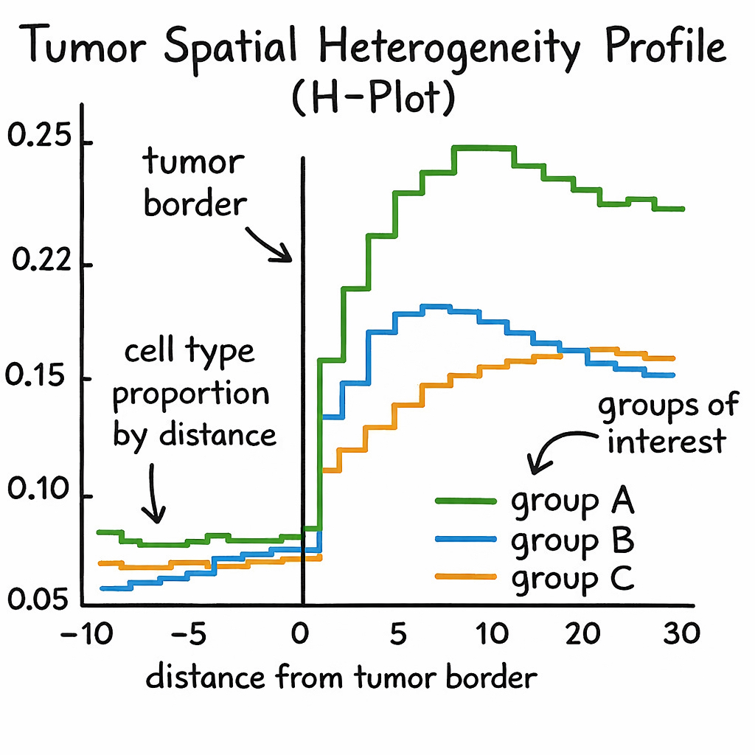
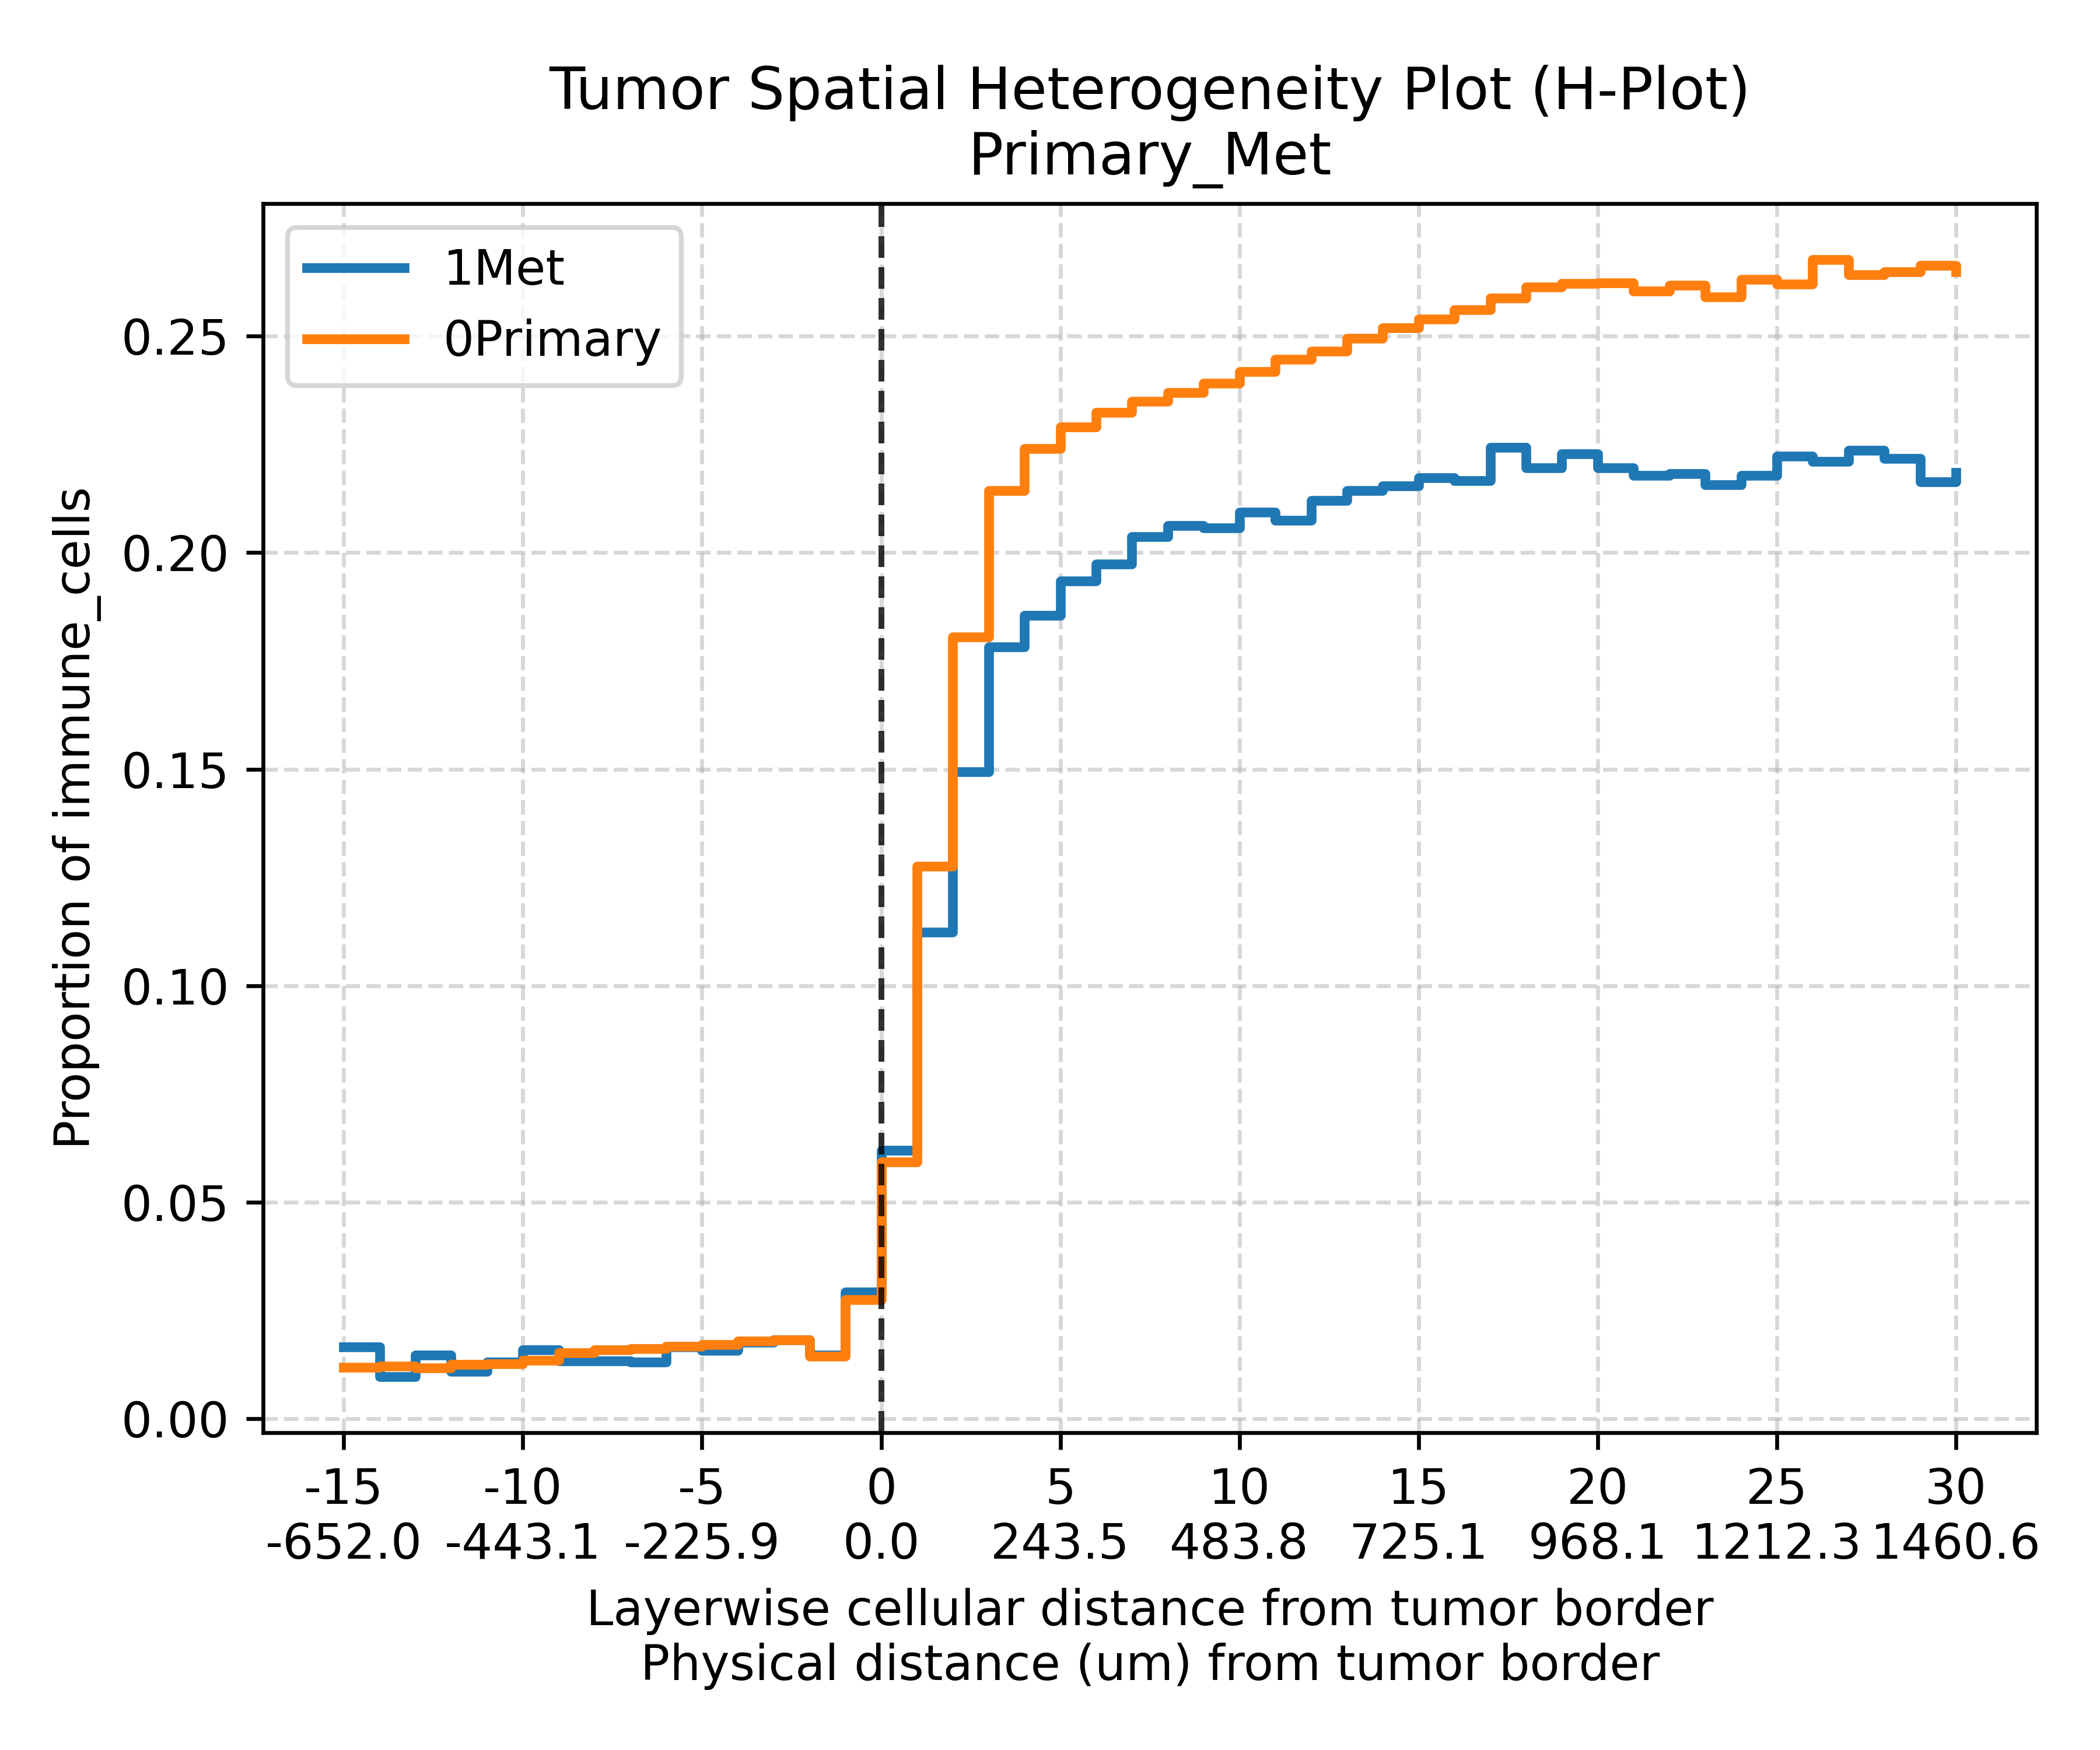
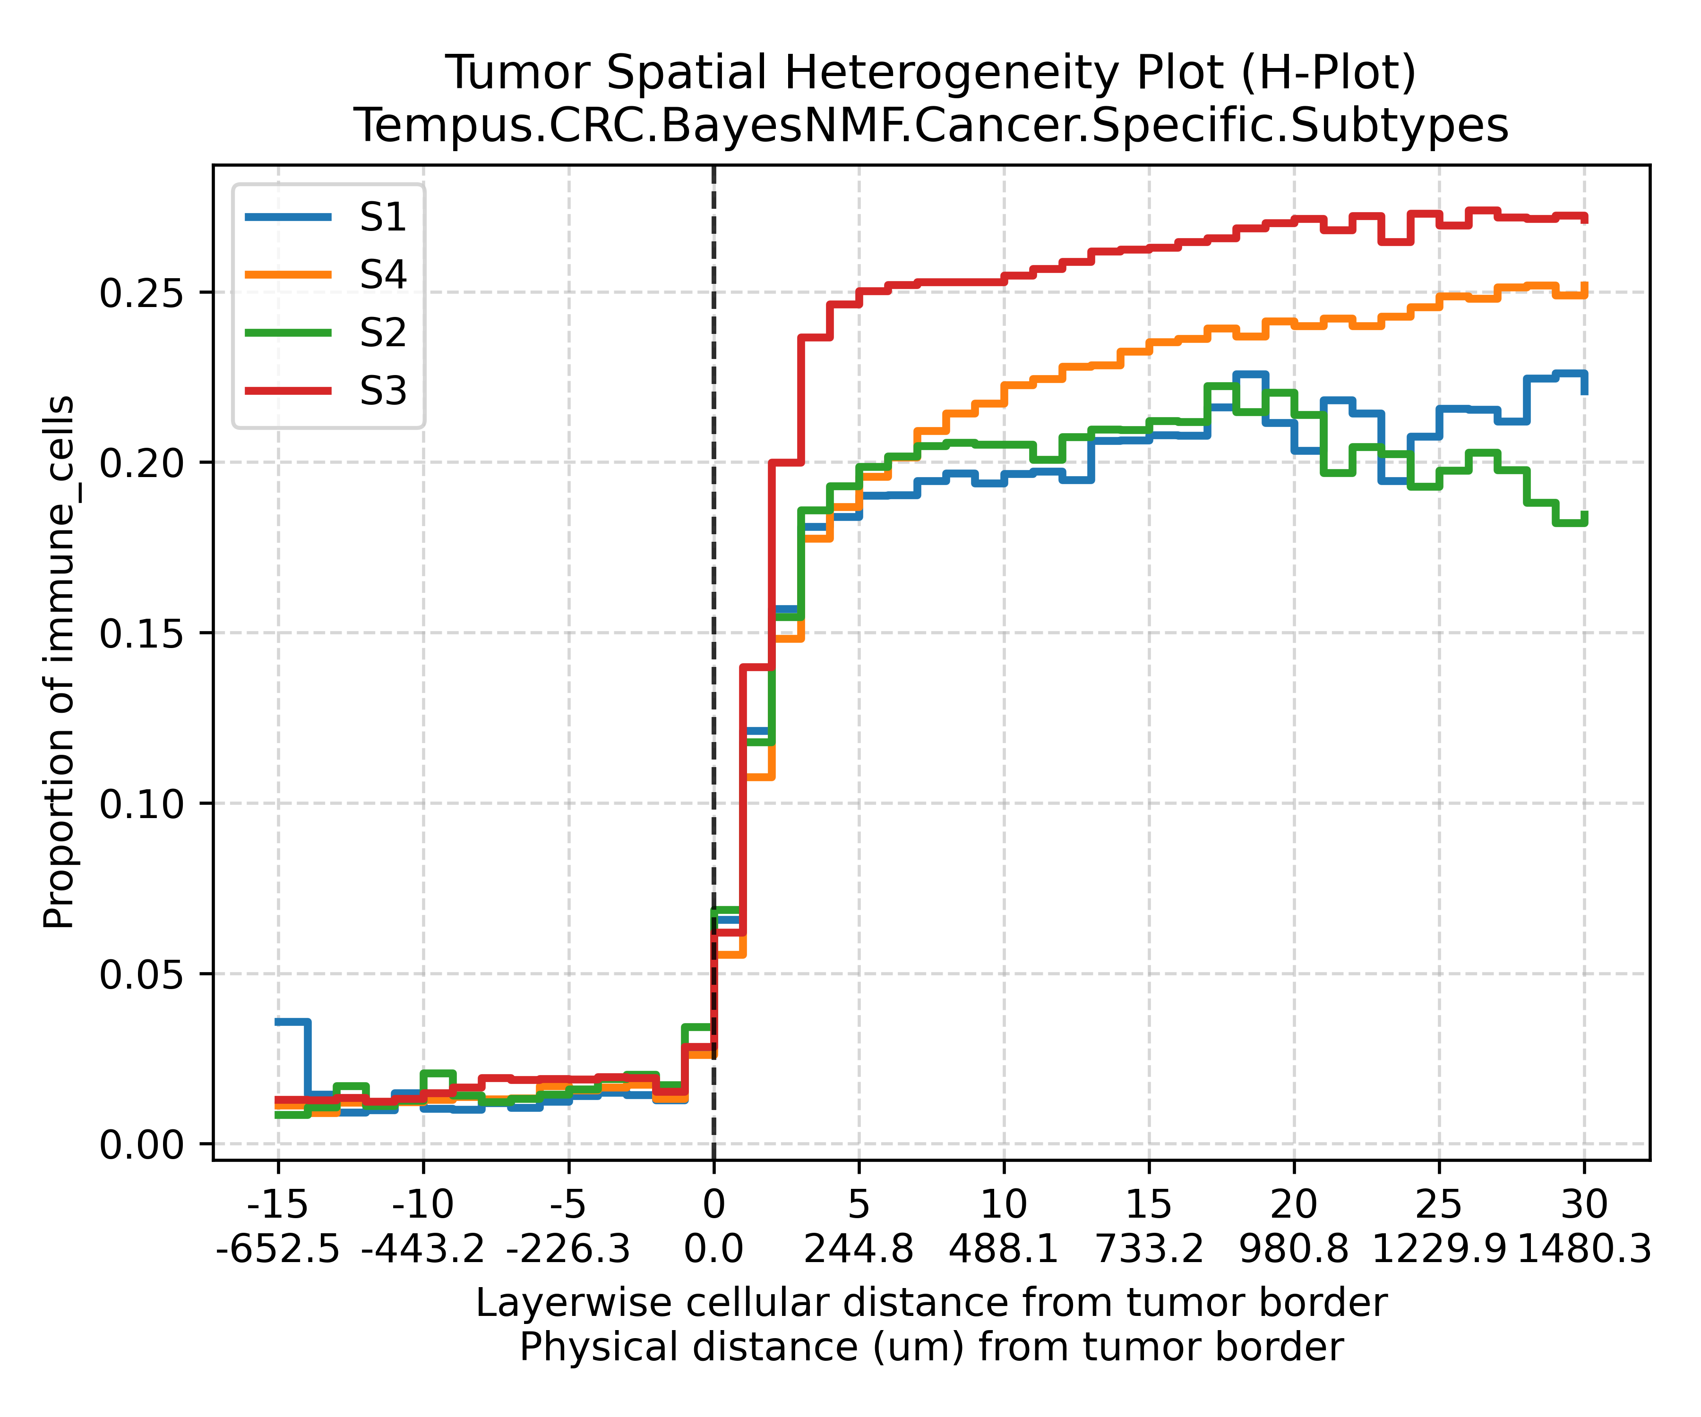
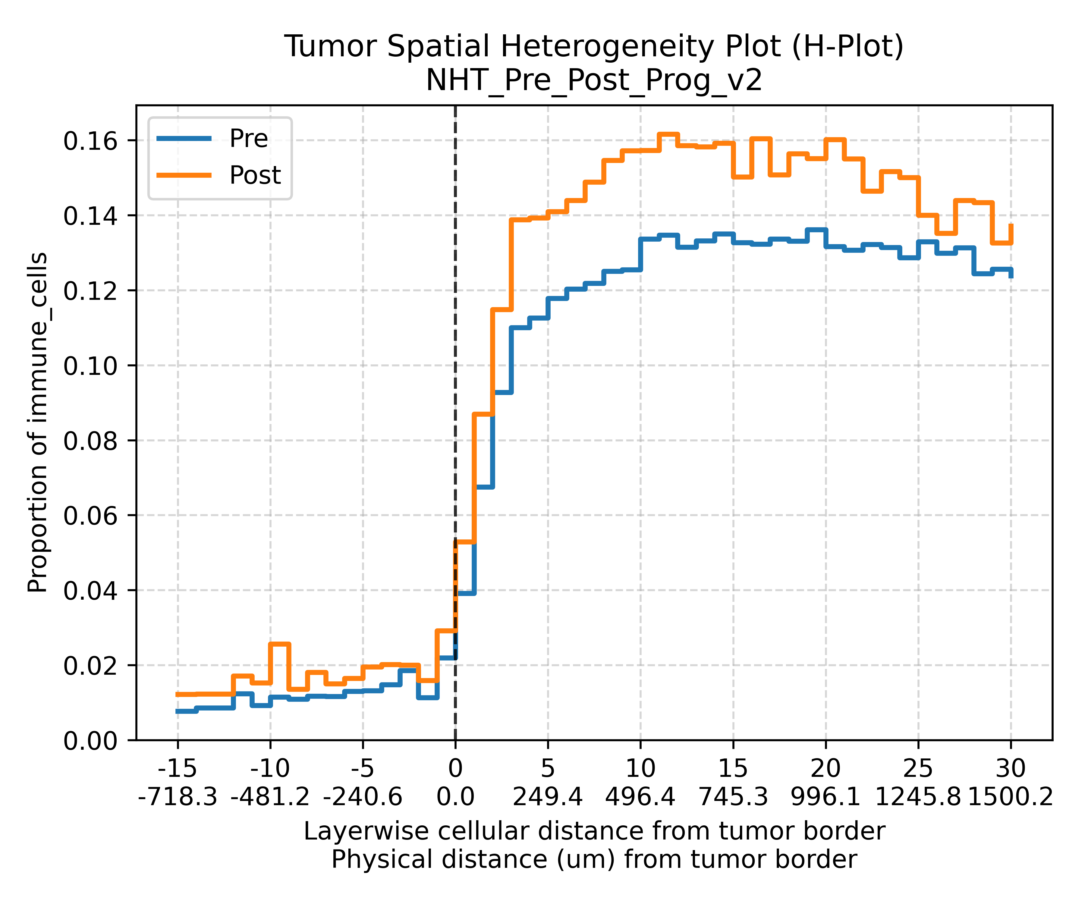
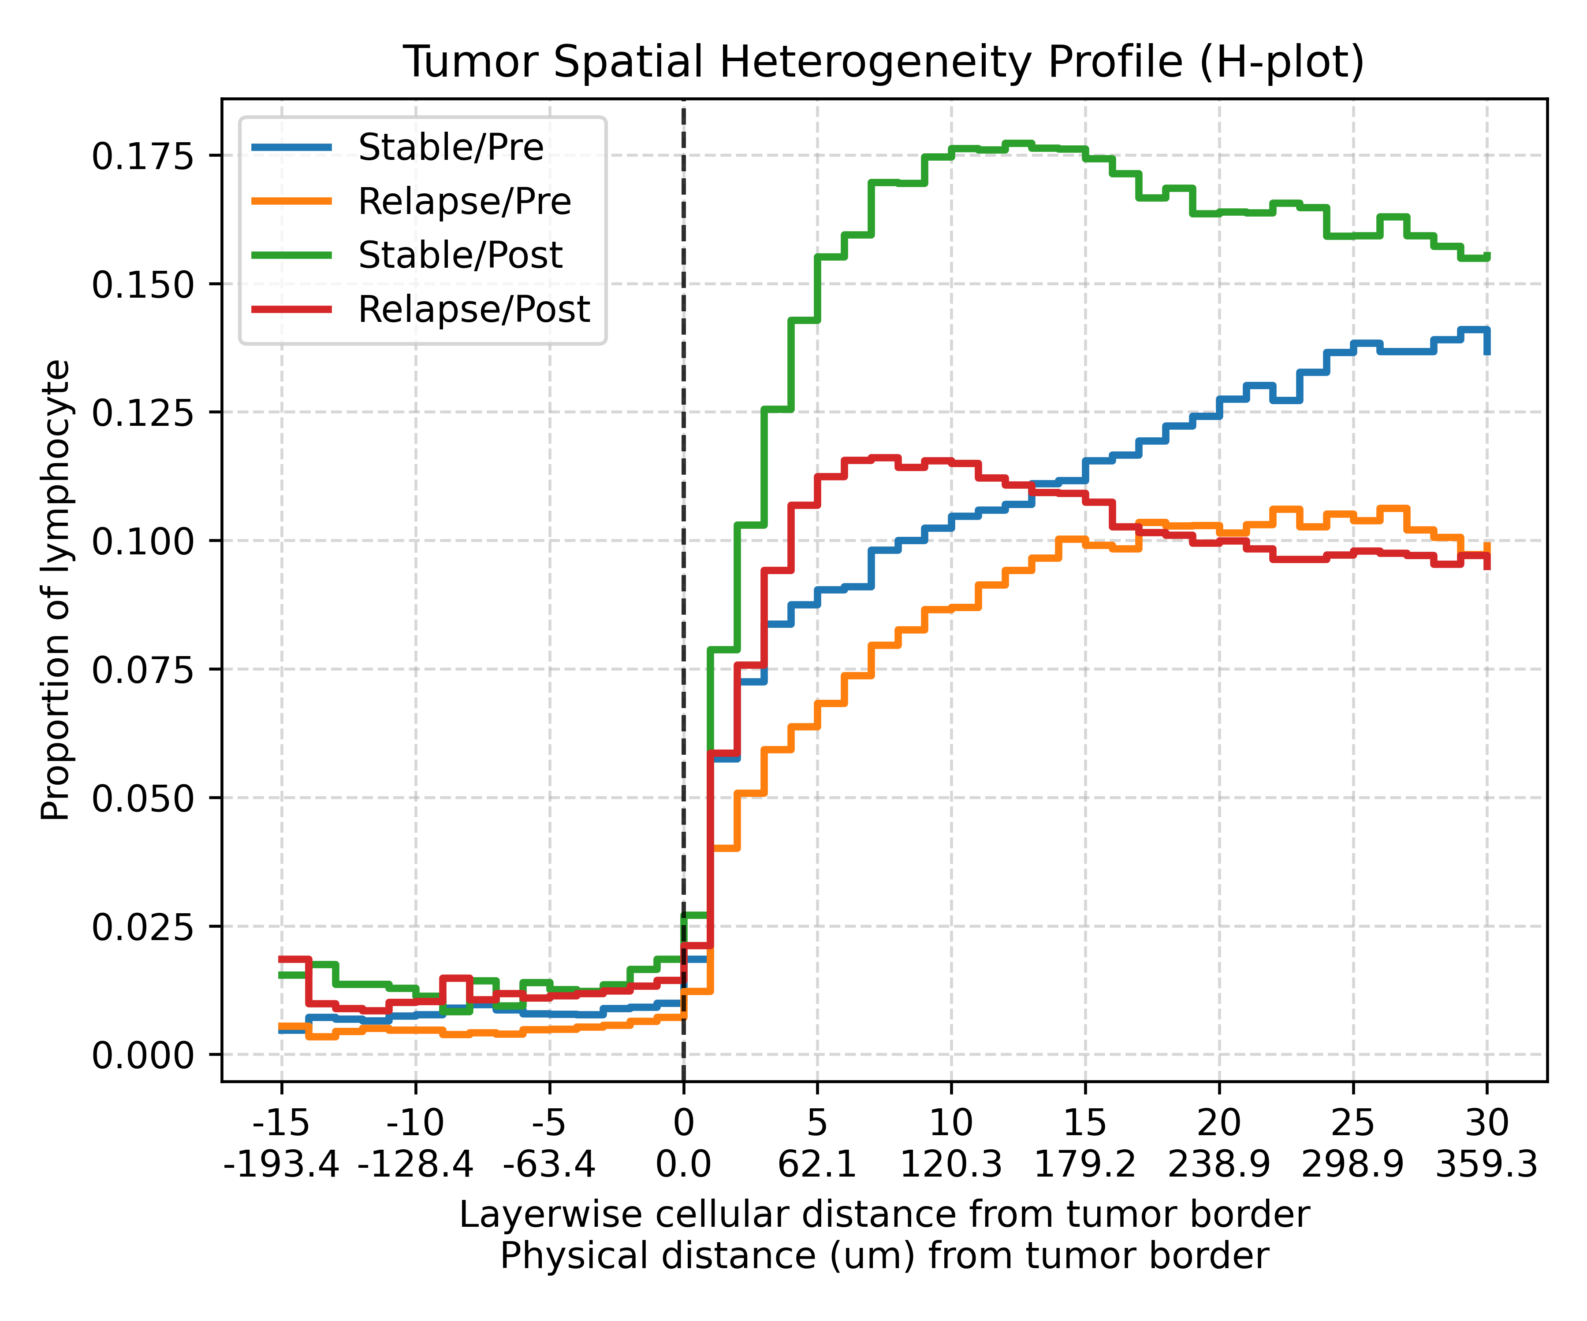
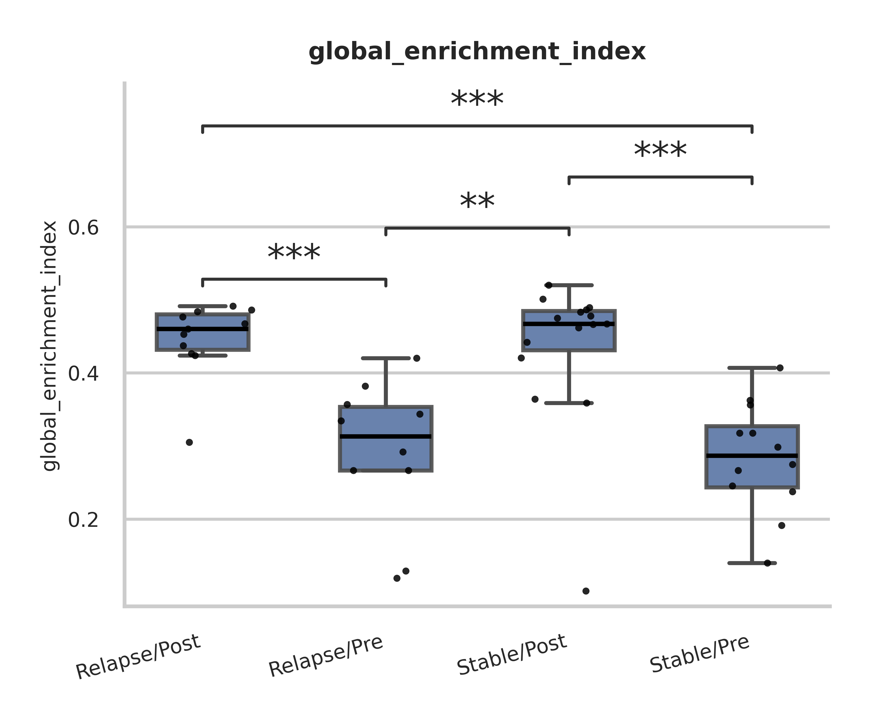
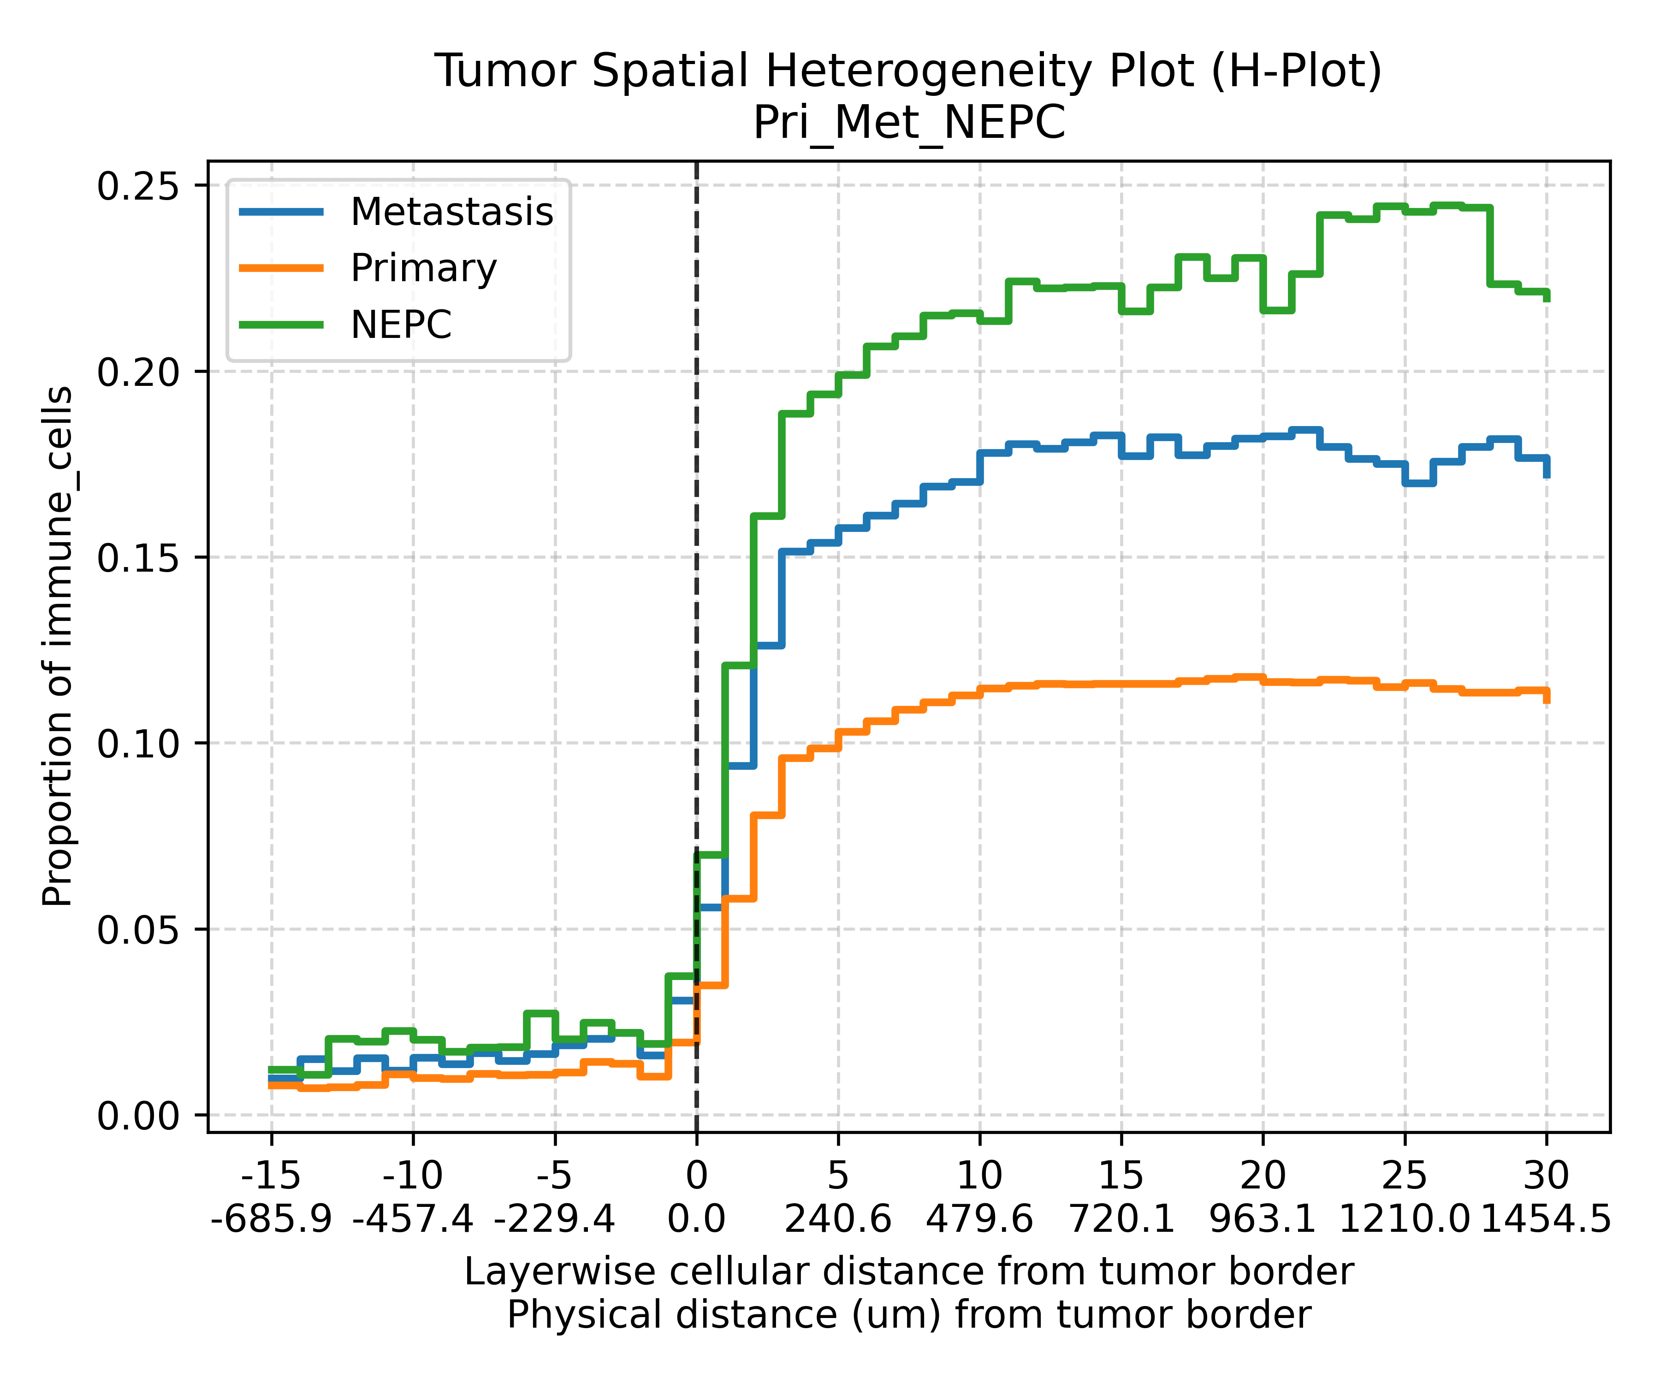
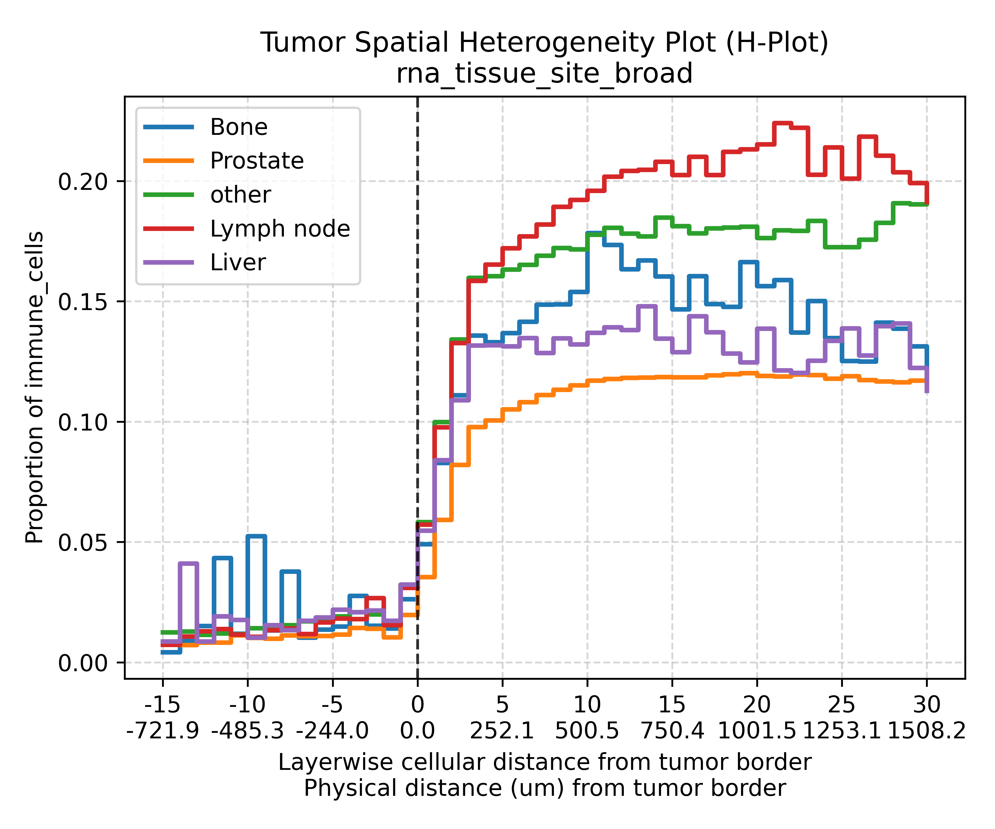


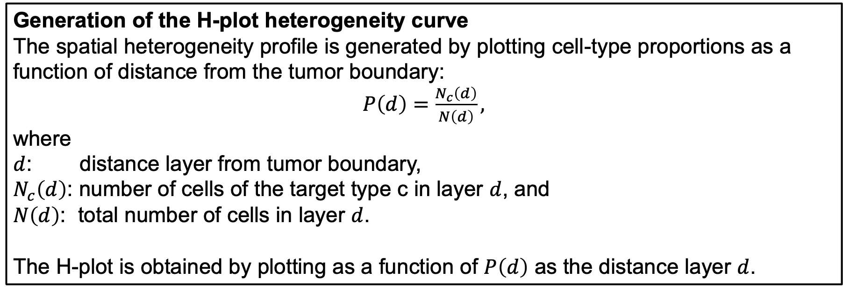
H-plot: A Quantitative Approach to Profiling Spatial Immune Heterogeneity and its Applications in Oncology Studies
Chao-Hui Huang¹, Jadwiga R. Bienkowska¹, Diane Fernandez¹, Sara B. Linker¹, Xinmeng Jasmine Mu¹, Robbin Nameki¹, Jennifer Kinong¹, Michelle Saul², Aakash Sur¹, Mehmet Tekman¹, Alexander Trageser¹, Wenjing Yang¹, Daniel Chawla¹, Arne Schmidt³, Alberto M. Gonzalo³, Srishti M. Mehta³, Rosemarie Krupar³, Nina Kozar-Gillan³, Sophie Laturnus³, Cornelius Böhm³, Marija Pezer³, Gloria H.Y. Lin³, Darlan C. Minussi¹, Greg Szeto², Keith Ching¹, Thomas Powles⁴, Craig B. Davis⁵
1. Pfizer, San Diego, CA 92121
2. Pfizer, Bothell, WA 98011
3. Aignostics, Berlin, Germany
4. Barts Cancer Institute, Experimental Cancer Medicine Centre, Queen Mary University of London, St. Batholomew’s Hospital, Charterhouse Square, London EC1M 6BQ, UK
5. Sage Healthcare Insights, Minnetonka, MN
Abstract
H-plot for Spatial Immune Heterogeneity Profiling
Metastatic Colorectal Cancer Study
The spatial relationship between immune and tumor cells plays a critical role in disease progression and therapeutic response in cancer. While recent advances in spatial transcriptomics and multiplex imaging technologies enable high-resolution mapping of tissue architecture, existing computational approaches often summarize cellular composition globally or focus only on local neighborhood interactions. As a result, spatial heterogeneity across biologically meaningful interfaces, such as the tumor boundary, is frequently overlooked.
To address this limitation, we present H-plot, a quantitative visualization and analytical framework designed to characterize tumor–immune spatial organization in a boundary-resolved manner. H-Plot transforms complex spatial cell distributions into an interpretable heterogeneity profile by stratifying cells according to their distance from the tumor border and computing cell-type proportions within each spatial layer. The method integrates single-cell spatial profiling, Delaunay triangulation-based neighborhood modeling, and cell-function enrichment analysis to quantify how immune cell composition varies across the tumor–stroma interface.
Using this framework, spatial heterogeneity can be summarized as a continuous profile that captures gradients of immune infiltration relative to tumor boundaries. This representation enables intuitive visualization and direct comparison of spatial immune organization across patient cohorts, disease states, and treatment conditions.
We applied H-Plot to oncology datasets including a metastatic castration-resistant prostate cancer (mCRPC) cohort and a metastatic colorectal cancer (mCRC) cohort from Tempus and a bladder cancer cohort from the ABACUS study, to investigate immune infiltration patterns associated with tumor progression. Our analysis reveals distinct spatial immune signatures between tumor subtypes and clinical groups, highlighting differences in lymphocyte enrichment near tumor interfaces and broader microenvironmental organization.
By converting complex spatial cellular distributions into interpretable boundary-resolved profiles, H-Plot enables systematic quantification of tumor spatial heterogeneity and facilitates the discovery of spatial biomarkers relevant to cancer immunology and therapeutic response.
a
b
a
b
Conceptual illustration of how H-plot summarizes spatial organization around a tumor region. Cells of different types (e.g., tumor cells, lymphocytes, stromal cells, and fibroblasts) are distributed across tissue surrounding the tumor. Each cell is assigned a distance layer relative to the tumor boundary (negative values inside the tumor and positive values outside). Within each layer, the proportion of a cell type of interest (e.g., lymphocytes) is calculated, generating a spatial profile of immune cell distribution relative to the tumor interface.
The resulting H-plot visualizes these distance-dependent proportions. The x-axis represents distance from the tumor border, where zero indicates the tumor boundary, negative values correspond to the tumor interior, and positive values represent the surrounding stromal region. The y-axis shows the proportion of the selected cell type among all cells within each distance layer. Each curve represents a sample group or biological condition. Differences in curve shape and magnitude reveal variations in immune infiltration patterns relative to the tumor boundary; peaks near the boundary indicate enrichment of the cell type at the tumor interface, whereas flatter curves indicate weaker spatial organization.
S1​: WNT signaling​ / MYC signature
S2: liver metastasis​ / metabolism​ / APC mut
S3: cell cycle signature​ / mTOR signature ​/ immune activation​/ APC mut​
S4: immune infiltration ​/ stromal infiltration angiogenesis ​ / TGF-b signature​ / BRAF mut
H-plot comparing immune cell fractions in the TME between primary tumors and metastatic lesions. Primary tumors exhibit consistently higher immune infiltration within the tumor region compared with metastatic tumors, suggesting that primary tumors are more immunologically active (“hot”) while metastatic lesions display relatively reduced immune infiltration and a more immune-suppressed (“cold”) microenvironment. A sharp increase in immune fraction is observed at the tumor boundary, indicating immune cell accumulation at the tumor interface.
H-plot stratified by molecular subtypes (S1–S4) reveals subtype-specific spatial immune infiltration patterns. Subtypes S3 and S4 show the highest immune fractions within the TME, consistent with their known biological features, including immune activation, cell-cycle signaling (S3), and stromal- and immune-rich microenvironments (S4). In contrast, S1 and S2 exhibit comparatively lower immune infiltration, suggesting more immune-cold tumor states. Together, these results demonstrate that both tumor progression status (primary versus metastatic) and molecular subtype influence the spatial distribution of immune cells within the tumor microenvironment.
Method
Cell identification and cell-type assignment
Cells are detected from spatial imaging or spatial omics data and annotated with cell-type labels using marker-based classification or computational prediction methods.
Metastatic Castrate-Resistant Prostate Cancer
a
Spatial graph construction by Delaunay triangulation
A spatial adjacency graph is constructed by applying Delaunay triangulation to cell centroid coordinates, defining local neighborhood relationships among cells.
ABACUS Bladder Cancer Study
a
b
Neighborhood-based cell function enrichment analysis
For each cell, the composition of its spatial neighbors is analyzed to quantify enrichment of specific functional cell types within the local microenvironment.
Tumor region and boundary definition
Tumor regions are identified using segmentation or annotation masks, and the tumor boundary is defined as the interface between tumor and surrounding non-tumor tissue.
b
c
Boundary-aware spatial layer assignment
The spatial position of each cell is quantified by calculating its distance to the nearest tumor boundary and assigning it to a corresponding distance layer.
Post_Atezolizumab / relapse vs. Pre_Atezolizumab / SD p_val:8.332e-04
Post_Atezolizumab / SD vs. Pre_Atezolizumab / SD p_val:8.332e-04
Post_Atezolizumab / relapse vs. Pre_Atzeolizumab / relapse p_val:9.818e-04
Post_Atezolizumab / SD vs. Pre_Atezolizumab / relapse p_val:1.186e-03
Cell-type proportion aggregation across spatial layers
For each distance layer, the proportion of cells belonging to a target cell type is computed by aggregating cell-type counts across all cells assigned to that layer.
H-plot for tumor samples stratified by treatment (Atezolizumab) response (Stable Disease-SD vs. relapse) and pre vs. post treatment sample collection. The results suggest that more lymphocytes were mobilized to the tumor border post treatment in Stable Disease cases. On the other hand, the relapse cases presented less lymphocytes in general.
The AUC of H-plot showed significant p-values differences comparing among these cases.
Generation of the H-plot heterogeneity curve
The spatial heterogeneity profile is generated by plotting cell-type proportions as a function of distance from the tumor boundary:
$P\left(d\right)=\frac{N_{c}\left(d\right)}{N\left(d\right)},$
where
$d$: distance layer from tumor boundary,
$N_{c}\left(d\right)$: number of cells of the target type c in layer $d$, and
$N\left(d\right)$: total number of cells in layer $d$.
The H-plot is obtained by plotting as a function of $P\left(d\right)$ as the distance layer $d$.
Consistent with RNA-seq–derived immune signatures, prostate cancer biopsies collected prior to NHT treatment exhibited a lower overall proportion of immune cells near the tumor border compared to those obtained after progression on NHTs. This suggests that the tumor microenvironment becomes more immunologically active, or “hotter”, upon progression. Given the enrichment of metastatic tumors post-NHT progression, we next stratified samples by tumor location.
As anticipated, biopsies from metastatic sites demonstrated higher immune cell densities both adjacent to and distal from the tumor border. To further explore spatial heterogeneity, we assessed immune distribution across different metastatic sites.
Across metastatic tissue sites, lymph node samples exhibited the highest immune cell proportions across spatial layers, followed by other metastatic tissues. This pattern likely reflects differences in the inherent immune composition of the host tissues rather than prostate cancer–specific effects.
Source code available at GitHub
H-Plot
WSInsight

