Slide 1
实现一种像google搜索一样方便的es查询api
黄琛(C.Wong)
https://github.com/huangchen007/elasticsearch-rest-command

Slide 2
elasticsearch的官方query dsl
{
"match" : {
"message" : {
"query" : "this is a test",
"operator" : "and"
}
}
}

Slide 3
elasticsearch的官方api特点
优点：
直观，可读性强
机器解析速度也快
扩展性好
缺点：
编写复杂，标点符号多
学习成本稍高

Slide 4
目前更加流行的人机交互接口
SQL系列
grep/awk
google搜索/高级搜索

Slide 5
这样的接口
search src="10.9.165.*" OR dst="10.9.165.8"
search src="10.9.165.*" OR dst="10.9.165.8" | sort dst
search src="10.9.165.*" OR dst="10.9.165.8" | sort dst | stats sum(bytes) as ASumOfBytes by clientip
search src="10.9.165.*" OR dst="10.9.165.8"
sort dst
stats sum(bytes) by clientip
搜索条件
管道符
处理命令
管道符
处理命令

Slide 6
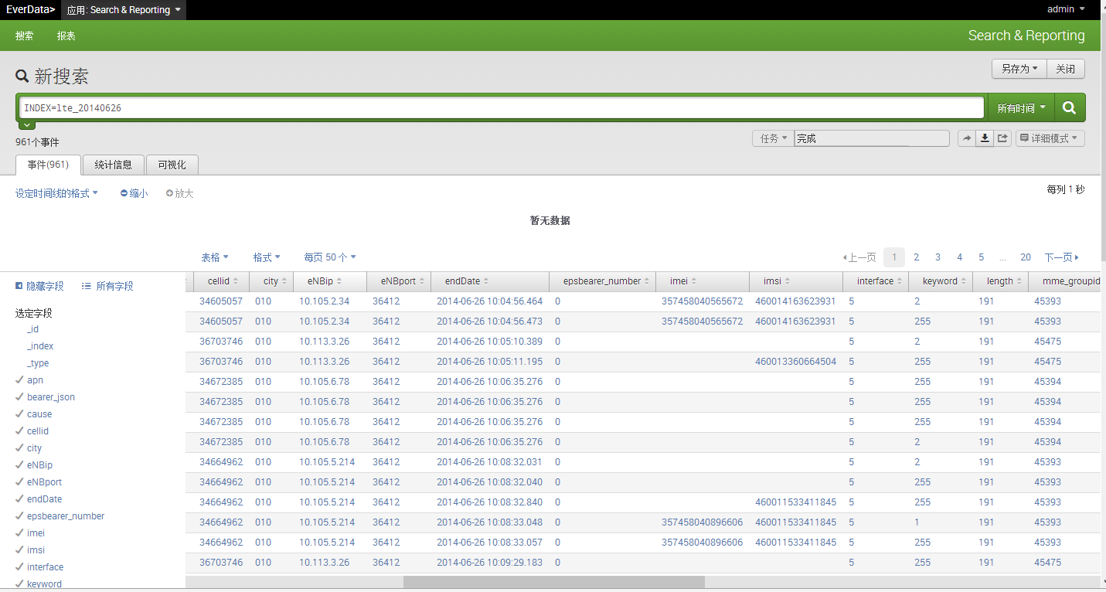
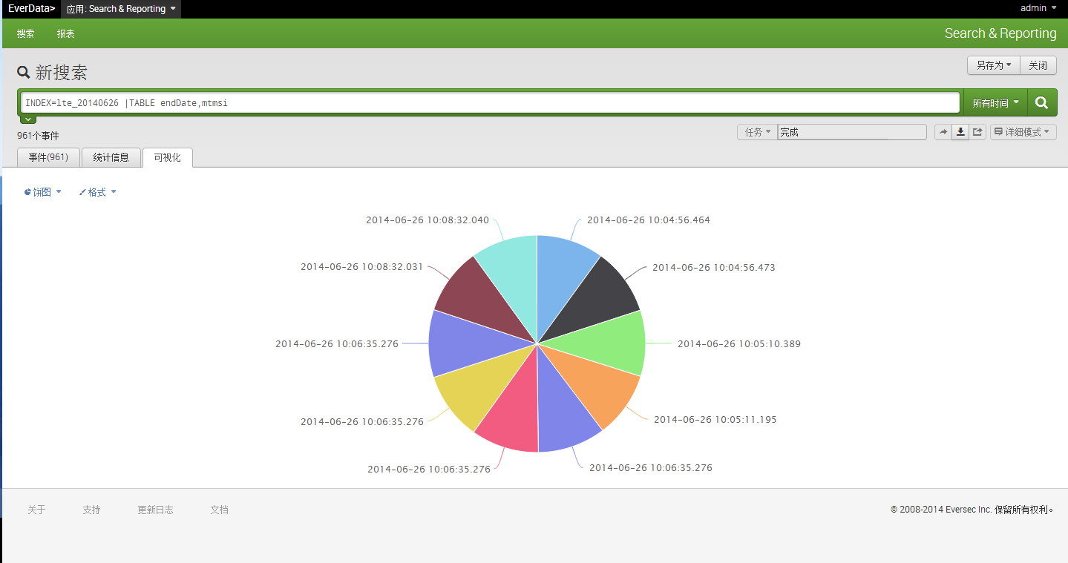
UI（演示）

Slide 7
SOURCETYPE=cdr234 APN="CMNET"
SOURCETYPE=cdr234 APN="CMNET" AND CID =41553
SOURCETYPE=cdr234 APN="CMNET" AND CID =41553 | TABLE upFlow
SOURCETYPE=cdr234 APN="CMNET" AND CID =41553 | TABLE upFlow | SORT upFlow
SOURCETYPE=cdr234 APN="CMNET" AND CID =41553 | TABLE upFlow | STATS SUM(upFlow)
SOURCETYPE=cdr234 APN="CMNET" AND CID =41553 | TABLE upFlow | STATS SUM(upFlow) BY L4Protocol
SOURCETYPE=cdr234 APN="CMNET" AND CID =41553 | STATS TIMESPAN=1s SUM(upFlow) BY endTime
SOURCETYPE=cdr234 APN="CMNET" AND CID =41553 | STATS SPAN=10 SUM(upFlow) BY upFlow
SOURCETYPE=cdr234 | STATS DC(MSISDN)
SOURCETYPE=cdr234 APN="CMNET" AND CID =41553 | JOIN MSISDN (SEARCH SOURCETYPE=userinfo)

Slide 8
支持的命令
search(2014-4-1)
  search <searchoptions> <BooleanExpression>
  logical expression:and/or/not/嵌套/default=and
  operator:[!]=/>[=]/<[=]/
  searchoptions: sourcetype/index/hasparent/haschild
sort (2014-4-21)
  ...| sort <field> [DESC/ASC]
stats（2014-4-10）
  ... | stats [statsoptions] <StatsFunction> [ByClause]
  StatsFunction:count(..),sum(..),avg(..),max(..),min(..),dc(...)
  parameter:fieldname/eval(script)
  ByClause: By <parameterlist>
  statsoptions:minicount,limit,span,timespan
join (2014-06-13)
  ... | join <fieldlist> ( subsearch )
  eg:index=comment | join userid (search index=user)
table(2014-06-16)
  ... | table <filedlist>
  filedlist支持通配符

Slide 9
实现/设计
es插件实现vs直接修改代码
javacc vs antlr

Slide 10
程序包
com.everdata.command
  根据语法解析的结果对es集群进行查询并返回结果
com.everdata.parser
  语法解析，转换成query dsl
org.elasticsearch.plugin.rest
  实现plugin所必要的接口

Slide 11
主要调用流程
class CommandRestHandler extends BaseRestHandler{
  void handleRequest(...){
    commandString = request.param("q", "");
    parser = new CommandParser(commandString);
    search = new Search(parser, client, logger);
    switch(mode){
      case 0:result = search.executeQueryWithNonJoin();
      case 1:result = search.executeQuery();
      case 2:result = search.executeReport();
      case 3:result = search.executeDownload();
      case 4:result = search.executeDelete()
    }
  }
}

Slide 12
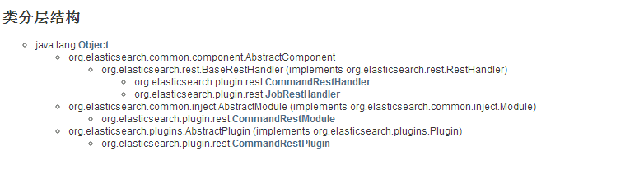
程序包org.elasticsearch.plugin.rest的分层结构

Slide 13
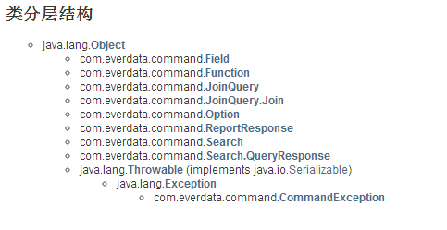
程序包com.everdata.command的分层结构

Slide 14
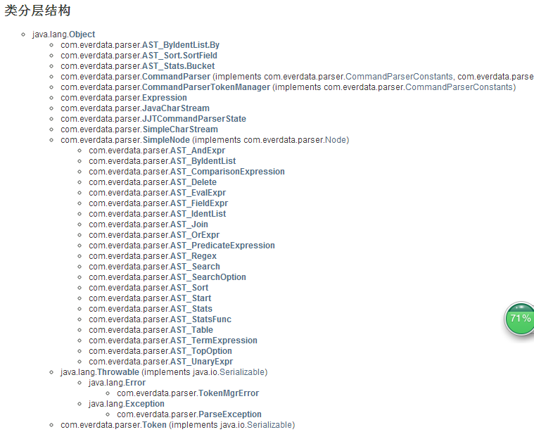
程序包com.everdata.parser的分层结构

Slide 15
如何表示嵌套的布尔表达式
SearchStatement::=<K_SEARCH> ( SearchOption )* ( BooleanExpression )?
BooleanExpression::=AndExpression ( <K_OR> AndExpression )*
AndExpression::=UnaryExpression ( <K_AND> UnaryExpression )*
UnaryExpression::=( <K_NOT> )? ( <O_LPAREN> BooleanExpression <O_RPAREN> | PredicateExpression )
PredicateExpression::=( ComparisonExpression ( ComparisonExpression | TermExpression )* | TermExpression ( ComparisonExpression | TermExpression )* )
TermExpression::=( ( <S_INTEGER> | <S_FLOAT> | <S_IDENTIFIER> ) | <S_QUOTED_STRING> )
ComparisonExpression::=<S_IDENTIFIER> ( <O_EQ> | <O_NEQ> | <O_GT> | <O_GTE> | <O_LT> | <O_LTE> ) ( ( <S_INTEGER> | <S_FLOAT> | <S_IDENTIFIER> ) | <S_QUOTED_STRING> )

Slide 16
递归遍历Abstract Syntax Tree得到Query DSL
QueryBuilder genQueryBuilder(SimpleNode tree){
switch(nodeType){
case JJT_OREXPR:
return fb.or(genQueryBuilder(tree.children));
case JJT_ANDEXPR/JJT_PREDICATEEXPRESSION:
return fb.must(genQueryBuilder(tree.children));
case JJT_UNARYEXPR:
return fb.mustnot(genQueryBuilder(tree.children));
case JJT_COMPARISONEXPRESSION/JJT_TERMEXPRESSION: return QueryBuilders.termQuery/matchPhraseQuery
/rangeQuery/prefixQuery/wildcardQuery;
}
}

Slide 17
感谢聆听!
github
  https://github.com/huangchen007/elasticsearch-rest-command
weibo：
  http://weibo.com/huang007
qq群昵称/QQ号
  C.Wong/3335956
姓名
  黄琛

