Slide 1
Team FinalCSProject
BY: Dawei huang, sADRAC CAMACHO, JUAN PABLO PRIETO

Slide 2
Dawei Method1 (slow) ~ 2 hours
3 major components to the program
1) Open the dictionary text file and appends each entry onto a list
2) Compare function compares two words and returns 1 if anagrams and -1 if not anagrams
3) Main engine: for each word, systematically selects a word in the dictionary and then program compares the word with every other word in dictionary. O(N^2) -This is why this program takes so long.

Slide 3

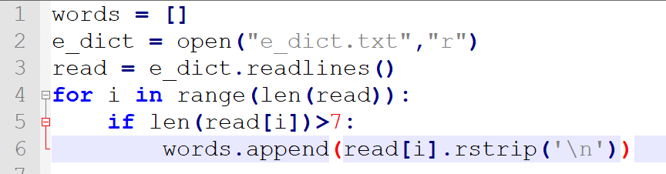



Component 1: Read Text File

Slide 4
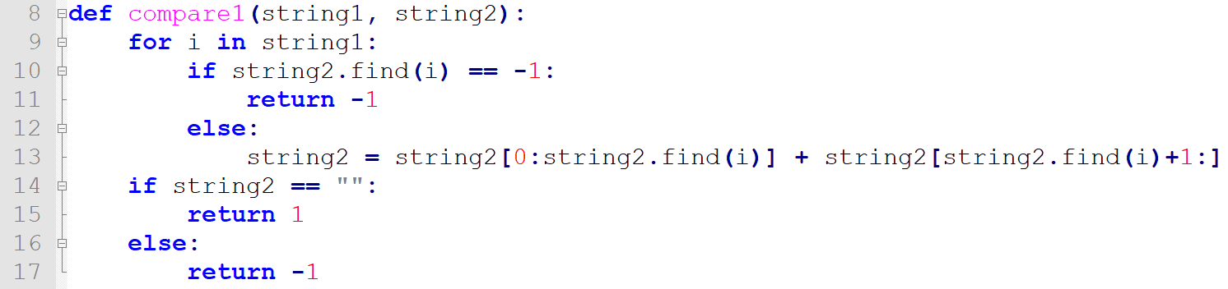
Component 2: Compare Method

Slide 5
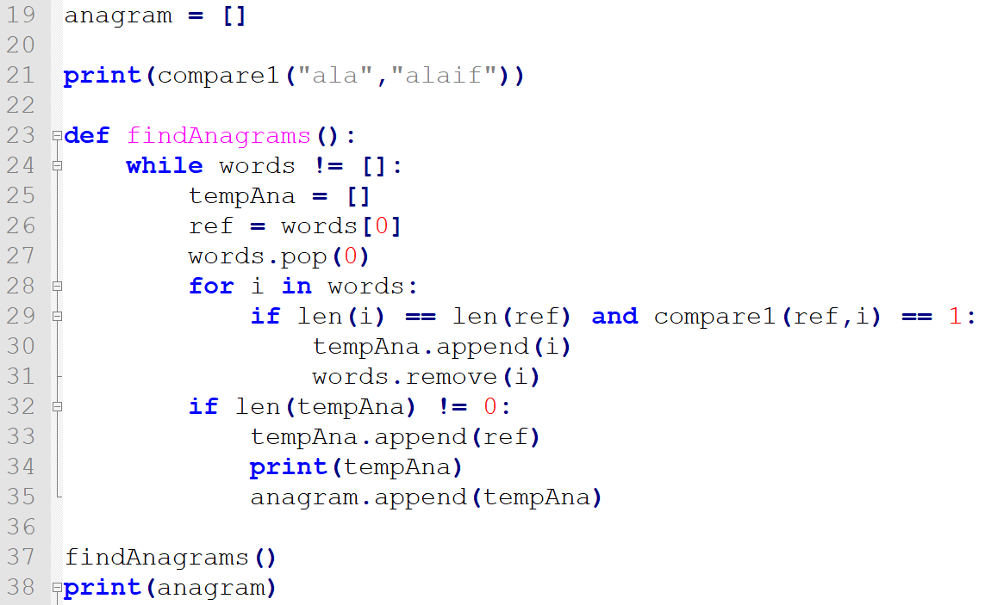
Component 3: Main Component

Slide 6
Sadrac's Method~ .6 seconds
Opens dict.txt and goes through every word , where it alphabetizes given word (variable: alphabatizer, sort) and makes it into a dictionary key
Later in the loop, words which have already had a distinct alphabetized key previously created don't receive a distinct key and are instead appended as a value to given key
In order to format the anagrams, I excluded all keys that had only one value

Slide 7
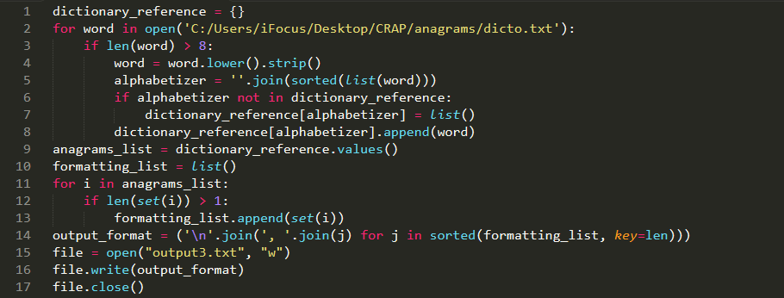

Slide 8
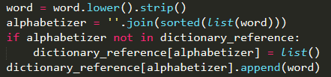
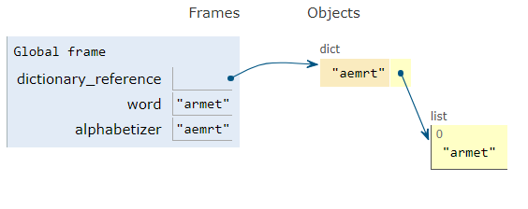
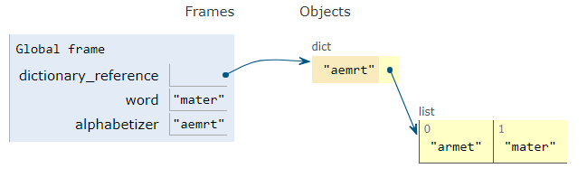
Process 1:
Process 2:

Slide 9
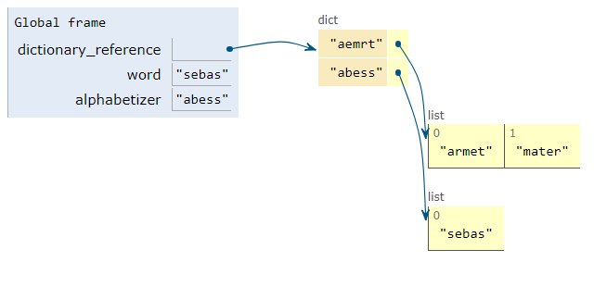
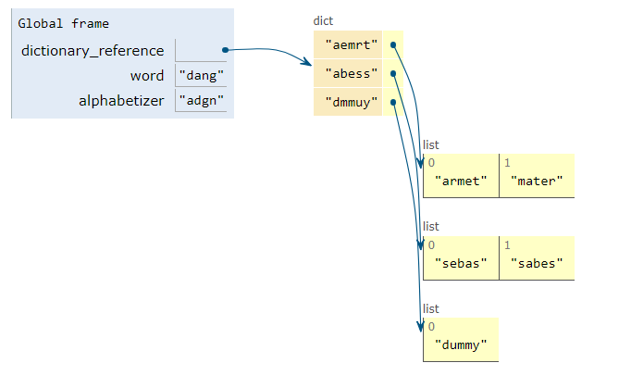
Process 3:
Process 4:

Slide 10
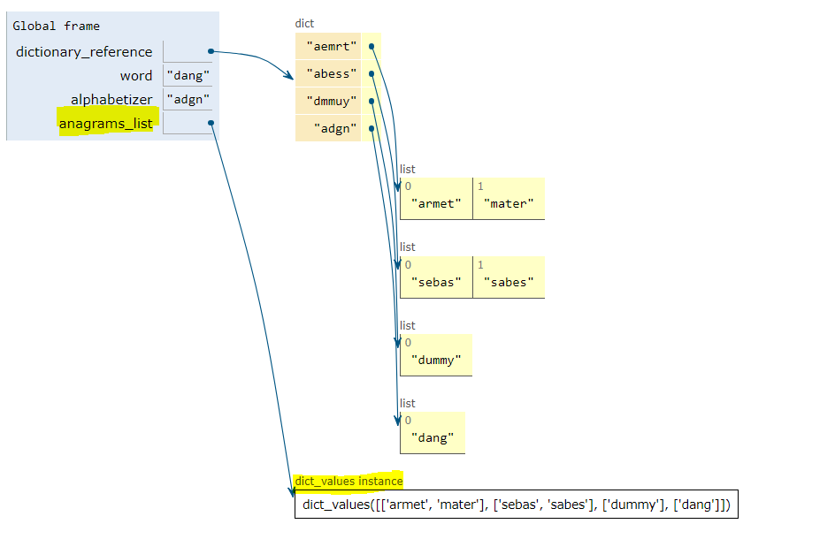
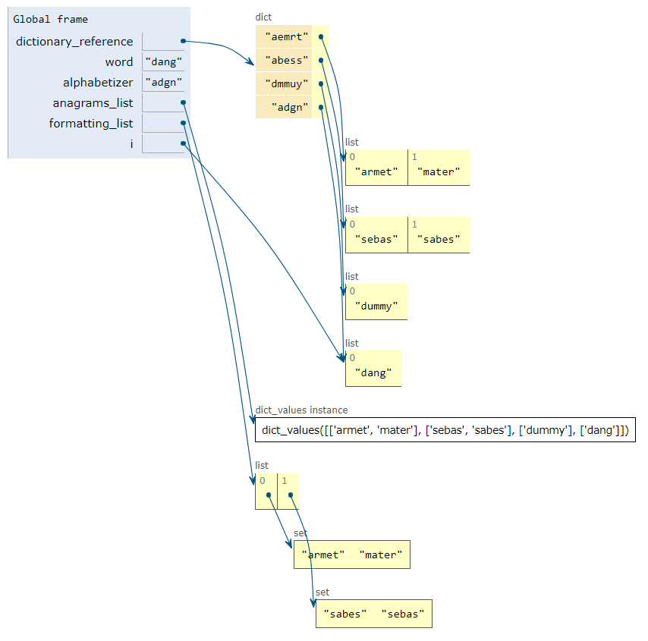

Process 5
Process 6

Slide 11

Review of Code:

Slide 12
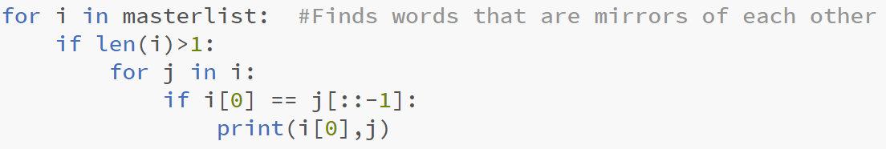
Interesting facts
In the dictionary we found words that are mirrors of each other
Amaroid Diorama
Anacara Aracana
Dessert Tressed
Leveler Relevel
Rotanev Venator
Artamus Sumatra
Redrawer Rewarder
Palindrome Counter:
Still Zero
Average Word Length:
8.63
Word Count:
18472 Words
Most Frequent Letter:
"e" (appears: 14200 time)

