Slide 1
Team FinalCSProject
BY: Dawei huang, sADRAC CAMACHO, JUAN PABLO PRIETO

Slide 2
Dawei Method1 (slow) ~ 2 hours
3 major components to the program
1) Open the dictionary text file and appends each entry onto a list
2) Compare function compares two words and returns 1 if anagrams and -1 if not anagrams
3) Main engine: for each word, systematically selects a word in the dictionary and then program compares the word with every other word in dictionary. O(N^2) -This is why this program takes so long.

Slide 3

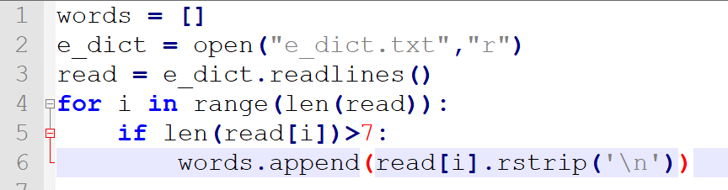



Component 1: Read Text File

Slide 4
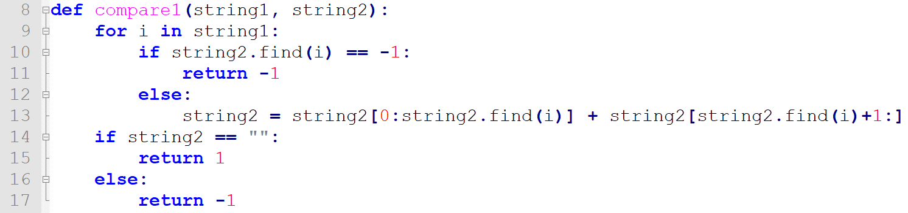
Component 2: Compare Method

Slide 5
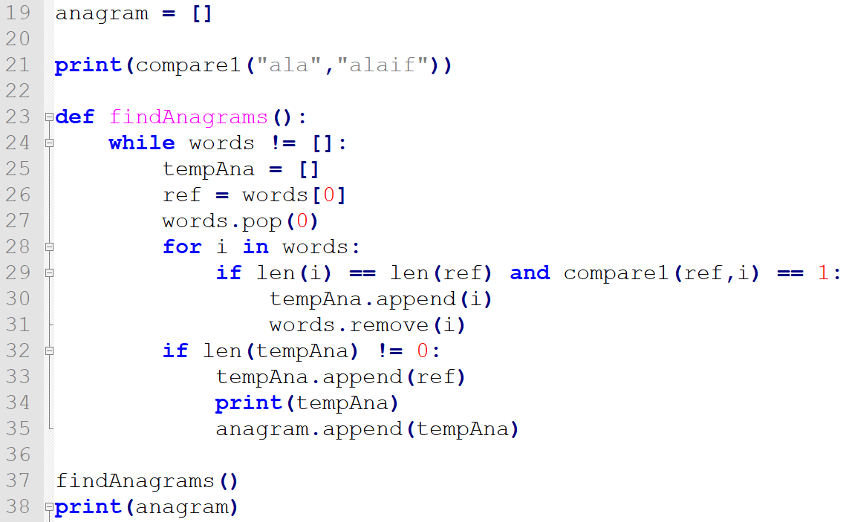
Component 3: Main Component

Slide 6
Sadrac's Method~ .6 seconds
Opens dict.txt and goes through every word , where it alphabetizes given word (variable: alphabatizer, sort) and makes it into a dictionary key
Later in the loop, words which have already had a distinct alphabetized key previously created don't receive a distinct key and are instead appended as a value to given key
In order to format the anagrams, I excluded all keys that had only one value

Slide 7
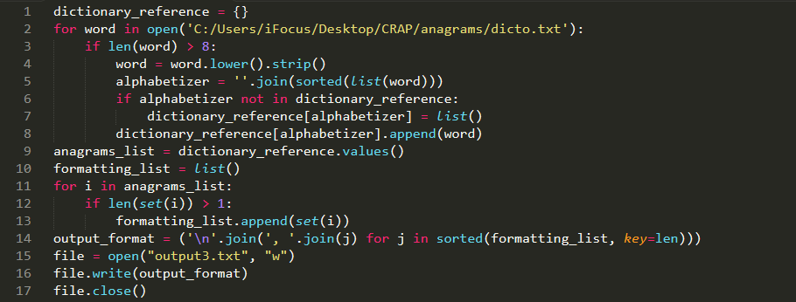

Slide 8
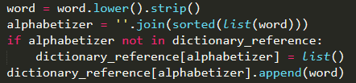
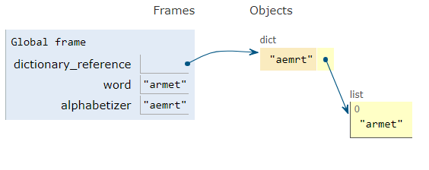
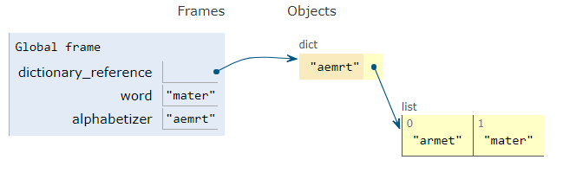
Process 1:
Process 2:

Slide 9
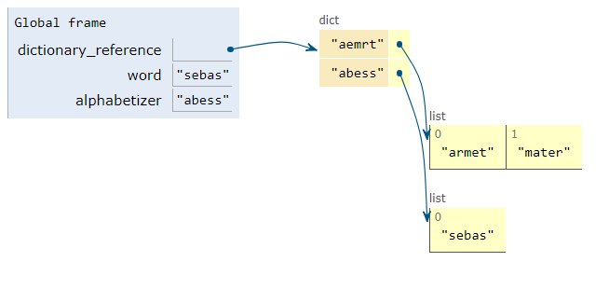
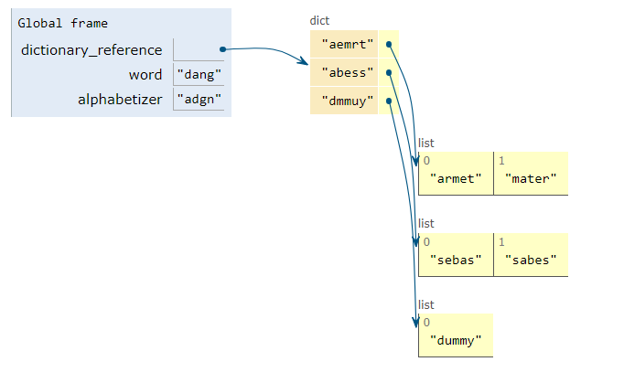
Process 3:
Process 4:

Slide 10
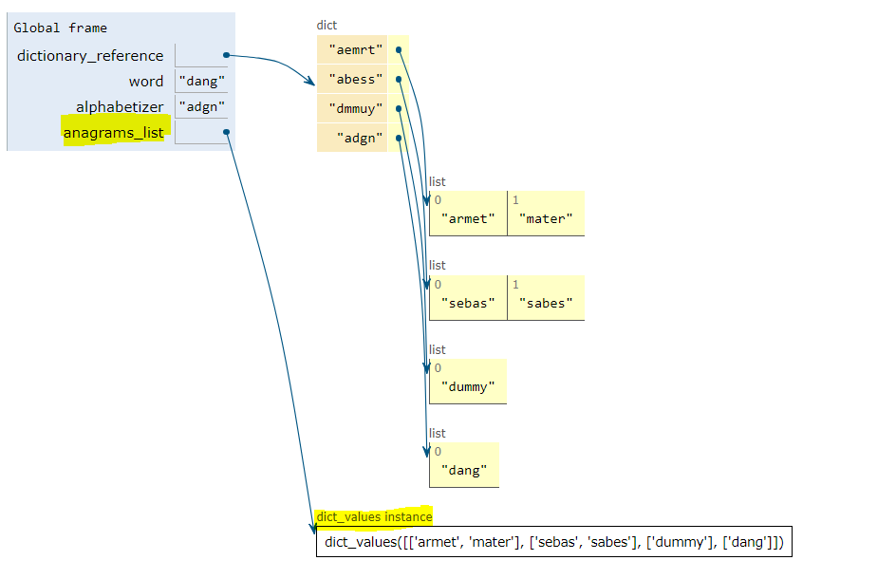
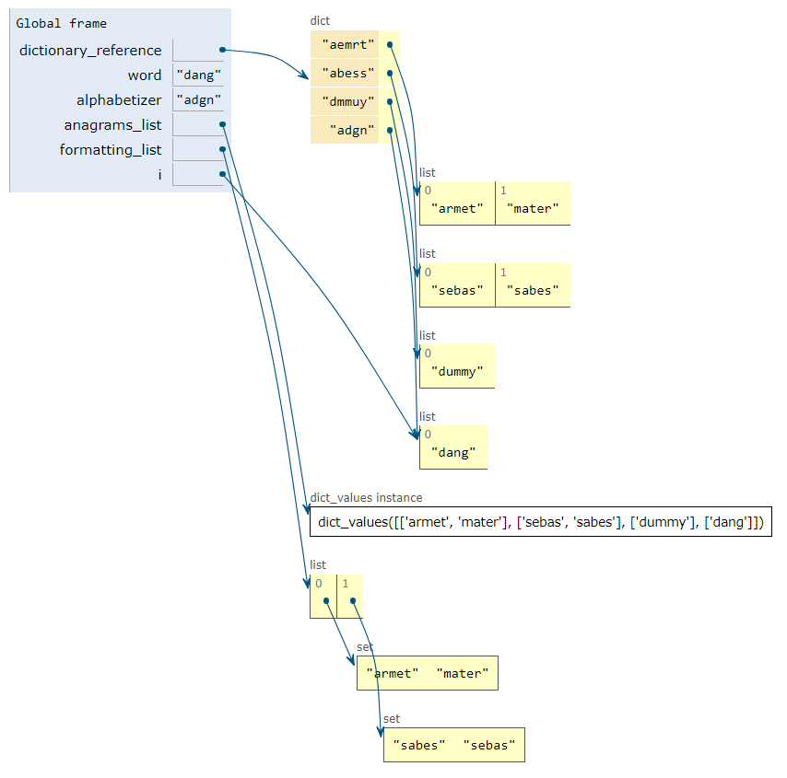

Process 5
Process 6

Slide 11

Review of Code:

Slide 12
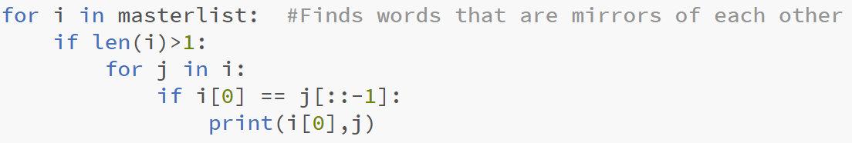
Interesting facts
Anagram Family Counter:
5,998
In the dictionary we found words that are mirrors of each other
Amaroid Diorama
Anacara Aracana
Dessert Tressed
Leveler Relevel
Rotanev Venator
Artamus Sumatra
Redrawer Rewarder
Palindrome Counter:
Zero
Average Word Length:
8.63
Word Count:
18472 Words
Most Frequent Letter:
"e" (appears: 14200 time)

