Slide 1
Classifying NFL Plays
Angela Huang

Slide 2
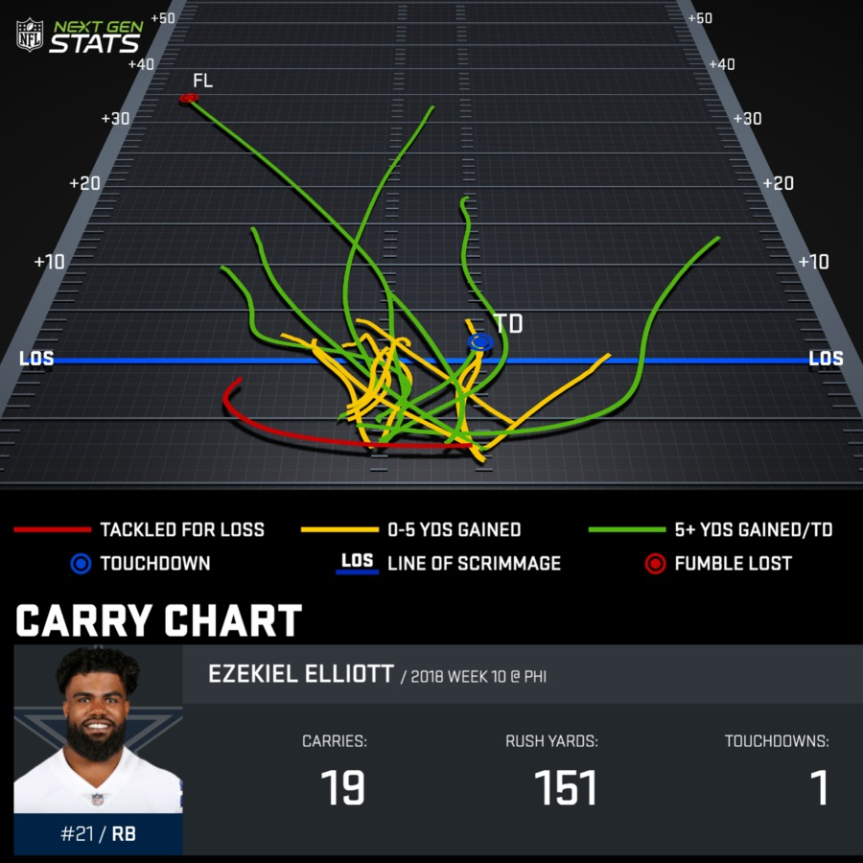
Background
Adoption of data analytics in football
Objective: Will a play be positive yards or not?

Slide 3
Data & Methodology
Play by play data from 2009 through 2018 (week 15)
PostgreSQL → pandas
Models tested:

Slide 4
Data & Methodology
Play by play data from 2009 through 2018 (week 15)
PostgreSQL → pandas
Models tested:
Logistic Regression
KNN
Naive Bayes - Gaussian
SVC
Decision Trees
Extra Trees
Random Forest

Slide 5
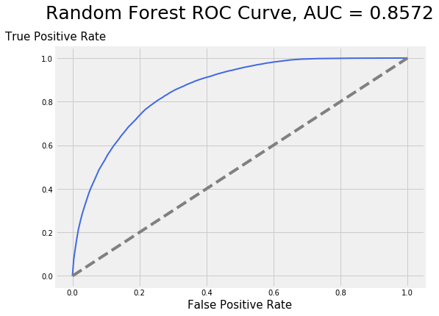
Data & Methodology
Play by play data from 2009 through 2018 (week 15)
PostgreSQL → pandas
Models tested:
Logistic Regression
KNN
Naive Bayes - Gaussian
SVC
Decision Trees
Extra Trees
Random Forest

Slide 6
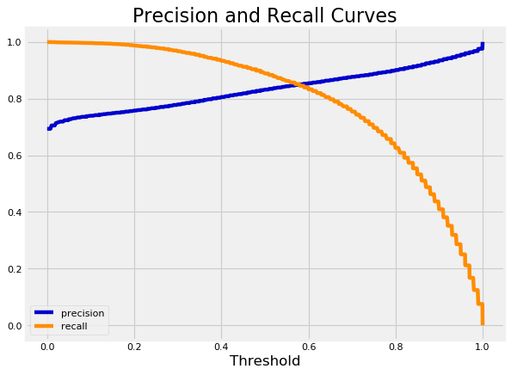
Results
Feature importance
Improved AUC by 3.74%
Adj threshold for F1 score
Threshold: 0.39
F1 score: 0.867

Slide 7
Tableau Dashboard Demo

Slide 8


Slide 9
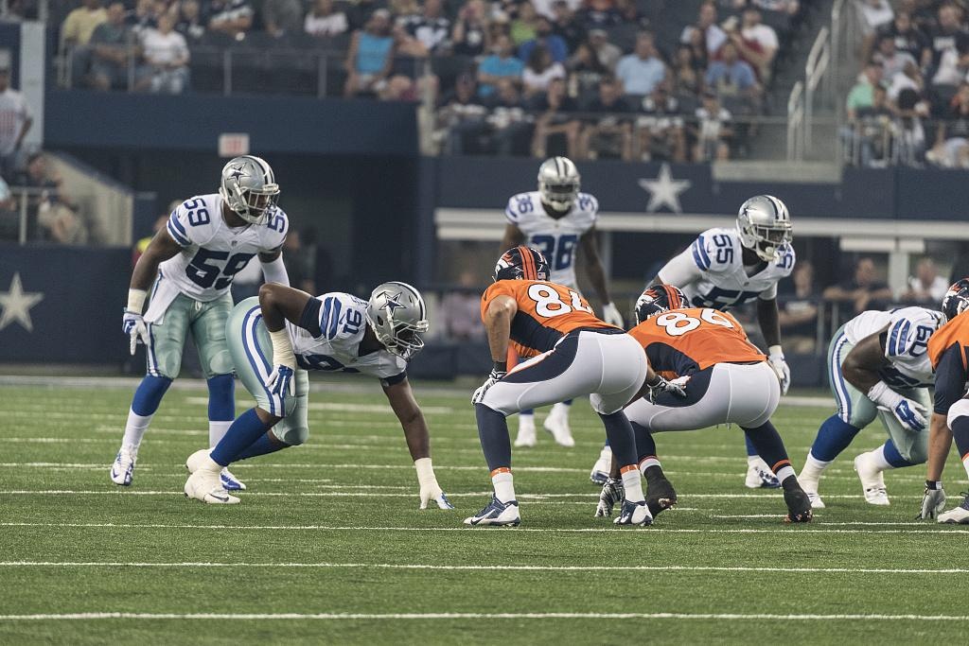
Future Work
Additional features from other sources
Increase Tableau dashboard functionality
Optimize for teams & coaches

Slide 10

Thank You!

Slide 11
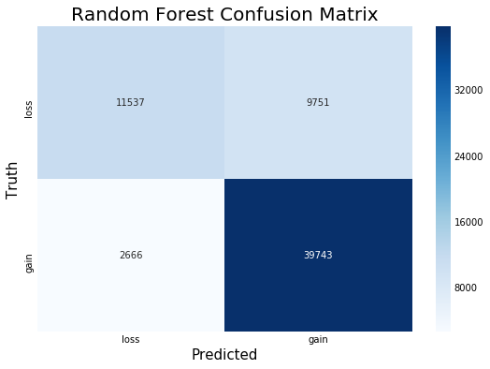
Appendix - Random Forest Confusion Matrix

Slide 12
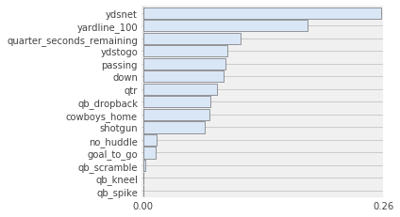
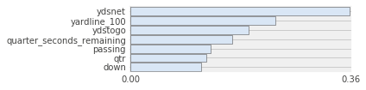
Appendix - Important Features

Slide 13
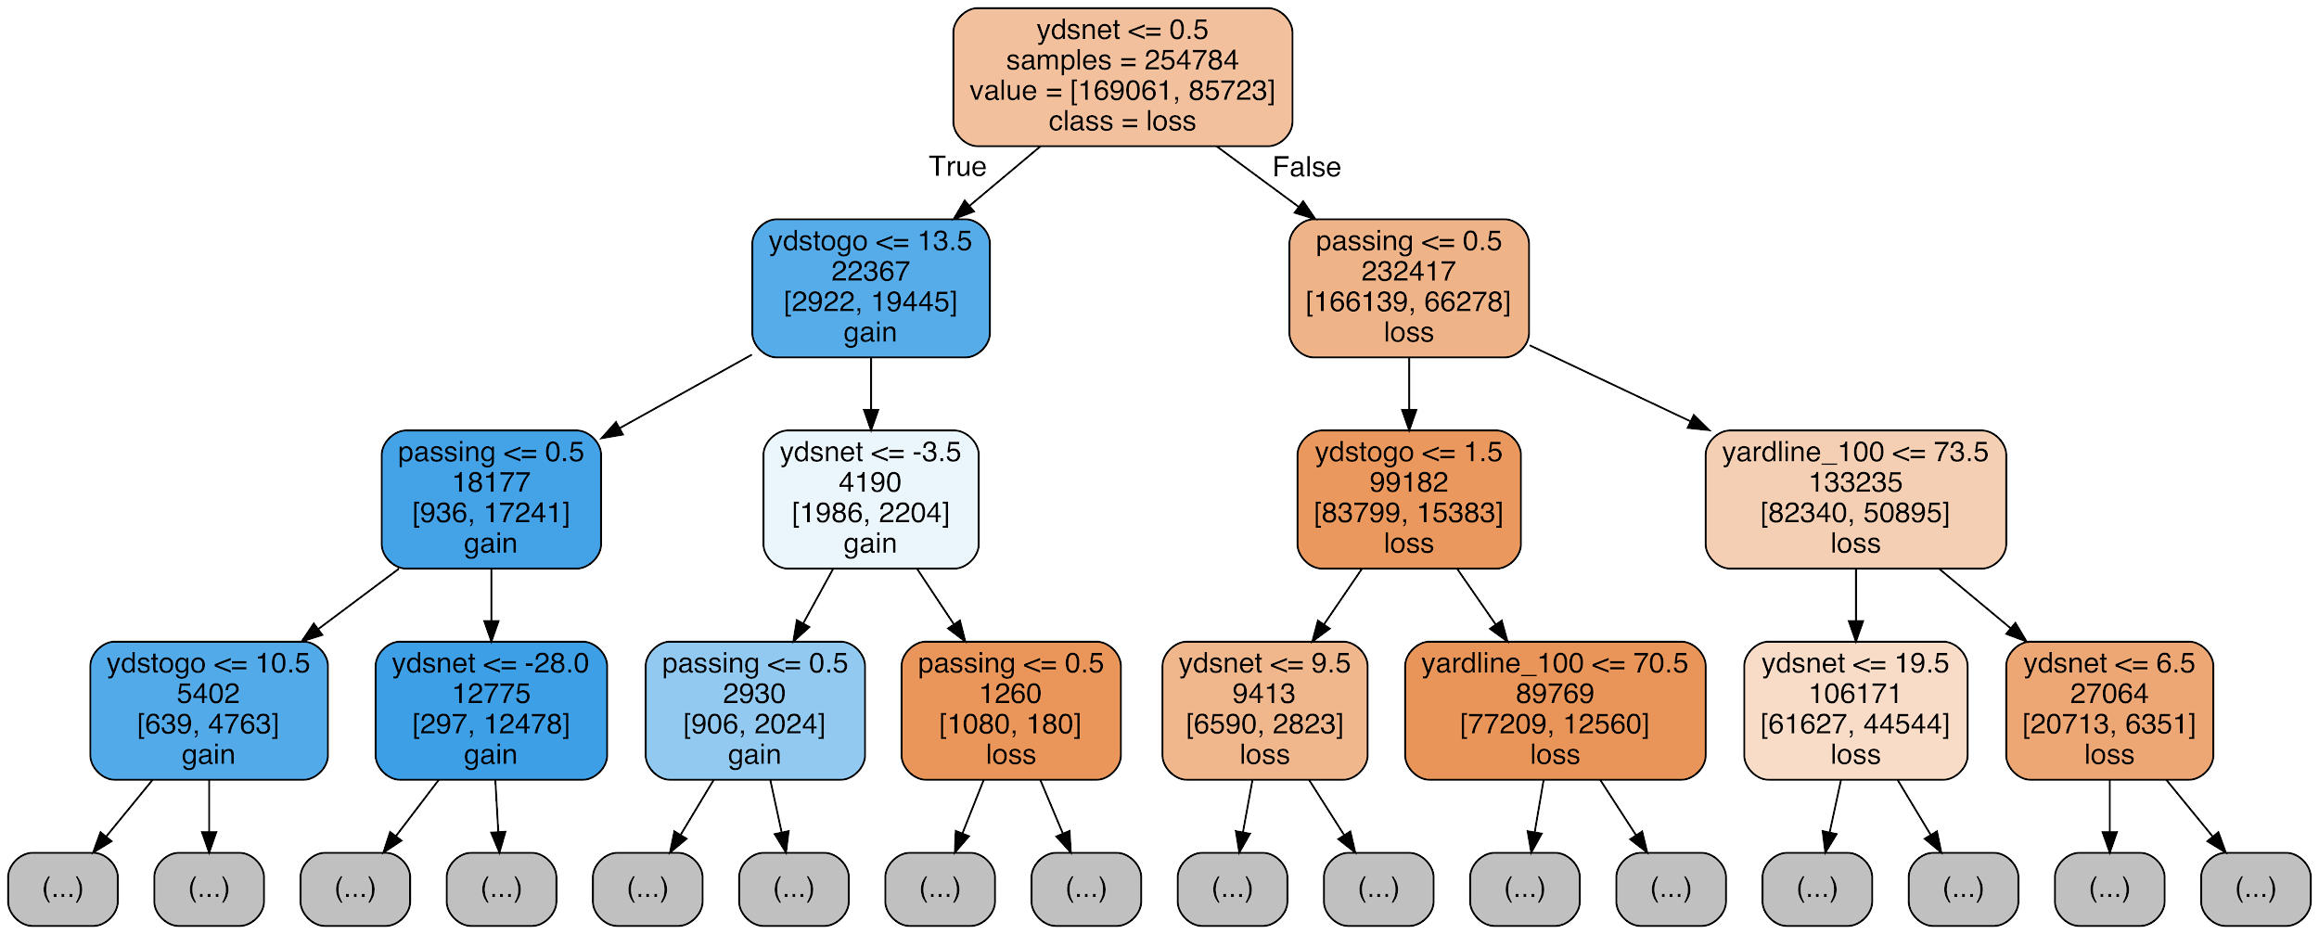
Appendix - Sample Decision Tree

Slide 14
Appendix - Tools Used
PostgreSQL
Pandas
Numpy
Matplotlib
Seaborn
Scikit Learn
rfpimp
TabPy
Tableau

