Slide 1
Fetch page
(Multithread)
Read file and Load Task
find term and
Write to file
Task
Queue
Result
Queue
App : main class
Config ：save configs from command line arguments
PageContainer : queue container
PageTask : value object , include url , result , staus …
PageLoader ：master of working thread
PageTaskHelper: load task and save result
Parser : create task form input text and search terms in page content
engine.ILoaderEngine : engine interface, multi implement, choose different engine for different scenario
engine.SimpleLoaderEngine: HttpURLConnection engine (default engine)
engine.OkHttpLoaderEngine: support redirect
engine.HtmlUnitLoaderEngine: use HtmlUnit to support javascript

Slide 2
Many web site can not access form China, it took me a long time to set a proxy and make proxy working properly in my program. I comment out some test case use proxy setting so you can pass the test.
First I use HttpURLConnection, but It can not handle redirect 302, so I turn to OkHttp, it’s work fine, and I try HtmlUnit to support javascript, but it very slow and get stuck sometimes. Maybe Selenium and headless-chrome is the better solution

Slide 3
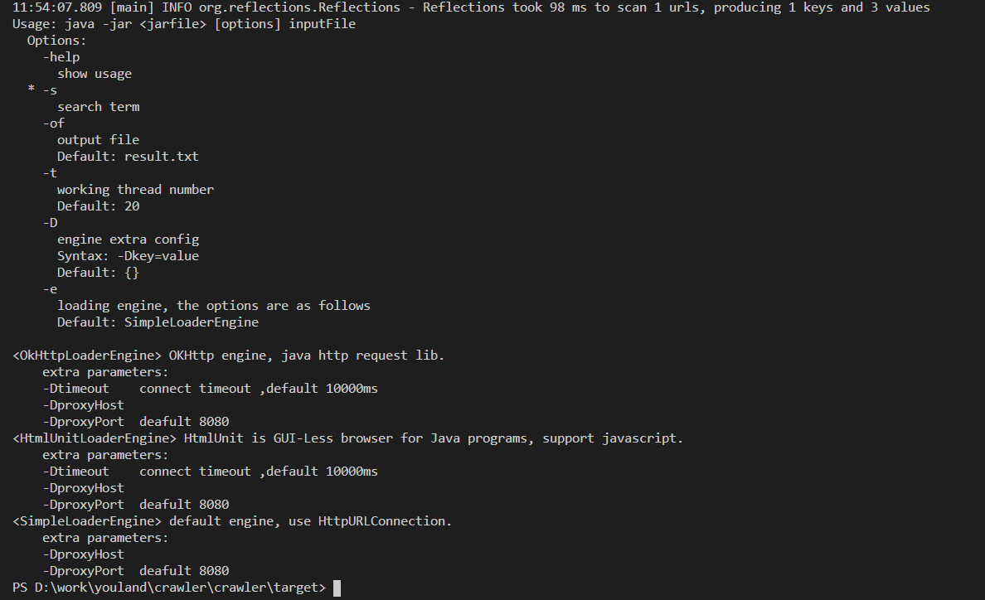
instruction
git clone https://github.com/huangfandev/youlandcrawler.git
mvn clean package //make the fatjar. (Java 1.8）
java –jar <package-with-dependence> -help // print usage
Example
java -jar .\crawler-1.0-SNAPSHOT-jar-with-dependencies.jar -s google D:\web_url.txt
java -jar .\crawler-1.0-SNAPSHOT-jar-with-dependencies.jar -s google -DproxyHost=localhost -DproxyPort=7890 D:\web_url.txt
java -jar .\crawler-1.0-SNAPSHOT-jar-with-dependencies.jar -s google –e OkHttpLoaderEngine -DproxyHost=localhost -DproxyPort=7890 D:\web_url.txt

Slide 4
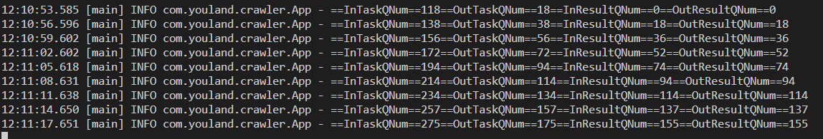
When program is running , it will print some message on screen:
It shows the progress ,
InTaskQNum : the task number of file loader put into the taskqueue;
outTaskQNum: the task number of worker take form taskqueue;
InResultQNum: the task number of worker finished and put into result queue
OutResultQNum the task number of file writer take form result queue

Slide 5
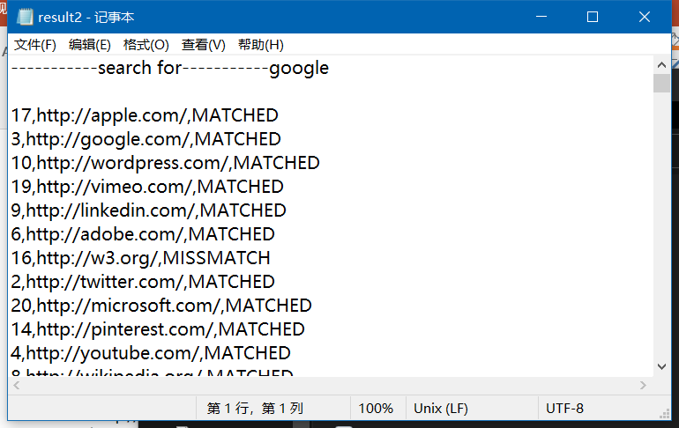
Result file
Print search term in first line
3 columns separate by comma
Column1 : id from input file
Column2 : request url
Column3 : search Result
LOAD_ERROR : load page failed, maybe proxy problem,Every time have different result.
MATCHED : find term in content
MISMATCHED : not find term in content

