Slide 1
PRM393 Review 1
Lecturer:
Mr. Nguyen Minh Sang
Group 3:
Nguyen Huy Hoang
Phung Tuan Minh
Nguyen Phuoc Long Nhat
Truong Tran Gia Bao
Nguyen Thanh Dai

Slide 2
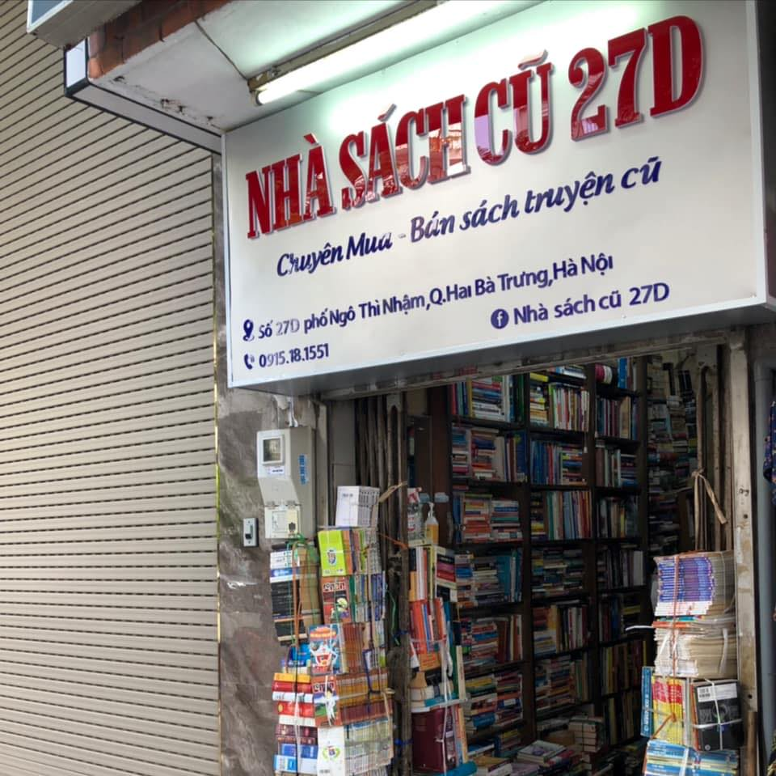





Context
Students have a growing demand for affordable books
Used books are mainly bought and sold through Facebook groups and e-commerce platforms
It is difficult to verify book condition and seller reliability
There is a need for a specialized platform for buying, selling, and exchanging used books
Source: Nhà sách cũ 27D Ngô Thì Nhậm

Slide 3

Solution
A dedicated platform for buying, selling and exchanging used books
Buy, sell or exchange books
Find available books by title, price and condition.
Clear book details and seller reviews
Moderated listings with photos and condition details.
Exchange terms agreed in advance
See book values, deposits and any cash difference.
A controlled transaction process
Track delivery, hold funds and review dispute evidence.
Prototype scope: simulated payments and delivery events.
Notes:
The proposed platform brings used-book purchases and exchanges into one dedicated place. Members can search available listings and inspect book photos and condition details. Reviews come from completed transactions. For exchanges, the system shows book values, deposits and any cash difference before acceptance. Transaction controls include fund holds, delivery tracking and evidence-based dispute handling. Payments and carrier events are simulated in the project prototype.
Sources: SRS-BOOK-001 v1.0, sections 2.2 and 2.4; FR-C04–C05, FR-L01–L03, FR-X02–X05, FR-W03, FR-S03, FR-D01–D05, FR-R01. Illustration: generated with the built-in ImageGen tool for this slide. Conceptual artwork, not a product screenshot.

