Slide 1

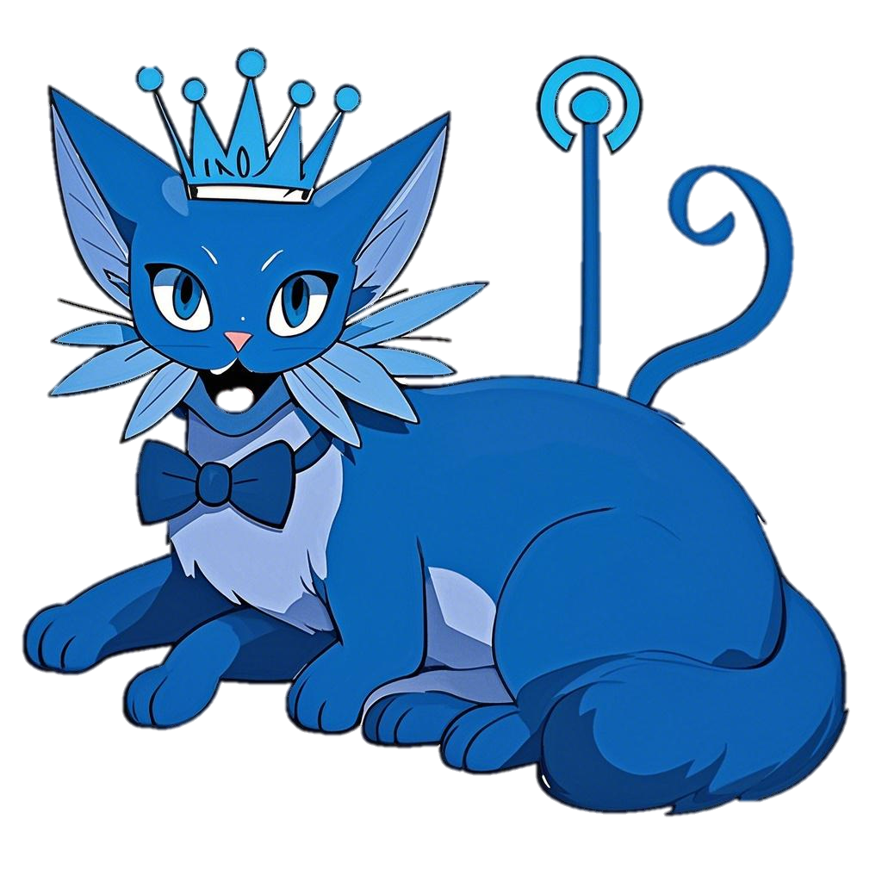
🤫
ON AIR

