Slide 1
Outline
Regularization techniques for deep learning – Part I
  The generalization problem and regularization techniques
  Parameter norm penalties
  Dataset augmentation
Notes:
CIS5370 week09-2.ppt
Dr. Xiuwen Liu

Slide 2
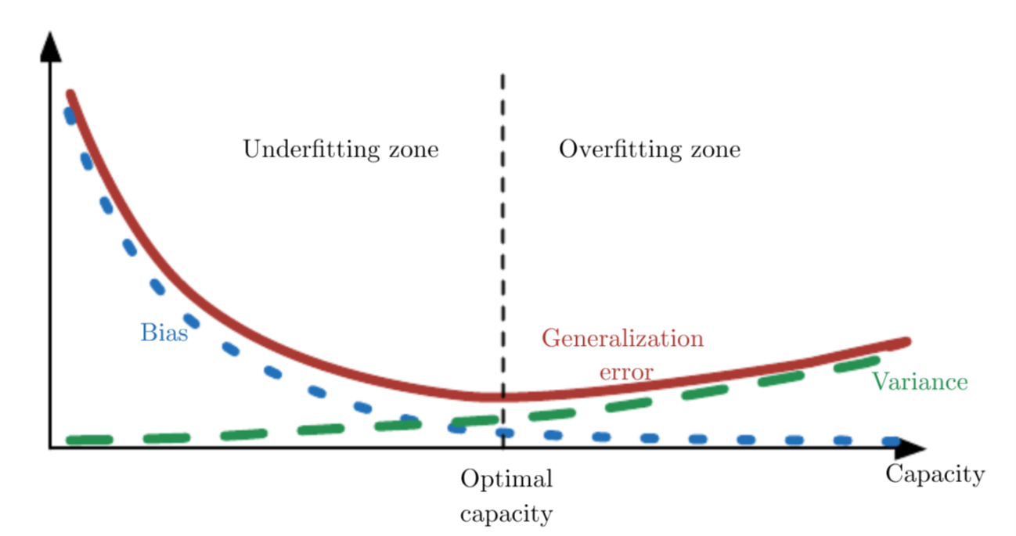
Introduction
A central problem in machine learning is how to make an algorithm that will perform well not just on the training data, but also on new inputs
week09-2

Slide 3
Introduction
A central problem in machine learning is how to make an algorithm that will perform well not just on the training data, but also on new inputs
  There are two related problems
    The model we have should have the required capacity but no more
    Our learning procedure should be able to reach a good solution (among many possible solutions)
week09-2

Slide 4
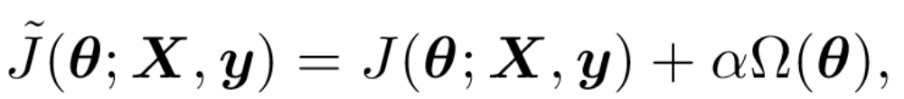
Parameter Norm Penalties
A family of approaches trying to limit the model capacity by adding a parameter norm penalty term to the objective function J
week09-2

Slide 5
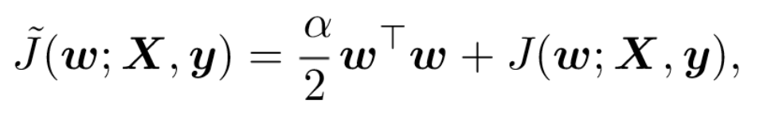
L₂ Parameter Regularization
In this case, we use a L₂ norm of the weights as the regularization term
  How to understand the regularization effect?
    Effect on the learning rule?
    Effect on the overall solution?
week09-2

Slide 6
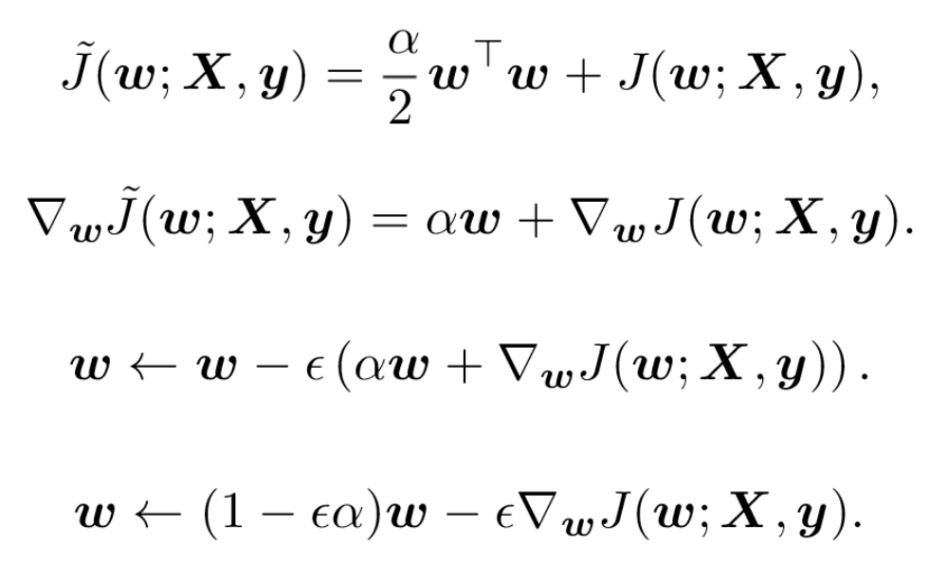
L₂ Parameter Regularization on the Learning Rule
Since almost all the learning rules use gradient descent optimization, we need to just understand the gradient of the regularization term
week09-2

Slide 7
L₂ Parameter Regularization on the Solution
In generally, analyzing the L₂ parameter regularization on the solutions of (deep) neural networks is difficult
An approximation of the system is commonly used for analysis purposes
week09-2

Slide 8
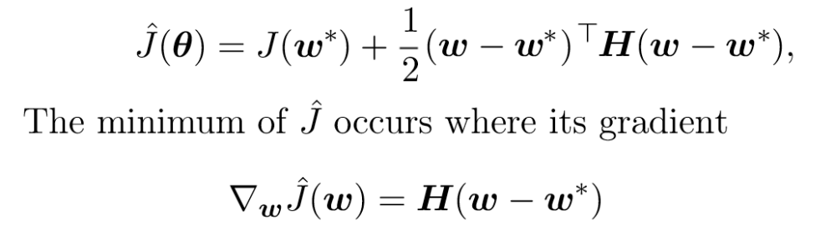
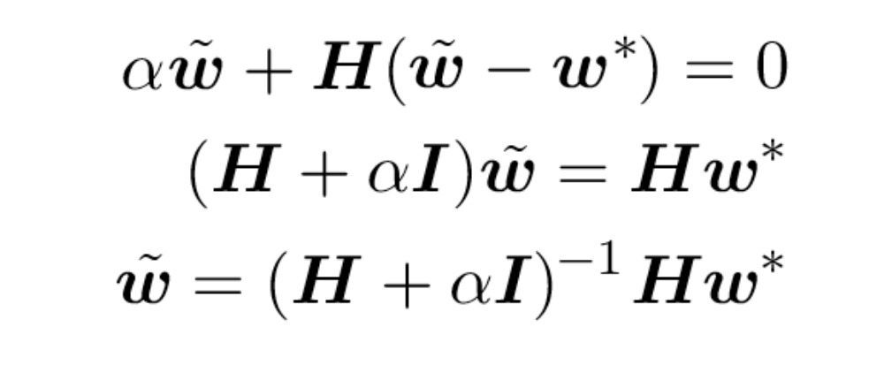
L₂ Parameter Regularization on the Solution
week09-2
Notes:
Dr. Xiuwen Liu
CIS5370 week09-2.ppt

Slide 9
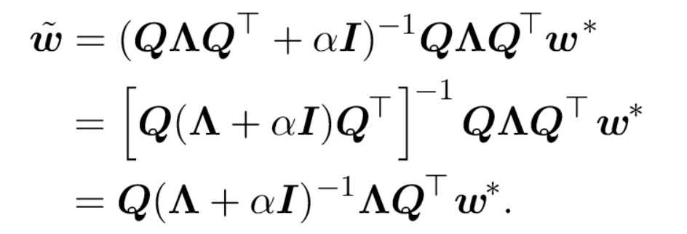
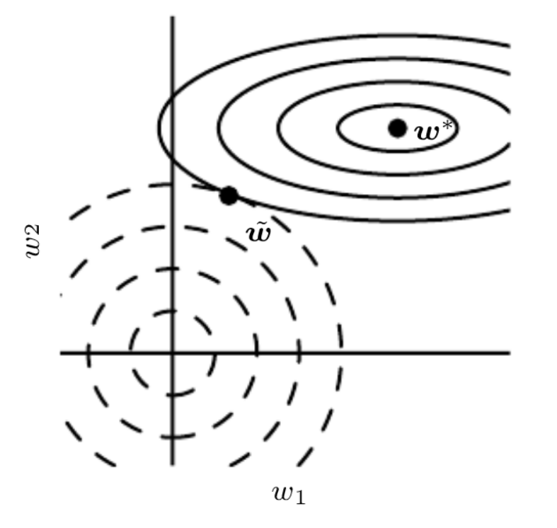
L₂ Parameter Regularization on the Solution
week09-2
Notes:
Here we have H=QAQ’ (singular value decomposition) because H is real symmetric. Q is a unitary matrix.
Dr. Xiuwen Liu
CIS5370 week09-2.ppt

Slide 10
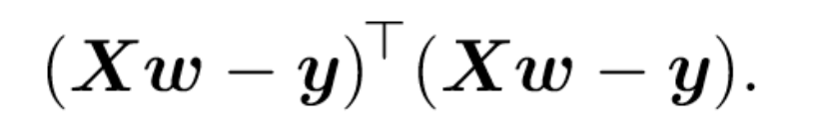
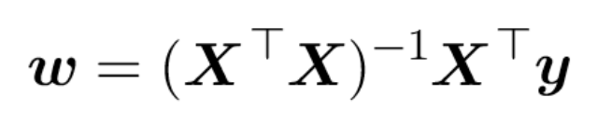
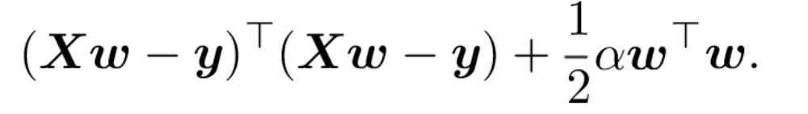
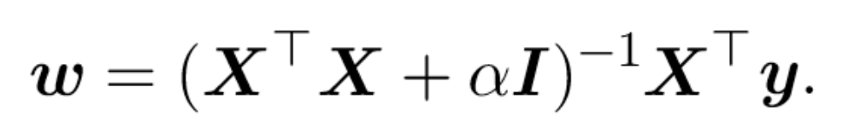
L₂ Parameter Regularization on the Solution
For linear regression, we have with no regularization
With L₂ regularization, we have

Slide 11
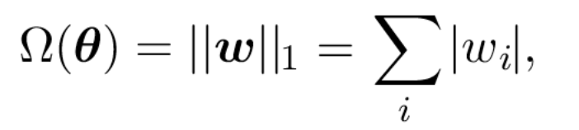
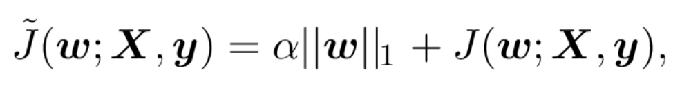
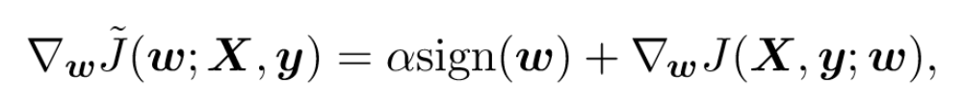
How about L₁ Regularization?
Formally, L₁ regularization on model is given
For the regularized objective function,
  The corresponding gradient is
week09-2

Slide 12
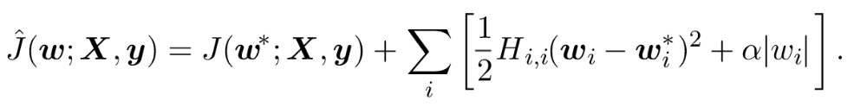
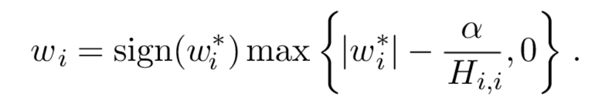
How about L₁ Regularization?
Analyzing L₁ regularization is more difficult as it does not admit closed form solution
For a further simplified problem where all the inputs are uncorrelated
  The solution is

Slide 13
L₁ Regularization and Sparse Representation
L₁ Regularization is widely used as a feature selection mechanism
  It is closed related to independent component analysis and sparse coding
    It is used in the well known LASSO model (least absolute shrinkage and selection operator)
  It is also closely related to compression sensing
week09-2

Slide 14
Norm Regularization and Constrained Optimization
Note that the norm regularization can be seen as constrained optimization where a constraint is imposed on the weights
  Via a generalized Lagrange function
week09-2

Slide 15
Data Augmentation
A good way to increase generalization is to increase the amount of training data
Manufacturing data
  Prior knowledge can be incorporated by “manufacturing” data
  Can be used to enforce invariance properties of the trained neural network
week09-2

Slide 16
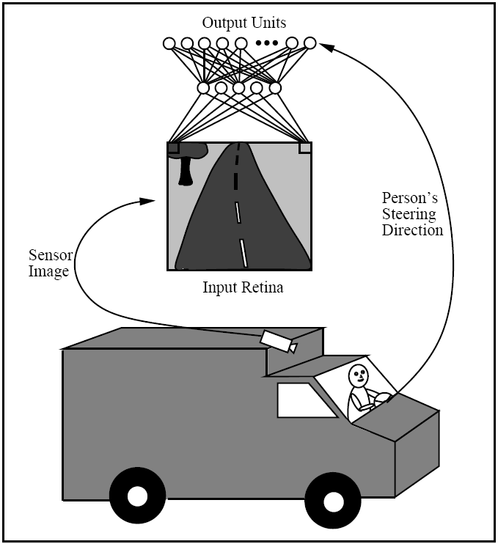
On-the-fly Training
week09-4
Notes:
CAP5638 week09-4.ppt
Dr. Xiuwen Liu

Slide 17
On-the-fly Training
Potential Problems
  The network will never be presented with situations where it must recover from misalignment errors
    The person only drives at the center of the road during training
  Overtraining of recent input
    For example, if the person drives the Navlab down a long segment of straight road at the end of the training, the network may “forget” what it had learned about driving on curved roads
week09-4
Notes:
CAP5638 week09-4.ppt
Dr. Xiuwen Liu

Slide 18
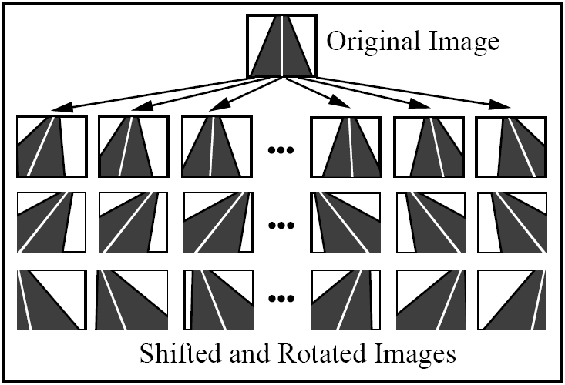
week09-4
Notes:
CAP5638 week09-4.ppt
Dr. Xiuwen Liu

Slide 19
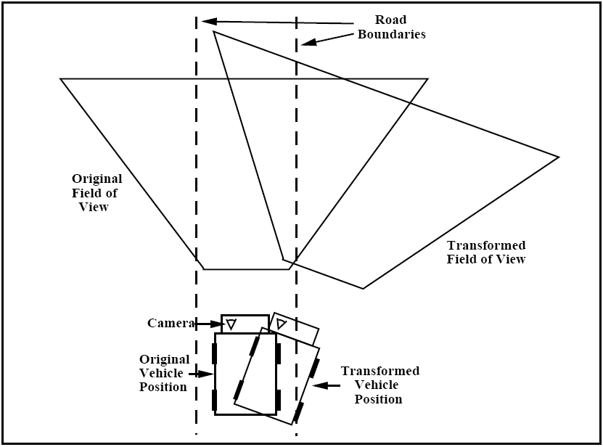
week09-4
Notes:
CAP5638 week09-4.ppt
Dr. Xiuwen Liu

Slide 20
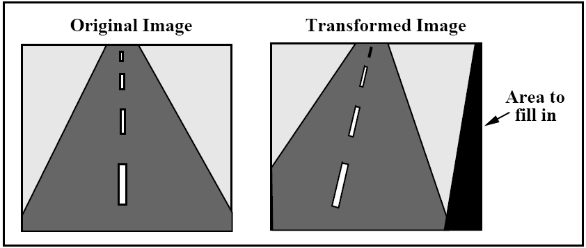
Extrapolating Missing Pixels
week09-4
Notes:
CAP5638 week09-4.ppt
Dr. Xiuwen Liu

Slide 21
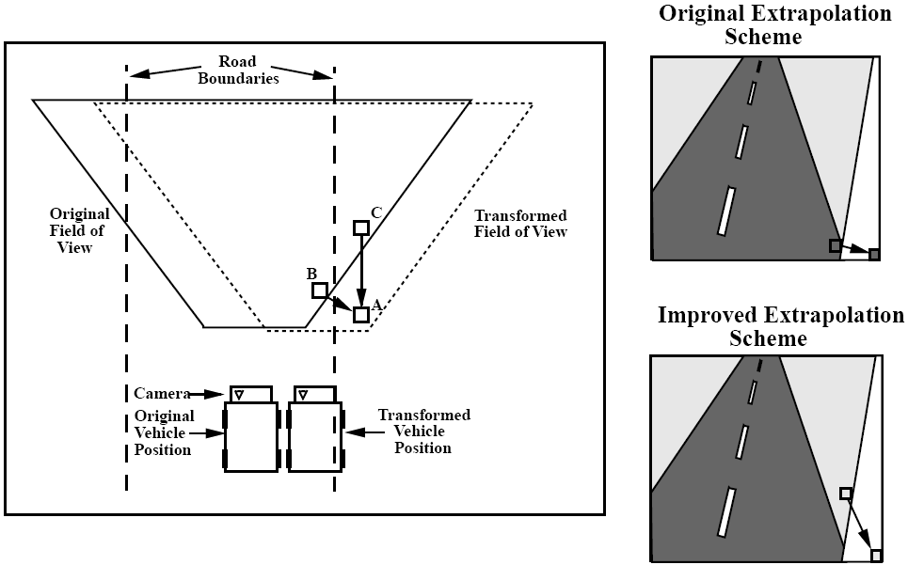
Extrapolating Missing Pixels
week09-4
Notes:
CAP5638 week09-4.ppt
Dr. Xiuwen Liu

Slide 22
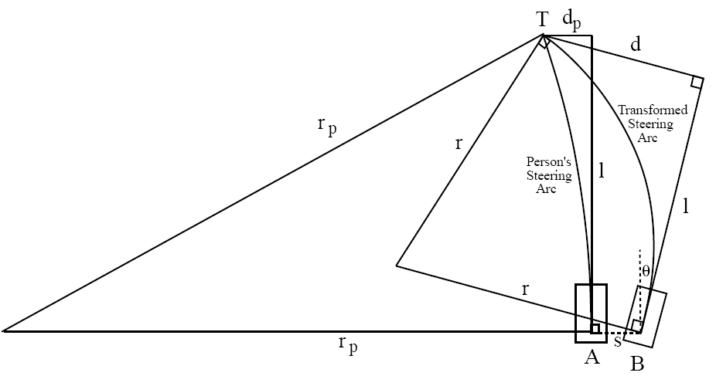
Transforming the Steering Direction
week09-4
Notes:
CAP5638 week09-4.ppt
Dr. Xiuwen Liu

Slide 23
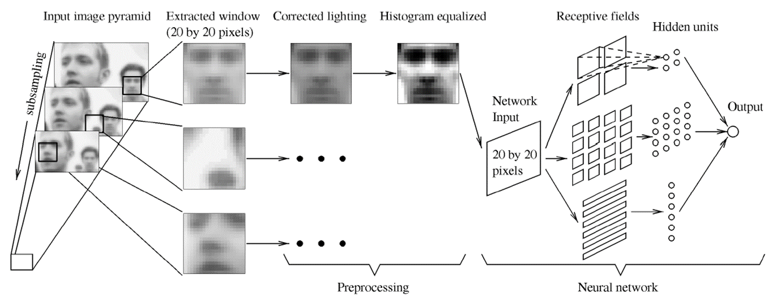
Face Detection
Face detection using a neural network
week09-2

Slide 24
Generating Face Training Images
Generate fifteen face examples from each image in the original training set by randomly rotating the image up to 10º, scaling between 90% and 110%, and translating slightly, and mirroring
week09-4
Notes:
CAP5638 week09-4.ppt
Dr. Xiuwen Liu

Slide 25
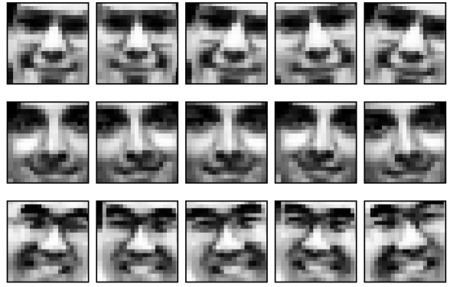
Generating Face Training Images
week09-4
Notes:
CAP5638 week09-4.ppt
Dr. Xiuwen Liu

