Slide 1
Efficient, Context-Sensitive Dynamic Analysis via Calling Context Uptrees
Jipeng Huang, Michael D. Bond
Ohio State University
Notes:
A new work about context sensitivity, which is more efficient than prior work like CCT for a lot of cases in deployed settings. A striking difference from CCT is that the pointer is pointing up.
Small change introduces big implications for performance.

Slide 2
What do we need for bug detection?
Why not calling context tree?

Slide 3
Example: dynamic race detector
Thread A
Thread B
race!
read x
write x

Slide 4
Report the race
Thread A
Thread B
race!
Helper.read():21
Helper.inc():11

Slide 5
Full Stack Trace
Thread A
Thread B
Helper.read():21
B. rd():68
B.m1():150
…
Helper.inc():11
A.doinc():37
A.m1():50
…
race!
read x
write x

Slide 6
How hard?
Thread A
Thread B
Helper.read():21
B. rd():68
B.m1():150
…
Helper.inc():11
A.doinc():37
A.m1():50
…
Hard
race!
read x
Easy
write x
B.method2()
Record previous stack
information

Slide 7
Calling Context Tree?
High time overhead
reuse existing context nodes, i.e, lookup child callee nodes before constructing new child nodes

Slide 8
Calling Context Tree
Main.main():10
Time Overhead (2X or more):
--child lookup
A.meth():12
A.meth():14
How to avoid lookup?
A.
m1():50
ThrB.run():10
B.
m1():150
A.doinc():37
B.rd():68
Helper.
inc():11
B.
wr():21
C.
wr():55
Helper.
read():21
x
x
Ammons et. al (PLDI’97)

Slide 9
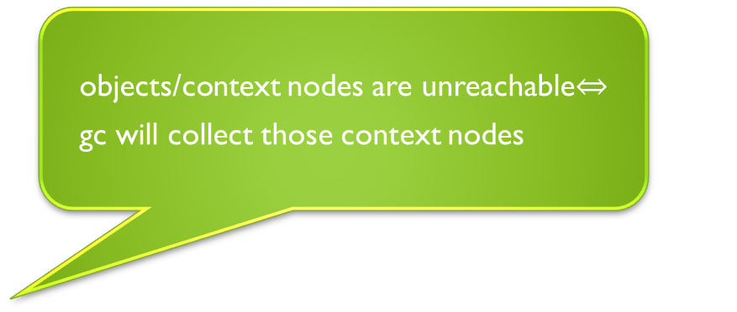
Calling Context Uptree
Main.main():10
objects/context nodes are unreachable
gc will collect those context nodes
Redundant context nodes (☹)
More space:
Allocate new nodes
A.meth():12
A.meth():14
Fast:
No lookup any more
ThrB.run():10
A.
m1():21
A.
m1():21
A.
m1():50
B.
m1():150
A.
wr():30
A.
wr():30
A.doinc():37
B.rd():68
B.
wr():21
C.
wr():55
y
z
Helper.
inc():11
Helper.
read():21
x
x
Notes:
What if we reverse the pointer and make the pointer point up instead of down?
What if we allocate new nodes all the time instead of looking up first when specific interesting event occurs?

Slide 10
Calling Context Uptree (with merging)
Main.main():10
A.meth():12
A.meth():14
After certain amounts of gc, do merging
A.
m1():21
A.
m1():21
A.
wr():30
A.
wr():30
y
z

Slide 11
Related work
Context encoding
PCCE(ICSE’10), Breadcrumbs(PLDI’10)
—cannot scale well to large/complex programs
Construct calling context from SP and PC
Mytkowicz et al. OOPSLA’09, Inoue et. al OOPSLA’09
— Low overhead but still not very safe enough to uniquely construct calling context

Slide 12
Conclusion
Time/Space Tradeoff
Instead of reusing existing nodes, allocate new nodes.
—lower time but higher space
Qualitative Improvement
Context sensitivity for all-the-time production system
Thank you!

