Slide 1
chapter 3
Introduction to R plot
Instructor: Li, Han

Slide 2
Contents
creat/save a plot
symbol, line and color
title and range
text and mtext
add lines
legend
combine multiple plots

Slide 3
Why plot?
When we analyze data, the first thing is to look at the data, and check its patterns, for example,
the range of the data
symmetric or left, right skew?
the most common values
any outlier?

Slide 4
data example
 | mpg | cyl | am
Mazda RX4 | 21.0 | 6 | 1
Mazda RX4 Wag | 21.0 | 6 | 1
Toyota Corolla | 33.9 | 4 | 1
Merc 280C | 17.8 | 6 | 0
Ford Pantera L | 15.8 | 8 | 1
Ferrari Dino | 19.7 | 6 | 1
... | ... | ... | ...

Slide 5
Example 1
attach(mtcars)
plot(wt, mpg, col=1)
abline(lm(mpg~wt), col=2)
title("Regression of MPG on Weight")
detach(mtcars)

Slide 6
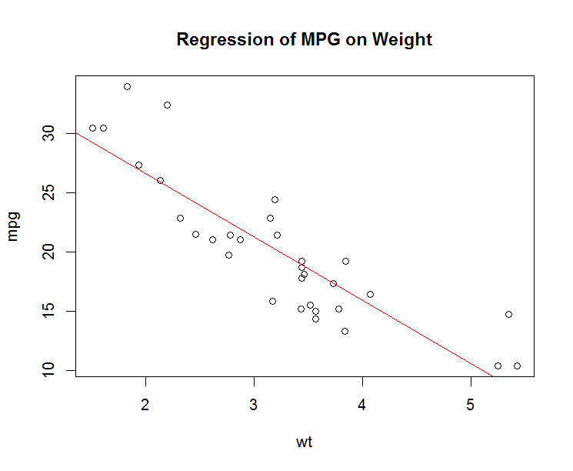

Slide 7
Creat a plot
To creat a plot, there are two methods:
directly plot, then save it under the graphics window, by clicking file -> save as -> choose the graph type
start a device, then plot, after that close the device

Slide 8
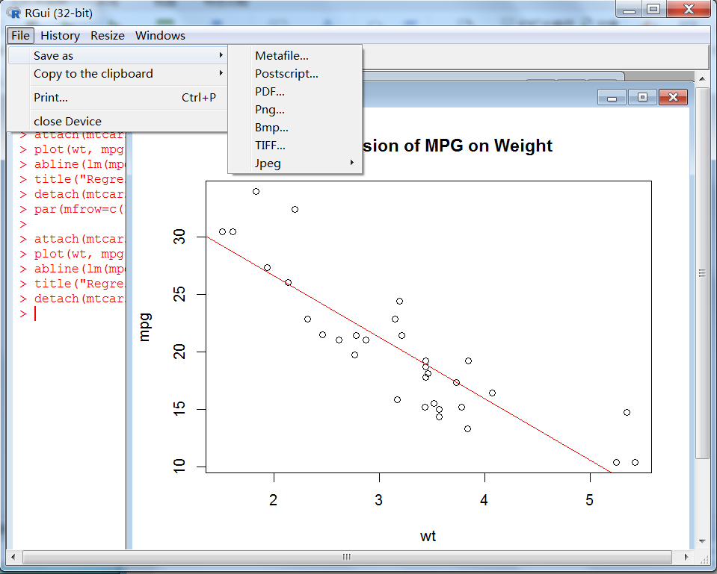

Slide 9
Example 2
jpeg("mygraph.jpeg")
attach(mtcars)
plot(wt, mpg, col=1)
abline(lm(mpg~wt), col=2)
title("Regression of MPG on Weight")
detach(mtcars)
dev.off()

Slide 10
Open multiple graph windows
In R, it will open one graph window by default. To open multiple graph windows, use
#make a new plot
dev.new()
#make another new plot
dev.new()

Slide 11
A simple plot
Example 3
dose <- c(20, 30, 40, 45, 60)
drugA <- c(16, 20, 27, 40, 60)
drugB <- c(15, 18, 25, 31, 40)
plot(dose, drugA, type="b")

Slide 12
Graph parameters
In R, we could set the parameters of par() to make a plot, for instance, the type and the color of a line, the size of the graph.
To save the original graph parameters, use opar <- par(no.readonly=TRUE). After finishing the plot, reset the paramters to their original values by using par(opar).

Slide 13
Example 4
opar <- par(no.readonly=TRUE)
par(lty=2, pch=17)
plot(dose, drugA, type="b")
par(opar)

Slide 14
Symbol and line
The parameters for setting the type and magnitude of symbol and lines are
pch=? the type of a symbol
cex=? the magnitude of a symbol
lty=? the type of a line
lwd=? the width of a line

Slide 15
Example 5
plot(dose, drugA, type="b", lty=3, lwd=3, pch=15, cex=2)

Slide 16
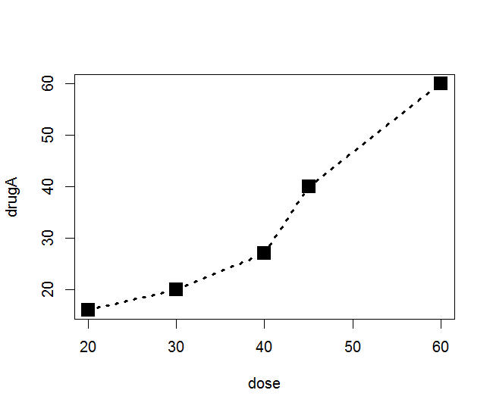

Slide 17
col
To specify the color for plotting, set col=?
We use set col=”red”, col=”black”, col=”blue” or col=1, col=2,....
Other color parameters:
col.axis, col.lab, col.main, col.sub

Slide 18
Size of a graph
pin=c(a, b): size of a graph in inch with width=a, height=b
mai=c(a, b, d, f): the marginal size of a graph in inch, with bottom=a, left=b, up=d, right=f

Slide 19
Example 6
opar <- par(no.readonly=TRUE)
par(pin=c(2,3))
par(lwd=2, cex=1.5)
par(cex.axis=0.75, font.axis=3)
plot(dose, drugA, type="b", pch=19, lty=2, col="red")
dev.new()
plot(dose, drugB, type="b", pch=23, lty=6, col="blue", bg="green")
par(opar)

Slide 20
title and range of plotting
Example 7
plot(dose, drugA, type="b", col="red", lty=2, pch=2, lwd=2, main="Clinical Trials for Drug A", sub="This is hypothetical data", xlab="Dosage", ylab="Drug Response", xlim=c(0, 60), ylim=c(0, 70))

Slide 21
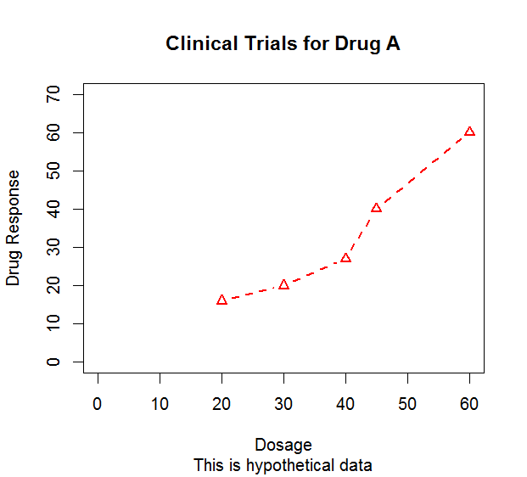

Slide 22
Add lines
To add lines to the graph, there are several methods:
abline(h=yvalues, v=xvalues, col=?, lty=?)
lines(x,y, col=?, lty=?)

Slide 23
Example 8
plot(dose, drugA, type="b", pch=19, lty=1, col="red")
abline(h=40,v=c(35, 50), col=2)
lines(dose, drugB, lty=2)

Slide 24
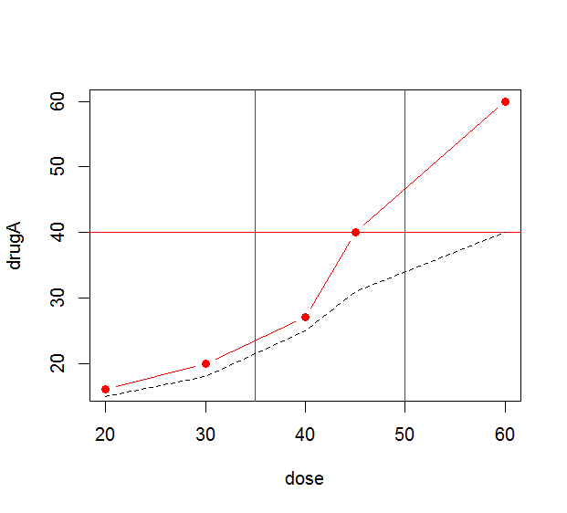

Slide 25
legend
When we have multiple lines in a graph, we need to use legend to tell their specific information to distinguish them.
legend(location, title, legend, lty, col,...)

Slide 26
Example 9
plot(dose, drugA, type="b", lty=1, col="red", ylab="Drug")
lines(dose, drugB, lty=2)
legend("topleft", title="Drug type", legend=c("Drug A", "Drug B"), lty=c(1,2), col=c("red",1))

Slide 27
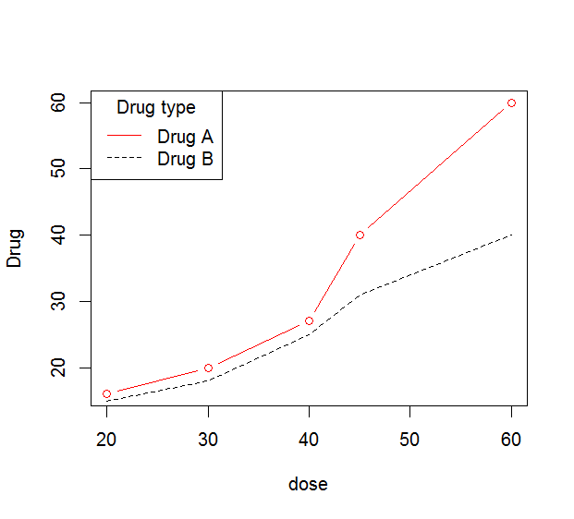

Slide 28
text()
To add text in specific location, use
text(location, “text to write”, pos,...)
mtext(“text to write”, side, line,...)

Slide 29
Example 10
attach(mtcars)
plot(wt,mpg)
text(wt,mpg, row.names(mtcars), cex=0.6, pos=4, col="red")
mtext("Cars", side=4, las=2, line=0.5)
detach(mtcars)

Slide 30
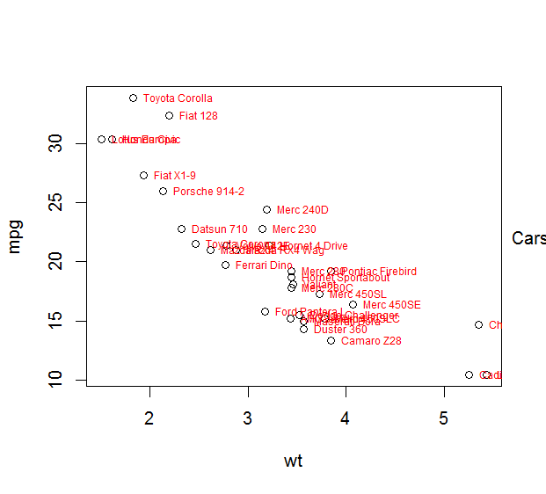

Slide 31
Combine multiple plots
If we would like to show multiple plots together, we need to specify the number of plots and how to place them.
# We will draw m*n plots, row by row
par(mfrow=c(m,n))
# We will draw m*n plots, column by column
par(mfcol=c(m,n))

Slide 32
Example 10
par(mfrow=c(2,2))
plot(dose, drugA, type="b", lty=1, col="red", ylab="Drug") #plot 1
plot(dose, drugA, type="b", lty=1, col="red", ylab="Drug") #plot 2
hist(drugA) #plot 3
hist(drugB) #plot 4

Slide 33
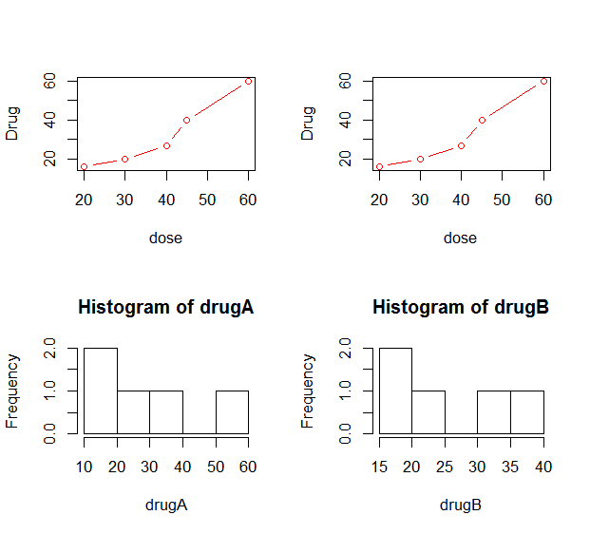

Slide 34
layout()
Example 11
layout(matrix(c(1,1,2,3), 2,2, byrow=T), widths=c(2,2), heights=c(3,3))
plot(dose, drugA)
plot(dose, drugB)
plot(drugA, drugB)

Slide 35
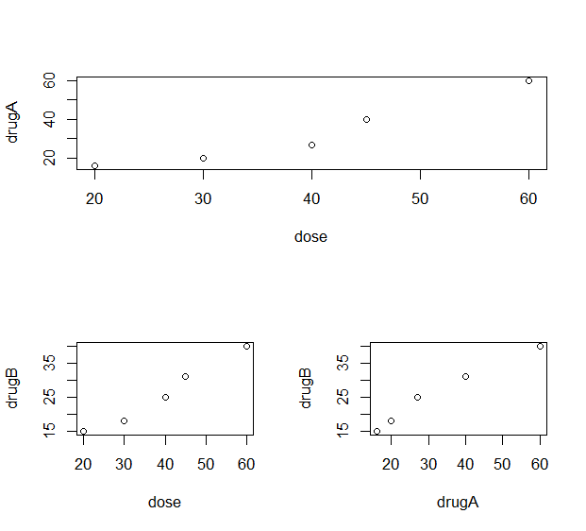

Slide 36
Try the examples and enjoy plotting!

