Slide 1
chapter 4
Basic data management
Instructor: Li, Han

Slide 2
Contents
Creat and recode variables
Rename the variables
Handle missing values
Convert data type
Handle date value
Sort variables

Slide 3
As the author said:
“Data is a messy business — a very, very messy business.” In my own work, as much as 60% of the time I spend on data analysis is focused on preparing the data for analysis. ”

Slide 4
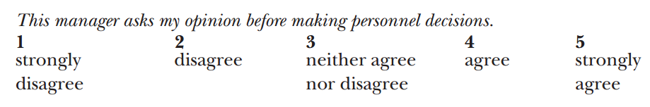
A working example
This example is studying how men and women differ in their ways they lead the organizations. The questions q1- q5 are asking their bosses to rate their deferential behavior.

Slide 5
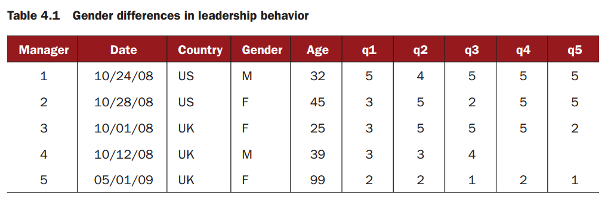

Slide 6
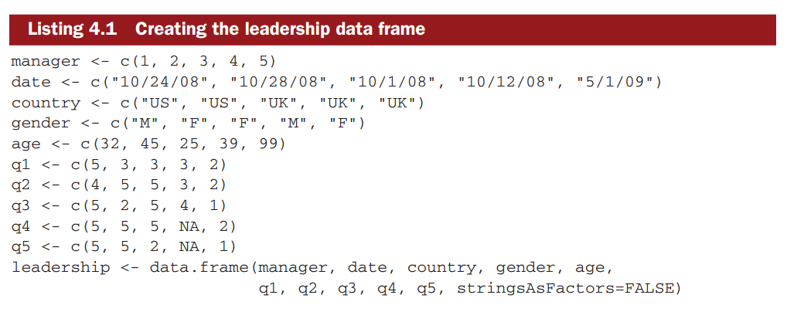
Creat the data frame

Slide 7
Interesting questions
What is the mean rating scores of each manager?
In surveys, respondents often skip questions. How to handle the incomplete data?
we may only be interested in a few variables. To simplify matters, how to create a new dataset with only the variables of interest.

Slide 8
Leadership behavior may change as a function of the manager’s age. We may recode the current values of age into a new categorical age grouping (for example, young, middle-aged, elder).
Leadership behavior may change over time. We may limit the study to data gathered during a specific period of time (say, January 1, 2009 to December 31, 2009).

Slide 9
Creat new variables
We could create new variables and transform existing ones.
dataframe$variable <- expression

Slide 10
Example 1
mydata<-data.frame(x1 = c(2, 2, 6, 4),
x2 = c(3, 4, 2, 8))
mydata$sumx <- mydata$x1 + mydata$x2
mydata$meanx <- (mydata$x1 + mydata$x2)/2

Slide 11
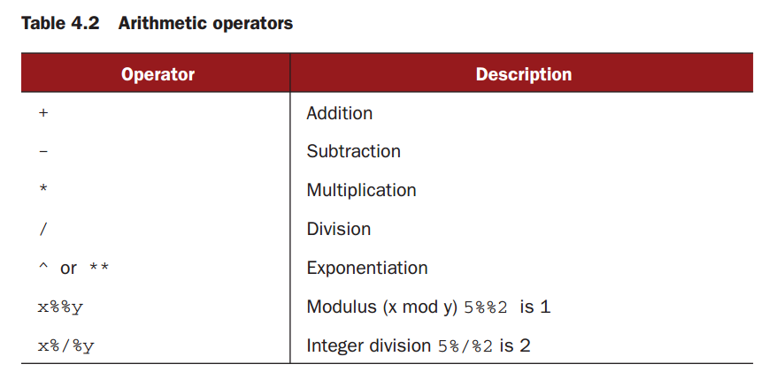

Slide 12
transform()
The above codes are equivalent to
mydata <- transform(mydata, sumx = x1 + x2, meanx = (x1 + x2)/2)

Slide 13
Recode variables
Recode variables conditional on their existing values, for example,
Change a continuous variable into a set of categories
Replace miscoded values with correct values
Create a pass/fail variable based on a set of cutoff scores

Slide 14
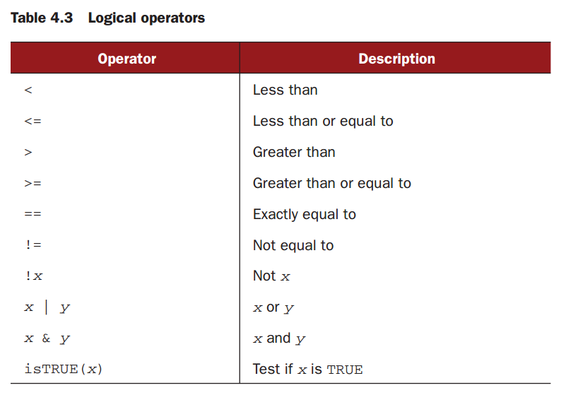

Slide 15
Example 2
leadership$age[leadership$age == 99] <- NA
leadership$agecat[leadership$age > 75] <- "Elder"
leadership$agecat[leadership$age >= 55 &
leadership$age <= 75] <- "Middle Aged"
leadership$agecat[leadership$age < 55] <- "Young"

Slide 16
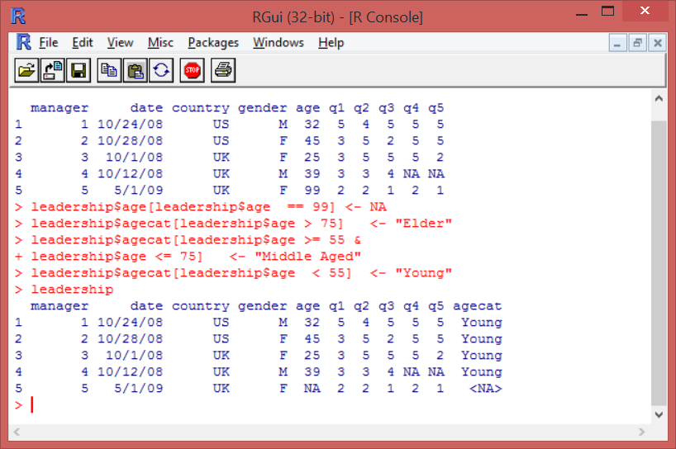

Slide 17
The above codes are equivalent to
leadership <- within(leadership,{
agecat <- NA
agecat[age > 75] <- "Elder"
agecat[age >= 55 & age <= 75] <- "Middle Aged"
agecat[age < 55] <- "Young" })

Slide 18
Rename variables
We could change the names of the variables to new ones.
Example 3
names(leadership)
names(leadership)[2] <- "testDate"
names(leadership)[6:10] <- c("item1", "item2", "item3", "item4", "item5")
leadership

Slide 19
Missing values
In a survey, data is likely to be incomplete. In R, missing values are represented by the symbol NA (not available). Impossible values (for example, dividing by 0) are represented by the symbol NaN (not a number).
The function is.na() allows you to check whether there is any missing value.

Slide 20
Example 4
y <- c(1, 2, 3, NA)
is.na(y)
Then R returns c(FALSE, FALSE, FALSE, TRUE)

Slide 21
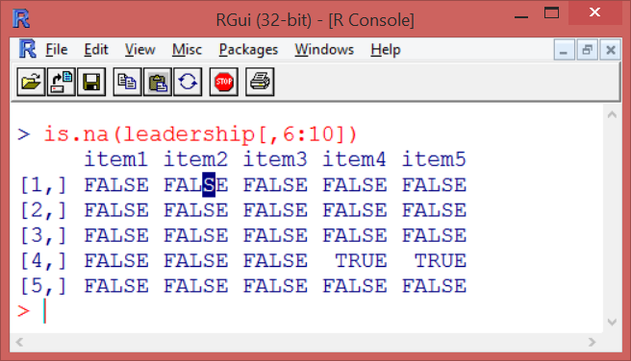
Example 5
is.na(leadership[,6:10])

Slide 22
Recode values to be missing
Example 6
leadership$age[leadership$age == 99] <- NA

Slide 23
Exclude missing values from analysis
Example 7
x <- c(1, 2, NA, 3)
y <- sum(x, na.rm=TRUE)

Slide 24
na.omit()
na.omit() will delete the rows with missing data.
Example 8
newdata <- na.omit(leadership)
newdata

Slide 25
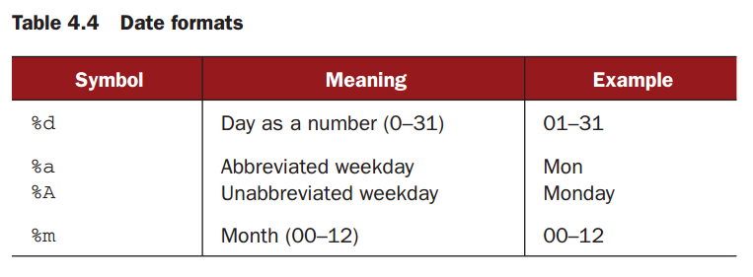
Date value
Dates are typically entered into R as character strings and then translated into date variables using as.Date().

Slide 26
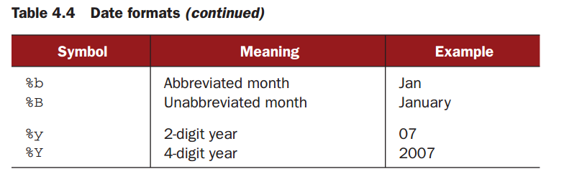

Slide 27
The default format for inputting dates is yyyy-mm-dd.
Example 9
mydates <- as.Date(c("2007-06-22", "2004-02-13"))
strDates <- c("01/05/1965", "08/16/1975")
dates <- as.Date(strDates, "%m/%d/%Y")

Slide 28
Example 10
myformat <- "%m/%d/%y"
leadership$date <- as.Date(leadership$testDate, myformat)

Slide 29
R can tell you what date it is today!
Example 11
Sys.Date()
date()

Slide 30
Type conversions
R provides a set of functions to identify an object’s data type and convert it to a different data type.
is.datatype(x) returns TRUE or FALSE.
x <- as.datatype(x) changes the data type of x.

Slide 31
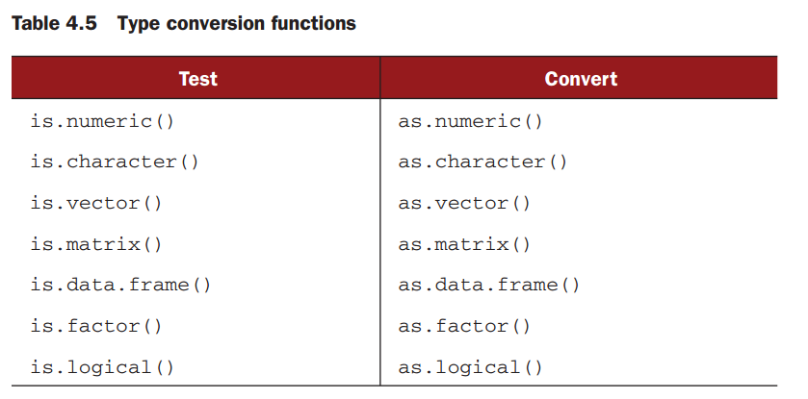

Slide 32
Example 12
a <- c(1,2,3)
is.numeric(a)
is.vector(a)
a <- as.character(a)
a
is.numeric(a)
is.vector(a)
is.character(a)

Slide 33
Sort data
To sort a data frame in R, use the order() function. By default, the sorting order is ascending.
Sorting the variable with a minus sign to indicate a descending order.

Slide 34
Example 12
newdata <- leadership[order(leadership$age),]
attach(leadership)
newdata <- leadership[order(gender, age), ]
detach(leadership)
attach(leadership)
newdata <-leadership[order(gender, -age), ]
detach(leadership)

Slide 35
Summary
In this session, we have learned
Creat and recode variables
Rename the variables
Handle missing values
Convert data type
Handle date value
Sort variables

Slide 36
Try the examples and have fun!

