Slide 1

Using R for Data Analysis and Data Visualization
Instructor: Li, Han

Slide 2
What is R
a calculator
generate random variables/distributions, for example, normal distribution
data visualization, that's, plot the data
data analysis, for example, linear regression
Almost all the things related to data analysis!

Slide 3
Why it is named
R is named partly after the first names of the two authors who created it: Ross Ihaka and Robert Gentleman, at the University of Auckland, New Zealand, and partly as a play on the name of S language.
The project was conceived in 1992, with an initial version released in 1994 and a stable beta version in 2000.

Slide 4
R's advantages
Compared with other softwares, for instance,
Excel
SPSS
SAS
STATA
MATLAB
Why do we choose R?

Slide 5
R's advantages
easy to install
easy to learn, very flexible
friendly graphical user interface (GUI)
many contributed packages
extremely popular
It is free!

Slide 6
Installing R
Website for downloading R:
https://mirrors.tuna.tsinghua.edu.cn/CRAN/
There are different versions of R for different platforms, for example, windows/(Mac) OS X/linux.

Slide 7
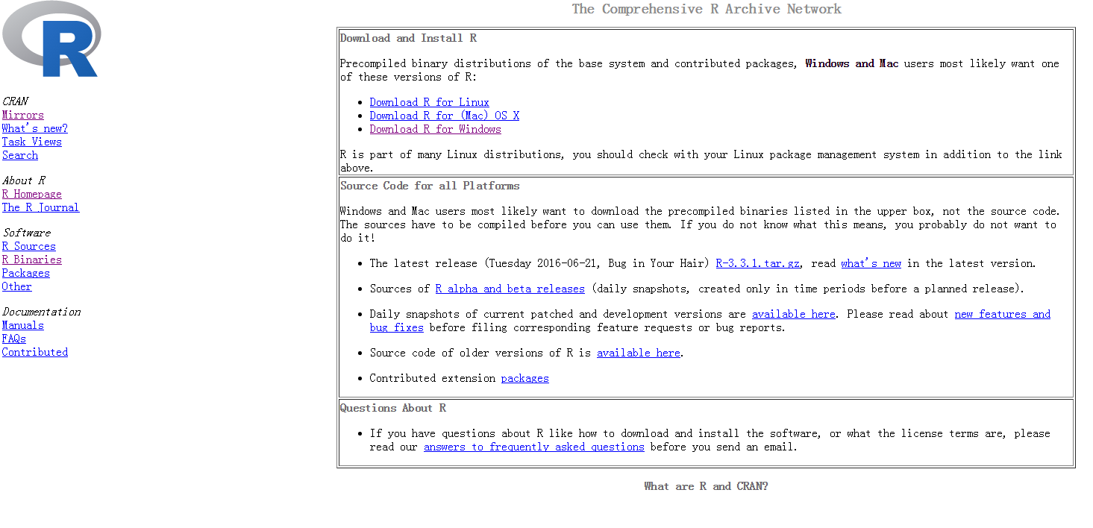

Slide 8
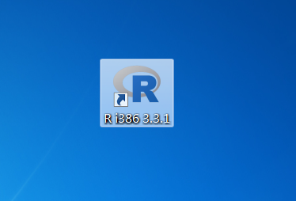
After installing R, click it to begin use it.

Slide 9
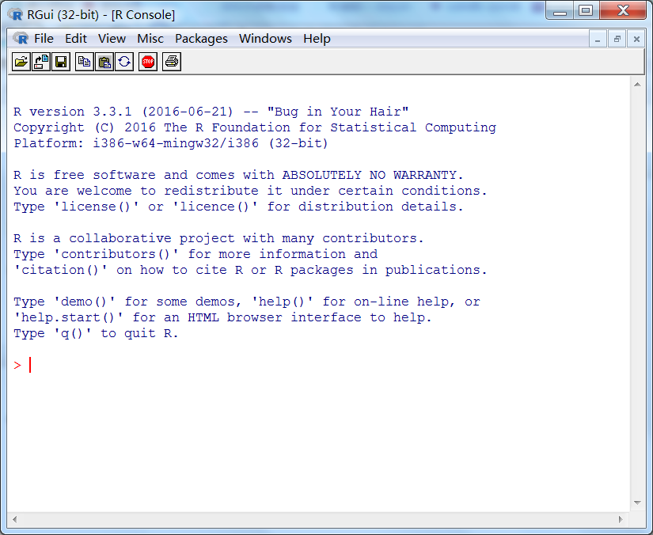
R's GUI(Graphical User Interface)

Slide 10
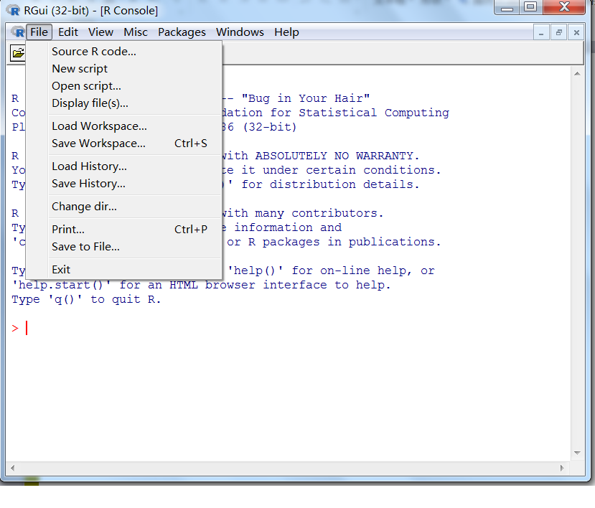

Slide 11
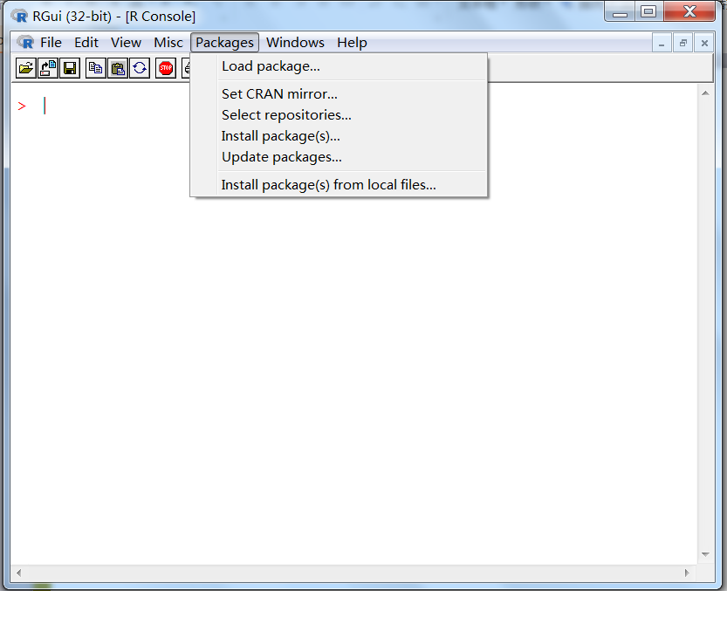

Slide 12
Calculation
2+3
100-15
5*9
3/4
7%%2
((1+2)*12-3*4)/2-8%%3
2^3
2^(-1)
pi
pi^3

Slide 13
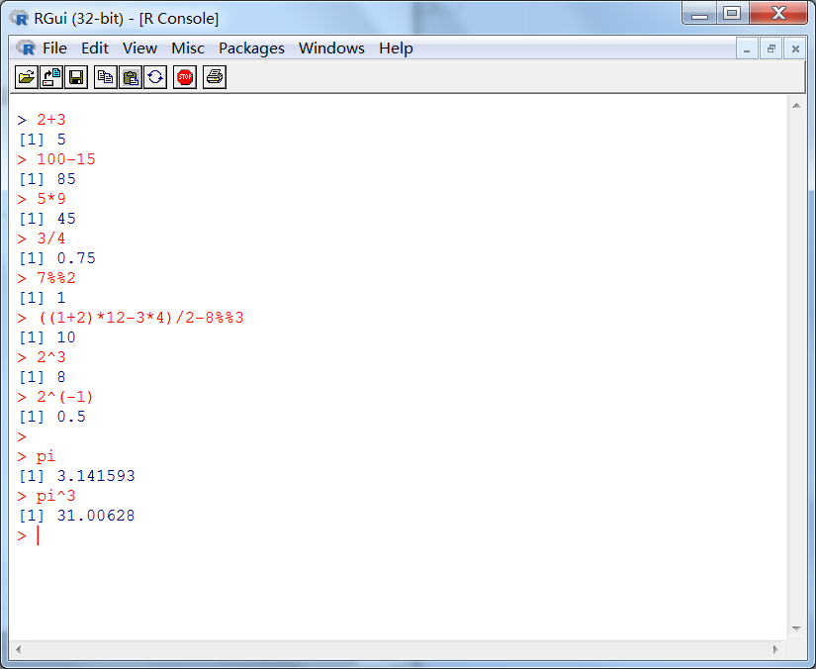

Slide 14
exp(0)
exp(1)
log(1)
log(2.718)
log10(10)
log2(4)
log(9,base=3)

Slide 15
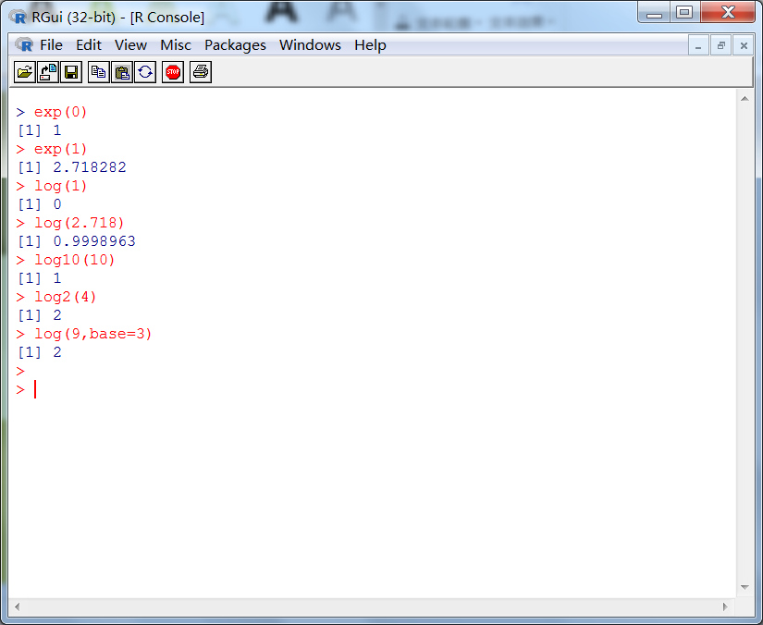

Slide 16
sin(0)
sin(pi/2)
sin(pi)
sin(90)
sin(90/180*pi)
cos(0)
cos(pi)
tan(pi/4)

Slide 17
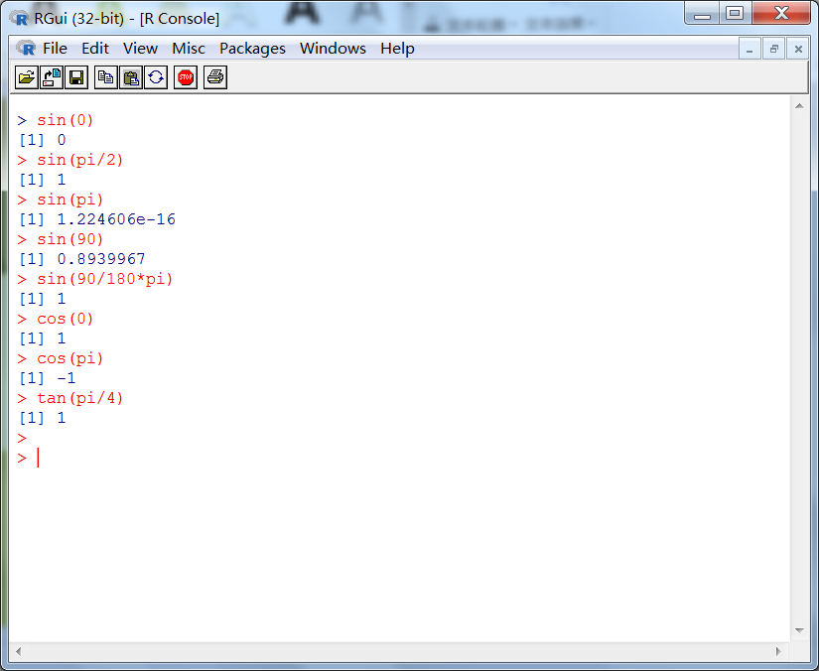

Slide 18
Variable assignment
x<-1
y<-2
x
y
x=1
y=2
x
y
x+y
x/y
x*y
(x+y*2)+x-y^2

Slide 19
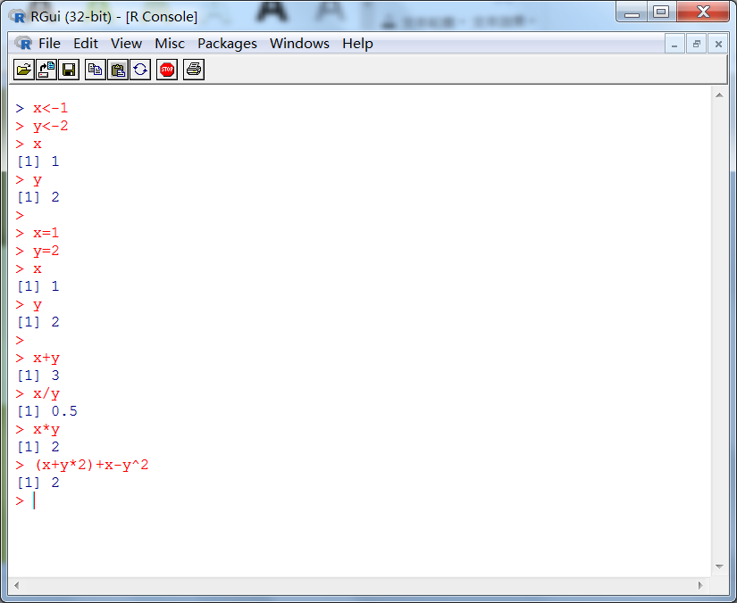

Slide 20
Script- a file ends with .R
A script is a file that saves the codes to run.
It could be a few lines, or a very large text file.
It could be edited like a text file, for example, copy, paste, delete ....
When running the R script, the console will run the codes line by line.

Slide 21
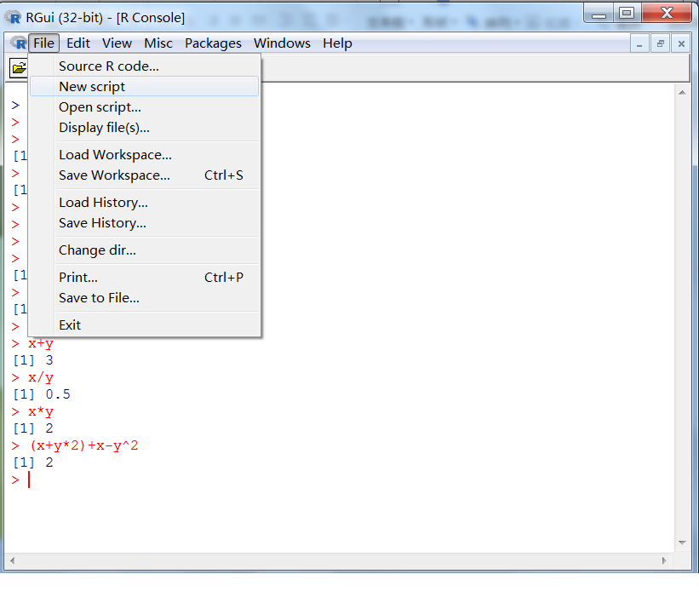
Build a new R script file

Slide 22
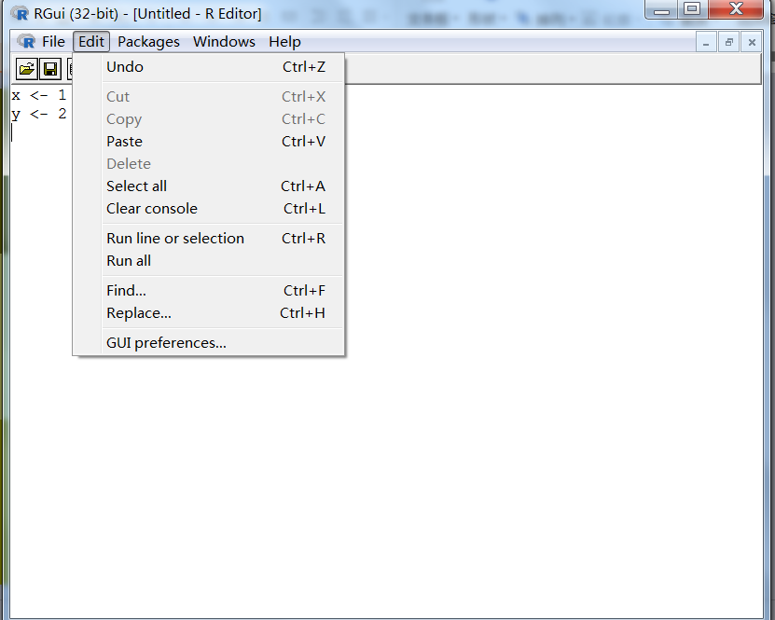

Slide 23
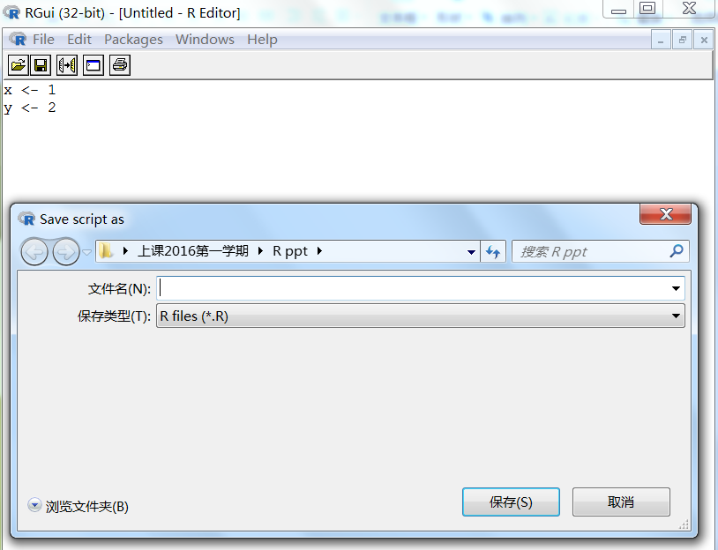
Save a R script file

Slide 24
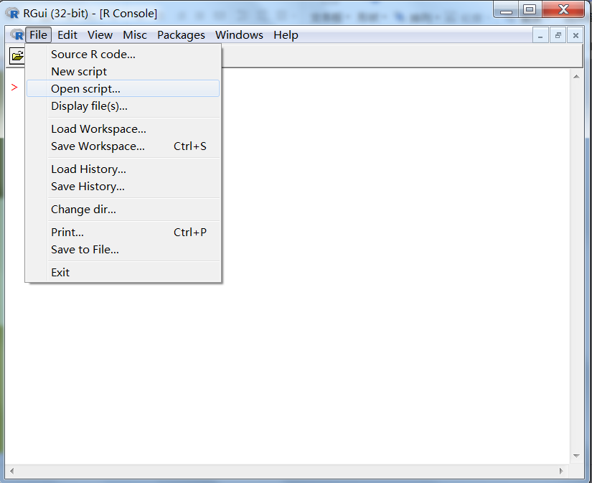
Open an existing R script file

Slide 25
Workspace
It is an environment that stores all defined objects, for example, x, y.
To save the objects, click File -Save Workspace, and then save it as a file that ends with “.RData”.
To load the objects, open R, click File - Load Workspace, and then choose the file that stores the objects.

Slide 26
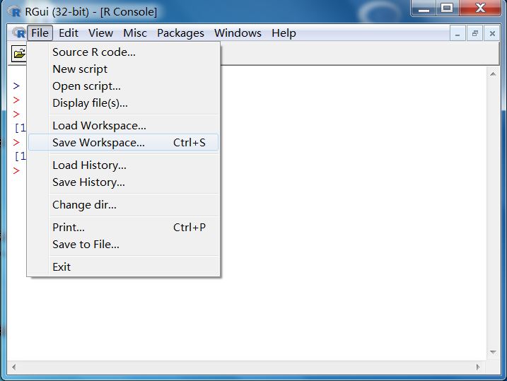

Slide 27
Working directory
Working directory is the current environment where R works, saves and reads varaibles or data by default.
Use getwd() to see the working directory, setwd() to change the working directory.

Slide 28
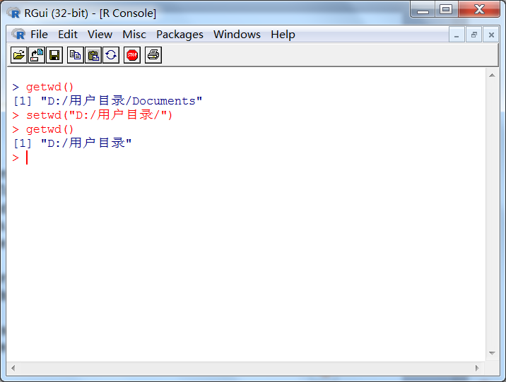

Slide 29
History
history() will show all the codes that were run in the console.
Click “File - Save History”, then save the codes that were run in a file end with “.RHistory”.
Click “File - Load History”, then load a R history file.

Slide 30
We can also save the history codes as a text file.
Use “history()” to see all the codes in the R history window.
Under the R history window, click “File - Save to File”, then save the codes as a file ended with “.txt”.

Slide 31
Package
R comes with extensive capabilities right out of optional modules that you can download and install. There are over 2,500 user-contributed modules called packages that you can download from
http://cran.r-project.org/web/packages

Slide 32
To see the packages already installed in R, use
library() or installed.packages()
To see the packages already loaded in R, use
search()

Slide 33
How to install a package
How to install a package called “gclus”? There are two ways.
Use the code directly as follows.
install.packages(“gclus”)
Manually by clicking “Packages - install package(s)”, then choose the package “gclus” to install.

Slide 34
How to load a packge
After installing the “gclus” package, if you want to use it, you need to use
library(“gclus”)
Then package “gclus” is loaded in the current environment, and you can acess its data and functions now.

Slide 35
help()
If you want to see the details of a R function, for example, “mean”, use
help(mean) or ?mean

Slide 36
Some tips for using R
Ctrl+L= clear the console
Ctrl+C=copy
Ctrl+V=paste
ls()=show all the existing variables
rm(x)= delete the variable x
rm(x,y)= delete the variable x and y

Slide 37
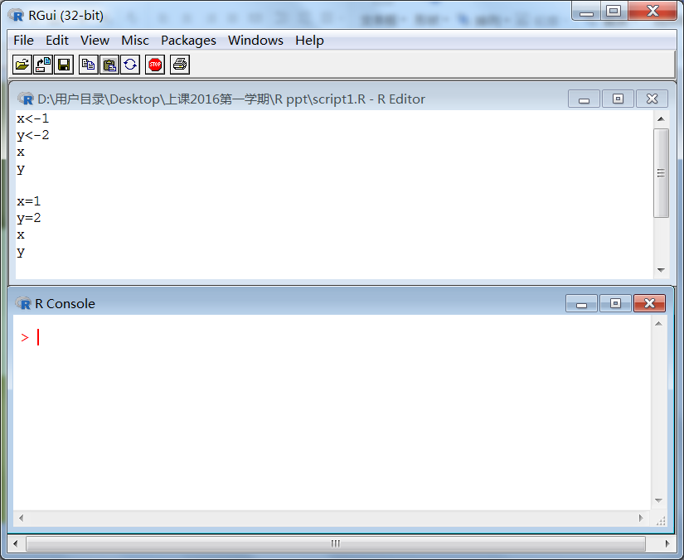

Slide 38
Summary
how to install R
R's advantages
R's GUI environment
Use R to do calculation
build, open and save R's script/workspace/history
install/load a R package
use help()
some tips
Begin the journey to explore R. Have fun!

