Slide 1
chapter 6
Simple plots using R
Instructor: Li, Han

Slide 2
Contents
box plot
histogram
density plot
bar plot
pie plot
dot char

Slide 3
data example
 | mpg | cyl | am
Mazda RX4 | 21.0 | 6 | 1
Mazda RX4 Wag | 21.0 | 6 | 1
Toyota Corolla | 33.9 | 4 | 1
Merc 280C | 17.8 | 6 | 0
Ford Pantera L | 15.8 | 8 | 1
Ferrari Dino | 19.7 | 6 | 1
... | ... | ... | ...

Slide 4
Box plot
A “box-and-whiskers” plot describes the distribution of a continuous variable by plotting its five-number summary:
maximum
upper quartile (75th percentile)
Median (50th percentile)
lower quartile (25th percentile)
minimum

Slide 5
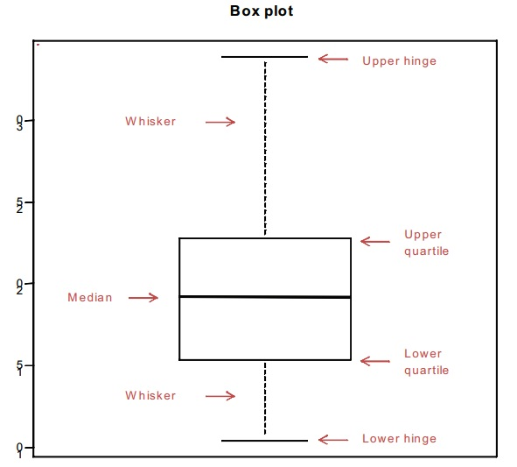

Slide 6
Example 1 (box plot)
attach(mtcars)
boxplot(mpg, main="Box plot", xlab="Cars", ylab="Miles per Gallon")

Slide 7
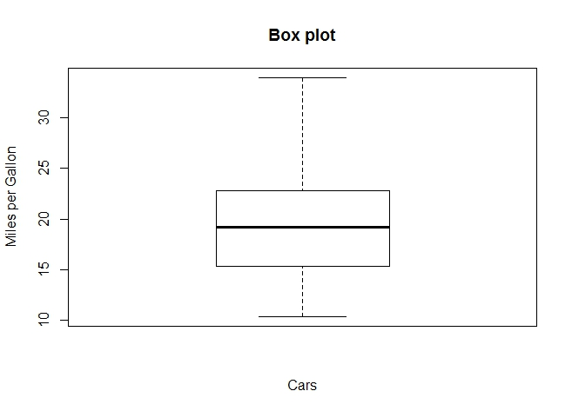

Slide 8
If the data have outliers
We change the data to have outliers by setting
mpg <- mtcars$mpg
mpg[1,1]=50
mpg[2,1]=45
mpg[32,1]=0
Then the box plot has some changes.

Slide 9
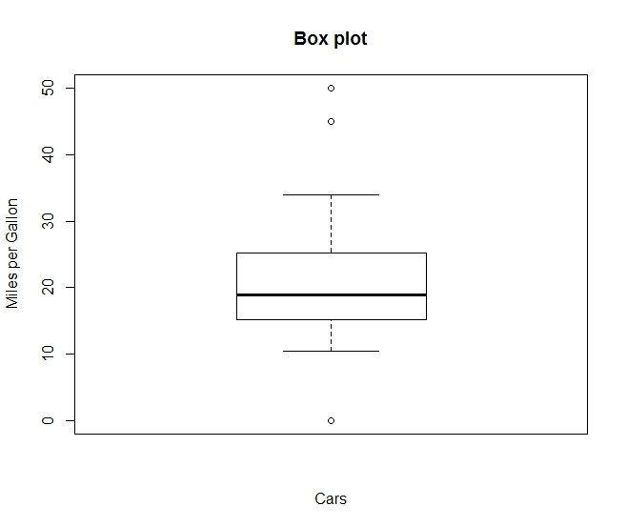

Slide 10
Box plots by group
Box plots can be created for multiple variables by group. The format is
boxplot(formula, data=dataframe, main=…)
formula: y ~ A, y is the whole data, A is a categorical variable, the elements of y and A are one-to-one match. Then we have box plots for each category of A.

Slide 11
Example 2(box plot by group)
mpg <- mtcars$mpg
cyl <- mtcars$cyl
boxplot(mpg ~ cyl, data=mtcars,
main="Car Mileage Data",
xlab="Number of Cylinders",
ylab="Miles Per Gallon")

Slide 12
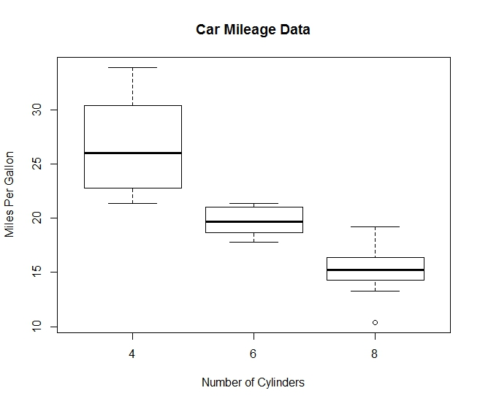

Slide 13
Change the color of the plot
Example 3
boxplot(mpg ~ cyl, data=mtcars,
main="Car Mileage Data",
xlab="Number of Cylinders",
ylab="Miles Per Gallon",
col=c("white","red","yellow"))

Slide 14
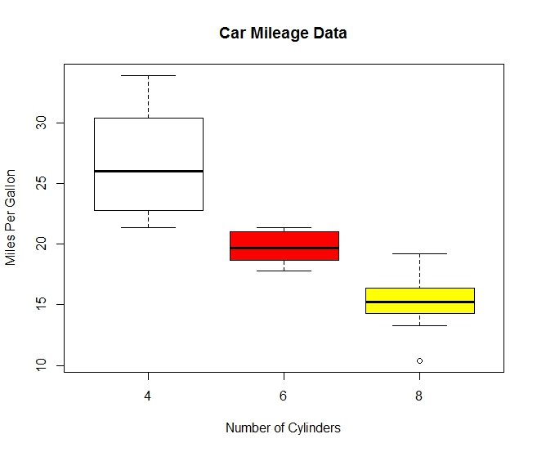

Slide 15
Histogram
Histogram displays the distribution of a continuous variable by dividing it into several bins.
hist(x, breaks=number of bins, main=…)
Example 4 (histogram)
hist(mtcars$mpg)

Slide 16
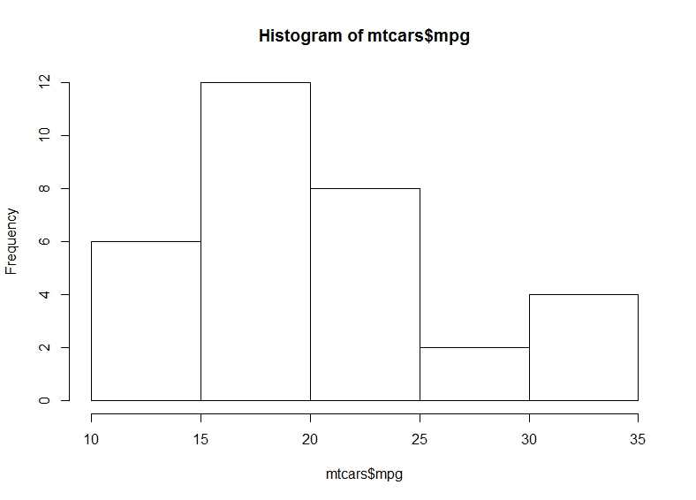

Slide 17
Specify the number of bins
Example 5
hist(mtcars$mpg, breaks=12, col="red",
xlab="Miles Per Gallon",
main="Colored histogram with 12 bins")

Slide 18
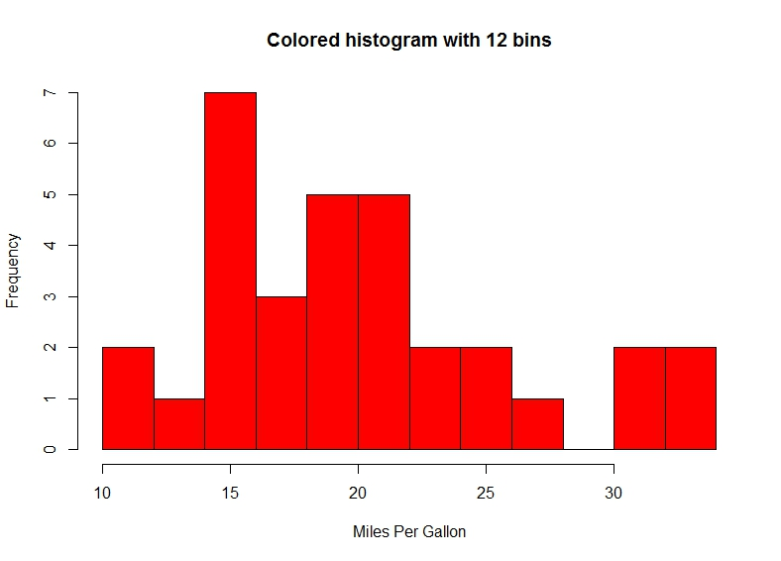

Slide 19
Density plot
Density plot is a nonparametric method for estimating the probability density function of a random variable.
Compare with histogram, which is discrete, density plot is a continous approximation of the distribution of the data.

Slide 20
Example 6
plot(density(mtcars$mpg))
If the plot already exists, we use lines(density(x)) to impose a density line in the original plot.

Slide 21
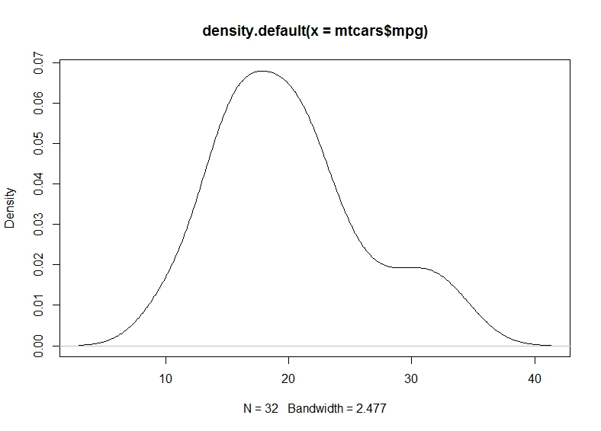

Slide 22
Example 7
d <- density(mtcars$mpg)
plot(d, main="Kernel Density of Miles Per Gallon")
polygon(d, col="red", border="blue")
rug(mtcars$mpg, col="brown")

Slide 23
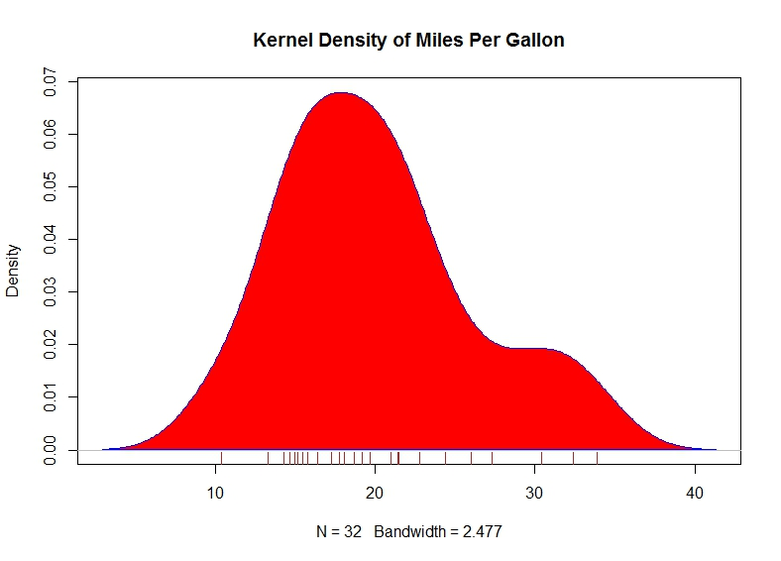

Slide 24
Add density plot to histogram
Example 8
hist(mtcars$mpg,
freq=FALSE, breaks=12, col="red",
xlab="Miles Per Gallon",
main="Histogram, rug plot, density curve")
rug(jitter(mtcars$mpg))
lines(density(mtcars$mpg), col="blue", lwd=2)

Slide 25
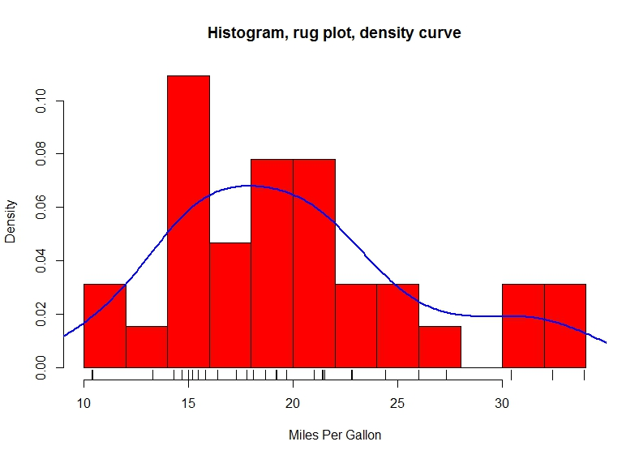

Slide 26
Bar plot
Bar plot displays the distribution (frequencies) of a categorical variable through vertical or horizontal bars.
barplot(x)

Slide 27
Example 8 (bar plot)
cyl <- mtcars$cyl
cyl
table(cyl)
barplot(table(cyl), main="Simple par plot", xlab="number of cylinders", ylab="Frequence")
table(x): summarize the counts in each category

Slide 28
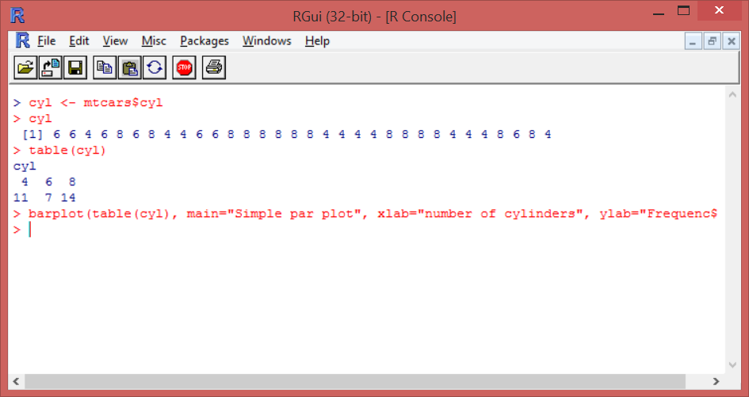

Slide 29
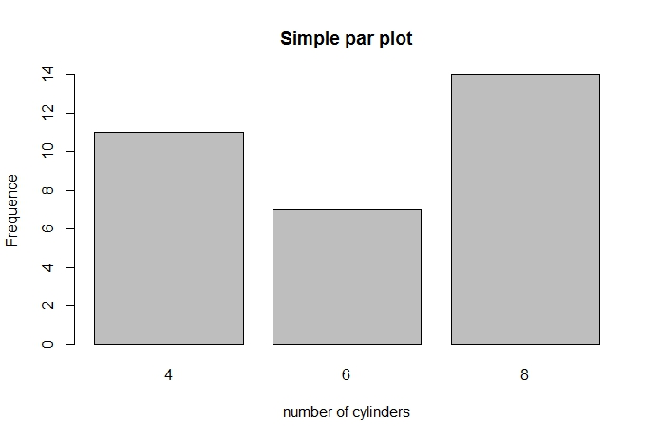

Slide 30
Example 9
barplot(table(cyl), horiz=TRUE,
main="Simple par plot", xlab="number of cylinders", ylab="Frequence")

Slide 31
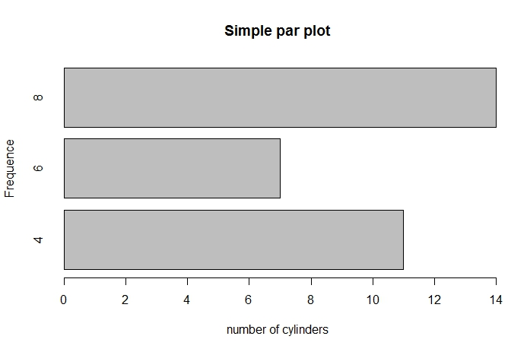

Slide 32
Multiple bar plots
am= 0, automatic,
am=1, manual.
counts <- table(mtcars$cyl, mtcars$am)
rownames(counts)=c("cyl4","cyl6","cyl8")
colnames（counts)=c("automatic","manual")

Slide 33
Example 10
barplot(counts,
main="Grouped Bar Plot",
xlab="Car type", ylab="Frequency",
col=c("red", "yellow", "green"),
legend=rownames(counts), beside=TRUE)

Slide 34
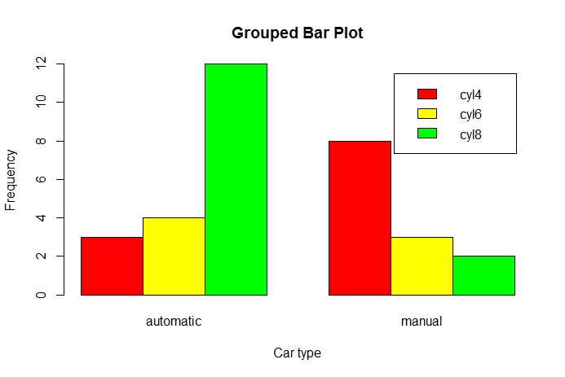

Slide 35
Pie chart
pie(x, labels=?,...)
Example 11 (pie plot)
users <- c(3000, 3200, 2000, 2500, 2800)
country <- c("US", "UK", "Austrilia", "Germany", "France")
pie(users, labels=country, col=2:6, main="Simple Pie Chart")

Slide 36
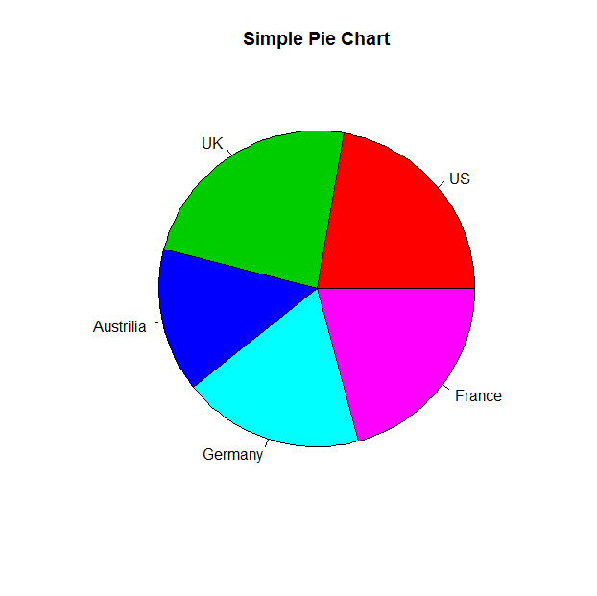

Slide 37
Example 12
#caculate the percentage
pct <- round(users/sum(users)*100)
#use paste to combine the characters
country2=paste(country, " ", pct, "%", sep="")
#pie plot
pie(users, labels=country2, col=2:6, main="Pie Chart with Percentages")

Slide 38
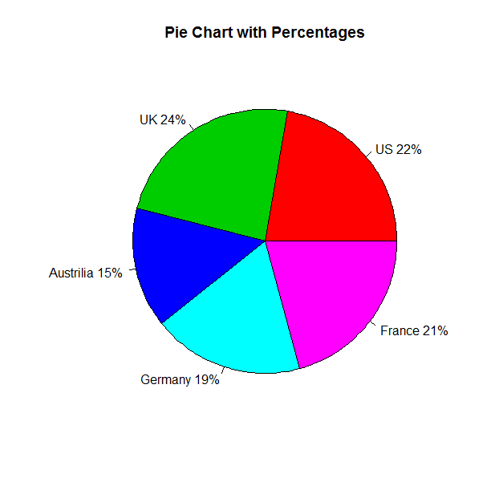

Slide 39
Example 13 (3D pie plot)
library(plotrix)
country3=paste(country, "\n", pct, "%", sep="")
pie3D(users, labels=country3, explode=0.1, col=2:6, labelcex=0.7, main="3D Pie Chart")

Slide 40
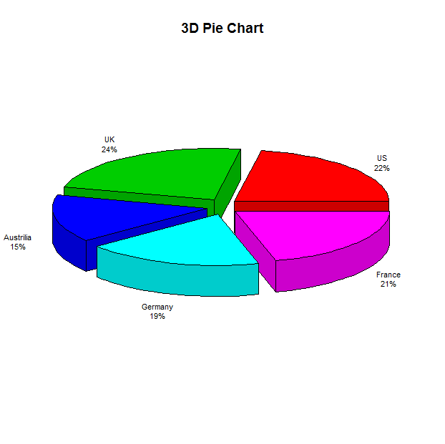

Slide 41
Dot plot
Dot plots provide a method of plotting a large number of labeled values on a simple horizontal scale.
dotchart(x, labels=?,...)

Slide 42
Example 14 (dot plot)
attach(mtcars)
dotchart(mpg, labels=row.names(mtcars), cex=.7, main="Gas Mileage for Car Models",
xlab="Miles Per Gallon")

Slide 43
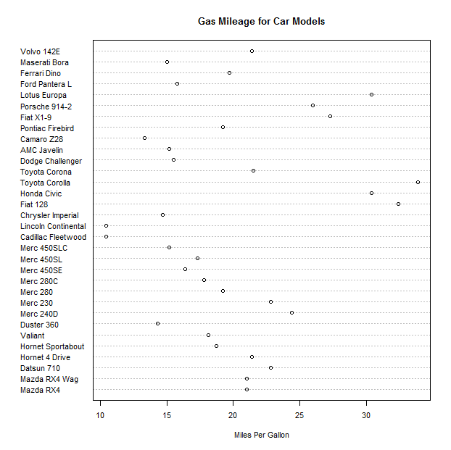

Slide 44
Dot plot by group
Suppose we would like to sort the mpg values in an increasing order, and then plot them in different colors based on the number of their cyl values.
Example 15
x <- mtcars[order(mtcars$mpg),]
x$cyl <- factor(x$cyl)
x$color[x$cyl==4] <- "red"
x$color[x$cyl==6] <- "blue"
x$color[x$cyl==8] <- "darkgreen"

Slide 45
dotchart(x$mpg,
labels = row.names(x),
cex=.7,
groups = x$cyl,
gcolor = "black",
color = x$color,
pch=19,
main = "Gas Mileage for Car Models\ngrouped by cylinder",
xlab = "Miles Per Gallon")

Slide 46
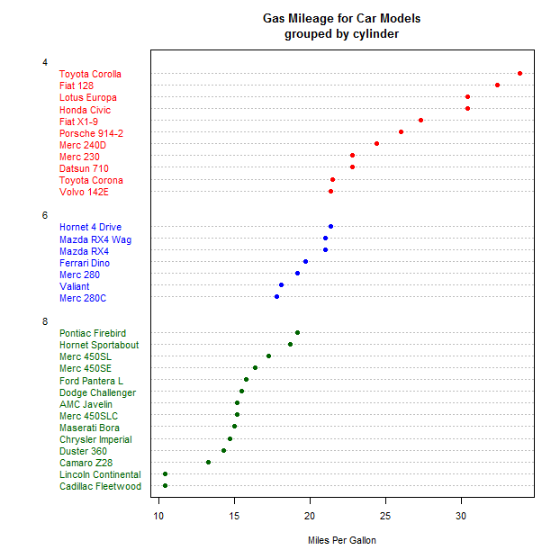

Slide 47
Try the examples and enjoy plotting!

