Slide 1
Chapter 5
R programming
Instructor: Li, Han

Slide 2
Contents
control flow: for, while, if-else, switch
user defined function
break
stop(), warning() and message()
global vs local environment
R vectorization

Slide 3
R has the standard control structures you'd expect to see in a modern programming language.
statement is a single R statement or a compound statement separated by semicolons or newline.
cond is an expression that is judged to be true or false.
expr is a statement that evaluates a number or character string.
seq is a sequence of numbers or character strings.

Slide 4
Repetition and looping
Looping constructs repetitively execute a statement or series of statements until a condition is false. These include structures of
for
while

Slide 5
for
The for loop executes a statement repetitively until the last element in the sequence seq. The syntax is
for (var in seq) statement
Example 1 (for loop)
for (i in 1:10) {
print("Hello")
}

Slide 6
while
A while loop executes a statement repetitively until the condition is no longer true. The syntax is
while (cond) statement
Example 2 (while loop)
i <- 10
while (i > 0) {
print("Hello")
i <- i - 1
}

Slide 7
In the above example, if you add 1 on each loop, R would never stop saying “Hello”. This is why while loops can be more dangerous than other looping constructs. In such case, you need to "stop" the loop forcefully.

Slide 8
Looping in R can be inefficient and time consuming when you are processing the rows or columns of large datasets. Whenever possible, it's better to use R's built-in numerical and character functions in conjunction with the apply family of functions.

Slide 9
Example 3 (caculate the column means)
x <- rnorm(100)
y <- matrix(x, 10,10)
z <- rep(0,ncol(y))
for (i in 1:ncol(y)) {
z[i]=mean(y[,i])
}
w <- apply(y, 2, mean)

Slide 10
Conditional execution
In conditional execution, a statement or statements are only executed if a specified condition is met. These constructs include
ifelse
if-else
switch

Slide 11
ifelse
The ifelse construct is a compact and vectorized version of the if-else construct. The syntax is
ifelse(cond, statement1, statement2)
Example 4 (ifelse)
score <- 80
ifelse(score > 60, print("Passed"), print("Failed"))
outcome <- ifelse(score > 60, "Passed", "Failed")

Slide 12
if-else
For the above example, we could also use the syntax
if(cond){ statement1} else{statement2}
Example 5 (if-else)
score <- 80
if (score > 60) {print("Passed")} else {print("Failed")}

Slide 13
If we have more than one condition to evaluate, we could use multiple if-else. The syntax is
if (cond 1) {
statement 1
} else if (cond 2) {
statement 2
} ... {
} else if (cond k) {
statement k
} else {
statement n
}

Slide 14
Example 6 (multiple conditions)
score <- 90
If (score >85) {
print("Excellent")
} else if (score >75) {
print("Good")
} else if (score >60) {
print("Passed")
} else{
print("Failed")
}

Slide 15
switch
switch chooses statements based on the value of an expression. The syntax is
switch(expr, ...)
Then it compares the expr with the predefined string that matches it, and then excutes the corresponding statements.

Slide 16
Example 7 (switch)
feelings <- c("sad", "afraid")
for (i in feelings) {
print(
switch(i,
happy = "I am glad you are happy",
afraid = "There is nothing to fear",
sad = "Cheer up",
angry = "Calm down now"
)
)
}

Slide 17
functions
We could build our own functions in R. The structure of a function looks like this:
myfunction <- function(arg1, arg2, ... ) {
statements
return(object)
}
Objects in the function are local to the function. The object returned can be any data type, from a single number to a list.

Slide 18
Example 8 (calculate the center and spread of the data)
mystats <- function(x, parametric=TRUE, print=FALSE) {
if (parametric) {
center <- mean(x); spread <- sd(x)
} else {
center <- median(x); spread <- mad(x)
}
if (print & parametric) {
cat("Mean=", center, "\n", "SD=", spread, "\n")
} else if (print & !parametric) {
cat("Median=", center, "\n", "MAD=", spread, "\n")
}
result <- list(center=center, spread=spread)
return(result)
}

Slide 19
set.seed(1234)
x <- rnorm(500)
y <- mystats(x)
y <- mystats(x, parametric=FALSE, print=TRUE)

Slide 20
break
In a loop, if we want to stop it, use break.
Example 9 (break)
for(i in 1:10){
print(i)
if(i>3){break}
}

Slide 21
stop()
If you want to stop the current excution, use stop().
Example 10 (stop)
for(i in 1:10){
print(i)
if(i>3){stop("It is larger than 3.")}
print("fine")
}

Slide 22
warning()
Example 11(warning)
for(i in 1:10){
print(i)
if(i>3){warning("It is larger than 3.")}
print("fine")
}

Slide 23
message()
Example 12 (message)
for(i in 1:10){
print(i)
if(i>3){message("It is larger than 3.")}
print("fine")
}

Slide 24
global vs local environment
In R, each function defines an environment that includes all its local variables that can not be accessed from outside. If the function finishes running, all the local variables disappear.
A local function can access the variables in its parent environment when running. Note that it actually copies the global variable, and it is not the global variable itself. So it can not change the value of the global variable.

Slide 25
Example 13 (global vs local environment)
w <- 12
f <- function(){
y <-5
h <- function(z){return(z^2)}
w <- 10
print(w)
return(h(y))
}
f()
w
y

Slide 26
R vectorization
Compare with the following two examples that summarize the sum of those x>0.
Example 14 (use R vectorization if possible)
x <- runif(1000000)
y =z=0
system.time(
for(i in 1:length(x)){
if(x[i]>0){y=y+x[i]}
}
)
system.time(sum(x[x>0]))

Slide 27
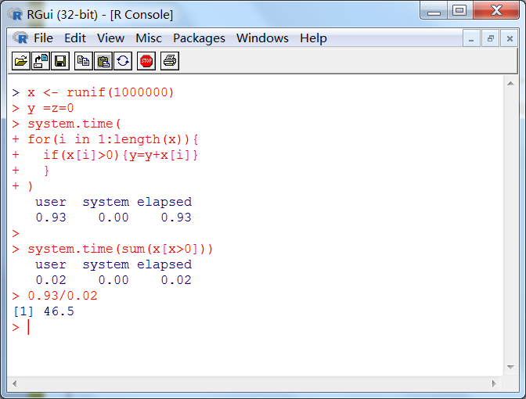

Slide 28
Summary
In this session, we have learned how to use the control flow structures and build functions in R.

