Slide 1
chapter 12
Regression analysis IV
categorical data analysis
Instructor: Li, Han

Slide 2
Contents
regression with categorical explanatory variables
regression with categorical response variable (logistic regression)

Slide 3
Categorical explanatory variables
When some explanatory variables are categorical data, we need to use the dummy variable to denote them, and then conduct regression analysis as usual.

Slide 4
Data example: mtcars
Fit <- lm(y ~ x1+…+xk, data=dataframe)
In the formula, we use x==val to denote whether x is equal to val. For the interaction term, use the production, for instance, (x1==val)*x2.

Slide 5
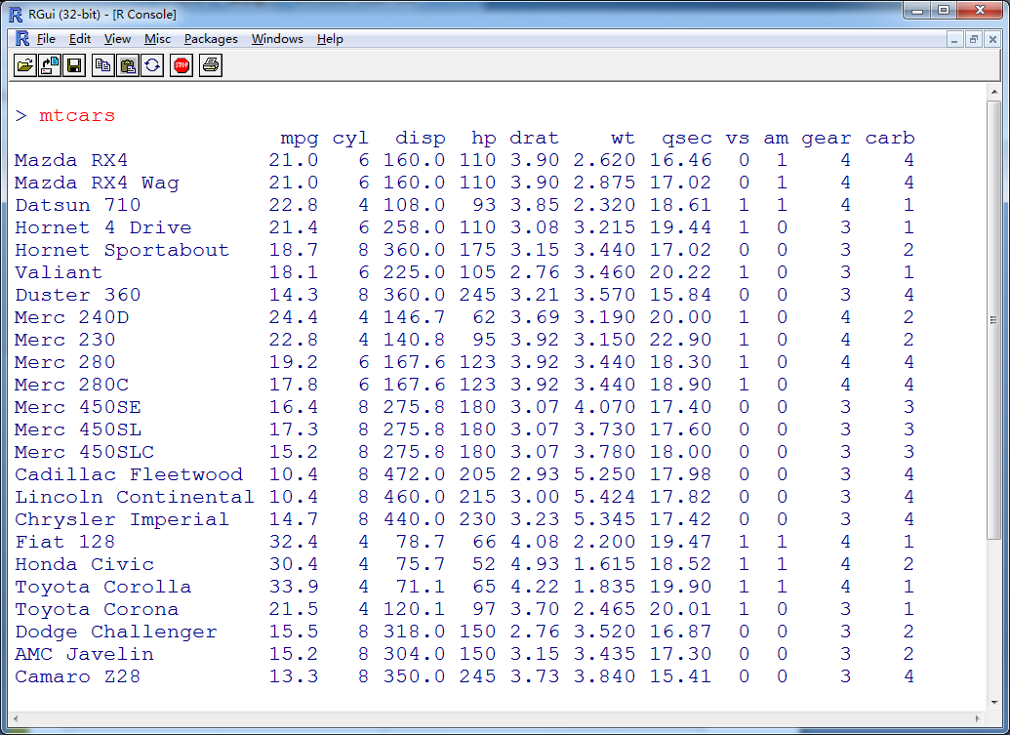

Slide 6
Example 1 (weight, automatic or manual)
fit1 <- lm(mpg ~ wt +I(am==1), data=mtcars)
summary(fit1)
Example 2 (weight, number of cylinders:4, 6, 8)
fit2 <- lm(mpg ~ wt +I(cyl==6)+I(cyl==8), data=mtcars)
summary(fit2)

Slide 7
Example 3 (weight, number of cylinders:4, 6, 8, and the interaction term)
fit3 <- lm(mpg ~ wt +I(cyl==6)+I(cyl==8)+I((cyl==6)*wt)+I((cyl==8)*wt), data=mtcars)
summary(fit3)
Example 4 (weight, number of cylinders: (4,6), 8, and the interaction term)
fit4 <- lm(mpg ~ wt + I(cyl==8)+ I((cyl==8)*wt), data=mtcars)
summary(fit4)

Slide 8
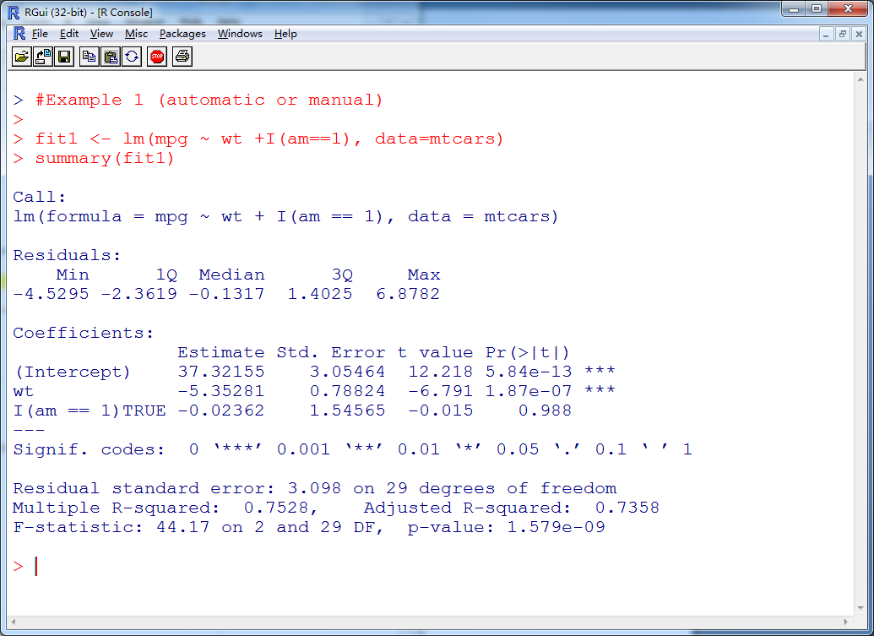

Slide 9
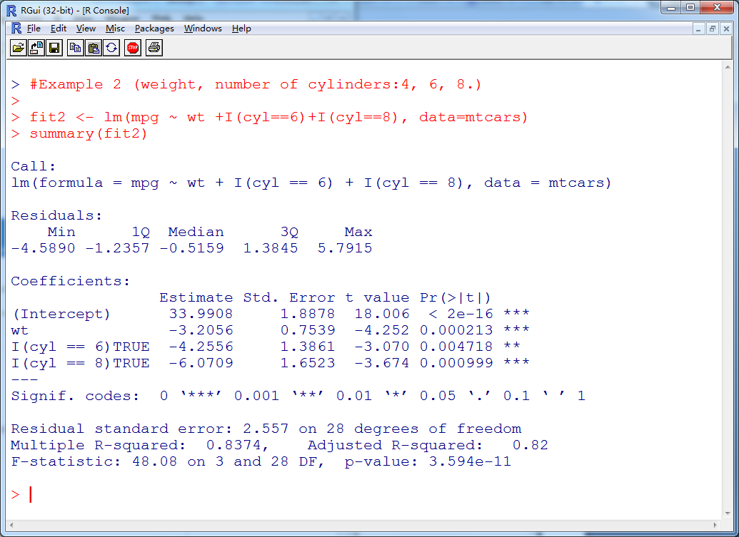

Slide 10
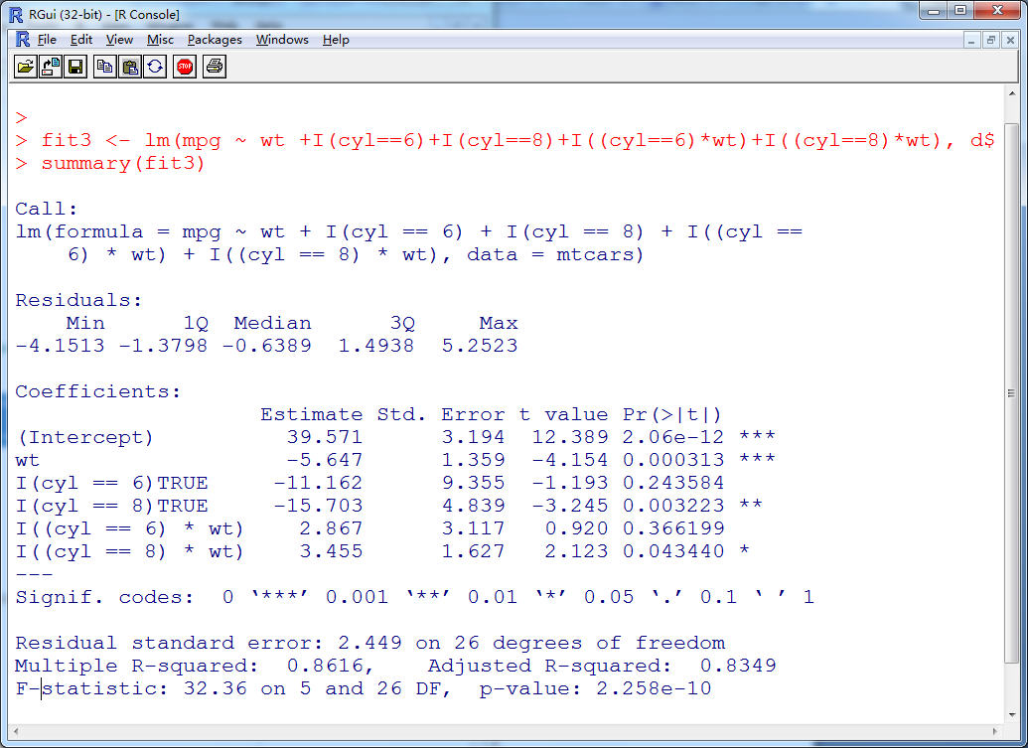

Slide 11
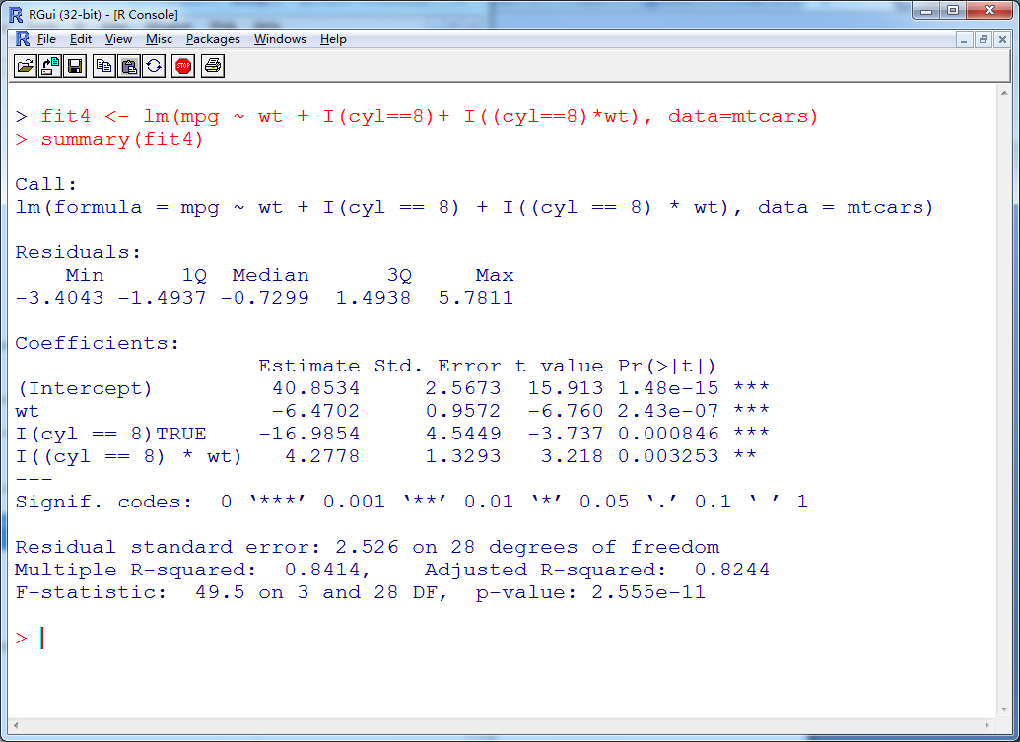

Slide 12
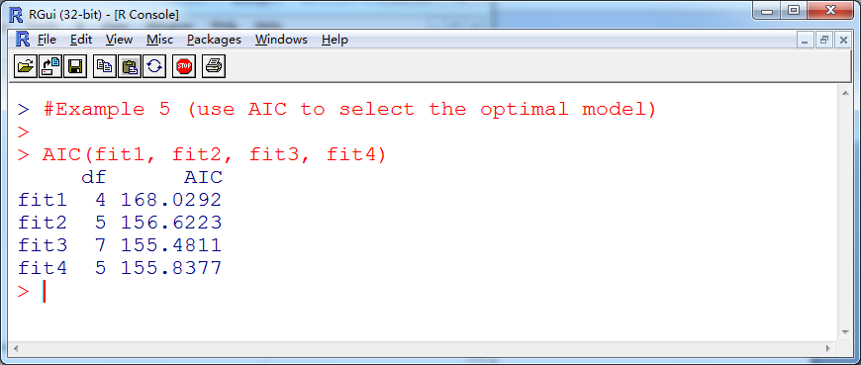
Example 5 (use AIC to select the optimal model)
AIC(fit1, fit2, fit3, fit4)

Slide 13
Categorical response variable
In some cases, we have categorical instead of continuous response variable. For instance,
pass/fail the exam
win/lose the game
alive/dead after a medical treatment
Here we focus on the case of binary response — that is, where it can take only two values.

Slide 14


Logistic model
Explanatory variables: X1,…, Xk.
Response variable: Y=0 or 1.
Model assumption:
(1) Y ~ Bernoulli(1,p), that is
P(Y=1)=p, P(Y=0)=1-p.
(2) (logit function)
Then, we have .
Or equivalently, .

Slide 15
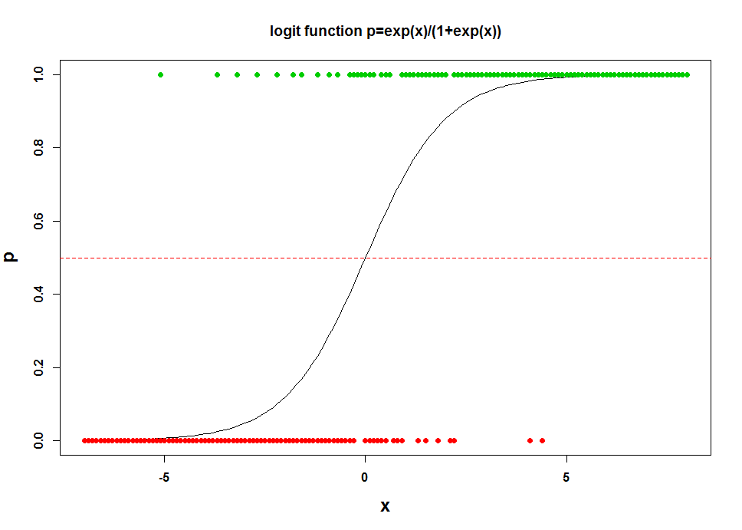

Slide 16
Statistical inference
(1) Parameter estimation
Maximum likelihood approach: choose parameters ,
such that the likelihood function is maximized.
No closed formed solution, thus we need to iteratively find parameters to optimize the above likelihood function.

Slide 17

(2) Find the statistically significant explanatory variables. In logistic regression, the explanatory variables have multiplicative instead of additive effect on the probability ratio.
If the parameter is close to 0, then is close to 1, then have little effect on the ratio.

Slide 18

(3) Make prediction of response given new x.
Classification criterion: if P(Y=1 | x)>0.5, then assign Y to group 1, otherwise, assign it to group 0.
This equivalent to assign Y to group 0, if

Slide 19
Example 6 (transform the response variable to 0 and 1)
install.packages("AER")
data(Affairs, package="AER")
class(Affairs)
dim(Affairs)
summary(Affairs)
table(Affairs$affairs)
Affairs$ynaffairs[Affairs$affairs > 0] <- 1
Affairs$ynaffairs[Affairs$affairs == 0] <- 0
Affairs$ynaffair <- factor(Affairs$ynaffair, levels=c(0,1), labels=c("No", "Yes"))
table(Affairs$ynaffair)

Slide 20
Example 7 (use glm to fit the data)
fit.full <- glm(ynaffair ~ gender+age+yearsmarried+children+religiousness+education+occupation+rating, data=Affairs, family=binomial())
summary(fit.full)

Slide 21
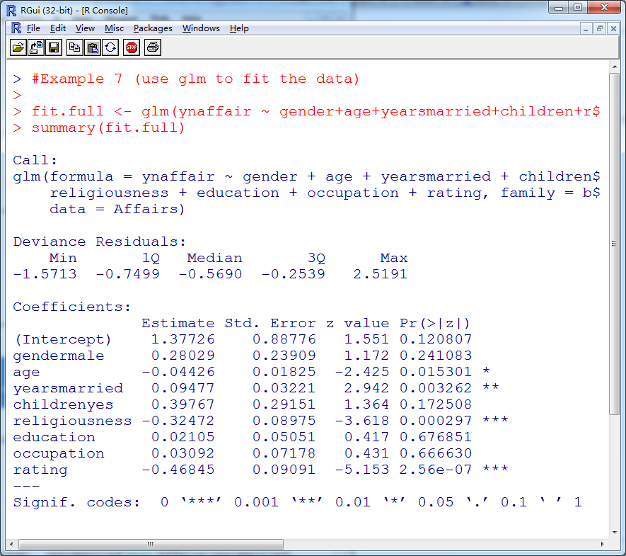

Slide 22
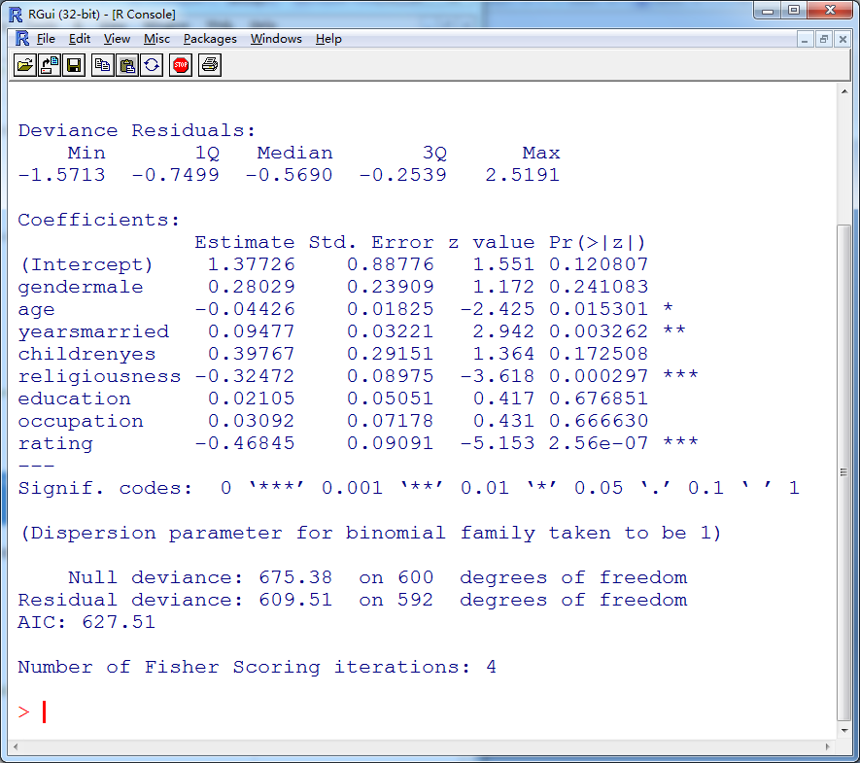

Slide 23
Example 8 (reduced model)
fit.reduced <- glm(ynaffair ~ age+yearsmarried+religiousness+rating, data=Affairs, family=binomial())
summary(fit.reduced)
anova(fit.reduced, fit.full, test="Chisq")
AIC(fit.reduced, fit.full)

Slide 24
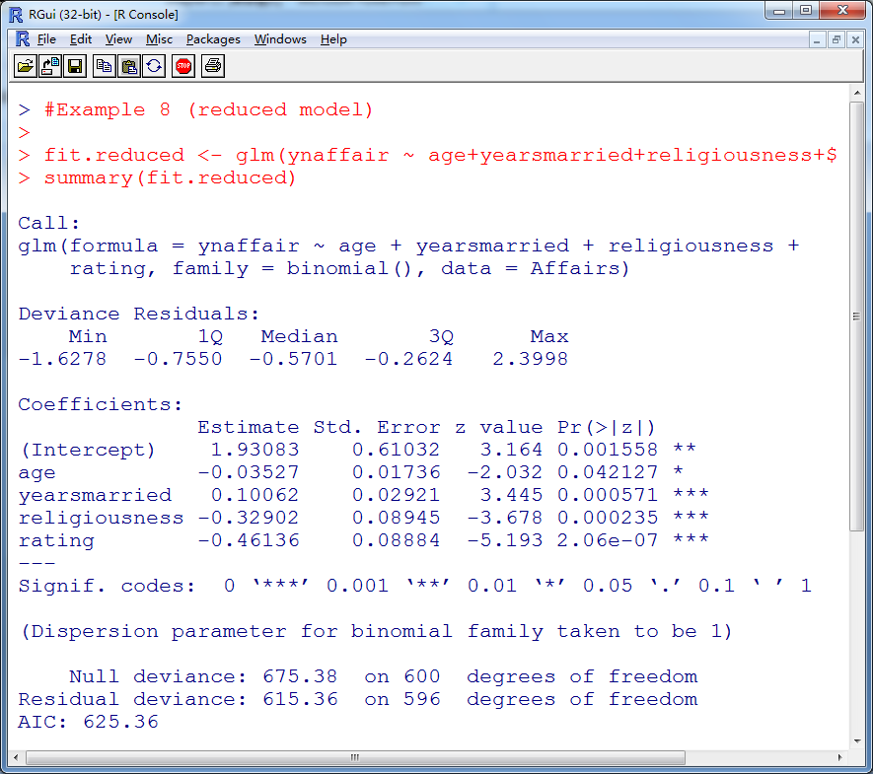

Slide 25
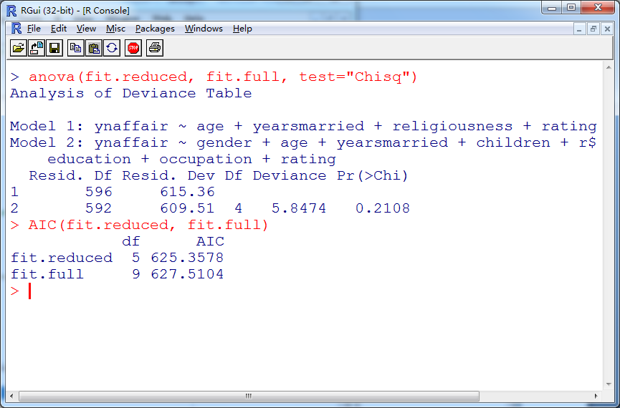

Slide 26
Example 9 (inference)
coef(fit.reduced)
exp(coef(fit.reduced))
exp(confint(fit.reduced))

Slide 27
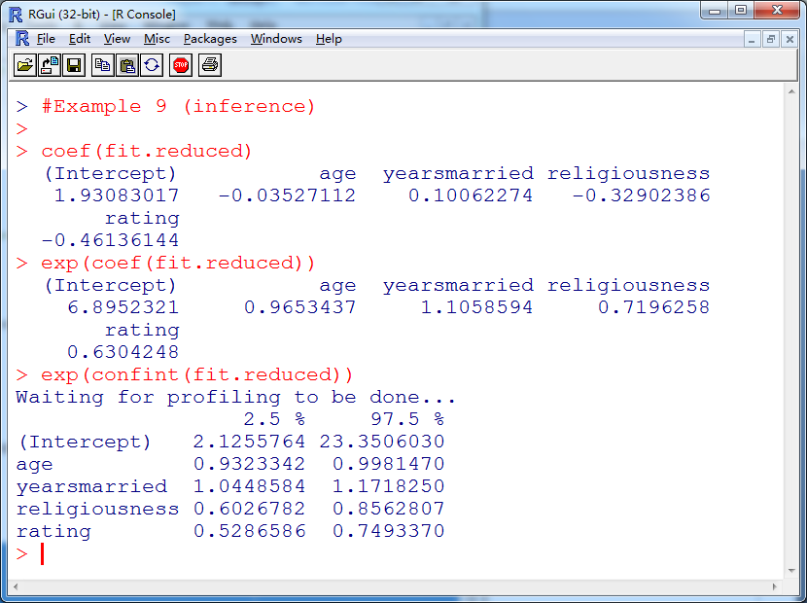

Slide 28
Example 10 (prediction with varying rating)
testdata <- data.frame(rating=1:5, age=mean(Affairs$age), yearsmarried=mean(Affairs$yearsmarried), religiousness=mean(Affairs$religiousness))
testdata
testdata$prob <- predict(fit.reduced, newdata=testdata, type="response")
testdata

Slide 29
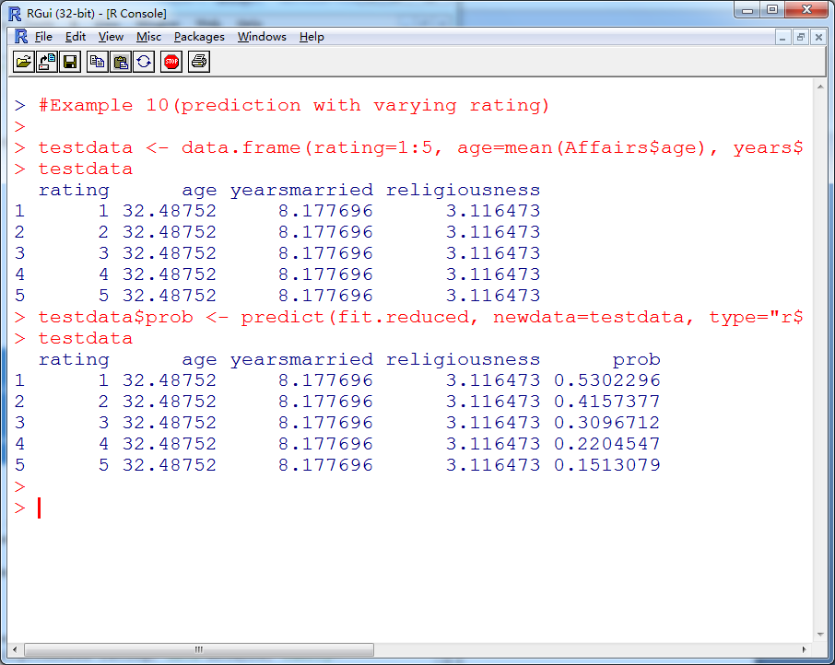

Slide 30
Example 11 (prediction with varying age)
testdata <- data.frame(rating=mean(Affairs$rating), age=seq(25, 60, 5), yearsmarried=mean(Affairs$yearsmarried), religiousness=mean(Affairs$religiousness))
testdata
testdata$prob <- predict(fit.reduced, newdata=testdata, type="response")
testdata

Slide 31
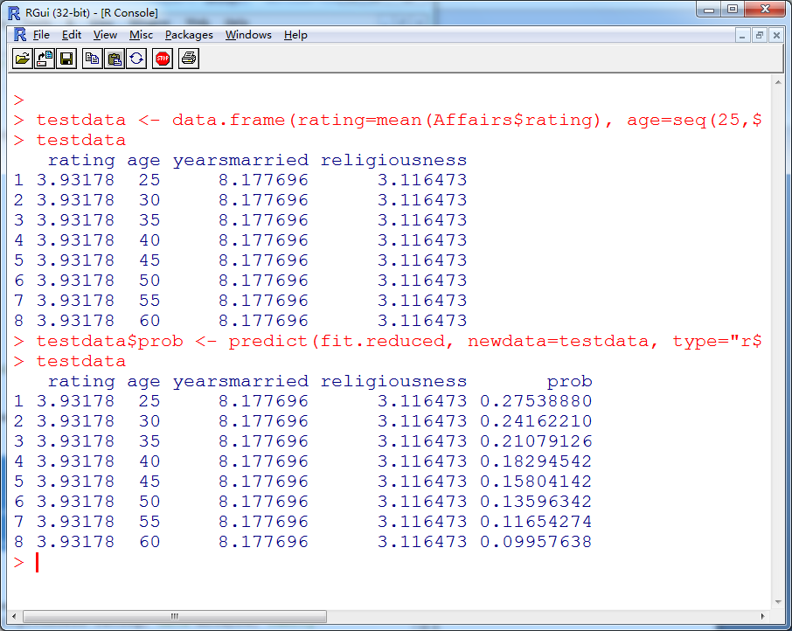

Slide 32
Example 12 (Check the dispersion of data)
fit <- glm(ynaffair ~ +age+yearsmarried+religiousness+rating, data=Affairs, family=binomial())
fit.od <- glm(ynaffair ~ gender+age+yearsmarried+religiousness+rating, data=Affairs, family=quasibinomial())
pchisq(summary(fit.od)$dispersion*fit$df.residual, fit$df.residual, lower=F)
summary(fit.od)$dispersion
summary(fit)$dispersion
fit$df.residual
summary(fit.od)$dispersion*fit$df.residual

Slide 33
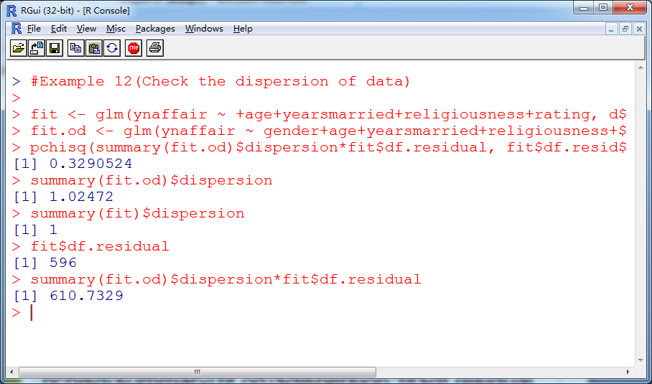

Slide 34
Summary
In this session, we have learned how to handle the regression when we have either categorical explanatory or response variables.

Slide 35
Try the examples and have fun!

