Slide 1
chapter 10
Regression analysis III
Instructor: Li, Han

Slide 2
Contents
Wellfitting, overfitting and underfitting
Model selection appropaches
ANOVA
AIC/BIC
Stepwise regression
Mallows’ Cp
Cross Validation (CV)

Slide 3
When we have multiple explanatory variables and we are not sure which variables are truely associated with the response variable, for the sake of data interpretation and prediction, we face the problem of variable selection, which is also called model selection.

Slide 4
Three cases for fitting the model:
Wellfitting (close to most of the data and the population regression line)
Overfitting (too close to the data and thus deviate from the population regression line)
Underfitting (far from most of the data and the population regression line)

Slide 5
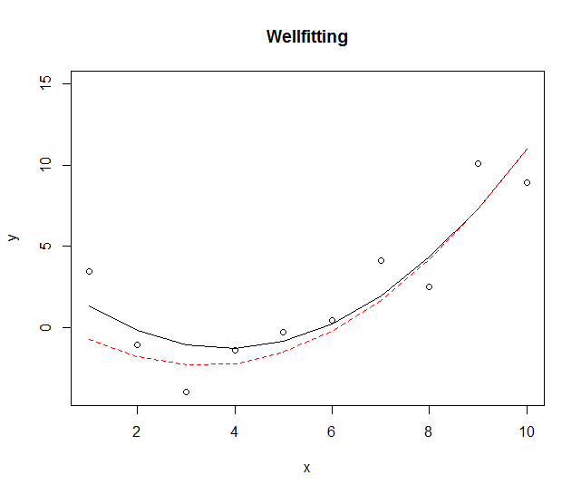
Wellfitting

Slide 6
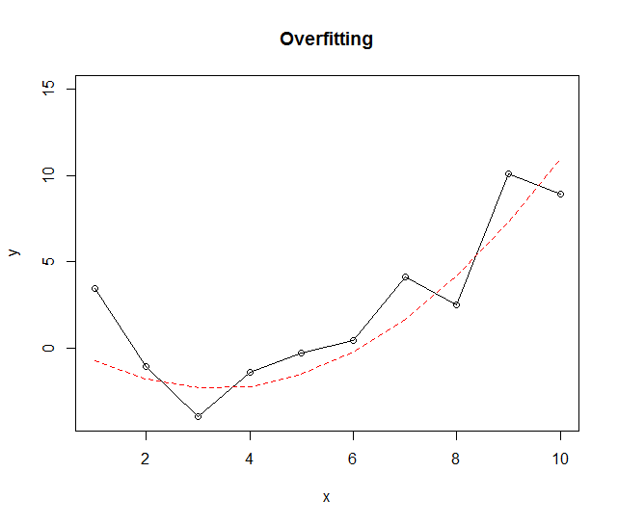
Overfitting

Slide 7
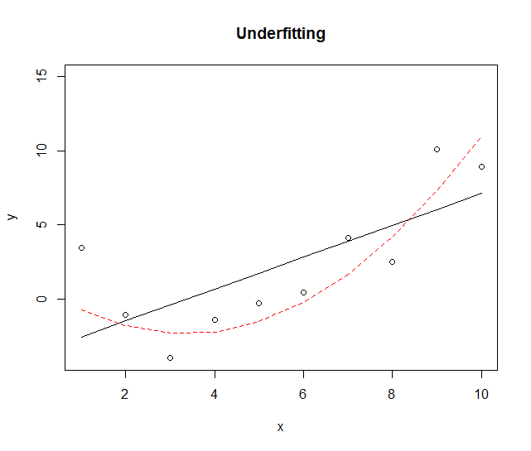
Underfitting

Slide 8
Selecting the "best" model
The selection of a final regression model always involves a compromise between
fitting accuracy (a model that fits the data as well as possible) , and
model complexity (the number of explanatory variables).
If we have two models with approximately equal fitting accuracy, we favor the simpler one.

Slide 9
Model selection approaches
Generally, we have three approaches for model selection.
Hypothesis testing (for instance, t test or F test)
Optimize an objective function, which balances two terms: fitting accuracy and model complexity, for instance, AIC or BIC, Mallows’ Cp.
Cross validation, use the data iteself to validate the model

Slide 10
ANOVA
For nested models, we could use anova() function. A nested model is one whose terms are completely included in the other model.
Example 1 (anova test)
states <- as.data.frame(state.x77[,c("Murder", "Population",
"Illiteracy", "Income", "Frost")])
fit1 <- lm(Murder ~ Population + Illiteracy, data=states)
fit2 <- lm(Murder ~ Population + Illiteracy + Income + Frost, data=states)
anova(fit1, fit2) # hypothesis testing beta3=beta4=0

Slide 11
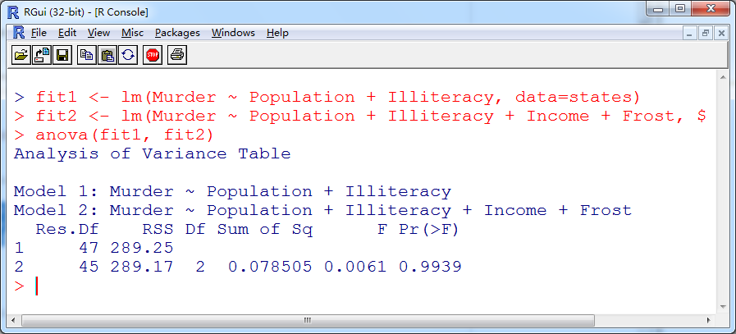
H₀: beta3=beta4=0. For p-value =0.9939 >>0.05, we retain H₀,
and thus prefer the simpler model, that’s, Model 1.

Slide 12
AIC
The Akaike Information Criterion (AIC) index takes into account a model's statistical fit and the number of parameters needed to achieve this fit. Models with smaller AIC values—indicating adequate fit with fewer parameters —are preferred.
AIC=-2lnL+2k
fitting model complexity
Example 2 (AIC)
AIC(fit1, fit2)

Slide 13
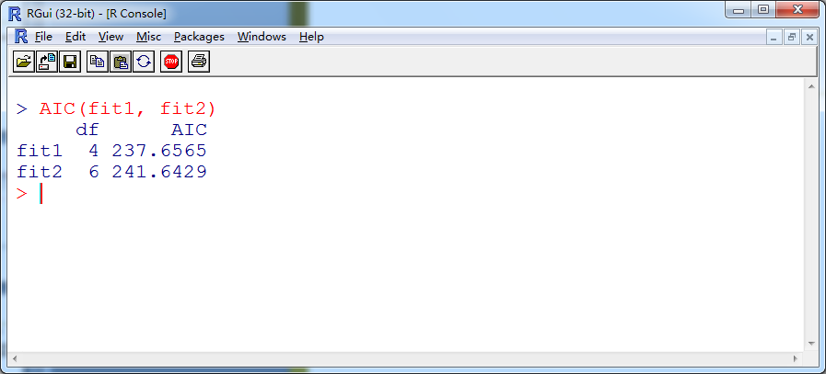

Slide 14
BIC
The Bayesian Information Criterion (BIC, also called Schwarz Information Criterion) is similar to AIC, but adds a heavier model complexity penalty, by replacing 2 with log(n), where n is the sample size.
BIC=-2lnL+log(n)k
fitting model complexity
Example 3 (BIC)
AIC(fit1, fit2, k=log(n))

Slide 15
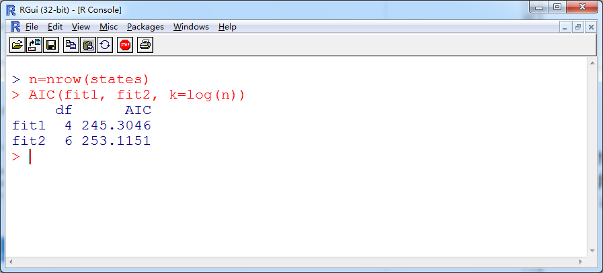

Slide 16
Both the AIC and BIC values suggest that the model without Income and Frost is the better model. Note that although the ANOVA approach requires nested models, the AIC/BIC approach doesn't.

Slide 17
AIC or BIC
Choosing AIC or BIC depends on the problem’s context.
For small or moderate samples, BIC often chooses models that are too simple, because of its heavy penalty on complexity.
For large sample size, AIC tends to choose more complex models than BIC.
Generally, BIC is more accurate.

Slide 18
Mallows Cp
Mallows Cp addresses the issue of overfitting, with a small value of C_{p} meaning that the model is relatively precise.
Cp=(SSE+2k ×se)/n
fitting model complexity
Where SSE is the sum of square errors, k is the number of predictors, n is the sample size and se is the standard error of the residuals.

Slide 19
Stepwise regression
Given the model selection criterion, variables are added to or deleted from a model one at a time, until the stopping criterion (AIC/BIC/Mallows Cp) is reached. There are three ways to update the model.
forward
backward
stepwise

Slide 20
Step forward - add one predictor variable that improves the model most at a time, stopping when the addition of variables would no longer improve the model.
Step backward- start with a model that includes all predictor variables, and then delete one predictor at a time such that the resulting model has better performance, until removing variables would degrade the quality of the model.

Slide 21
Stepwise
Stepwise - combine the step forward and step backward approaches. Variables are entered one at a time, but at each step, the variables in the model are reevaluated, and those that don’t contribute to the model are deleted.
The above approaches do NOT guarantee to reach the optimal model, due to their discrete variable selection process.

Slide 22
The implementation of stepwise regression methods vary by the criteria used to enter or remove variables. The stepAIC() function in the MASS package performs
stepwise model selection (forward, backward, stepwise) using an exact AIC criterion.
Example 4 (backward AIC)
library(MASS)
fit1 <- lm(Murder ~ Population + Illiteracy + Income + Frost, data=states)
stepAIC(fit1, direction="backward")

Slide 23
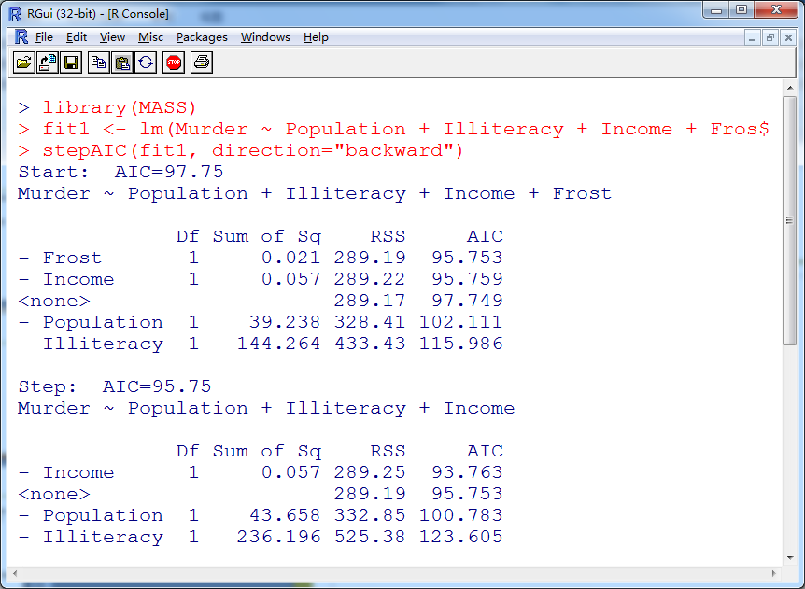

Slide 24
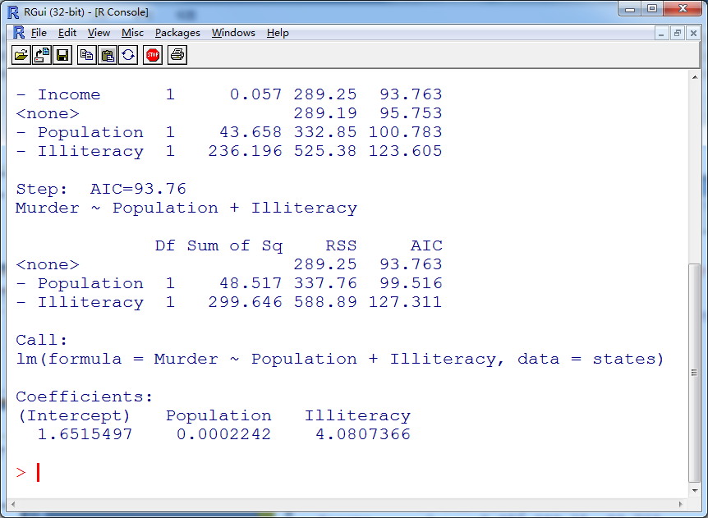

Slide 25
All subsets regression
In all subsets regression, every possible model is inspected. All subsets regression is performed using the regsubsets() function from the leaps package. You can choose Adjusted R-squared, or Mallows Cp statistic
as your criterion for reporting "best" models.
Example 5 (All subset selection)
library(leaps)
leaps <- regsubsets(Murder ~ Population + Illiteracy + Income + Frost, data=states, nbest=4)
plot(leaps, scale="adjr2")

Slide 26
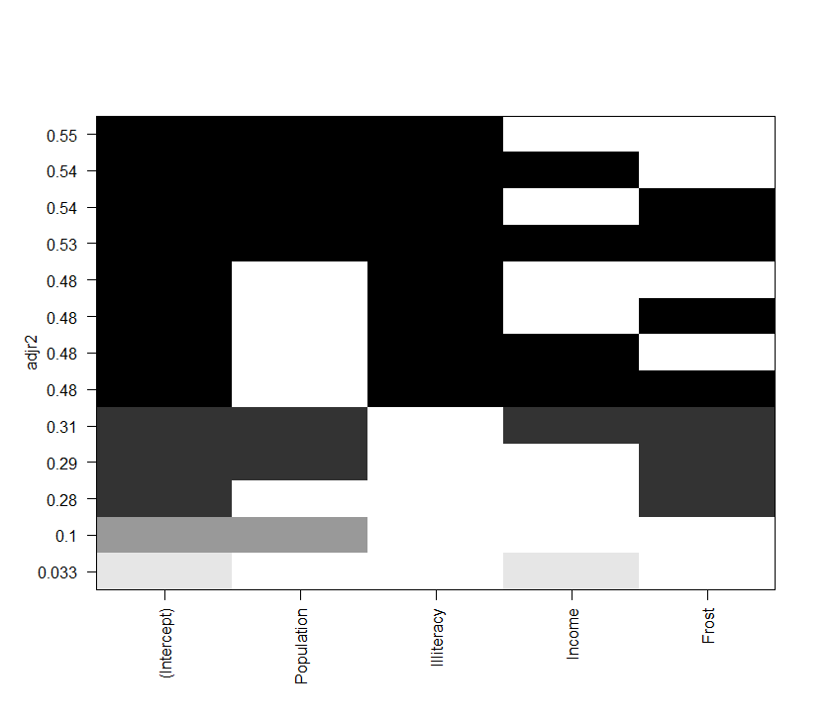

Slide 27
Example 6 (Mallows cp)
leaps <- regsubsets(Murder ~ Population + Illiteracy + Income + Frost, data=states, nbest=4)
cp=summary(leaps)$cp
index=which.min(cp)
summary(leaps)$which[index,]
summary(leaps)

Slide 28
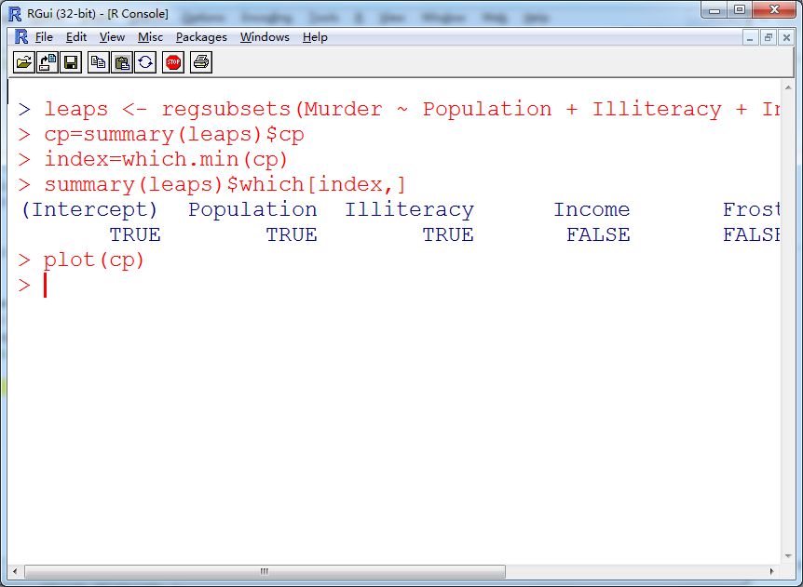

Slide 29
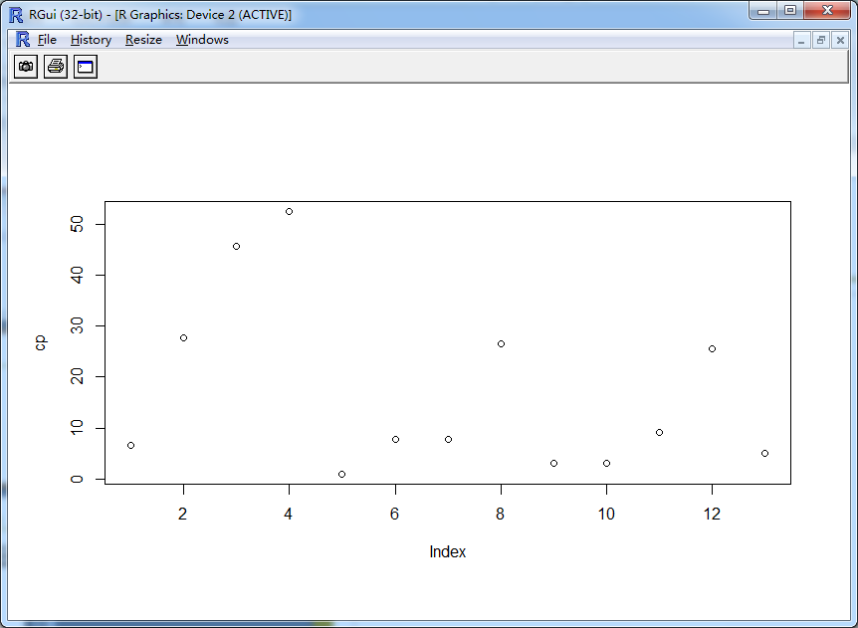

Slide 30
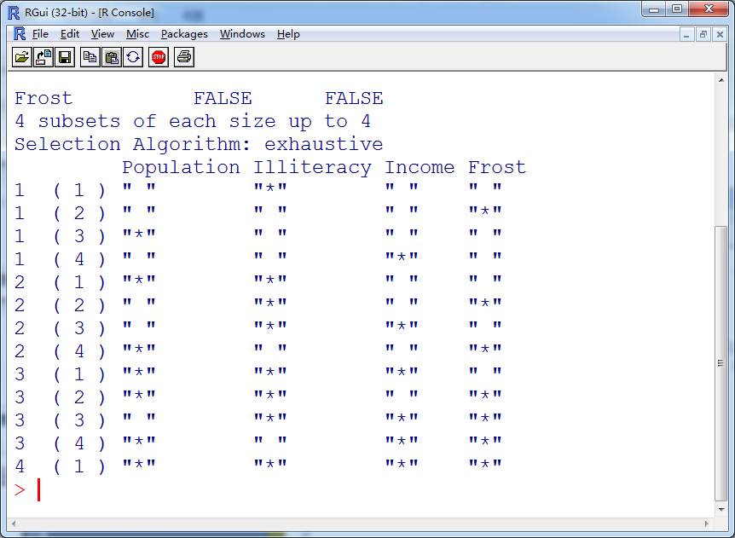

Slide 31
All subset or stepwise method
In most instances, all subsets regression is preferable to stepwise regression, because more models are considered. However, when the number of predictors is large, it takes much more computing time.

Slide 32
Cross validation
When data description is your primary goal, the selection and interpretation of a regression model is the end of data analysis. But when your goal is prediction, you can justifiably ask, “How well will this model perform in the real world?”
The simplest way to use the data iteself to test the model.

Slide 33
k-fold cross validation
In k-fold cross-validation, we split the data into roughly equal-size parts. For the k-th part (test samples), fit the model to the other k-1 parts (training samples) and calculate the prediction error of the fitted model when applying it to predict the k-th part of the data.
The optimal model is the one that has the smallest average prediction error.

Slide 34
Summary
Each model selection approach has its own advantages and disadvantages. No approach is optimal in any case.
In general, automated variable selection methods should be seen as an aid rather than a directing force in model selection. A wellfitting model that doesn't make sense doesn't help you. Ultimately, it's your knowledge of the subject matter that should guide you.

