Slide 1
Sorting
Sorting = arranging data in some order according to their values
Example:
  arranging a sequence of numbers from largest to smallest
  arranging a sequence of names in alphabetical order
  arranging a sequence of records (structs) based on a "key" (e.g. the name field or the salary field)

Slide 2
Sorting
There are several sorting algorithms, some more efficient than others. We will discuss:
  selection sort
  insertion sort
In all of our examples, we will assume that
  the items to be sorted are stored in an array
  we want to sort the items in ascending order

Slide 3
Selection Sort
Idea:
  Select item that should be first in order
    How? Traverse the array keeping track of the largest element as you go.
  Swap it with the actual first item in the array.
  The part of the array containing the first item is now sorted. From now on, ignore it.
  The rest of the array is still unsorted.
  Repeat the process on the unsorted part of the array.

Slide 4
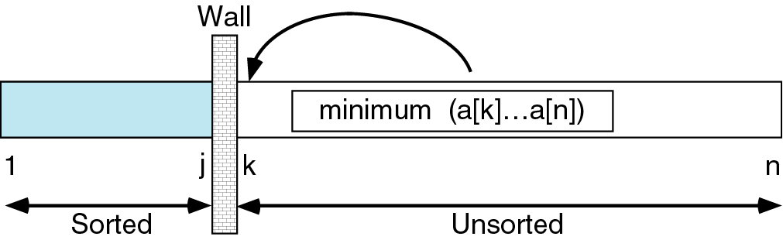
Selection Sort
As we "move" items to the sorted part of the array, this imaginary wall between the parts moves towards the end of the array. When it reaches the edge, we are done!

Slide 5
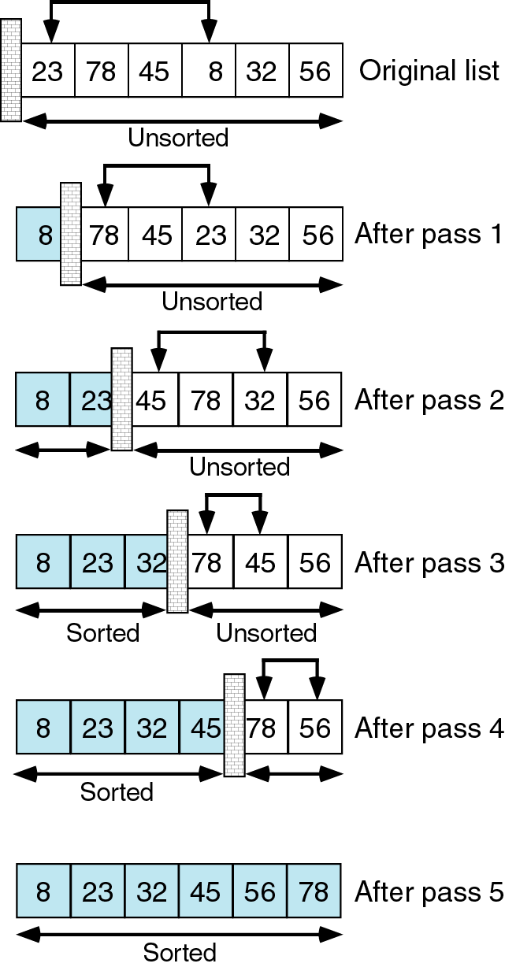
Selection Sort
Selection Sort

Slide 6
Insertion Sort
Idea:
  Divide the array in two imaginary parts: sorted, unsorted
  The sorted part is initially empty
  Pick the first element from the unsorted part and insert it in its correct slot in the sorted part.
    Do the insertion by traversing the sorted part to find where the element should be placed. Shift the other elements over to make room for it.
  Repeat the process.
This algorithm is very efficient for sorting small lists
  Example: sorting homeworks by name

Slide 7
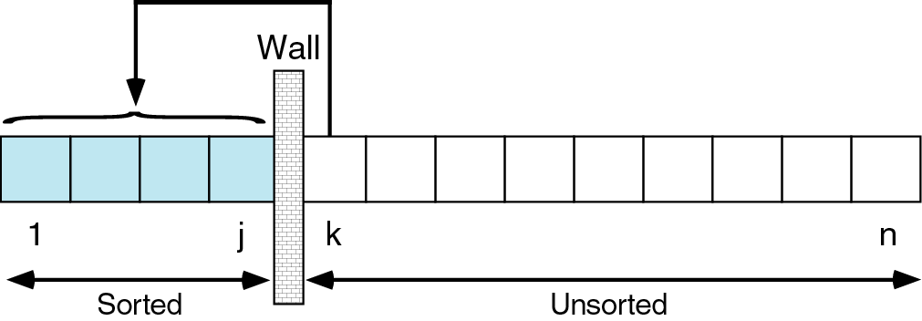
Insertion Sort
As we "move" items to the sorted part of the array, this imaginary wall between the parts moves towards the end of the array. When it reaches the edge, we are done!

Slide 8
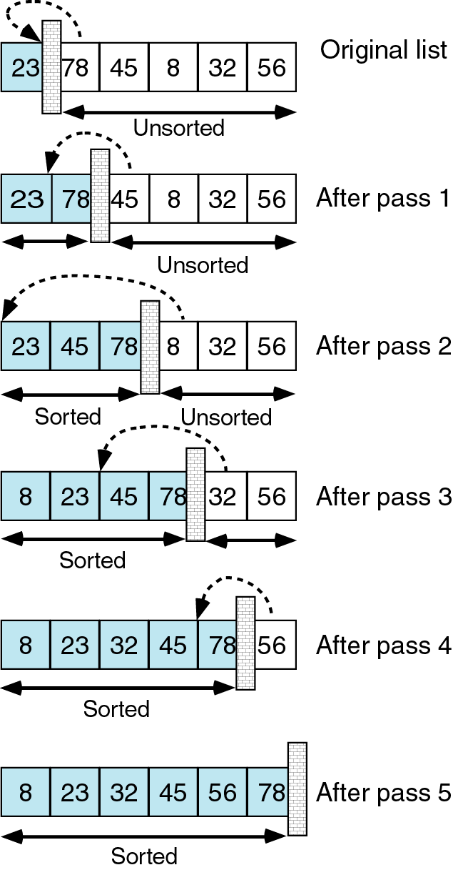
Insertion Sort

