Slide 1
Software Engineering
Basic Methods that Fail
Waterfall, spiral, and rapid prototyping

Slide 2

Basic Engineering Steps
Eliciting functional goals
Requirements analysis
Design
Coding
Unit testing
System testing
Regression analysis
Integration
Integration testing
Maintenance

Slide 3
Waterfall Method
Requirements
Design
Coding
Testing
Integration
Evaluation
Maintenance

Slide 4
Waterfall Results
Requirements
Reqs & Use cases
Design
Architecture
Coding
System
Testing
Verified System
Integration
Integrated System
Evaluation
Feedback
Maintenance
Plan

Slide 5
Waterfall Resources
Business/Users
Requirements
Architect
Design
Programmers
Coding
Testers
Testing
Int. Developers
Integration
Users
Evaluation
IT Staff
Maintenance

Slide 6
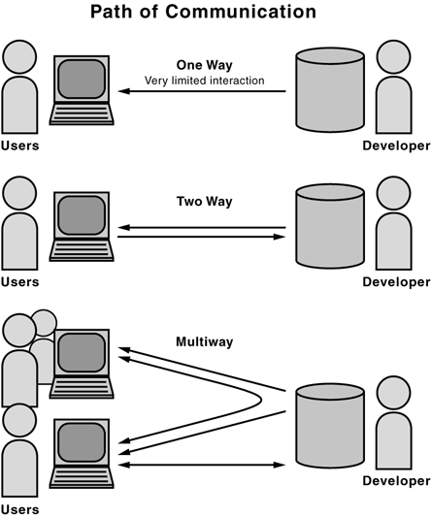
The Problem

Slide 7
Advantages
You always know what you are doing
Forces discipline
Each step is clear and can be signed off on
Project timeline can be managed on a macro level
Looks like good business

Slide 8
Disadvantages
Limited communication
No user feedback
Resistant to change
Project can not be managed on a micro scale
Limited predictability
Has nothing to do with good business

Slide 9
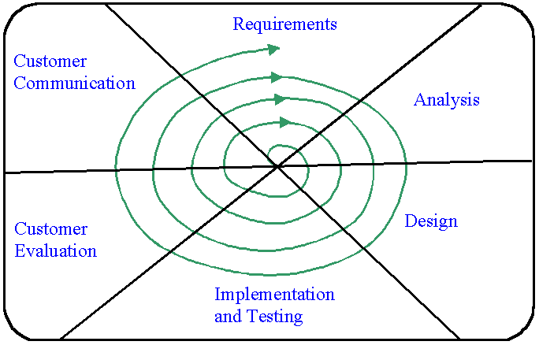
Spiral Method

Slide 10
Spiral Method

Slide 11
Rapid Prototyping

Slide 12
Rapid Prototyping

