Slide 1
Apache Struts Technology
A MVC Framework for Java Web Applications

Slide 2
Agenda
Introduction
  What is Apache Struts?
  Overview of traditional JSP/Servlet web applications
The Model-View-Controller Design Pattern
Struts’ implementation of the MVC Pattern
  ActionServlet
    struts-config.xml
  Action Classes
  ActionForms
    Validating user input
  JSPs and Struts TagLibs
  The Model
Control flow of a typical request to a Struts application
Additional features
Summary

Slide 3
Introduction - What is Apache Struts?
Struts is an open-source framework for building more flexible, maintainable and structured front-ends in Java web applications
There are two key components in a web application:
  the data and business logic performed on this data
  the presentation of data
Struts
  helps structuring these components in a Java web app.
  controls the flow of the web application, strictly separating these components
  unifies the interaction between them
This separation between presentation, business logic and control is achieved by implementing the Model-View-Controller (MVC) Design Pattern

Slide 4
Traditional JSP/Servlet Web-Applications
Traditionally, there are 3 ways to generate dynamic output (typically HTML or XML) in Java web applications:
  Servlets
    Java classes with some special methods (doGet(), doPost(), …)
    Example: out.println("<H1>" + myString + "</H1>");
    no separation between code and presentation!
  JSPs (Java Server Pages)
    HTML (or other) code with embedded Java code (Scriptlets)
    compiled to Servlets when used for the first time
    Example: <H1><% out.println(myString); %></H1>
    better, but still no separation between code and presentation!
  JSPs with JSTL (JSP Standard Tag Library)
    JSTL defines a set of tags that can be used within the JSPs
    There are tags for iterations, using JavaBeans, printing expressions…
    Example: <H1><c:out value="${myBean.myString}"/></H1>
    better readable and thus better maintainability

Slide 5
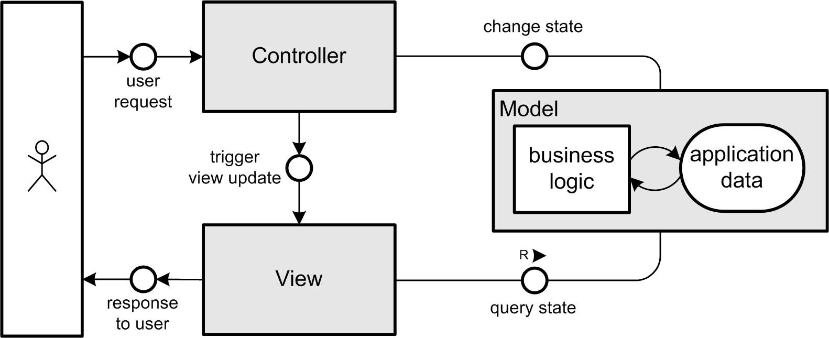
The Model-View-Controller Pattern - Overview
Splits up responsibilities for handling user interactions in an application into three layers:
  Model, View, Controller
Model
  holds application data and business logic
  is absolutely independent from the UIs

Slide 6
The Model-View-Controller Pattern - Details
View
  presentation of parts of the Model to the user
  independent from the internal implementation of the Model
  there can be different Views presenting the same Model data
Controller
  “bridge” between Model and View
  controls the flow of the application
    receives/interprets user input
    performs operations on the Model
    triggers View update
Benefits:
  better maintainability and testability of applications
  ability to easily develop different kinds of UIs (e.g. console, GUI, …)
  separation of different tasks in development
  code reusability

Slide 7
Controller ► ActionServlet
The central component in a Struts application
manages the flow of the application
  receives user requests and delegates them
  to the corresponding Action classes
  selects the appropriate View to be displayed next
  (according to ActionForward returned by an Action class)
represents a Single Point of Entry of the web application
(Front Controller Pattern)
implemented as a simple Java Servlet
  listed in the deployment descriptor of the surrounding Web Container (usually web.xml) for handling *.do requests
can be extended, but in most cases this is not necessary

Slide 8
Controller ► ActionServlet ► struts-config.xml
Struts’ main configuration file
  used by the ActionServlet
defines the control flow, the mapping between
components and other global options:
  action-mappings
  form-beans
  forwards
  plug-ins
  …
can be considered a Struts
internal deployment descriptor
Example:
<struts-config>
<!– [...] -->
<action-mappings>
<action path="/login"
type="app.LoginAction">
<forward name="failure"
path="/login.jsp" />
<forward name="success"
path="/welcome.jsp" />
</action>
</action-mappings>
<!– [...] -->
</struts-config>

Slide 9
Controller ► Actions
perform logic depending on a user’s request
Actions
  are Java classes that extend Struts’ Action
  class org.apache.struts.action.Action
  The Action's execute() method is called by
  the ActionServlet
Tasks usually performed by Actions:
  depending on the type of action:
    perform the action directly (non-complex actions)
    call one or more business logic methods in the Model
  return an appropriate ActionForward object that tells the ActionServlet which View component it should forward to
    Ex.: “failure” or “success” in login application

Slide 10
Controller ► ActionForms
represent the data stored in HTML forms
  hold the state of a form in their properties
  provide getter/setter methods to access them
  may provide a method to validate form data
ActionForms
  are Java classes that extend Struts’ ActionForm
  class org.apache.struts.action.ActionForm
  are filled with the form data by the ActionServlet
one ActionForm can be used for more than one HTML form
  very useful when building wizards or similar types of forms

Slide 11
Controller ► ActionForms ► Validating user input
Validation is done
  right in the beginning before the data is used by any business methods (at this point, validation is limited to the data structure!)
Struts offers two options for server-side validation of user input:
  the validate() method in ActionForms
    can be implemented by the ActionForm developer
    returns either null (no errors) or an ActionErrors object
  a plug-in to use the Jakarta Commons Validator within Struts
    based on rules defined in an XML file
      there can be one or more rules associated with each property in a form
      rules can define required fields, min./max. length, range, type
    error messages and rules can be localized using resource bundles

Slide 12
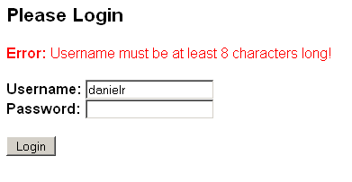
View ► JSPs with Struts tag libraries
The presentation layer in a Struts
application is created using standard JSPs
together with some Struts Tag Libraries
Struts tag libraries
  provide access to Model data
  enable interaction with ActionForms
  provide simple structural logic (such as iteration)
  ...
Example:
<%@ prefix="html" uri="/WEB-INF/struts-html.tld" %>
<body>
<html:errors/>
<html:form action="login.do">
Username: <html:text property="username"/><br/>
Password: <html:password property="passwd" redisplay="false"/><br/>
<html:submit>Login</html:submit>
</html:form>
</body>

Slide 13
The Model
Holds the data of an application and provides
business logic methods
Not directly part of the Struts framework!
The Model is usually built of different kinds
of Business Objects:
  JavaBeans
    simple Java classes, that follow certain naming conventions
    contain attributes and corresponding getters/setters
    reside in the Web Container
  Enterprise JavaBeans (EJBs)
    components containing business logic in a J2EE architecture
    reside in an EJB Container
    kinds of EJBs: Session Beans, Entity Beans, Message Driven Beans
Often a database server is used to make data persistent

Slide 14
Additional Features
Tiles (Struts Plug-In)
  many different page components can be assembled to a “big” page
    very useful when having content that is used on many different pages (e.g. sidebars)
  defined in XML
Internationalization (i18n)
  Struts offers some features to easily internationalize an application
  Text output can be defined in "resource bundles" that can be provided for many different languages
  Struts automatically detects the users language through the HTTP request

Slide 15
Summary
So, why is Struts so useful?
  structural separation of data presentation and business logic
    easy separation of development tasks (web design, database, …)
    increases maintainability and extendibility (new views!)
    increases reusability of code
  Struts provides a Controller that manages the control flow
    changes in the flow can all be done in struts-config.xml
    abstraction from (hard coded) filenames (forwards)
  easy localization (internationalization is more important than ever)
  based on standard Java technologies (JSP, Servlets, JavaBeans)
    thus running on all kinds of JSP/Servlet containers
  open-source
    affordable
    no dependence on external companies
    robustness (due to freely accessible source code)
  very vivid open-source project with growing developer community

Slide 16
Bibliography
Struts online documentation
http://struts.apache.org
Richard Hightower, "Jakarta Struts Live"
James Goodwill, Richard Hightower, "Professional Jakarta Struts"
Ted Husted et. al., "Struts In Action"

