Slide 1


UVM Rapid Adoption: A Practical Subset of UVM
Stuart Sutherland, Sutherland-HDL, Inc.
Tom Fitzpatrick, Mentor Graphics Corp.

Slide 2






The Problem…
The UVM 1.2 Library has 357 classes, 938 functions, 99 tasks, and 374 macros
How do I find what I need in this huge library?
If it’s in the library, you have to use it!
Why are there so many different ways to print a message?
I’m so confused!
Which way should I use?

Slide 3
The Goals of this Paper
Understand why the UVM library is so complex
Examine UVM from three different perspectives
The Environment Writer
The Test Writer
The Sequence Writer
Define a practical subset of UVM that meets the needs of nearly all verification projects
A subset makes UVM easier to learn, use & maintain!
You will be amazed at how small of a subset of UVM you really need!

Slide 4
Why the UVM Library Is Overly Large and Complex
Why 357 classes, 1037 methods, 374 macros?
The history of UVM adds to UVM’s complexity
UVM evolved from OVM, VMM and other methodologies
UVM adds to and modifies previous methodologies
UVM contains “old ways” and “new ways” to do things
Object Oriented Programming adds complexity
OOP extends and inherits functionality from base classes
uvm_driver inherits from uvm_component which inherits from uvm_object which inherits from …
Only a small number of UVM classes, methods and macros are intended to be used by end users
Much of the UVM library is for use within the library

Slide 5
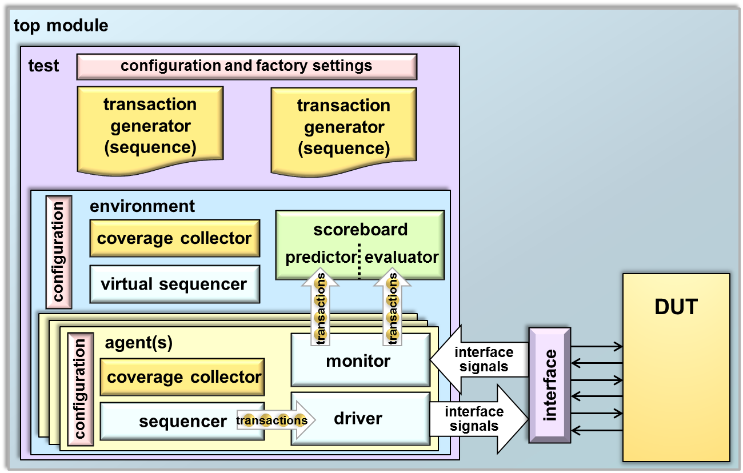
Three Aspects of a UVM Testbench
The Test
Connects the testbench to the DUT
Selects the sequencers
Configures the environment
The Sequencer
Generates transactions (stimulus)
The Environment
Delivers stimulus
Verifies DUT outputs

Slide 6
UVM Constructs Used By The Environment Writer

Slide 7
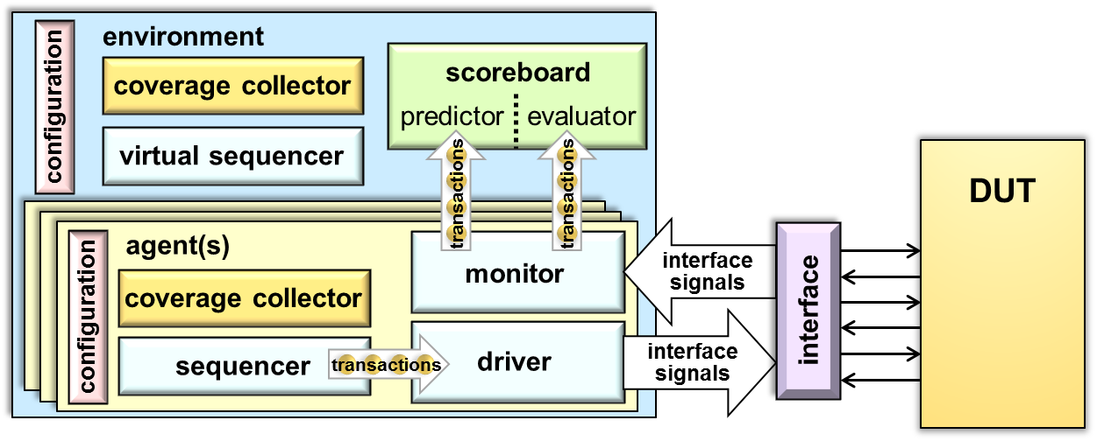
The Role of the UVM Environment Writer
The Environment Writer defines the testbench parts
Agents
Sequencers
Drivers
Monitors
Scoreboards
Coverage collectors
The environment delivers stimulus to the DUT and verifies DUT outputs

Slide 8
The Environment Component
About the examples in this presentation:
UVM-specific constructs are shown in blue text
UVM constructs not shown in previous examples are shown in
boxed text
Extend base class from UVM lib.
class my_env ;
...
extends uvm_env
`uvm_component_utils( my_env )
Factory registration macro
function new(string name,
uvm_component parent);
super.new(name, parent);
endfunction: new
Factory will call new() constructor
(continued on next page)
UVM Constructs | First Time Seen | Running Total
Classes | 2 | 2
Methods | 0 | 0
Macros | 1 | 1
To save time, we are only going to count the number of UVM constructs required – refer to the paper for more details on these constructs

Slide 9
The Environment Component (continued)
UVM Constructs | First Time Seen | Running Total
Classes | 0 | 2
Methods | 4 | 4
Macros | 0 | 1
Environments encapsulate an agent and scoreboard
...
my_agent agent;
my_scoreboard scorebd;
endclass: my_env
The “build phase” uses factory to “create” components
function void build_phase(uvm_phase phase);
agent = my_agent::type_id::create("agent", this);
scorebd = my_scoreboard::type_id::create("scorebd", this);
endfunction: build_phase
function void connect_phase(uvm_phase phase);
agent.dut_inputs_port.connect(scorebd.dut_in_imp_export);
agent.dut_outputs_port.connect(scorebd.dut_out_imp_export);
endfunction: connect_phase
The “connect phase” is used to “connect” component ports

Slide 10
The Agent Component
An agent encapsulates low-level components needed to drive and monitor a specific interface to the DUT
class my_agent ;
`uvm_component_utils(my_agent)
function new(string name, uvm_component parent);
super.new(name, parent);
endfunction: new
// handles for agent’s components
my_sequencer sqr;
my_driver drv;
...
...
extends uvm_agent
Extend agent’s UVM base class
UVM Constructs | First Time Seen | Running Total
Classes | 2 | 4
Methods | 0 | 4
Macros | 0 | 1
Add ports to the monitor (classes defined in the UVM library)
// handles to the monitor's ports
uvm_analysis_port #(my_tx) dut_inputs_port;
uvm_analysis_port #(my_tx) dut_outputs_port;
(continued on next page)

Slide 11
The Agent Component (continued)
The Test Writer “sets” a configuration object handle into UVM’s configuration data base
The agent’s build phase “creates” a sequencer, driver, monitor, etc.
The agent “gets” this handle from the data base
...
function void build_phase(uvm_phase phase);
mon = my_monitor::type_id::create("mon", this);
if (m_config.is_active == UVM_ACTIVE) begin
sqr = my_sequencer::type_id::create("sqr", this);
drv = my_driver::type_id::create("drv", this);
end
if (m_config.enable_coverage)
cov = my_cover_collector::type_id::create("cov", this);
endfunction: build_phase
...
if (!uvm_config_db #(my_cfg)::get(this, "", "t_cfg", m_cfg))
`uvm_warning("NOCFG", Failed to access config_db.\n")
Warning messages can provide debug information
UVM Constructs | First Time Seen | Running Total
Classes | 1 | 5
Methods | 1 | 5
Macros | 1 | 2
(continued on next page)

Slide 12
The Agent Component (continued)
The agent’s connect_phase connects the agent’s components together
No additional UVM constructs needed!
...
function void connect_phase(uvm_phase phase);
// set agent's ports to point to the monitor's ports
dut_inputs_port = mon.dut_inputs_port;
dut_outputs_port = mon.dut_outputs_port;
if (is_active == UVM_ACTIVE)
// connect driver to sequencer
drv.seq_item_port.connect(sqr.seq_item_export);
if (enable_coverage)
// connect monitor to coverage collector
mon.dut_inputs_port.connect(cov.analysis_export);
endfunction: connect_phase
endclass: my_agent
UVM Constructs | First Time Seen | Running Total
Classes | 0 | 5
Methods | 0 | 5
Macros | 0 | 2

Slide 13
The Driver Component
The driver receives transactions from a sequencer and drives values to the DUT via a virtual interface
class my_driver ;
`uvm_component_utils(my_driver)
function new(string name, uvm_component parent);
super.new(name, parent);
endfunction
virtual tb_if tb_vif; // virtual interface pointer
function void build_phase(uvm_phase phase);
if (!uvm_config_db #(virtual my_dut_interface)::get(this,
"", "DUT_IF", tb_vif))
endfunction: build_phase
...
extends uvm_driver #(my_tx)
Extend driver’s UVM base class
UVM Constructs | First Time Seen | Running Total
Classes | 1 | 6
Methods | 0 | 5
Macros | 1 | 3
`uvm_fatal("NOVIF", Failed virtutal interface from db")
A fatal error report terminates simulation

Slide 14
The Driver Component
The driver receives transactions from a sequencer and drives values to the DUT via a virtual interface
The “run phase” is a task that can take clock cycles to execute
...
my_tx tx;
forever begin
@tb_vif.clk // synchronize to interface clock
tb_vif.operand_a = tx.operand_a; // drive values
tb_vif.operand_b = tx.operand_b;
tb_vif.opcode = tx.opcode;
end
endtask: run_phase
endclass: my_driver
task run_phase(uvm_phase phase);
UVM Constructs | First Time Seen | Running Total
Classes | 0 | 6
Methods | 3 | 8
Macros | 0 | 3
seq_item_port.get_next_item(tx); // get a transaction
seq_item_port.item_done();
Port methods “block” execution flow as part of a handshake process with a sequence stimulus generator written by the Sequence Writer

Slide 15
Additional Components
UVM Constructs | First Time Seen | Running Total
Classes | 3 | 9
Methods | 2 | 10
Macros | 2 | 5
A sequencer routes stimulus to the driver
Specializes the uvm_sequencer base class
No additional UVM constructs are needed
A monitor observes DUT ports via a virtual interface
Extends the uvm_monitor base class
Only additional UVM construct needed that has not already been shown is an analysis port write() method
A scoreboard verifies DUT output value correctness
Extends uvm_subscriber or uvm_component
Only additional UVM constructs that might be needed are: report_phase(), `uvm_info() and `uvm_analysis_imp_decl()
A coverage collector performs functional coverage
No additional UVM constructs are needed

Slide 16
UVM Constructs Used By The Test Writer

Slide 17
The Role of the UVM Test Writer
The Test Writer defines the specifics of a testcase
Connects the testbench to the DUT
Selects the sequences
Configures the environment
The test defines the particulars of the given testcase
test
configuration and factory settings
transaction generator
(sequence)
transaction generator
(sequence)
DUT
environment
interface
signals
interface
interface
signals

Slide 18
The Top-Level Module
Top-level module connects DUT and starts test
UVM Constructs | First Time Seen | Running Total
Classes | 0 | 9
Methods | 2 | 12
Macros | 0 | 5
module test_top;
import my_test_pkg::*;
my_dut_interface my_dut_if();
my_dut_rtl my_dut(.if(my_dut_if());
initial begin
end
endmodule
import uvm_pkg::*;
uvm_config_db #(virtual my_dut_interface)::set(null, "uvm_test_top", "DUT_IF", my_dut_if);
run_test();

Slide 19
The Base Test
Test instantiates & configures the environment
UVM Constructs | First Time Seen | Running Total
Classes | 0 | 9
Methods | 0 | 12
Macros | 1 | 6
class my_test extends uvm_test;
`uvm_component_utils(my_test)
my_env m_env;
my_env_config_obj m_env_cfg;
...
function void build_phase(uvm_phase phase);
m_env_cfg = my_env_config_obj::type_id::create("m_env_cfg");
m_env = my_env::type_id::create("my_env", this);
if(!uvm_config_db#(virtual my_dut_interface)::get(this, "" , "DUT_IF", m_env_cfg.dut_if))
// set other aspects of m_env_cfg
uvm_config_db#(my_env_config_obj)::set(this, "my_env", "m_env_cfg", m_env_cfg);
endfunction
`uvm_error("TEST", "Failed to get virtual intf in test")

Slide 20
The Extended Test
The extended test specializes the base test
class my_ext_test extends my_test;
`uvm_component_utils(my_ext_test)
...
function void build_phase(uvm_phase phase);
// optionally override type of my_env_cfg object
// optionally make additional changes to my_env_cfg object
endfunction
my_env::type_id::set_type_override(my_env2::get_type());
my_comp::type_id::set_inst_override(my_comp2::get_type(), "top.env.c2");
super.build_phase(phase);
UVM Constructs | First Time Seen | Running Total
Classes | 0 | 6
Methods | 4 | 16
Macros | 0 | 6

Slide 21
The Extended Test
The test starts sequences and manages objections
UVM Constructs | First Time Seen | Running Total
Classes | 0 | 6
Methods | 3 | 19
Macros | 0 | 6
class my_ext_test extends my_test;
`uvm_component_utils(my_ext_test)
...
task run_phase(uvm_phase phase);
my_seq seq = my_seq::type_id::create(“seq”);
//optionally randomize sequence
assert(seq.randomize() with {src_addr == 32’h0100_0800;
xfer_size == 128;});
endtask
phase.raise_objection("Starting test");
seq.start(m_env.m_agent.m_sequencer);
phase.drop_objection("Ending test");

Slide 22
UVM Constructs Used By The Sequence Writer

Slide 23
The Sequence Writer
Each sequence defines stimulus and/or response functionality
Provide list of sequence types and sequencer types to start them on
Inheritance hierarchy and other details irrelevant to Test Writer

Slide 24
Designing a Sequence Item
class my_tx extends
(my_tx)
rand bit [23:0] operand_a;
rand bit [23:0] operand_b;
randc opcode_t opcode;
logic [23:0] result;
function new(string name = "my_tx");
super.new(name);
endfunction
endclass: my_tx
uvm_sequence_item;
“Input” variables should be rand
`uvm_object_utils
“Output” variables should not be
Standard Object constructor
User calls
copy(), compare(),
etc.
do_copy()
do_compare()
convert2string()
do_record()
do_pack()
do_unpack()
UVM Constructs | First Time Seen | Running Total
Classes | 1 | 7
Methods | 6 | 25
Macros | 1 | 7
Alternately use `uvm_field_xxx macros (73) to auto-generate the do_ methods

Slide 25
The Sequence Body Method
The body method defines the transactions to generate
class tx_sequence extends
`uvm_object_utils(tx_sequence)
...
task
repeat(50) begin
tx = my_seq_item::type_id::create("tx");
...
end
endtask
endclass:tx_sequence
uvm_sequence#(my_item);
body();
start_item(tx);
finish_item(tx);
UVM Constructs | First Time Seen | Running Total
Classes | 1 | 8
Methods | 3 | 28
Macros | 0 | 7

Slide 26
The Virtual Sequence
The virtual sequence starts subsequences
class my_vseq extends uvm_sequence#(uvm_sequence_item);
...
bus_sequencer_t bus_sequencer;
gpio_sequencer_t gpio_sequencer;
virtual function void init(uvm_sequencer bus_seqr,
uvm_sequencer gpio_seqr);
bus_sequencer = bus_seqr;
gpio_sequencer = gpio_seqr;
endfunction
task body();
aseq.start( bus_sequencer , this );
bseq.start( gpio_sequencer , this );
endtask
endclass
UVM Constructs | First Time Seen | Running Total
Classes | 0 | 8
Methods | 0 | 28
Macros | 0 | 7

Slide 27
UVM Constructs Used For Advanced Examples

Slide 28
phase_ready_to_end
Delay the end of a phase when necessary
function void my_comp::
if( !is_ok_to_end() ) begin
phase.raise_objection( this , "not ready to end phase" );
fork begin
wait_for_ok_end();
phase.drop_objection( this , "ok to end phase" );
end
join_none
end
endfunction : phase_ready_to_end
phase_ready_to_end( uvm_phase phase );
UVM Constructs | First Time Seen | Running Total
Classes | 0 | 8
Methods | 1 | 29
Macros | 0 | 7

Slide 29
Pipelined Protocols
Use the Response Handler in the sequence
class my_pipelined_seq extends uvm_sequence #(my_seq_item);
`uvm_object_utils(my_pipelined_seq)
...
task body();
my_seq_item req = my_seq_item::type_id::create("req");
...
start_item(req);
...
finish_item(req);
endtask
function void
...
endfunction
endclass: my_pipelined_seq
use_response_handler(1);
UVM Constructs | First Time Seen | Running Total
Classes | 0 | 8
Methods | 2 | 31
Macros | 0 | 7
response_handler(uvm_sequence_item response);

Slide 30
Pipelined Protocols
Driver uses one thread per pipeline stage
class my_pipelined_driver extends uvm_driver #(my_seq_item);
`uvm_component_utils(my_pipelined_driver)
...
task do_pipelined_transfer;
my_seq_item req;
forever begin
pipeline_lock.get();
...// execute first pipeline stage
pipeline_lock.put();
...// execute second pipeline stage
end
endtask
endclass: my_pipelined_seq
UVM Constructs | First Time Seen | Running Total
Classes | 0 | 8
Methods | 2 | 33
Macros | 0 | 7
seq_item_port.get(req);
seq_item_port.put(req);

Slide 31
UVM Features to Avoid
Phase Jumping
Callbacks
UVM 1.2 features

Slide 32
The Solution…
How do I find what I need in this huge library?
The UVM 1.2 Library has 357 classes, 938 functions, 99 tasks, and 374 macros
Our recommended subset in the paper uses 10 classes, 30 tasks/functions and 6 macros
You really only need to learn 3% of UVM to be productive!
2% of classes
3% of methods

