Slide 1

UVM’s MAM to the Rescue
Michael Baird
Willamette HDL, Inc.

Slide 2
Agenda
The Setup
The Issue
The Rescue
MAM Details
Contrast
  Doing it the hard way
  Doing it the MAM way
Conclusions
Michael Baird, Willamette HDL, Inc.

Slide 3
Memories in the UVM Register Model
Memories are mapped into the UVM register model with a base address and a range
  Locations are accessed using an offset from the base address
    Base address determined by register map
  Register model translates this address to a physical address
  Not mirrored in the register model
Six types of accesses supported:
  read(), write(), peek(), poke(), burst_read(), burst_write()
Michael Baird, Willamette HDL, Inc.

Slide 4
Issues with Multiple Temporary Buffers
Certain designs use local memory for temporary buffers
  LAN controller buffers for incoming/outgoing packets
  DMA controller source & destination buffers
Managing buffers can be a burdensome, error prone task for verification engineer
  Allocation/deallocation of buffers
  Abstracting location details (start/end address etc.) within test code
  Avoiding buffer overlap, or memory overflow
Michael Baird, Willamette HDL, Inc.

Slide 5
UVM’s MAM to the Rescue
Memory Access Manager (MAM)
  Set of utility classes
  Service requests for a contiguous range of memory of a specific size
    Allocates a region of size requested in specified memory
    No user knowledge of exact location of buffers required
    Manages buffer location avoiding overlap
Michael Baird, Willamette HDL, Inc.

Slide 6
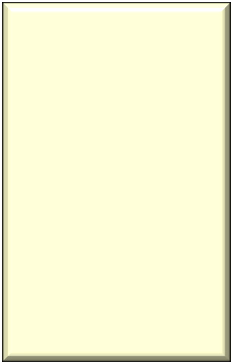
Allocated Region
Allocated region treated as if an independent memory
  Operations on region automatically translated into corresponding operations on actual memory
Memory
end offset
12A6
len = 3
n_bytes = 12
start offset
12A4
7CC1
len = 2
n_bytes = 8
7CC0
0
Michael Baird, Willamette HDL, Inc.

Slide 7
MAM Utility Class – uvm_mem_mam
uvm_mem_mam
  Provides methods for requesting and releasing memory regions
Memories in the register model are modeled using the uvm_mem base class
  Every uvm_mem object has a property mam of type uvm_mem_mam
    Allows for use of MAM on any memory in the register model
Michael Baird, Willamette HDL, Inc.

Slide 8
uvm_mem_mam API
request_region()
  Creates a region at a random location of specified size
reserve_region()
  Creates a region at a specified location and size
release_region()
  Releases previously allocated memory region
release_all_regions()
  Forcibly releases all memory regions
get_memory()
  Get the memory where the region resides
Michael Baird, Willamette HDL, Inc.

Slide 9
Example uvm_mem_mam usage
// create handle to memory in register model
uvm_mem mem0 = system_block.mem0;
// request buffers, size in BYTES
uvm_mem_region src_buf = mem0.mam.request_region(num_words*4);
uvm_mem_region dst_buf = mem0.mam.request_region(num_words*4);
...
mem0.mam.release_region(src_buf); // release src_buf region
mem0.mam.release_all_regions(); // release all regions
...
// reserve buffers
uvm_mem_region src_buf = mem0.mam.reserve_region(32’h1000,
num_words*4);
uvm_mem_region dst_buf = mem0.mam.reserve_region(32’h3000,
num_words*4);
...
mem0.mam.release_all_regions(); // release all regions
Michael Baird, Willamette HDL, Inc.

Slide 10
MAM Descriptor Class: uvm_mem_region
For each allocated memory region there is a uvm_mem_region descriptor object created
  The request_region() and reserve_region() methods of the uvm_mem_mem class return the descriptor object
Access methods. Same as memory access methods
  write(), burst_write(), read(), burst_read()
  peek(), poke()
Michael Baird, Willamette HDL, Inc.

Slide 11
uvm_mem_region API – Access Methods
Call the API methods on the uvm_mem_region descriptor object
uvm_mem_region src_buf = mem0.mam.request_region( num_words*4);
...
src_buf.write(status, 1, 32’h1234);
src_buf.read(status, 1);
Michael Baird, Willamette HDL, Inc.

Slide 12
uvm_mem_region API – Introspection Methods
get_start_offset()
  Get the start offset address relative to the memory
get_end_offset()
  Get the end offset address relative to the memory.
get_len()
  Get the size of the region in consecutive locations (not necessarily bytes)
get_n_bytes()
  Get the size of the region in bytes
get_memory()
  Returns the handle to the uvm_mem object where the region resides
Michael Baird, Willamette HDL, Inc.

Slide 13
Example Circuit For Illustrating MAM usage
32 channel DMA controller
  WISHBONE DMA/Bridge IP core from opencores.org
  WISHBONE bus interface
    Master for DMA transfers
    Slave for access to its registers
Two instances of the WISHBONE Slave Memory from opencores.org
  Configured as 1 Mbyte slave memories
Michael Baird, Willamette HDL, Inc.

Slide 14





DMA DUT
DMA chip initialization:
  Initialize general registers
DMA transfer:
  Initialize channel registers
    Source buffer address
    Destination buffer address
    Size of transfer
  Initiate transfer by writing the CSR register
top
wishbone
DMA
WISHBONE
bus
Chan_n
...
Chan_1
Chan_0
WB
IF
mem 1
mem 0
Michael Baird, Willamette HDL, Inc.

Slide 15
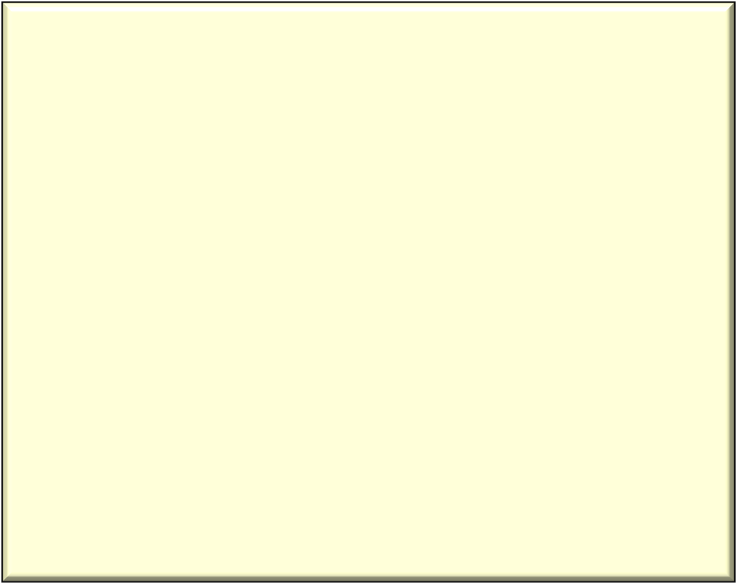
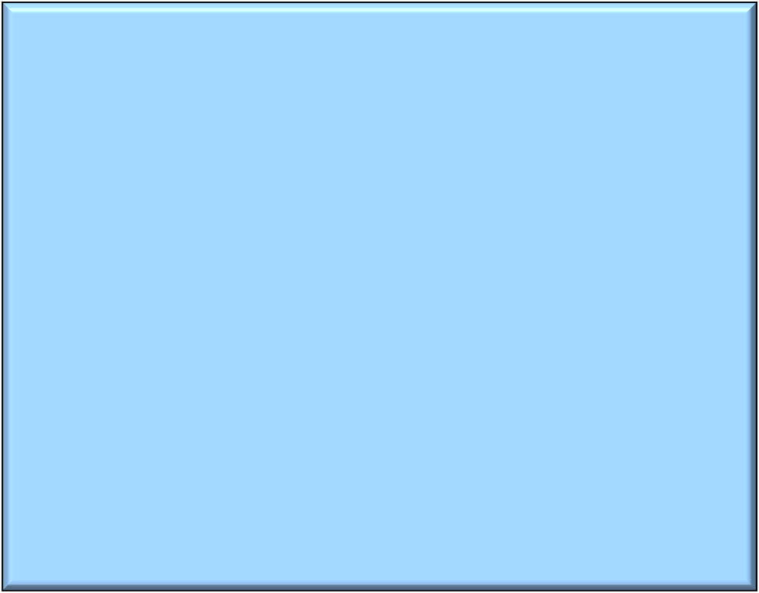
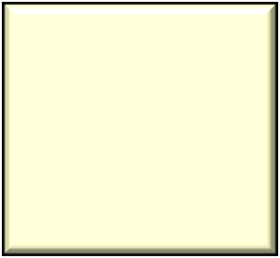






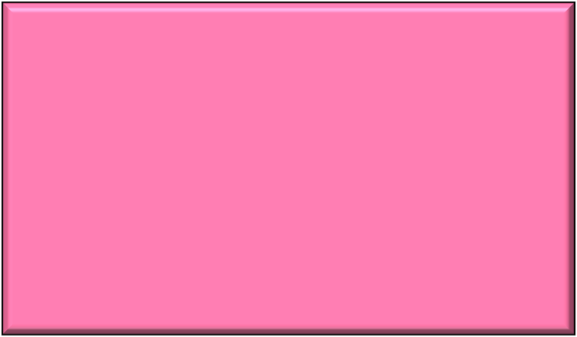
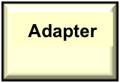
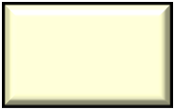


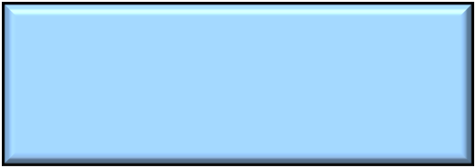





Testbench
test
Register Model
test_dma
Register
Database
Map
mem
top
reg
wishbone
DMA
env
WISHBONE
bus
Chan_n
predictor
SB
...
Chan_1
Chan_0
Virtual
Sequence
WB Agent
monitor
WB
IF
mem 1
wb_read_seq
sequencer
driver
mem 0
wb_write_seq
Michael Baird, Willamette HDL, Inc.

Slide 16
Non-MAM Based Tests
“by-hand” Approach Steps
DMA transfers executed by the dma_transfer() task in a virtual sequence
  Four inputs to the task:
    DMA channel number
    Source buffer's start address (absolute address)
    Destination buffer's start address (absolute address)
    Size of the DMA transfer (in 32-bit words)
Michael Baird, Willamette HDL, Inc.

Slide 17
dma_transfer()
virtual task dma_transfer(
int chan_num, // channel number
int srce_addr, // source buffer addr
int dest_addr, // dest buffer addr
int tot_sz, //size of transfer, 32-bit words
bit[2:0] ch_priority = 0, // channel priority
int chk_sz = 0 );
uvm_status_e txn_status;
init_srce_data(tot_sz); // initialize data for source buffer
// initialize the source buffer (does not use register model)
wb_blk_write(srce_addr, srce_data, tot_sz,txn_status);
// Set up the registers in DMA channel and start DMA
dma_setup(chan_num, srce_addr, dest_addr, tot_sz);
wait_for_dma_complete(chan_num); // wait for interrupt
// verify the data in the destination buffer
check_data(dest_addr, tot_sz);
endtask
Michael Baird, Willamette HDL, Inc.

Slide 18
Tedious!
Only takes a few transfers with manual setup for each transfer to become quite tedious!
  Care must be taken to ensure no buffer overlap
  Simply changing buffer size results in checking to ensure:
    No buffer overlap
    No spilling beyond the memory space
  Introducing concurrent transfers further acerbates the problem
Michael Baird, Willamette HDL, Inc.

Slide 19
MAM Based Tests Steps
DMA transfers executed by the dma_transfer() task in virtual sequence
  Inputs reduced from four to just two
    DMA channel number
    Size of the DMA transfer (in 32-bit words)
Michael Baird, Willamette HDL, Inc.

Slide 20
dma_transfer()
virtual task dma_transfer(
int chan_num, // channel number
int tot_sz, // size of transfer, 32-bit words
bit[2:0] ch_priority = 0, // channel priority
int chk_sz = 0
);
uvm_status_e txn_status;
uvm_mem_region src_buf, dest_buf; //buffer descriptor handles
// Ask the MAM for a block of memory inside mem0
src_buf = mem0.mam.request_region(tot_sz*4);
if(src_buf == null) // check for buffer not allocated
`uvm_error("DMA", "DMA buffer allocation error”)
// Ask the MAM for a block of memory inside mem1
dest_buf = mem1.mam.request_region(tot_sz*4);
if(dest_buf == null) // check for buffer not allocated
`uvm_error("DMA", "DMA buffer allocation error")
Michael Baird, Willamette HDL, Inc.

Slide 21
dma_transfer() (cont.)
init_srce_data(tot_sz); // initialize data for source buffer
// Seed the source buffer
src_buf.burst_write(txn_status, 0, srce_data);
// Perform the DMA transfer
dma_setup(chan_num,
// use introspection method get_start_offset()
// to get offset address of the buffer (start address)
mem0.get_address(src_buf.get_start_offset()),
mem1.get_address(dest_buf.get_start_offset()),
tot_sz);
wait_for_dma_complete(chan_num);
// Verify that the destination buffer data matches the source
check_data(dest_buf, tot_sz);
// release buffers
mem0.mam.release_region(src_buf);
mem1.mam.release_region(dest_buf);
endtask
Michael Baird, Willamette HDL, Inc.

Slide 22
Simulator Output
Output message from request_region()
UVM_INFO @ 830: reporter [RegModel] Attempting to reserve ['h0000000000017a8a:'h0000000000017a91]...
UVM_INFO @ 830: reporter [RegModel] Attempting to reserve ['h000000000001b554:'h000000000001b55b]...
Note the random address location of allocated buffers
Michael Baird, Willamette HDL, Inc.

Slide 23
Calling dma_transfer()
A simple set of calls to dma_transfer() illustrates ease of use with MAM
task body;
// do dma transfers
dma_transfer(0, // channel number
8 ); // transfer size in 32-bit words
// do transfers in parallel
fork
dma_transfer(1, 1600);
dma_transfer(2, 1000);
. . .
join
dma_transfer(3, 800);
endtask
No need to supply buffer addresses
Concurrent transfers? No problem - unless you run out of memory
Michael Baird, Willamette HDL, Inc.

Slide 24
Bonus Coverage
What if it is desirable to allocate buffers across multiple different memories?
  Don’t want to specify a specific memory
    Issue: You have to request or reserve a region using the mam property of that memory
One solution is to declare an “overlay” memory
  Spans full address occupied by different physical memories
  Use the mam of the overlay memory to randomly allocate a buffer using request_region()
Michael Baird, Willamette HDL, Inc.

Slide 25
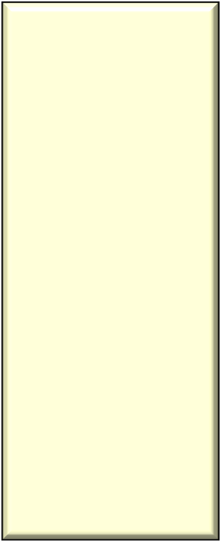


“Overlay” Memory with Contiguous Address Space
FFFFFFFF
WISHBONE bus
Address Space
WISHBONE
DMA (slave)
002FFFFF
00200000
001FFFFF
001FFFFF
mem 1
overlay
memory
00100000
000FFFFF
mem 0
0
0
Michael Baird, Willamette HDL, Inc.

Slide 26


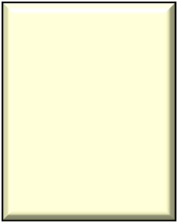
“Overlay” Memory with Non-contiguous Address Space
For each “hole” in the memory address space reserve a region in the overlay memory using reserve_region()
FFFFFFFF
WISHBONE bus
Address Space
004FFFFF
004FFFFF
mem 1
00400000
003FFFFF
reserved
region
WISHBONE
DMA (slave)
002FFFFF
00200000
00100000
overlay
memory
000FFFFF
mem 0
0
0
Michael Baird, Willamette HDL, Inc.

Slide 27
MAM Benefits
Avoidance of by-hand buffer management
Portability of stimulus code
  Only need the handle to the register model memory where buffer is to be allocated
Randomization
  Randomization for the size and number of buffers
    By-hand: Problematic
    MAM: Easily supported
Michael Baird, Willamette HDL, Inc.

Slide 28
Conclusions
UVM’s MAM to the rescue when testing designs that use local buffers!
Using the MAM resulted in tests that were:
  Easier to maintain
  Easier to change
  More portable
  Less error prone
  Much less time consuming to generate
  More easily and quickly scaled
Michael Baird, Willamette HDL, Inc.

