Slide 1

CFD Lab: Geometry Optimization
M.Sc. Praktikum: Scientific Computing: CFD
Tomaso Bianucci, Olga Glogowska, Keefe Huang
Technische Universität München
Munich, 23.April.2018

Slide 2
Background
- Automized geometry optimization has been the end goal of many CFD-based solvers
- Especially relevant due to additive technologies [2]

Slide 3
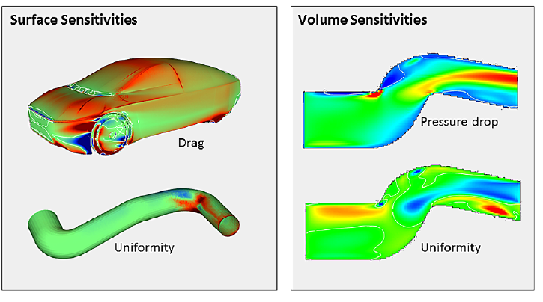
Background
Fig 1: Geometry Optimization via Drag / Pressure Sensitivities [1]
Fig 1: Geometry Optimization via Drag / Pressure Sensitivities [1]

Slide 4
Goal & Scope
Optimize Geometry by:
- Detecting regions that result in lower flow
- Updating the CFD solver to update pgms and improve (hopefully optimize) the geometry

Slide 5
Workflow
Optimize Geometry by:
Detecting regions that result in lower flow:
  Dead zones
  Regions of high „drag“
  Regions with formed vortices
Updating the CFD solver to update pgms and optimize (improve) the geometry and avoid forbidden geometry!

Slide 6
Detection: Vortices (Filling)
Idea from [3]:
  Identify center of vertex and iteratively identify associated regions

Slide 7
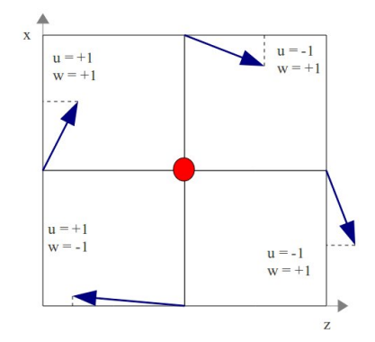
Detection: Vortices (Filling)
Fig 2: Vortex Center Identification using point velocities [3]

Slide 8
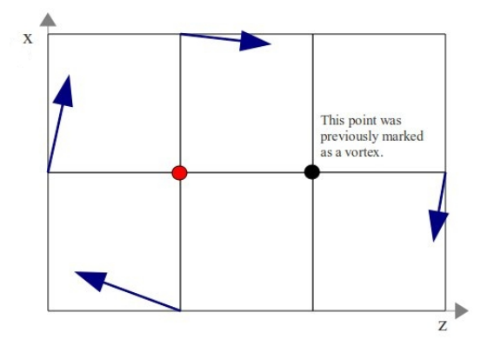
Detection: Vortices (Filling)
Fig 3: Vortex growth algorithm [3]

Slide 9
Detection: Dead zones (Filling)
Simple-is-Best Approach:
  Identify regions where velocity magnitude is small
  Problem: What is small?

Slide 10
Detection: Dead zones (Filling)
Simple-is-Best Approach:
  Initially fixed threshold velocity was used but this was too unstable
  After trial-and-error, percentage of max velocity (p) was found to be effective for model problems
  0.01 < p < 0.05

Slide 11
Detection: Areas of high „drag“ (Removal)
Simple-is-Best Approach:
  Determine pressure and velocity magnitude differences across corners, if differences were too big, fill in region
  Acts as a „smoothener“ to surfaces to reduce drag

Slide 12
Problem: Overly Aggresive Vortex Removal
Any region with instability would be flagged as a vortex and removed
Vortex detection of small (minor) vortexes to be ignored

Slide 13
Problem: Disappearing Geometry!
The best geometry is no geometry at all:
  Once problem reached steady state geometries tend to head towards outflow and disappear
  Create masks (ie geometry that could not be removed)

Slide 14
Problem: Aggressive Geometry Addition
The best geometry is no geometry at all:
  Once problem reached steady state geometries tend to head towards outflow and disappear
  Create masks (ie geometry that could not be removed)

Slide 15
Implementation: Psuedo-Code
initializeMatrices( … );
for( pgmConvergenceCriteria )
  performSimulation( … );
  updatePgm( …, imax, jmax, U, V, P, Flags );
  decodeAndWrite_pgm( … , PGM, Flags );
freeMatrices(… );
cleanup( … );
Qunsheng, Huang (TUM) | MsC. Computational Science and Engineering

Slide 16
Implementation: Update PGM Psuedo-Code
void updatePGM( … ){
  fillVortices( …, Flag );
  for(x,y : 1→ imax, jmax)
      if(isObstacle(Flag[x][y])):
        checkPressure( … );
        checkVelocity( … );
      else:
        checkDeadZone( … );
Qunsheng, Huang (TUM) | MsC. Computational Science and Engineering

Slide 17
Case 1: Flow Over Step

Slide 18
Case 2: Simple Bend

Slide 19
Case 3: Immersed Obstacle

Slide 20
Case 4:

Slide 21
References
[1]C. Othmer, “Adjoint methods for car aerodynamics,” Journal of Mathematics in Industry, vol. 4, no. 1, p. 6, Jun. 2014.
[2]C. Othmer and T. Grahs, CFD topology and shape optimization with adjoint methods. 2006.
[3]V. Holmén, “Methods for Vortex Identification,” Master’s Theses in Mathematical Sciences, 2012.

