Slide 1

CFD Lab: Geometry Optimization
M.Sc. Praktikum: Scientific Computing: CFD
Tomaso Bianucci, Olga Glogowska, Keefe Huang
Technische Universität München
Munich, 23.April.2018

Slide 2
Background
- Automized geometry optimization has been the end goal of many CFD-based solvers
- Especially relevant due to additive technologies [2]
[2]C. Othmer and T. Grahs, CFD topology and shape optimization with adjoint methods. 2006

Slide 3
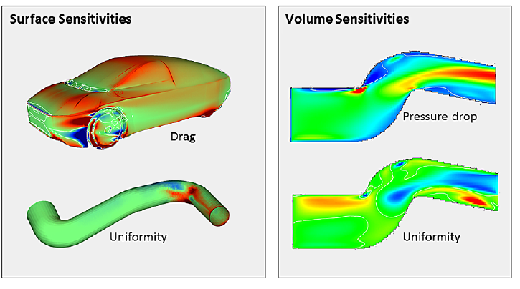
Background
Fig 1: Geometry Optimization via Drag / Pressure Sensitivities [1]
[1]C. Othmer, “Adjoint methods for car aerodynamics,” Journal of Mathematics in Industry, vol. 4, no. 1, p. 6
,Jun. 2014.

Slide 4
Goal & Scope
Optimize Geometry by:
  Detecting regions that result in lower flow:
    Regions with formed vortices
    Dead zones
    Regions of high „drag“
  Updating the CFD solver to update .PGMs and optimize (improve) the geometry and avoid forbidden geometry!

Slide 5
Detection: Vortices (Filling)
Idea from [3]:
  Identify center of vertex and iteratively identify associated regions
[3]V. Holmén, “Methods for Vortex Identification,” Master’s Theses in Mathematical Sciences, 2012.

Slide 6
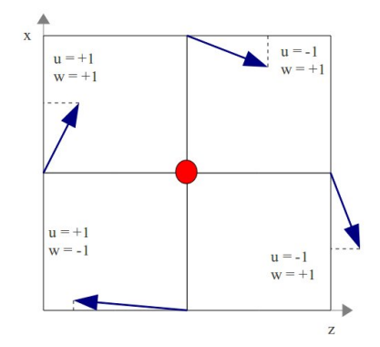
Detection: Vortices (Filling)
Fig 2: Vortex Center Identification using point velocities [3]

Slide 7
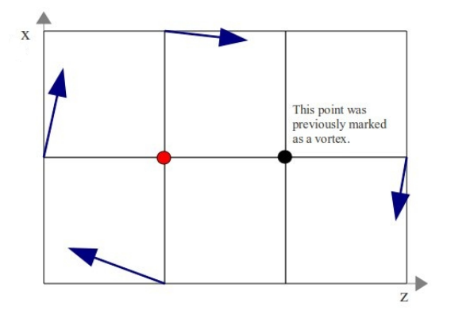
Detection: Vortices (Filling)
Fig 3: Vortex growth algorithm [3]

Slide 8

Problem: Aggresive Vortex Fill-in
Any region with instability would be flagged as a vortex and filled-in

Slide 9
Problem: Aggresive Vortex Fill-In
Any region with instability would be flagged as a vortex and filled-in
Solution:
  Only fill-in vortices of certain size and with certain velocities
  Only apply vortex detection every k iterations

Slide 10
Detection: Dead zones (Filling)
Initially fixed threshold velocity was used as a threshold to fill-in
But this was too unstable!

Slide 11
Problem: Over-aggresive fill-in
Problem: What is small?
  After trial-and-error, using percentage of max velocity was found to be effective
  Add material at boundaries and prevent material from being repeatedly cheanged
  Implement additional „budget“ to limit changes to pgm per update iteration

Slide 12
Detection: Areas of high „drag“ (Removal)
Determine pressure and velocity magnitude differences across corners, if differences were too big, fill in region
Determine if upstream/downstream of flow

Slide 13
Implementation: Psuedo-Code
initializeMatrices( … );
for( PGMConvergenceCriteria )
  performSimulation( … );
  fillVortices( …, Flag );
  updatePGM( …, imax, jmax, U, V, P, Flags );
  detectAndFixGeometry( … , imax, jmax, Flags);
  decodeAndWrite_pgm( … , PGM, Flags );
freeMatrices(… );
cleanup( … );
Qunsheng, Huang (TUM) | MsC. Computational Science and Engineering

Slide 14
Implementation: Update PGM Psuedo-Code
void updatePGM( … ):
  for(x,y : 1→ imax, jmax)
      if(isObstacle(Flag[x][y])):
        isFlip = checkPressure( … );
        isFlip += checkVelocity( … );
        if(isFlip):
          fliptoFluid(Flag[x][y], … );
      else:
        isFlip = checkDeadZone( … );
        if(isFlip):
          fliptoSolid(Flag[x][y], … );
Qunsheng, Huang (TUM) | MsC. Computational Science and Engineering

Slide 15
Case 1: Flow Over Step
Used a modified flow over step PGM file to see the shifting of the step due to reduce drag
Used as model case to see vortex fill-in

Slide 16
Case 2: Simple Bend
Used to investigate cases when direction of flow changes during updates
Performed suprisingly well

Slide 17
Case 3: Immersed Obstacle
Single cube immersed in middle of simulation
Masking performed at the middle of the obstacle to prevent it from „floating“ away
Initial Steady-State Outflow: 10.06
Final Steady-State Outflow: 25.26

Slide 18
Case 4: Erosion
The simulation is easily tuned to see the effects of erosion of on suspended bodies in water

Slide 19
Summary
Successful implementation of output „maximisation“ - not necessarily optimization
However, input cases are highly sensative to input factors (ie. Pressure/Velocity threshholds for removal and addition, vortex strength detection etc.)

Slide 20
References
[1]C. Othmer, “Adjoint methods for car aerodynamics,” Journal of Mathematics in Industry, vol. 4, no. 1, p. 6, Jun. 2014.
[2]C. Othmer and T. Grahs, CFD topology and shape optimization with adjoint methods. 2006.
[3]V. Holmén, “Methods for Vortex Identification,” Master’s Theses in Mathematical Sciences, 2012.

