Slide 1
Hybrid III-V/Si Modulator
Qiangsheng Huang
August/26/2015

Slide 2
Schematic description of absorption in quantum wells
E<0
E=0
E>0
|ϕ_{e1}|²
|ϕ_{e1}|²
|ϕ_{e1}|²
E_{F}
E_{e1}
E_{e1}
E_{e1}
E_{F}
E_{F}
E_{hh1}
E_{hh1}
E_{hh1}
|ϕ_{hh1}|²
|ϕ_{hh1}|²
|ϕ_{hh1}|²
Quantum Confined Stark Effects (QCSE)
Band Filling Effects (BFE)
The exciton absorption peak red shifts, in the reverse bias.
The exciton absorption peak blue shifts, in the forward bias.

Slide 3
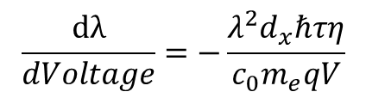
Absorption Spectra
Experimental Results
Simulation Results
QCSE
BFE
QCSE
BFE
$$Voltage →carrier density →Fermi energy→Absorption peak$$
$$\frac{dλ}{dVoltage}=−\frac{λ^{2}d_{x}ℏτη}{c_{0}m_{e}qV}$$
50nm/V
The absorption peak red shifts quadratically as a function of voltage
The absorption peak blue shifts linearly as a function of voltage

Slide 4
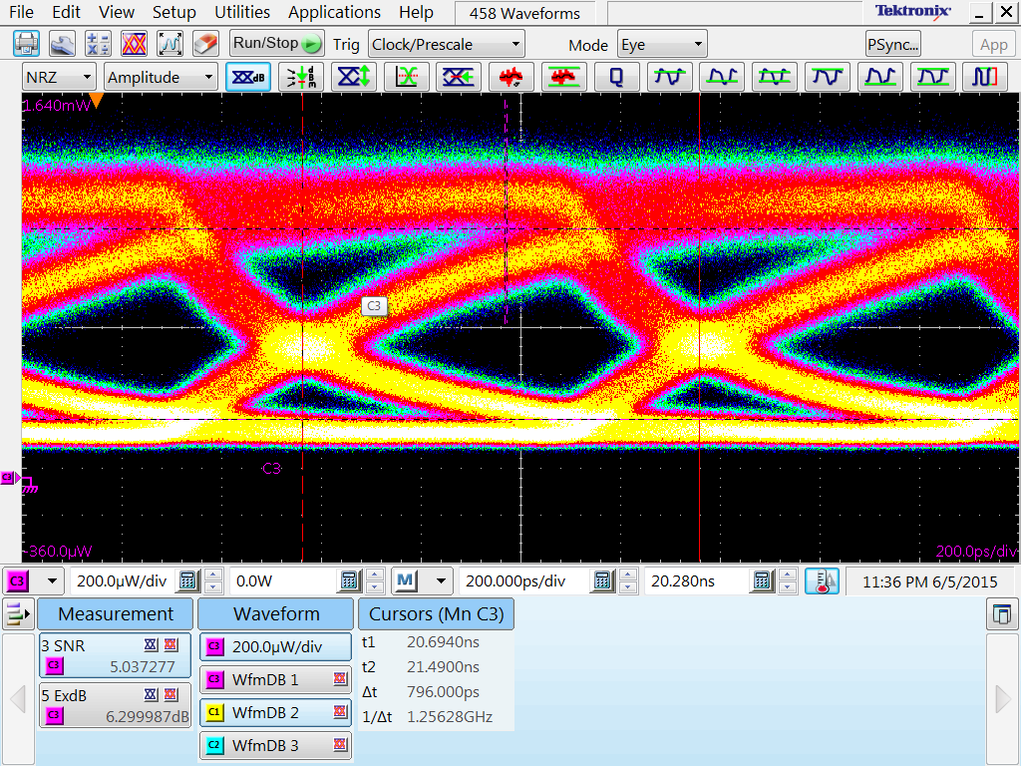
DC Property and RF Property
@1550nm
Exciton transitions absorption
Continuum transtions absorption
Bias: 0.6V; Vpp: 50mV;

Slide 5



Speed limitation
Carrier lifetime
$$Voltage( current ) →carrier density$$
$$\frac{dN}{dt}=\frac{ηI}{qV}−\frac{N}{τ}$$
$$N(t)=\frac{Iτ}{qV}(1−{(1−\frac{N_{0}qV}{Iτ})e}^{−\frac{t}{τ}})$$
$$N\left(t\right)=N_{0}+\frac{Iτ}{qV}(1−\frac{N_{0}qV}{Iτ})e^{−\frac{t}{τ}}$$
Carrier lifetime τ ≈ 1ns
Improve the Speed
The speed is limited by the carrier lifetime.
We can use n-doped MQW to move the work position to the reverse bias.
In this way, can we reduce the carrier lifetime?

