Slide 1
Hybrid III-V/Si Modulator
Qiangsheng Huang
August/30/2015

Slide 2
Schematic description of absorption in quantum wells
E<0
E=0
E>0
|ϕ_{e1}|²
|ϕ_{e1}|²
|ϕ_{e1}|²
E_{F}
E_{e1}
E_{e1}
E_{e1}
E_{F}
E_{F}
E_{hh1}
E_{hh1}
E_{hh1}
|ϕ_{hh1}|²
|ϕ_{hh1}|²
|ϕ_{hh1}|²
Quantum Confined Stark Effects (QCSE)
Band Filling Effects (BFE)
The exciton absorption peak red shifts, in the reverse bias.
The exciton absorption peak blue shifts, in the forward bias.
Gabriela Livescu, et. al., “Free carrier and many-body effects in absorption spectra of modulation-doped quantum wells”, IEEE Journal of Quantum Electronics, vol. 24, No. 8, 1988

Slide 3
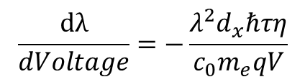
Absorption Spectra
Experimental Results
QCSE
BFE
$$Voltage →carrier density →Fermi energy→Absorption peak$$
$$\frac{dλ}{dVoltage}=−\frac{λ^{2}d_{x}ℏτη}{c_{0}m_{e}qV}$$
50nm/V
The absorption peak red shifts quadratically as a function of voltage
The absorption peak blue shifts linearly as a function of voltage

Slide 4
Absorption Spectra
Experimental Results
Simulation Results
QCSE
BFE
QCSE
BFE
The absorption peak red shifts quadratically as a function of voltage
The absorption peak blue shifts linearly as a function of voltage

Slide 5
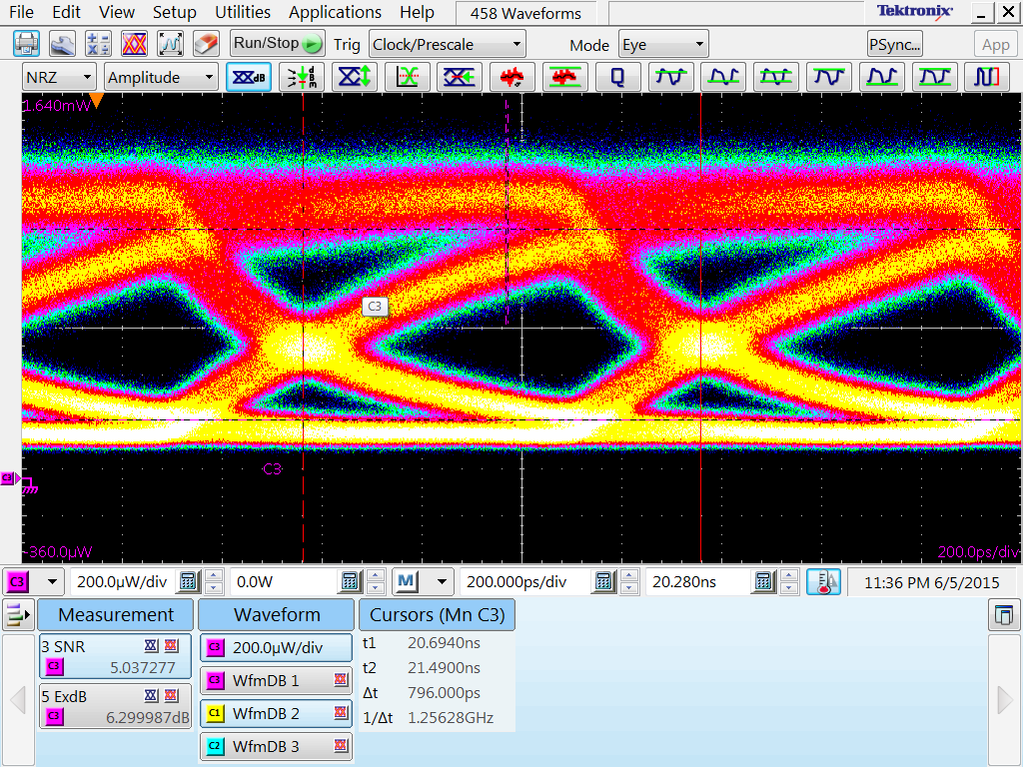
DC Property and RF Property
@1550nm
Exciton transitions absorption
Continuum transtions absorption
Bias: 0.6V; Vpp: 50mV;

Slide 6



The Speed is limited by the carrier lifetime
$$Voltage( current ) →carrier density$$
Carrier lifetime
$$\frac{dN}{dt}=\frac{ηI}{qV}−\frac{N}{τ}$$
$$N(t)=\frac{Iτ}{qV}(1−{(1−\frac{N_{init}qV}{Iτ})e}^{−\frac{t}{τ}})$$
Carrier lifetime τ ≈ 1ns
Bandwidth~1GHz
$$N\left(t\right)=N_{0}+\frac{Iτ}{qV}(1−\frac{N_{init}qV}{Iτ})e^{−\frac{t}{τ}}$$
How to Improve the Speed ?
We can use n-doped MQW to move the work position to the reverse bias.
In this way, can we reduce the carrier lifetime?

