Slide 1
(a)
F=0
(b)
F<0
E_{e1}
E_{e1}
E_{hv}
E_{g}
E_{F}
E_{hv}
E_{g}
E_{F}
E_{hh1}
E_{hh1}
量子阱的能带和波函数的示意图（a）没有外界加电场下；（b）在外界电场的时候

Slide 2
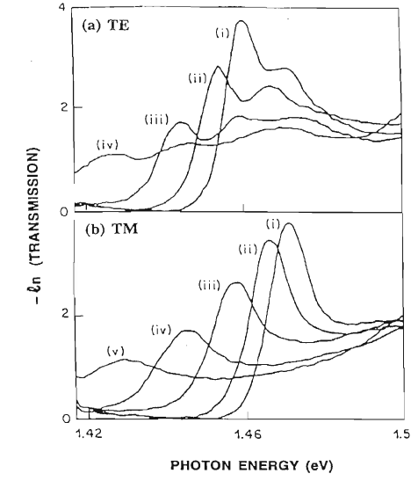
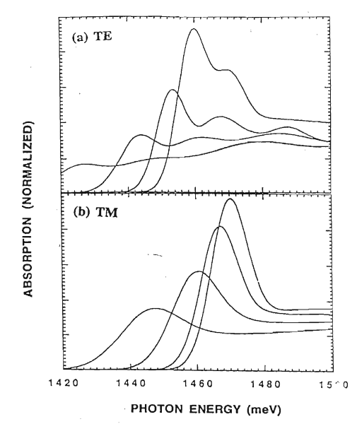
实验测量结果
理论计算结果
(a) TE
(c) TE
(b) TM
(d) TE

Slide 3
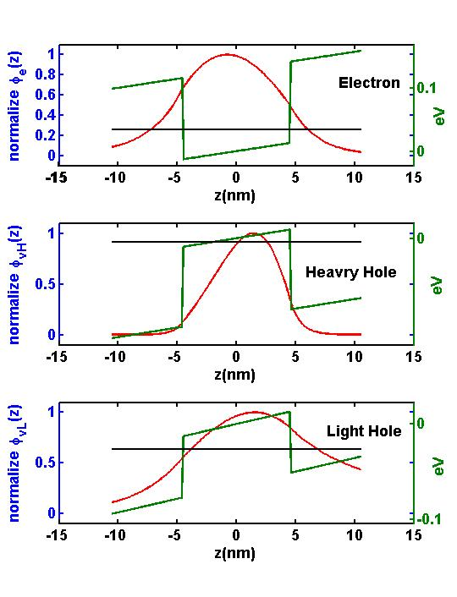
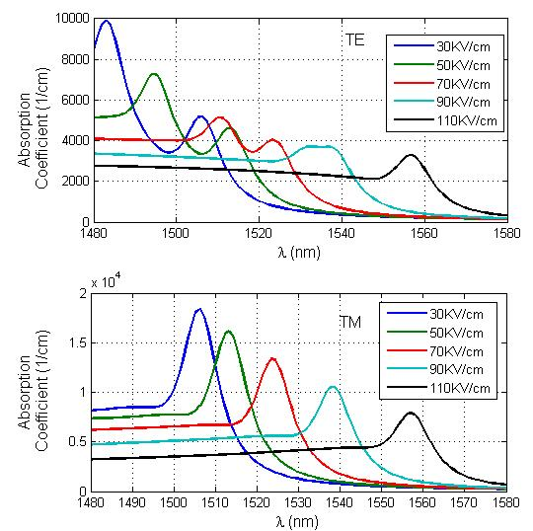
(a)
(1) 导带和价带能带边沿
电子，空穴的等效质量
量子阱的厚度
(b)
(c)
步骤(1), (2)后的计算结果
步骤(3), (4)后的计算结果
(2) 电子，重空穴和轻空穴的
能级和波函数
(3) 激子束缚能量和激子波函数
(4)带间跃迁的吸收谱

Slide 4

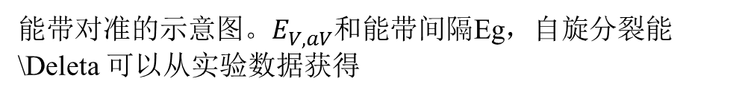



(a) Compressive strain
(b) Zero strain
E_{c}(z)
E_{c}(z)
ΔE_{c}
ΔE_{c}
$${E_{c}=E}_{v}^{0}+E_{g}\left(x\right)+P_{c}$$
P_{c}
E_{g}(x)
E_{g}(x)
$$E_{v}^{0}$$
-P_{ε}
${E_{vH}=E}_{v}^{0}−\text{P}\text{ε}−$Q_{ε}
-Q_{ε}
ΔE_{v}
ΔE_{v}
$E_{vL}=E_{v}^{0}−$P_{ε}+Q_{ε}
Q_{ε}
E_{v}(z)
E_{v}(z)
能带对准的示意图。$E_{V,aV}^{}$和能带间隔Eg，自旋分裂能\Deleta 可以从实验数据获得

Slide 5
A_{l}
A_{l+1}
B_{l}
B_{l+1}
V₀
V_{l+1}
V_{l}
V₁
V_{N+1}
h_{l}
V2
Z₀
Z₁
Z₂
Z_{l-1}
Z_{l}
Z_{l+1}
Z_{N+1}

Slide 6
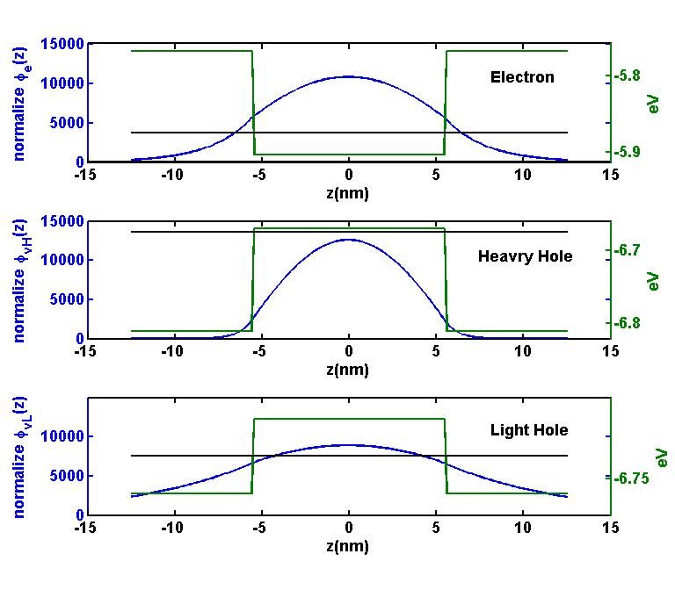
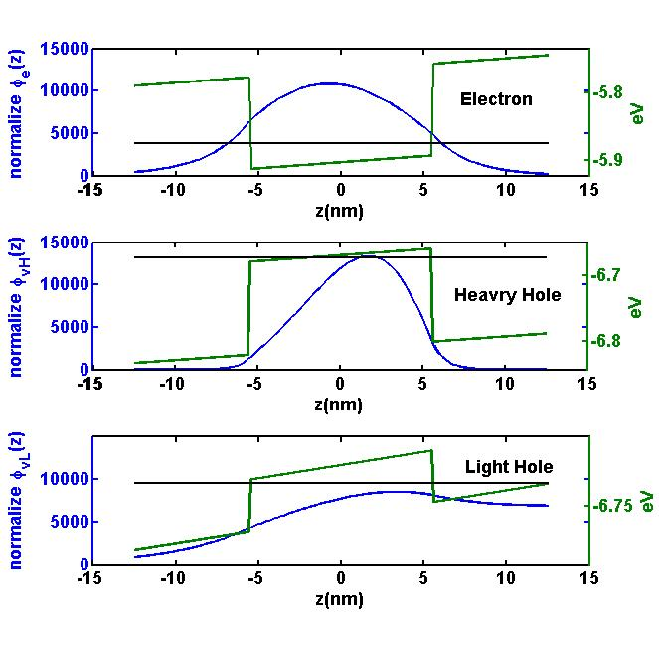
(a) Zeros Bias
(b) 18KV/cm

Slide 7
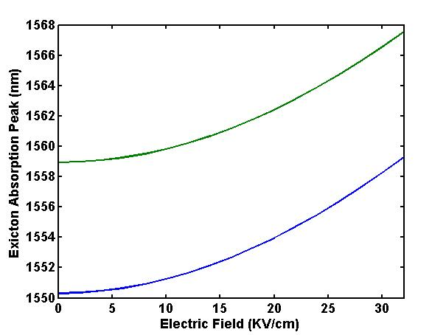
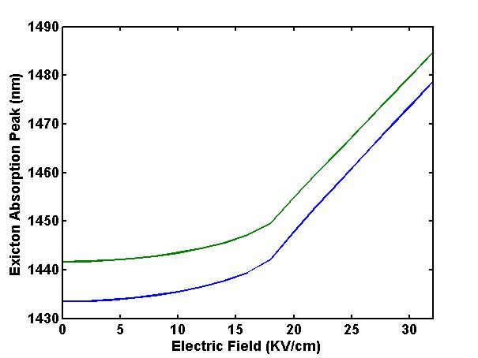
(a)
(b)
E_{e-hh}
E_{e-lh}
With Binding Energy
With Binding Energy
Absorption Edge (nm)
Absorption Edge (nm)
Without Binding Energy
Without Binding Energy

Slide 8
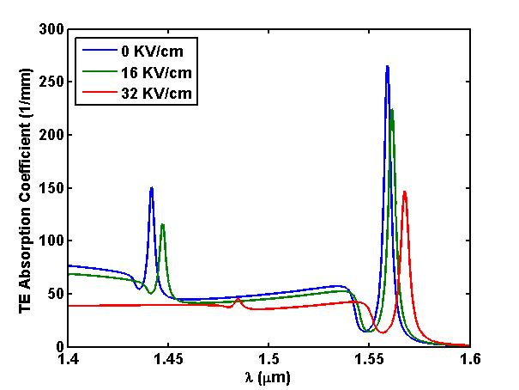
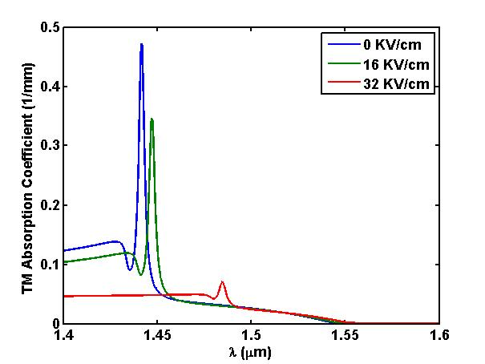

Slide 9

InGaAs
p-InP
SCH
MQW
SCH
n-InP

Slide 10
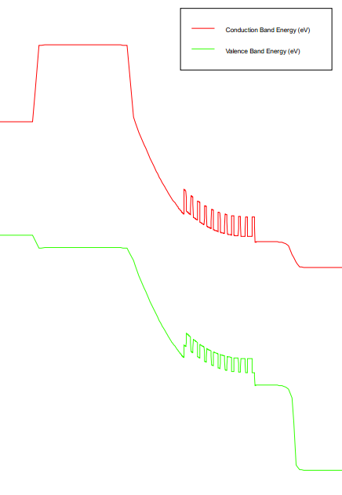
(a)
InGaAs
p-InP
SCH
MQW
SCH
n-InP
(b)
InGaAs
p-InP
SCH
MQW
SCH
n-InP
Conduction Band Energy (eV)
Valence Band Energy (eV)

Slide 11
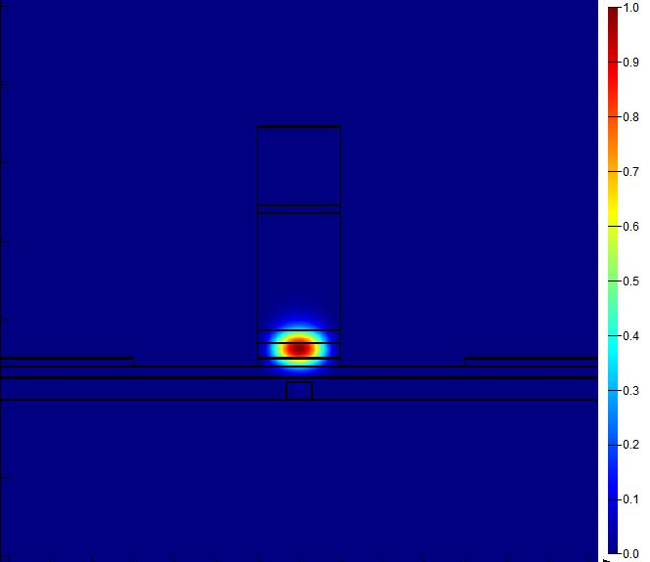
(a)
_{1μm}
Source Metal
(b)
InGaAs
DVS-BCB
p-InP
w_{wg}
Ground Metal
_{3 μm}
SCH
h_{mqw}
MQW
_{0.1 μm}
SCH
n-InP
50 nm
Si
0.22 μm
SiO₂
0.6 μm
Substrate

Slide 12
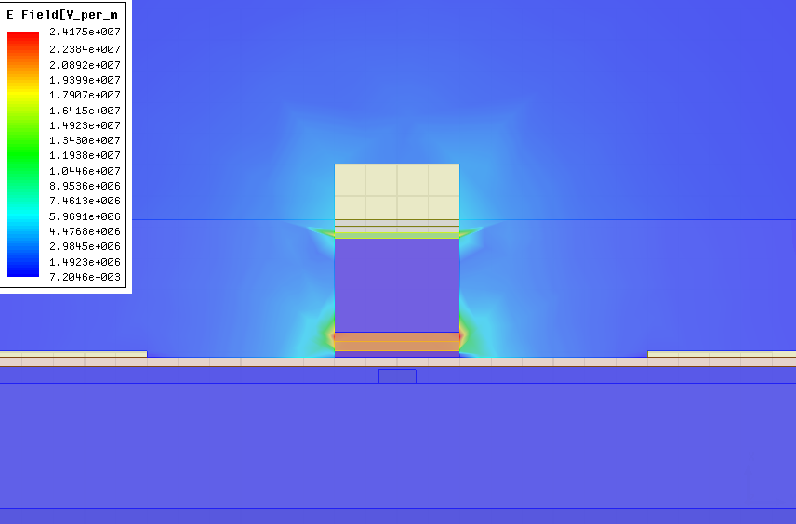
Zc, γ_{m}
(a)
(b)

Slide 13
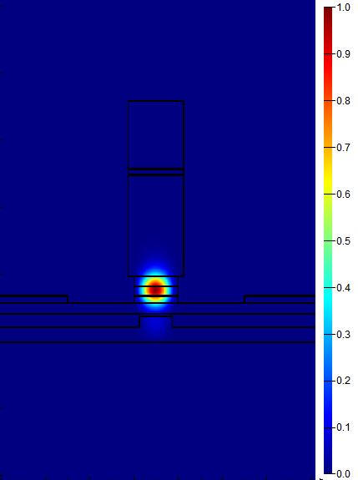
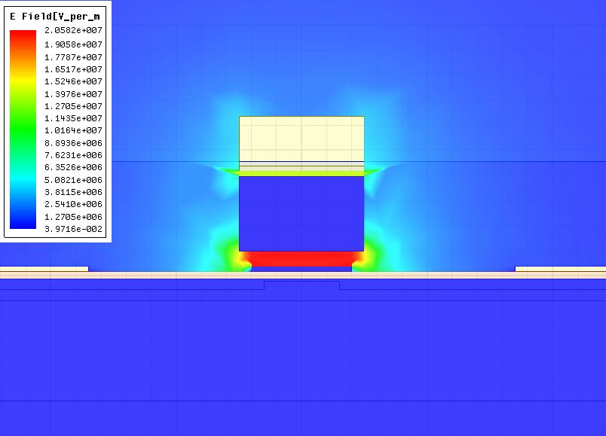
(a)
_{1μm}
Source Metal
(b)
(c)
InGaAs
DVS-BCB
2.5 μm
p-InP
w_{wg}
Ground Metal
_{3 μm}
SCH
h_{mqw}
MQW
_{0.1 μm}
SCH
n-InP
50 nm
Si
0.38 μm
0.22 μm
n-InP
SiO₂
1.5 μm
Substrate

Slide 14
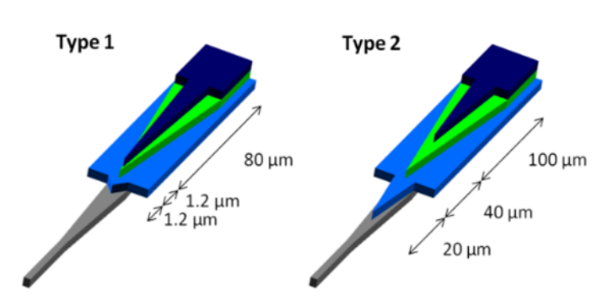
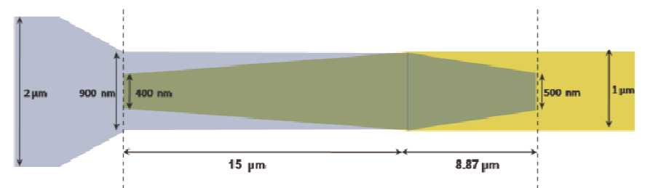
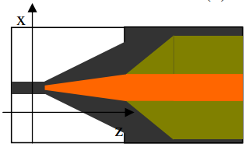
(a)
(b)
(c)

