Slide 1
S_{i}
S_{t}
μ_{i}
S_{r}
α₋
α₊
μ_{r}

Slide 2
S_{i}
τ
S_{t}
k
k
A_{N+1}
τ
A₁
i
Λ
B_{N+1}
B₁
A_{i}
h_{g}
A_{i+1}
l_{g}
B_{i}
r
B_{i+1}
i

Slide 3
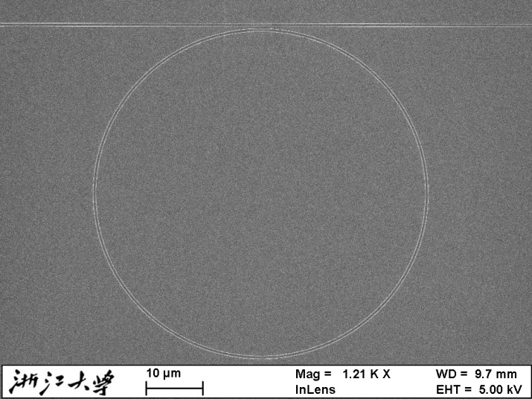
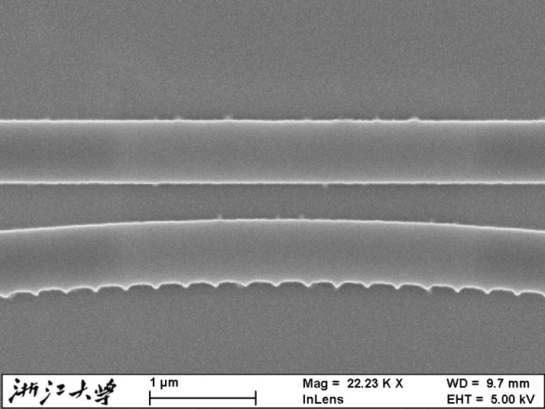

Slide 4
(a)
(b)
r = 0.00132
r = 0.001
r = 0.00078
Transmission (dB)
r
r = 0.00054
(c)
r = 0.000335
r = 0.0001736
λ (μm)
r

Slide 5
(a)
(b)
τ = 0.9
τ = 0.86
τ = 0.76
Transmission (dB)
τ = 0.628
τ
(c)
τ = 0.43
τ = 0.3
λ (μm)
τ

Slide 6
ϕ₁
t
3 dB
Coupler
3 dB
Coupler
Loop Mirror
相位调制区域
r
E_{in}
ϕ₂

Slide 7
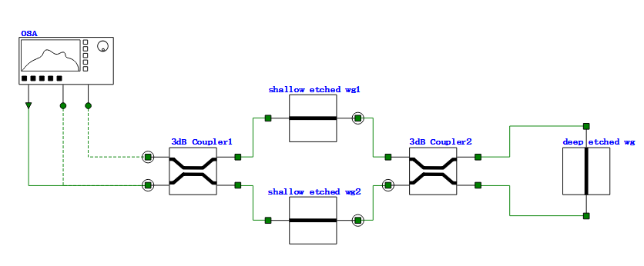
光谱仪
in
R
T
相位调制区域
Loop Mirror

Slide 8
(a)
(b)
T
R
R
T

Slide 9
T
R

Slide 10
ϕ₁
ϕ₂
r
3 dB
Coupler
3 dB
Coupler
3 dB
Coupler
3 dB
Coupler
相位调制区域
相位调制区域
E_{in}
t
ϕ₂
ϕ₁

Slide 11
S_{i}
S_{t}
S_{r}
k_{s1} or k_{s2}
_{集总电极}
n_{eff1}
n_{eff2}

