Slide 1
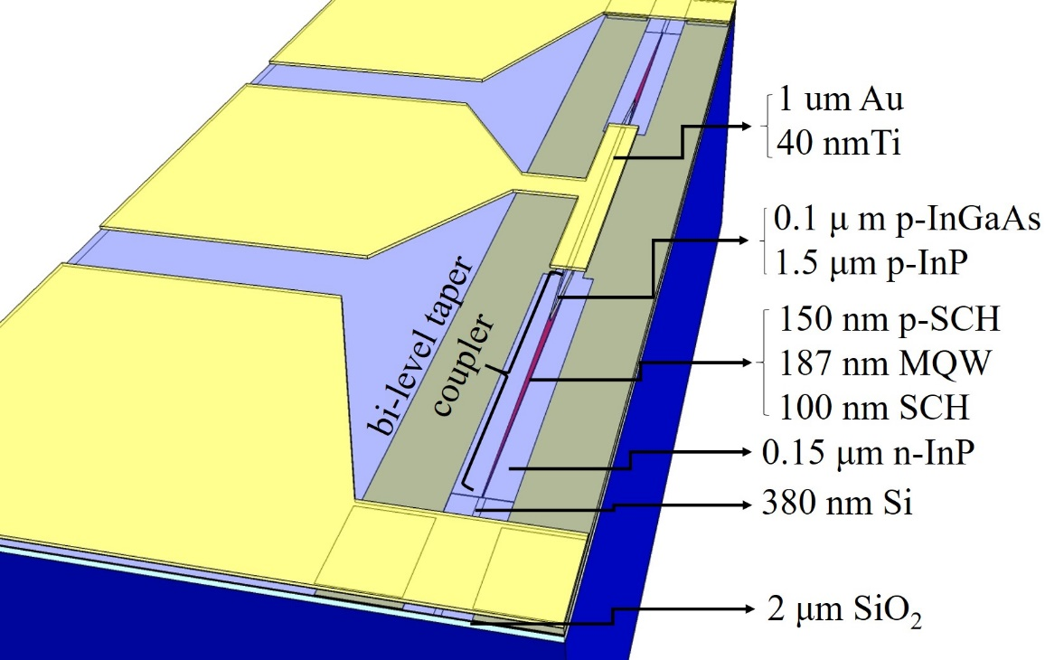
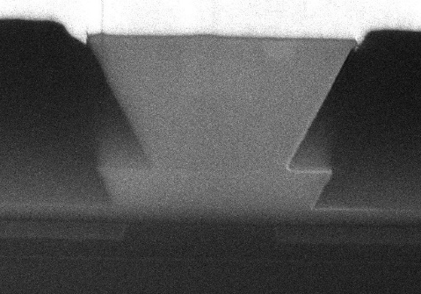
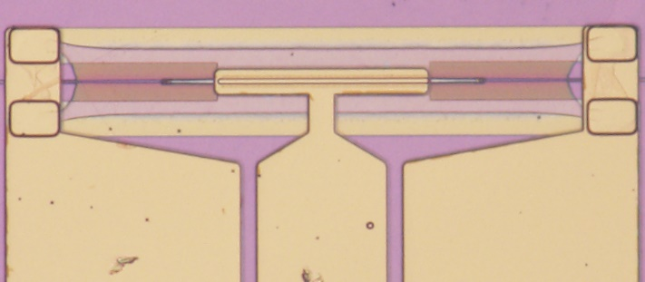
Structure
(a)
(b)
(c)

Slide 2
Schematic description of the absorption in quantum wells
When MQW region is under reverse bias, the overlap between the hole’s wavefunction and the electron’s wavefunction is decreased and the transition energy is reduced. In this situation, the excition absorption will red shift and the absorption strength will decrease.
When MQW region is under forward bias, the overlap between the hole’s wavefunction and electron’s wavefunction remains the same as zeros bias, and the lowest electron energy state is filled with electrons. Because light absorption is related with the transition to unfilled electronic states, the exciton absorption blue shifts and the absorption strength is also strong.
(a)
(c)
F<0
F=0
F>0
(b)
E_{F}
E_{e1}
E_{e1}
E_{e1}
E_{hv}
E_{g}
E_{F}
E_{hv}
E_{g}
E_{F}
E_{hv}
E_{g}
E_{hh1}
E_{hh1}
E_{hh1}

Slide 3
Comparison between the experimental and simulation absorption spectra.
In the simulation results, we only consider the exciton absorption, without the continuum interband transitions absorption.

Slide 4
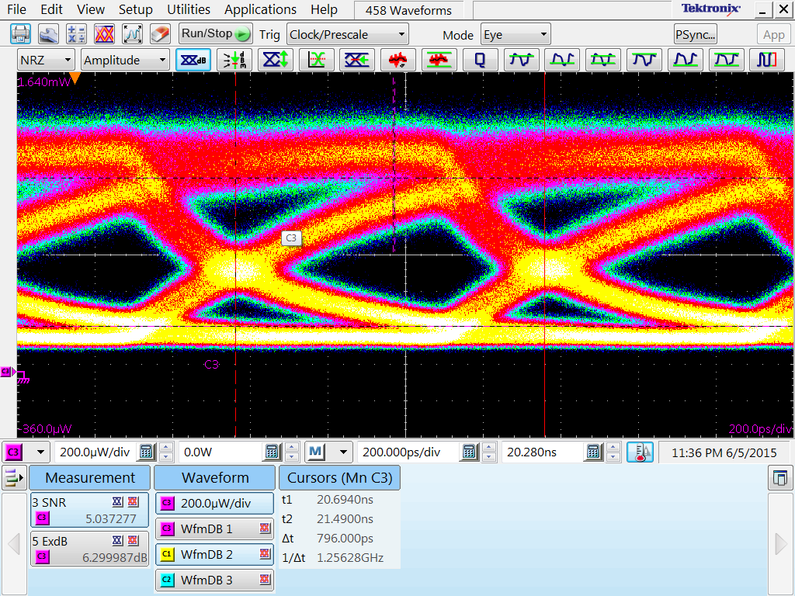
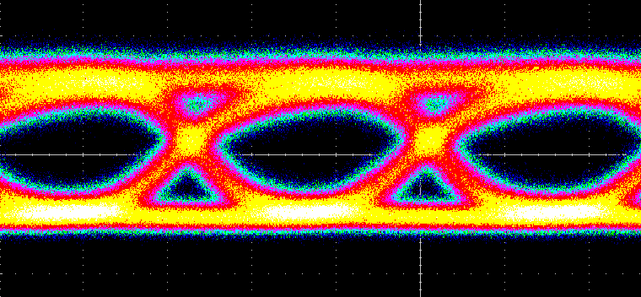
Static response and high speed response of the electroabsorption modulator at 1.55μm. The bandwidth of this modulator is limited by the carrier lifetime, instead of resistance and capacitance.
Continuum transitions absorption
Exciton transitions absorption
Exciton transitions absorption, @1550nm
1.25Gb/s, Vpp=50mV, Bias = 0.6V, ER = 6.3dB
Continuum transitions absorption, @1550nm
12.5Gb/s, Vpp=1.1V, Bias = -1.5V, ER = 3.1dB

