Slide 1
S_{i}
S_{t}
μ_{i}
S_{r}
α₋
α₊
μ_{r}

Slide 2
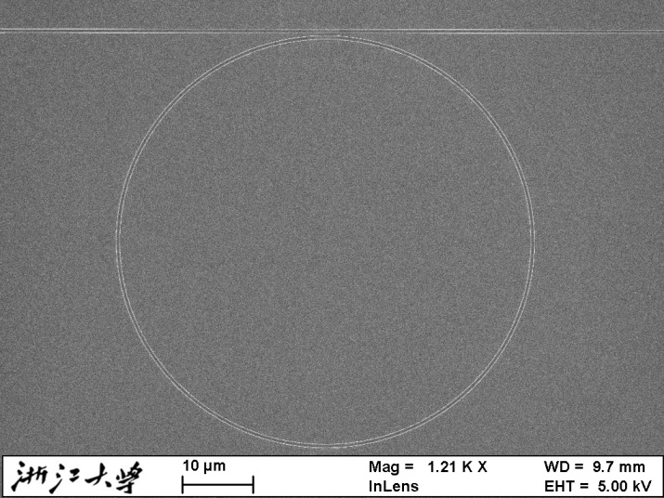
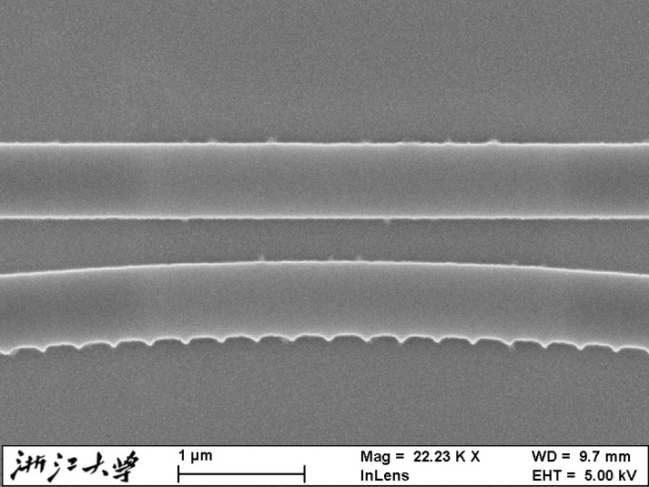
τ
T
(a)
k
k
A_{N+1}
τ
A₁
Λ
B_{N+1}
B₁
A_{i}
h_{g}
A_{i+1}
l_{g}
B_{i}
r
B_{i+1}
(b)

Slide 3
(a)
(b)

Slide 4
(a)
(b)
r = 0.00132
r = 0.001
r = 0.00078
r = 0.00054
(c)
r = 0.000335
r = 0.0001736

Slide 5
(a)
(b)
τ = 0.9
τ = 0.86
τ = 0.76
τ = 0.628
(c)
τ = 0.43
τ = 0.3

Slide 6
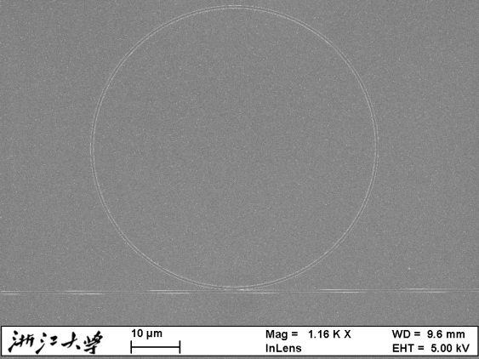
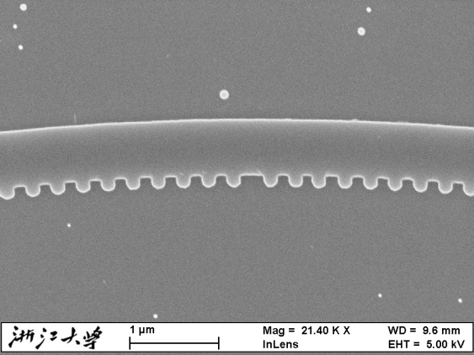
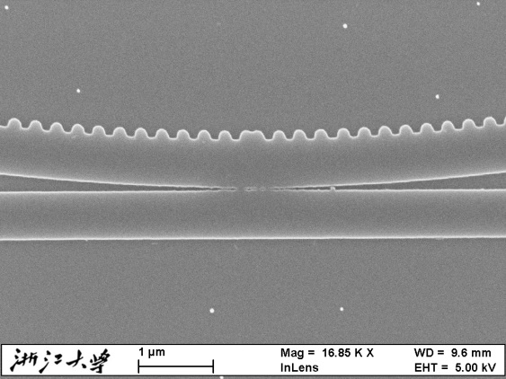
(a)
(b)
π shift
(c)
(d)

Slide 7
(a)
(b)

Slide 8
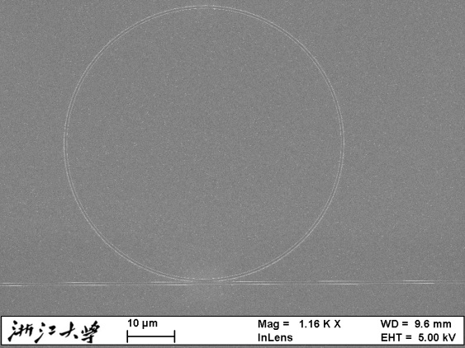
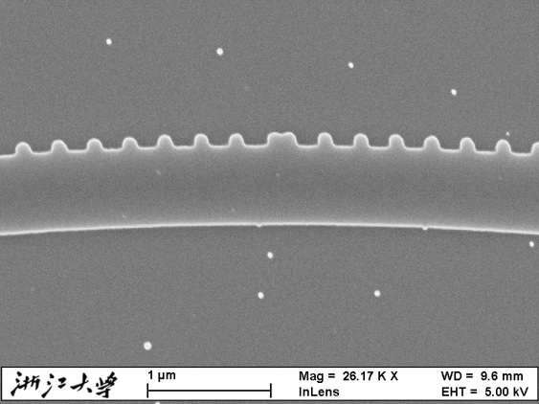
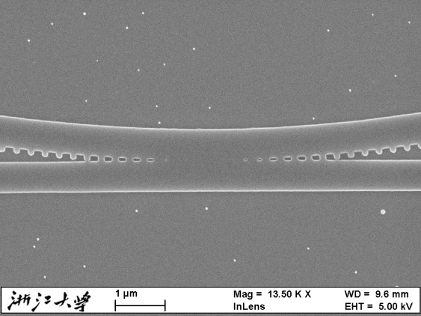
(a)
(b)
π shift
(c)
(d)

Slide 9
(a)
(b)

