Slide 1
Semi-Supervised Federated Learning for Travel Mode Identiﬁcation
From GPS Trajectories
汇报人：黄其涵
导师：章静 教授
Zhu Y, Liu Y, James J Q, et al. Semi-supervised federated learning for travel mode identification from gps trajectories[J]. IEEE Transactions on Intelligent Transportation Systems, 2021, 23(3): 2380-2391
Notes:
基于半监督联邦学习的出行模式识别
IEEE智能交通系统汇刊

Slide 2
Contents
01
Introduction
02
Preliminaries
03
Methodology
04
Experiments
05
Conclusions

Slide 3
01
Introduction

Slide 4
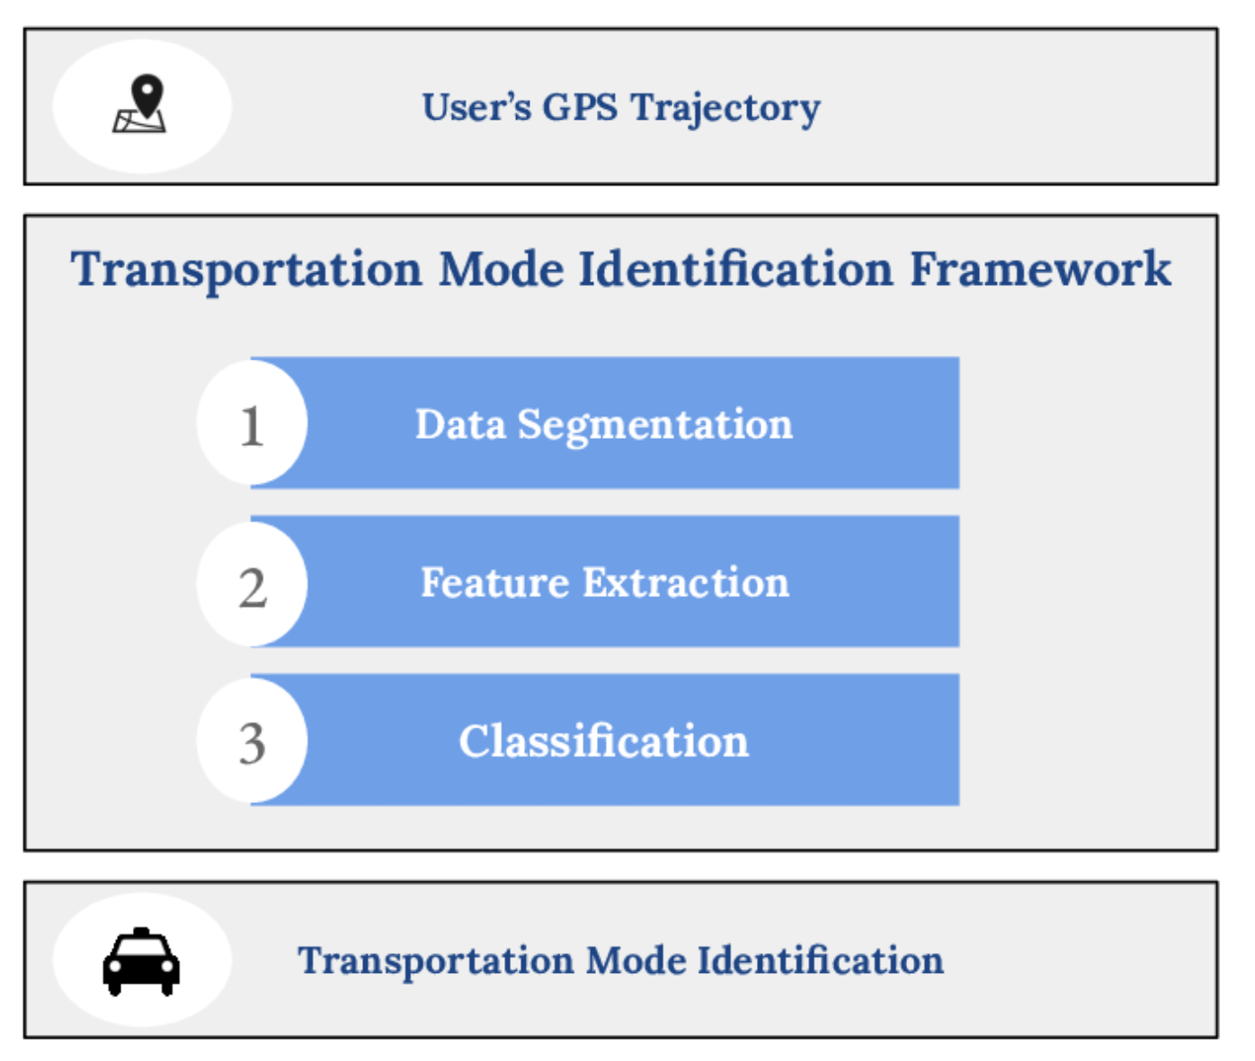
Introduction
1.1 Background
GPS trajectories serve as a significant data source for travel mode identiﬁcation along with the development of various GPS-enabled smart devices. AI-based travel mode identification applications is an indispensable component of data-driven Intelligent Transportation System, which can enable governments, com-panies, and institutes to understand human behaviors and urban management better and planning. Therefore, in this paper, we focus on studying how AI technology can empower travel mode identiﬁcation applications in ITS.
Notes:
随着各种支持 GPS 智能设备的普及，GPS 轨迹是出行模式识别的重要数据源。
出行模式识别是智能交通系统不可或缺的组成部分，它可以更好地对城市交通进行规划。
因此，在本文中，我们重点研究 AI 技术如何赋能 ITS 中的出行方式识别应用。

Slide 5
Introduction
1.2 Problems
However, in most cases, putting together a labeled dataset for a given travel mode identification task is a timeconsuming, expensive, and complicated endeavor.
First, it generally requires a large amount of GPS trajectory as well as real ground-truth travel mode label information to train high-quality identification models.
Second, GPS trajectories information is closely related to user privacy, which makes it impractical for third-party entities to directly upload or share raw data to the server.
Notes:
然而，在大多数情况下，为给定的旅行模式识别任务整合标记数据集是一项耗时、昂贵和复杂的工作。
首先，它通常需要大量的GPS轨迹和真实的地面旅行模式标签信息来训练高质量的识别模型，可能涉及从不同实体征求数据。
其次，GPS轨迹信息与用户隐私密切相关，这使得第三方实体直接上传或共享原始数据到服务器是不现实的。

Slide 6
Introduction
1.3 Challenges
Lack of Labeled data: Existing travel mode identification approaches and the applications it spawned are based on an impractical assumption: all clients hold a precisely labeled dataset. However, it is difﬁcult to guarantee that each client holds such data in practice. While the clients can generate much data, they are typically unincentivized to also develop data anno-tations.
Privacy Protection: While the clients collect a large amount of data, due to privacy concerns and legal supervision, the server cannot directly access or obtain the client data.
System and Statistical Heterogeneity: Clients may collect data by different devices (e.g., mobile phones, smartwatches), use different systems (e.g., IOS, Android) as well as collect local data in different environments. On the other hand, the local dataset of each client may have different distribution and volume for each category.
Notes:
1缺乏标注数据：所有客户端都拥有一个精确标记的数据集，在实践中很难保证每个客户都持有这样的数据。
2隐私保护：服务器无法直接访问或获取客户端数据。
3系统和统计异质性：对于每个类别，每个客户机的本地数据集可能具有不同的分布和容量。

Slide 7
Introduction
1.2 Contributions
A decentralized semi-supervised machine learning system for privacy-preserving travel mode identification: They consider a more realistic assumption that the client data is unlabeled and we propose a novel semi-supervised federated learning system to accurately infer the travel mode without compromising privacy.
A new deep neural network (DNN) architecture for travel mode identification: They propose a novel convolutional neural network (CNN)-gated recurrent unit (GRU) model, which uses CNN to extract the trajectory changes and ﬁne-grained features of GPS trajectories and use GRU to capture the time-correlation of GPS data.
Notes:
1 提出一种去中心化的半监督机器学习系统，用于隐私保护的出行方式识别。
2 提出一种用于出行模式识别的深度神经网络(DNN)结构。

Slide 8
Introduction
1.2 Contributions
3. A novel group clustering aggregation algorithm and data augmentation methods: They propose a group-clustering (GCL) algorithm to group client and aggregate local model parameters according to the distribution of the client dataset.
4. Extensive experimentation and model validation: They conducted a comprehensive set of experiments, showing that our system achieves over 90% accuracy with only 50% of labeled data, regardless of the data distribution.
Notes:
3 提出一种新的群聚类聚合算法和数据增强方法
4 得到广泛的实验和模型验证

Slide 9
02
Preliminaries

Slide 10
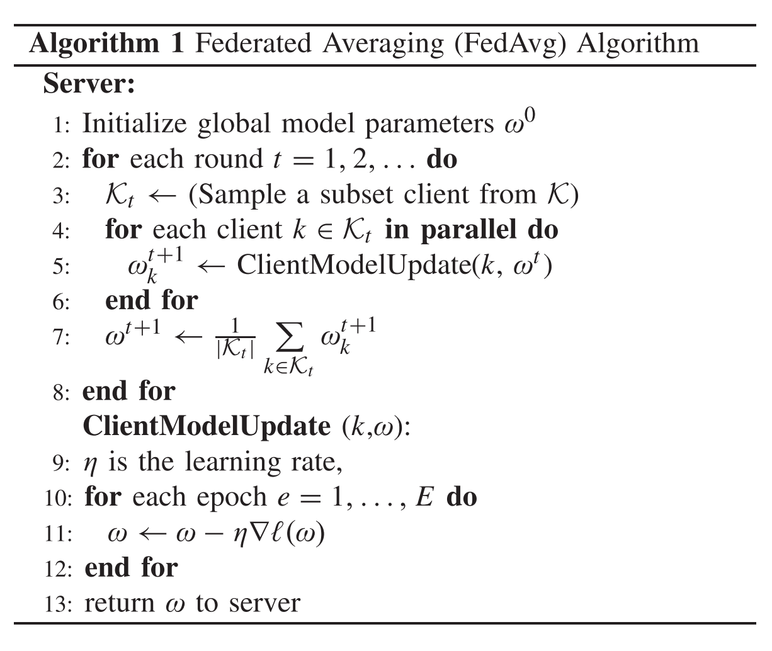
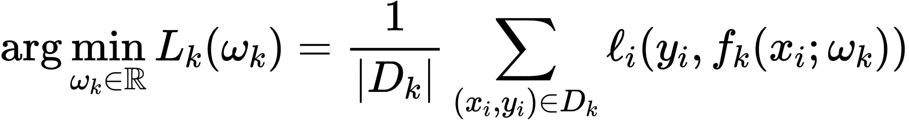
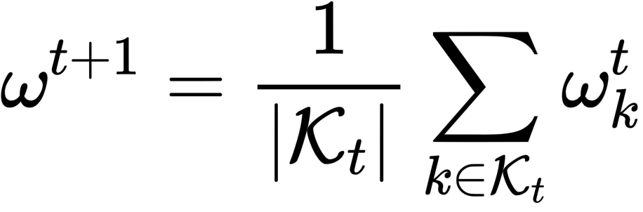
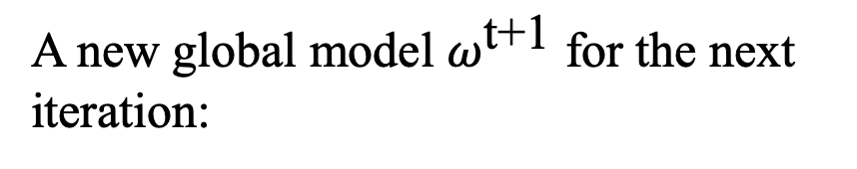
Preliminaries
2.1 Federated Averaging Algorithm(FedAvg)
The goal of the client is to minimize the following objective function:
A new global model $ω^{\text{t}\text{+1}}$ for the next iteration:
B. McMahan, E. Moore, D. Ramage, S. Hampson, and B. A. y Arcas, “Communication-efficient learning of deep networks from decentralized data,” in Artiﬁcial Intelligence and Statistics. 2017, pp. 1273–1282.
Notes:
联邦平均算法
主要思想就是把参与训练的客户端所上传的权重进行平均化，统一的去调和中心节点的模型权重
这个算法还有一个比较值得注意的点，就是在进行联合学习的时候，不是所有的节点都参与训练，而是选择一部分节点进行训练，这样是为了减少算法的通信开销；
1 目标函数 最小化整体的模型损失值；
2 每一步的全局权重更新公式，也就是模型平均的一个过程

Slide 11
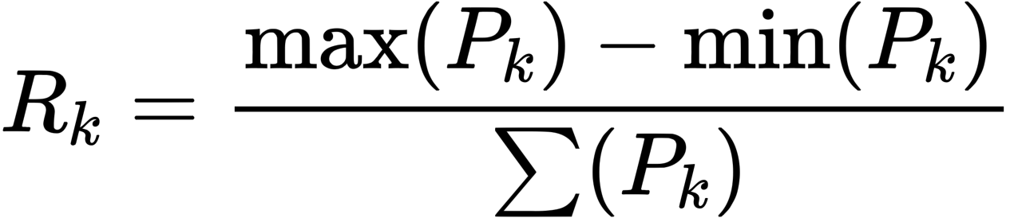
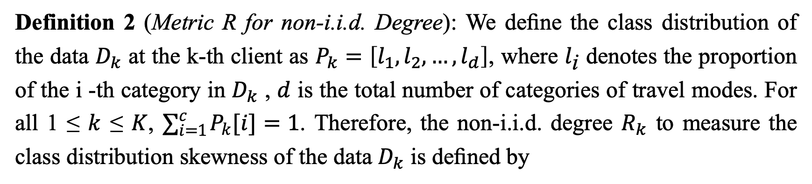
Preliminaries
2.2 Related Definitions
Definition 1 (GPS Raw Record): In this paper, the proposed method is applied to raw GPS data comprised of GPS records, which can be formally represented as follows:
Definition 2 (Metric R for non-i.i.d. Degree): We deﬁne the class distribution of the data $D_{k}$ at the k-th client as $P_{k}=\left[l_{1},l_{2},…,l_{d}\right]$, where $l_{\text{i}}$ denotes the proportion of the i -th category in $D_{k}$ , $d$ is the total number of categories of travel modes. For all 1 ≤ $k$ ≤ $K$, $∑_{i=1}^{c} P_{k}[i]=1$. Therefore, the non-i.i.d. degree $R_{k}$ to measure the class distribution skewness of the data $D_{k}$ is deﬁned by
Notes:
1 GPS原始记录={纬度，经度，时间戳，运动模式}
2 用R来表示数据集非独立同分布的程度，其实简单来说，在联邦训练时各个客户端中各类型的轨迹的分配比例是不同的，那么就用下面这个公式来度量这个分配不平衡的程度。pk是数据集中各个旅行模式的占比。

Slide 12
03
Methodology

Slide 13
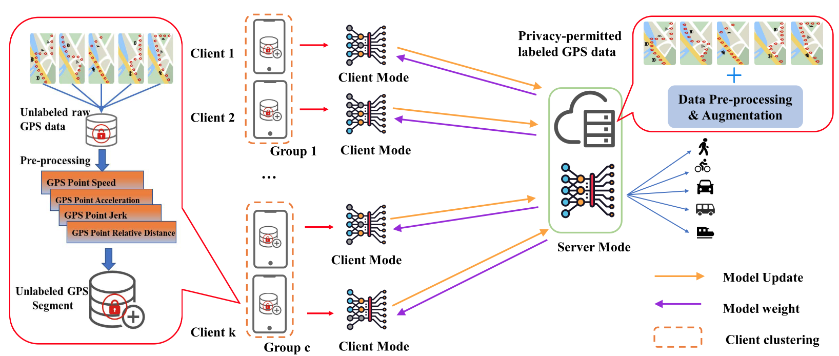
Methodology
3.1 Overview of LDP-FL
1
3
2
Fig. 1. Overview of the semi-supervised federated learning travel mode identification system.
Notes:
主要是分为四个步骤：
1 第一步 是在中心服务器提取隐私允许的轨迹数据的运动特征，训练中心模型，并且把它当作一个标准模型，并发送到客户端；
2 第二步 客户端可能会采集到一些无标签的数据，但是也同样对他们进行特征提取，并且用标准模型进行伪标签的预测，预测程度大于一定阈值，就给它打上标记，认为数据可用。
3 第三步 主要是联邦学习权重的迭代
先用有标签数据训练网络（此时网络一般过拟合...），从该网络中提取所有数据的特征，以这些特征来用某种分类算法对无标签数据进行分类，挑选你认为分类正确的无标签数据加入到训练集，再训练网络。

Slide 14
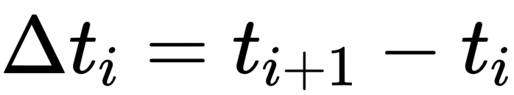
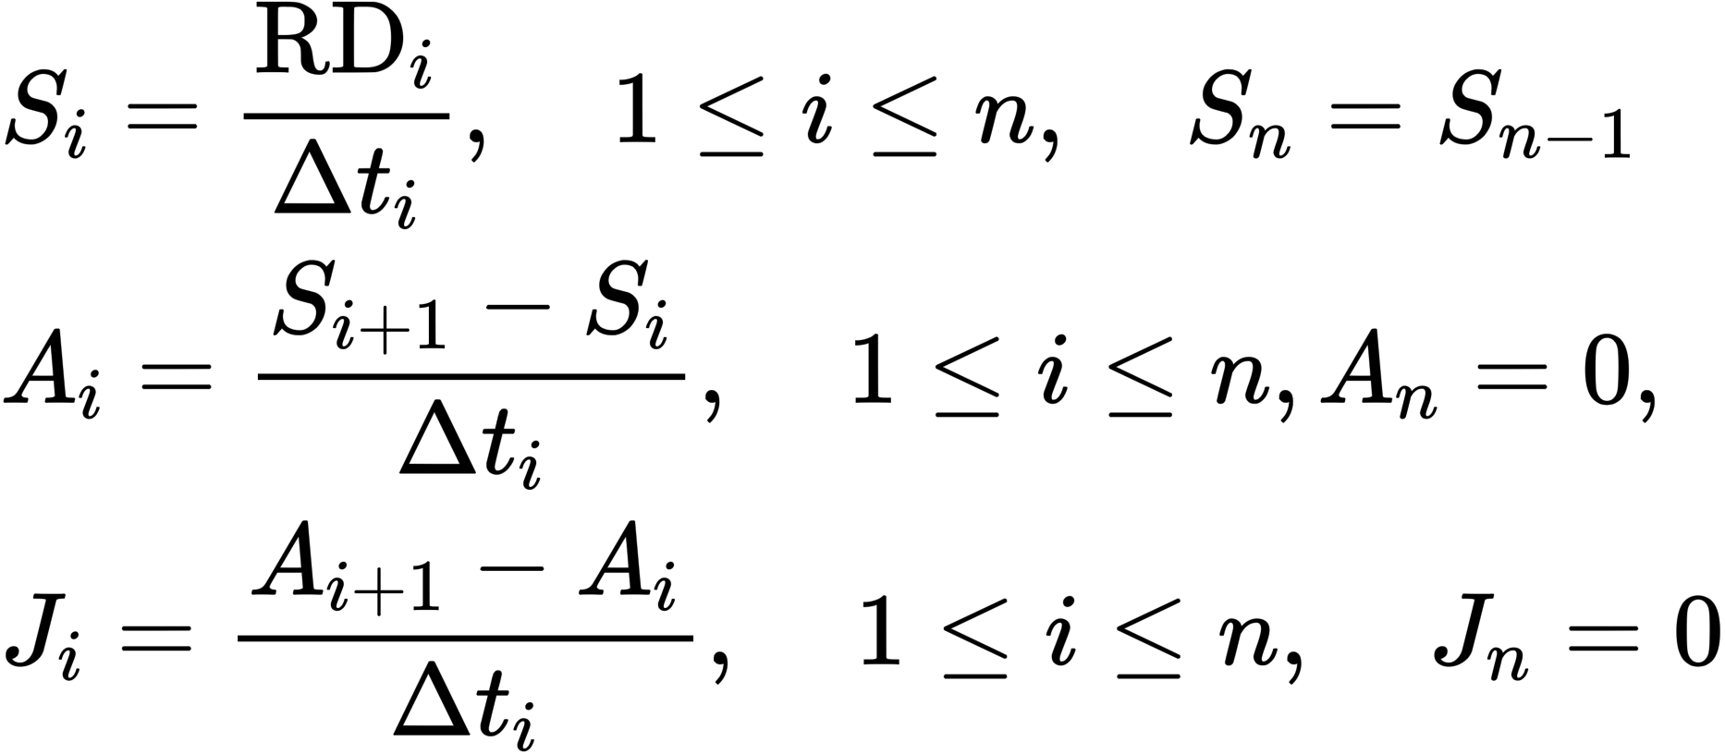
Methodology
3.2 GPS Record Processing
The GPS record processing steps comprise data motion feature calculation, data augmentation, and time-domain feature extraction.
1) Capturing Motion Feature
The relative distance (RD) between two consecutive GPS record can be computed by Vincenty Formula* :
T. Vincenty, “Direct and inverse solutions of geodesics on the ellipsoid with application of nested equations,” Surv. Rev., vol. 23, no. 176, pp. 88–93, Apr. 1975.
Notes:
数据运动特征计算，数据增强，时域特征提取。
RD 两个位置点之间的距离；
t 两个位置点之间的时间间隔；
s 速度
A 加速度
j 加加速度

Slide 15
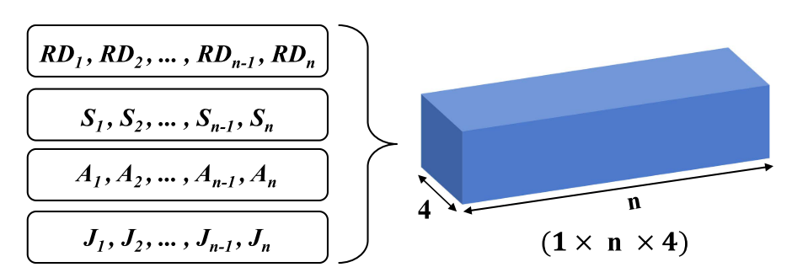
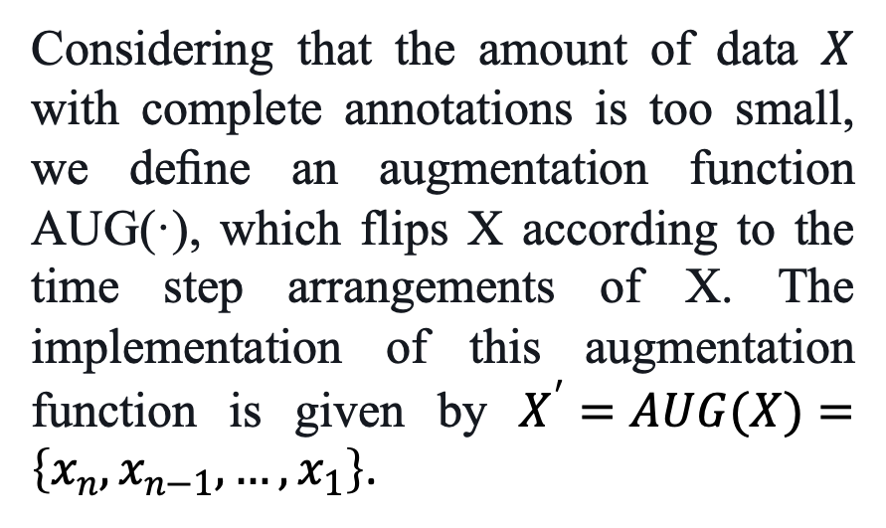
Methodology
3.2 GPS Record Processing
2) Training Data Setup and Augmentation
Considering that the amount of data $X$ with complete annotations is too small, we deﬁne an augmentation function AUG(·), which flips X according to the time step arrangements of X. The implementation of this augmentation function is given by $X^{′}=AUG(X)=\left\{x_{n},x_{n−1},…,x_{1}\right\}$.
Fig. 2. The four channel structure of a GPS segment.
Notes:
处理后得到四种特征向量，把他们拼在一起就变成了一条轨迹的特征张量
之后他们还使用了一种数据增强的函数，其实就是把原始数据反转，或者说是逆序。

Slide 16
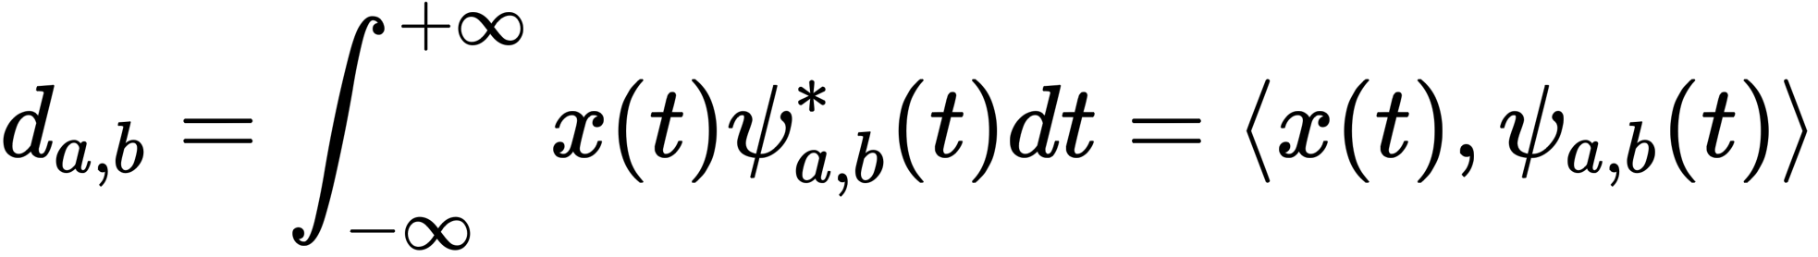
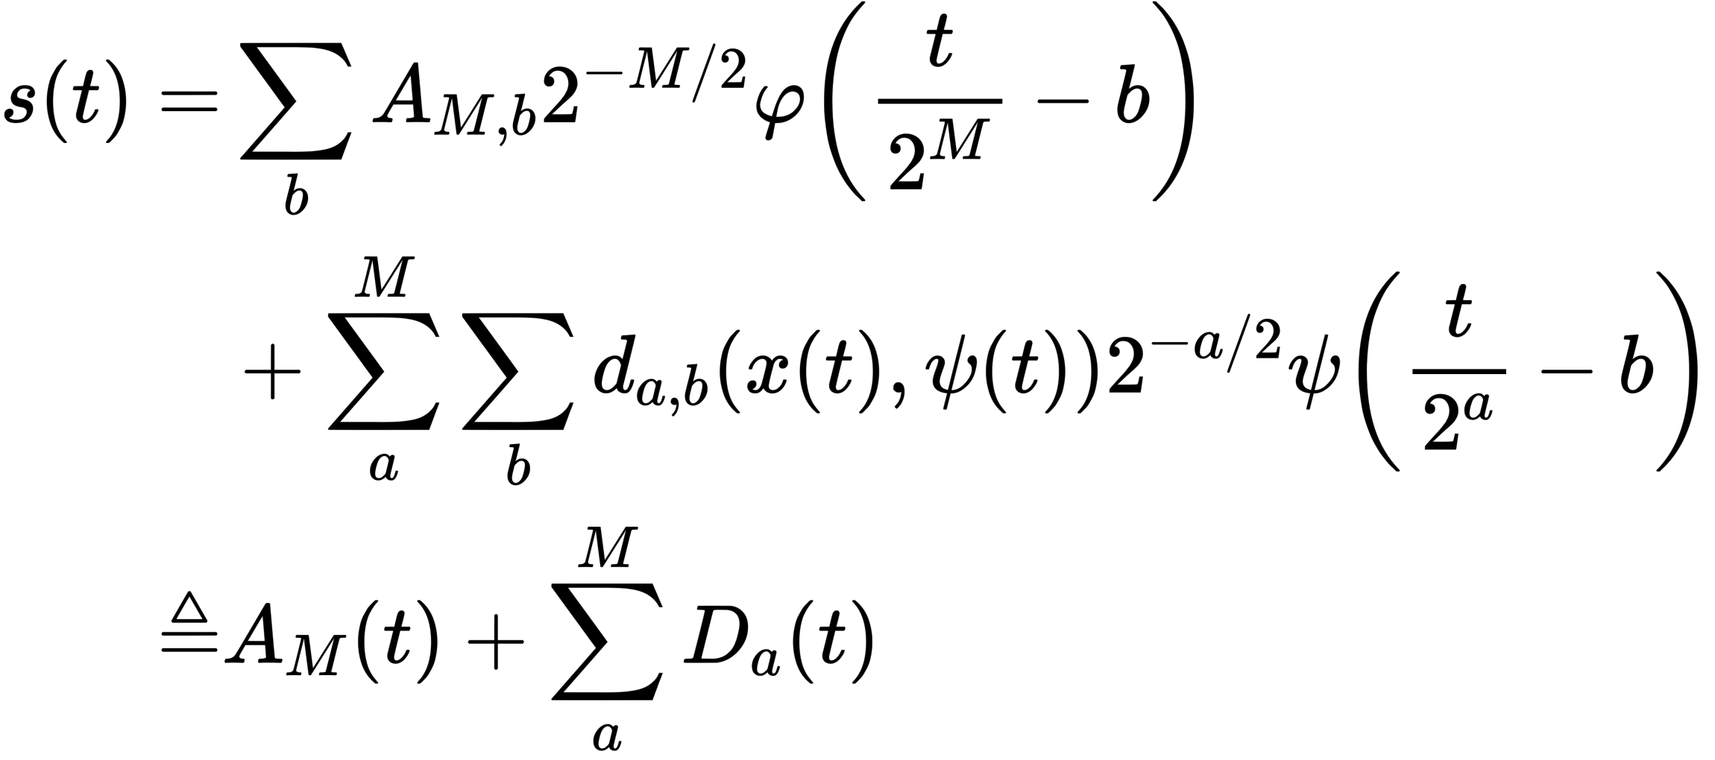
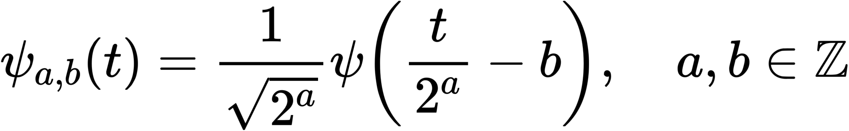
Methodology
3.2 GPS Record Processing
3) Capturing Time-Domain Feature
Given a time sequence signal x(t), DWT (Discrete wavelet transform) adopts discrete wavelets ψa,b(t) to transform the input signals into the following signal:
Notes:
小波变换 Discrete wavelet transform
其实就是利用小波变换进行频谱分析，对几个运动特征再进一步的进行特征的分解，来扩张轨迹特征的维度
给定时间序列信号x(t)， DWT (Discrete wavelet transform)采用ψa,b(t)离散小波变换将输入信号变换为:

Slide 17
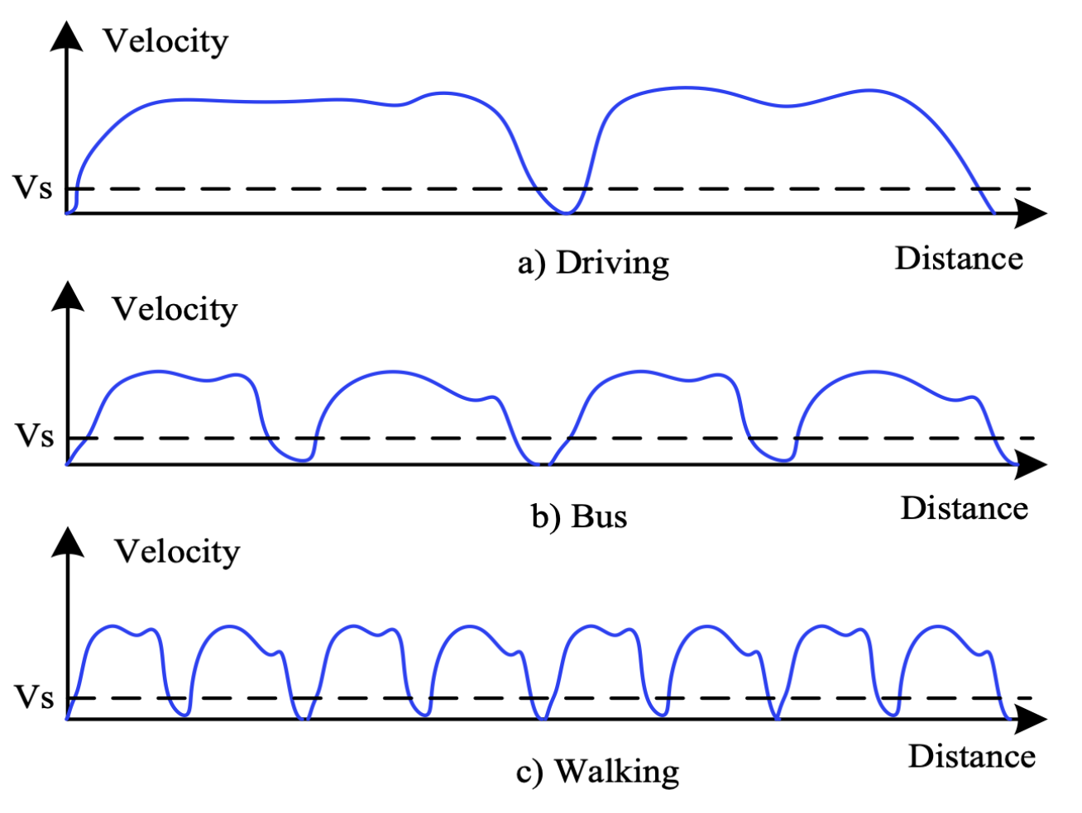
Methodology
3.2 GPS Record Processing
3) Capturing Time-Domain Feature
Notes:
J:加加速度

Slide 18
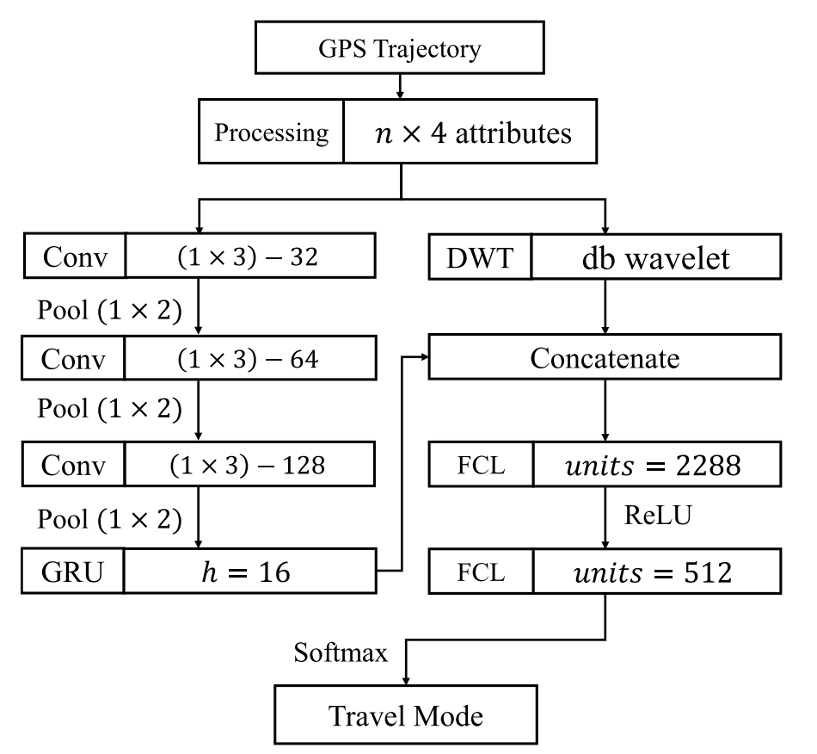
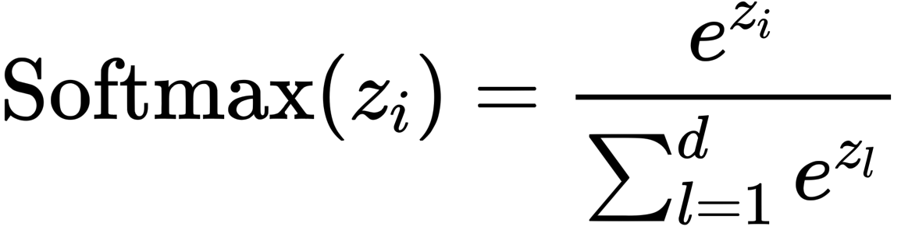
Methodology
3.3 Travel Mode Identification Model
They use the softmax function as the activation function of the last layer, which can be mathematically expressed as follows:
where d represents the total modes, and Softmax(zi) can be used to calculate the probability that z belongs to a certain modes.
Fig. 3. The architecture of the proposed network.
Notes:
GRU 门控循环单元
hidden size = 16

Slide 19
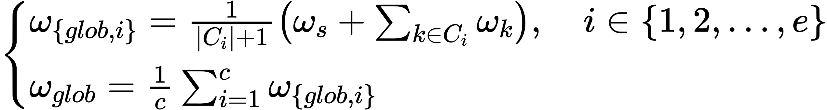
Methodology
3.4 Semi-Supervised Federated Learning
1) Pseudo-Labeling Training Method
When the model’s predicted probability of an input belonging to a specific travel mode is greater than τ , we consider this expected model has high conﬁdence and set it as a pseudo label for the input data.
2) Training Objective and Model Averaging
Notes:
先用有标签数据训练网络（此时网络一般过拟合...），从该网络中提取所有数据的特征，以这些特征来用某种分类算法对无标签数据进行分类，挑选你认为分类正确的无标签数据加入到训练集，再训练网络。
其实这边是进行分组的联邦学习，也就是把数据分布相似的客户端归为一组，所以还会有局部权重更新的过程。这种方式进行训练，其实我理解，是有这么一个目标，也就是客户端希望更准确的去标记无标签的数据，而中心模型希望有更好的鲁棒性，对各种数据都用通用性。

Slide 20
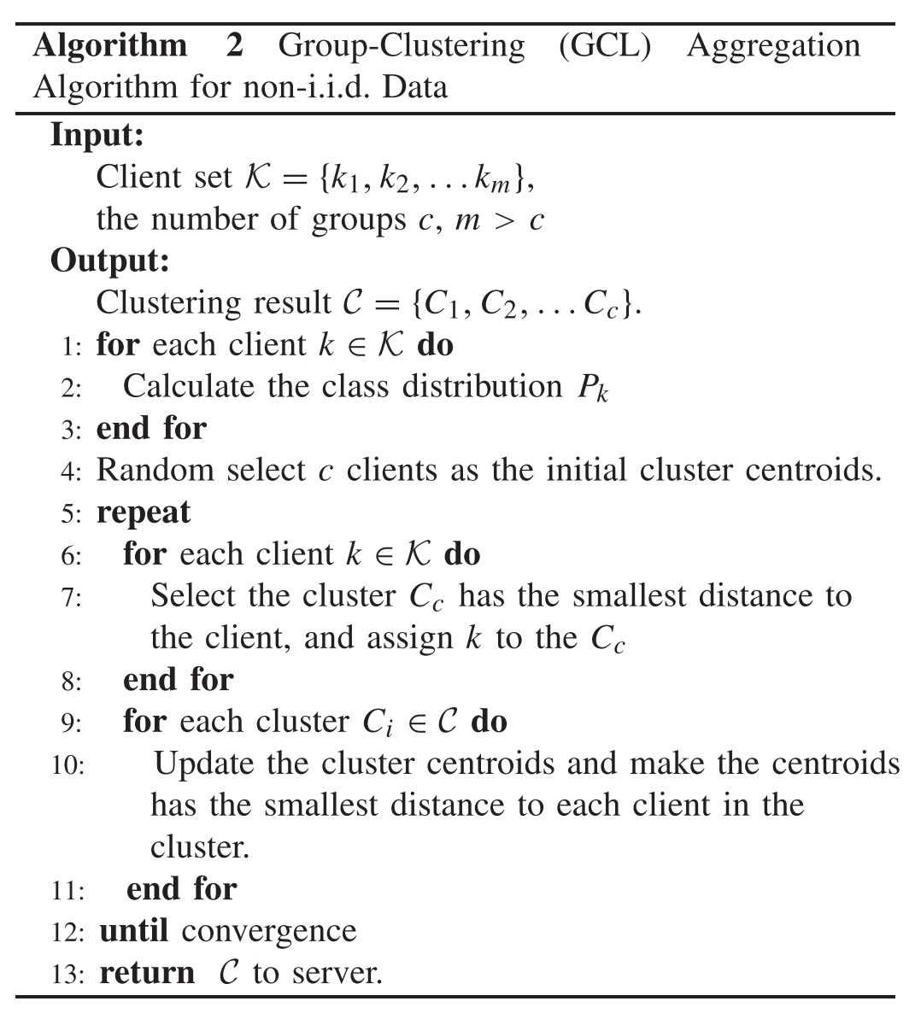
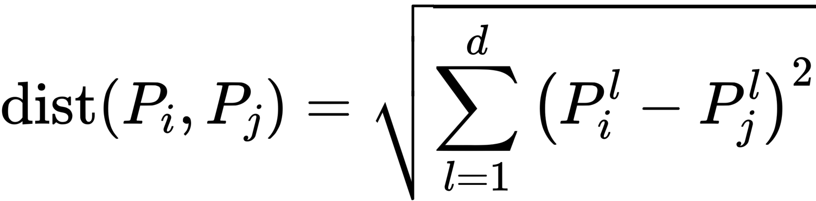
Methodology
3.5 Group-Clustering Aggregation Algorithm
Euclidean distance of the class distribution Pk and uses the K-means clustering algorithm.
Notes:
数值扰动算法的伪代码
w是本地模型权重，下标l+1是指训练轮次，C是数值范围的中心，R是数值范围的半径，

Slide 21
04
Experiments

Slide 22
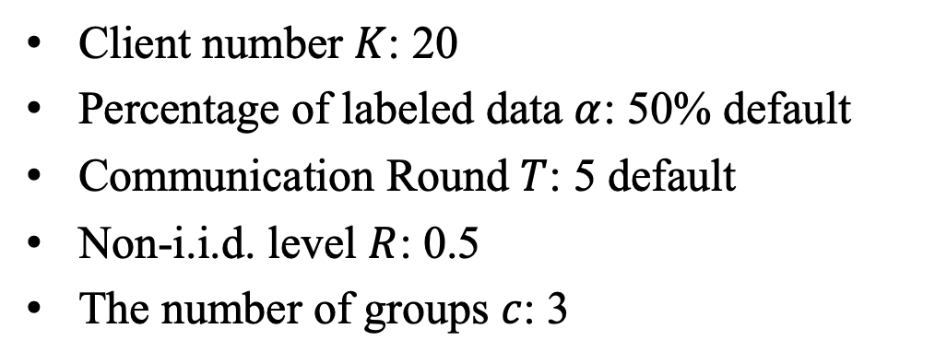
Experiments
4.1 Dataset:
GeoLife
4.2 Parameter Setup:
Client number $K$: 20
Percentage of labeled data $α$: 50% default
Communication Round $T$: 5 default
Non-i.i.d. level $R$: 0.5
The number of groups $c$: 3
4.3 Evaluation metrics:
Accuracy for mode identification
Notes:
Geolife 这个数据集的每一条轨迹都有运动模式的标注，而且类型还比较丰富，所以也比较契合这篇文章的任务
K 联邦学习中客户端的个数
alpha 含有标签数据的比例
T 通信的回合数
R 非独立同分布的一种程度表示
c 分组数量
评价指标：模式识别的准确度
此GPS 轨迹数据集在（微软亚洲研究）地球生活项目中由178 个用户在四年多的时间（从2007 年4 月到2011 年10 月）收集。 此数据集的GPS 轨迹由一系列时间戳点表示，每个点包含纬度、经度和高度的信息。 此数据集包含17，621 条轨迹，总距离为1，251，654 公里，总持续时间为48，203 小时。

Slide 23
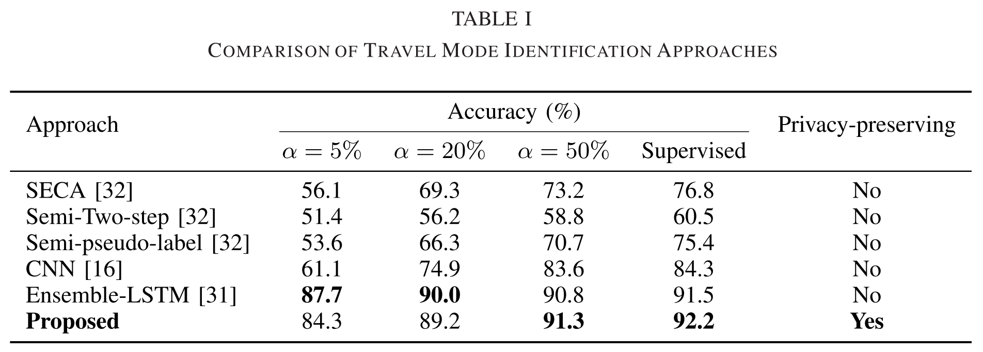
Experiments
4.4 Results
Notes:
表1表示了含标签数据的比率不同时，各个模型的精度之间的比较，说明本文提出模型在具有隐私保护的条件下，还能有较好的模型精度。

Slide 24
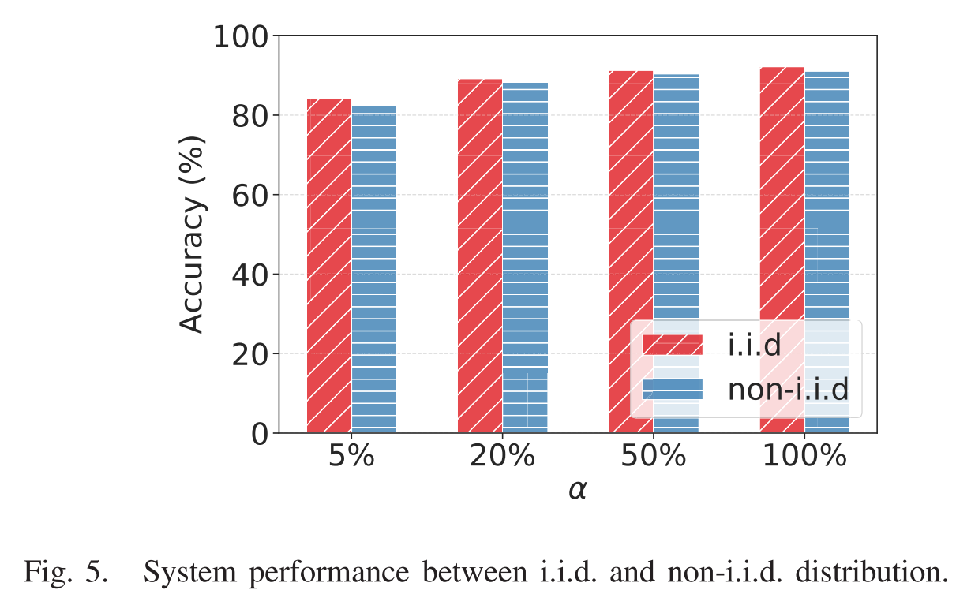
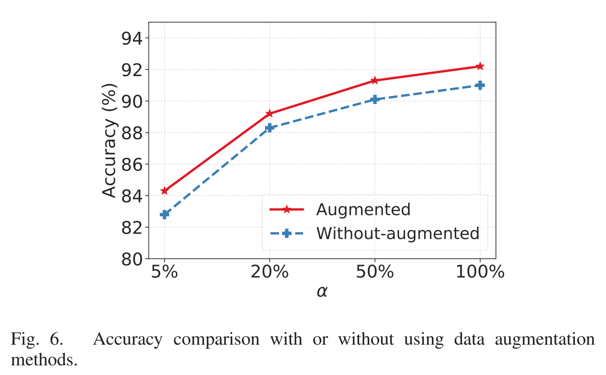
Experiments
4.4 Results
Notes:
图5 说明iid和non-iid时，模型精度的一个比较，其实是说明本文模型在非独立同分布的情况下也能够有相当的模型精度。
图6 说明在使用增强函数之后，模型精度有所提升。

Slide 25
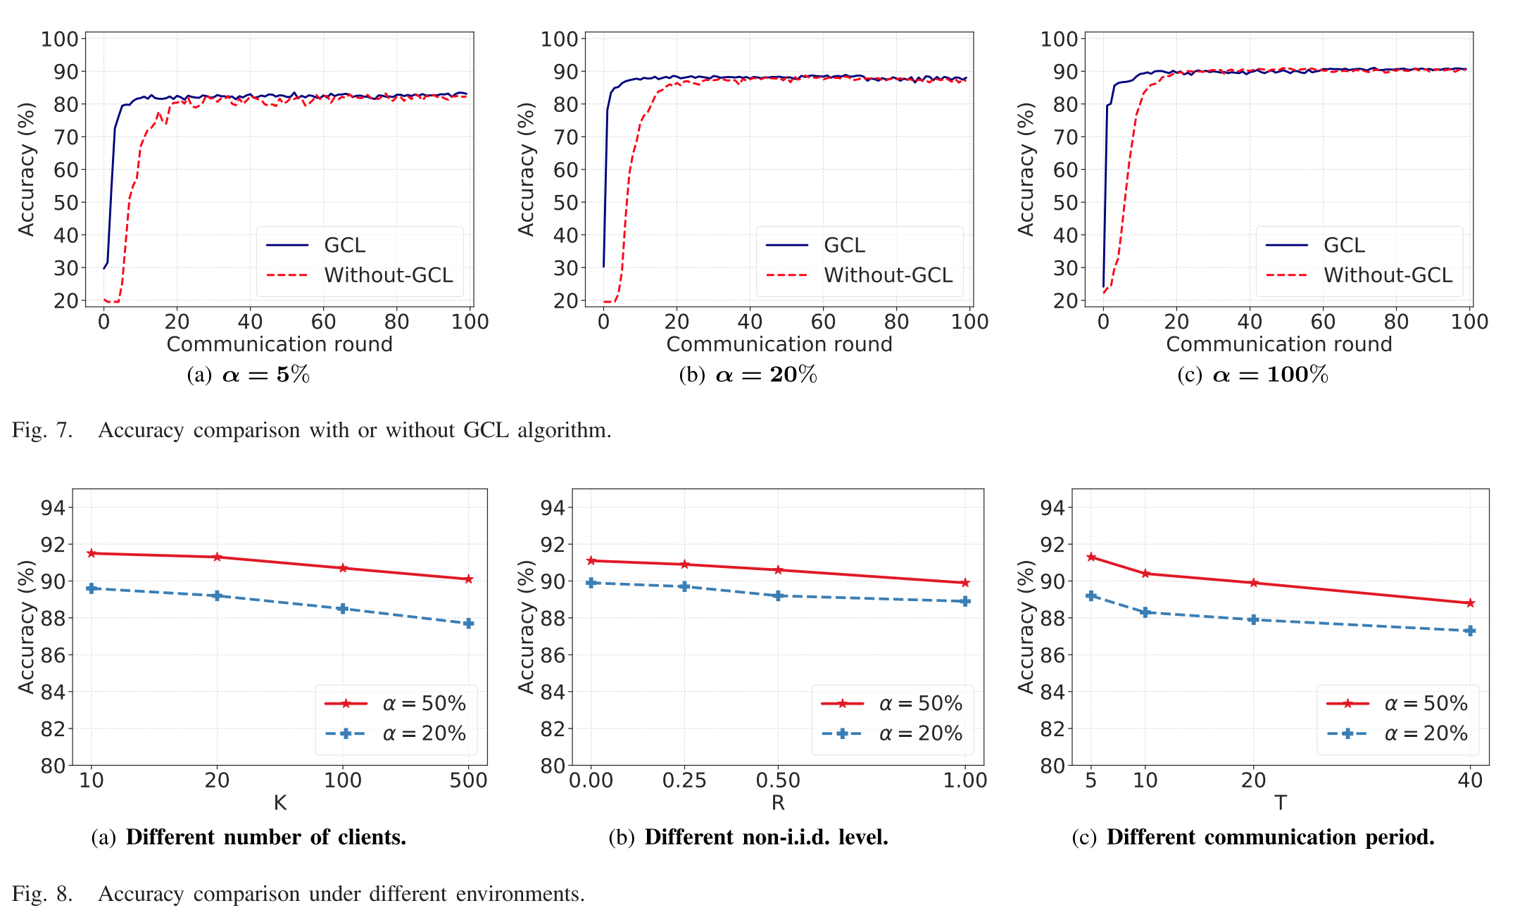
Experiments - 4.4 Results
Notes:
图7 表示聚类算法的回合数对于模型精度的影响
图8 表示不同k值、R值以及联邦学习通信轮次数对于模型精度的影响。

Slide 26
05
Conclusions

Slide 27
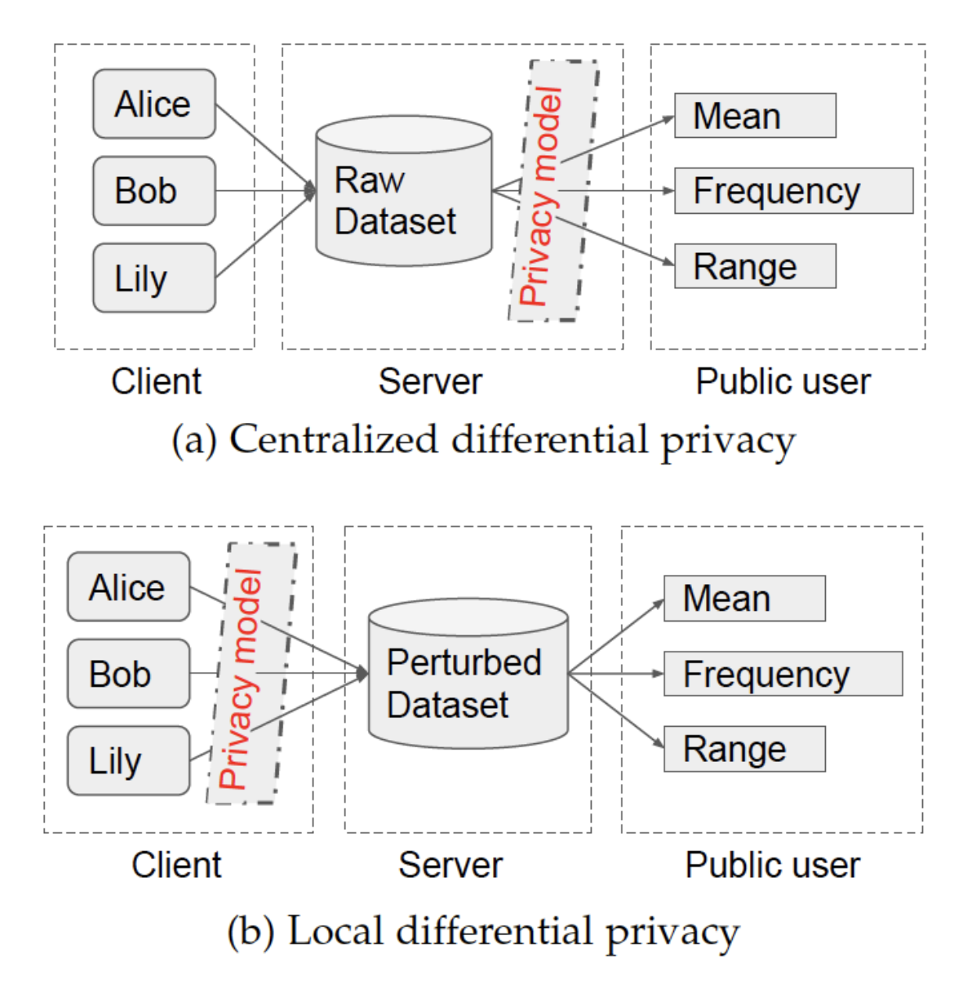
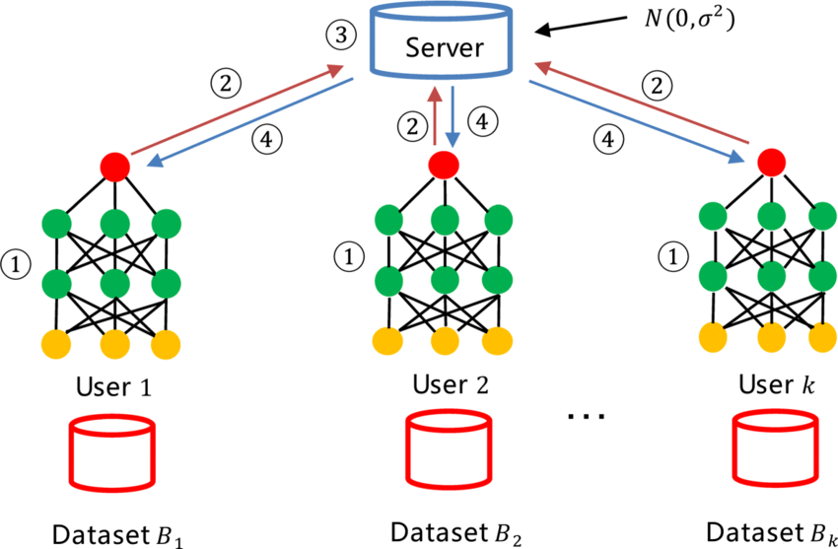
Conclusions
1 LDP 用来满足传输过程中的隐私安全
2 CDP 用来满足发布结果当中的隐私安全

Slide 28
汇报完毕
Thanks for listening

