Slide 1
LDP-FL: Practical Private Aggregation in Federated Learning
with Local Differential Privacy
汇报人：黄其涵
导师：章静 教授
Proceedings of the Thirtieth International Joint Conference on Artificial Intelligence (IJCAI2021)
Notes:
国际人工智能联合会议（International Joint Conference on Artificial Intelligence, 简称为IJCAI）是人工智能领域中最主要的学术会议之一

Slide 2
Contents
01
Introduction
02
Preliminaries
03
Methodology
04
Experiments
05
Conclusions

Slide 3
01
Introduction

Slide 4
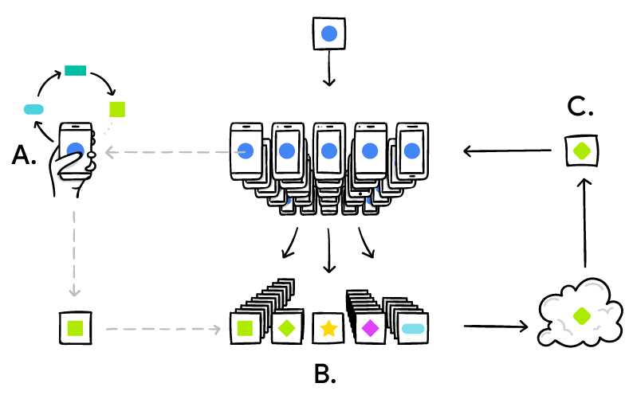
Introduction
1.1 Background
Many attractive applications involve training models on highly sensitive data, e.g., diagnosis of diseases with medical records, or genetic sequences. In order to protect the privacy of the training data, the federated learning framework is of particular interest since it can provide a well-trained model without touching any sensitive data directly. The original purpose of the federated learning (FL) framework is to share the weights of the model trained on sensitive data instead of data directly. However, some studies show that the weights also can leak privacy and the original sensitive data can be recovered.
Notes:
有一些应用的训练模型是基于敏感数据，例如，通过医疗诊断模型。
为了保护训练数据的隐私，联邦学习框就特别适合这样的场景，因为它可以提供训练良好的模型，而无需直接接触任何敏感数据。
联邦学习（FL）本质上是共享训练模型的权重，而不是直接共享数据。 然而，一些研究表明，权重也会泄露隐私，并且可以恢复原始敏感数据。

Slide 5
Introduction
1.2 Challenges
Notably, there are at least two remaining challenges in applying local differential privacy (LDP) in FL.
First, existing approaches have assumed a fixed range of weights for simplicity. However, in complicated models such as those used in deep learning tasks, the range of model weights at different neural network layer varies signiﬁcantly. Assuming weights in all layers to be in a ﬁxed range will introduce a large variance of the estimated model weights, which leads to the poor model accuracy.
Second, when client uploads the local model to the server, the server can explore the private connections of model weights, which causes the privacy budget explosion due to the high dimensionality of deep learning models.
Notes:
把本地差分隐私应用在FL有两个挑战
1权重的加噪范围固定，估计的平均值会引入较大的方差，从而导致模型精度变差；
2由于深度学习模型中权重的高维数，会导致隐私预算爆炸。

Slide 6
Introduction
1.2 Contributions
They propose a new data perturbation with adaptive range by considering that model weights at different deep neural network (DNN) layer could vary signiﬁcantly;
They propose a parameter shuffling mechanism to each clients’ weights to mitigate the privacy degradation caused by the high data dimensionality of deep learning models and many query iterations.
Notes:
1）他们考虑到不同神经网络层的模型权重数值范围可能会显着变化，提出了一种具有自适应范围的数据扰动；
2）他们为本地客户端的权重提出了一种参数混洗机制，来增强本地差分隐私应用在联邦学习当中的隐私保护能力。
以减轻由深度学习模型的高数据维数和多次查询迭代引起的隐私退化。

Slide 7
02
Preliminaries

Slide 8
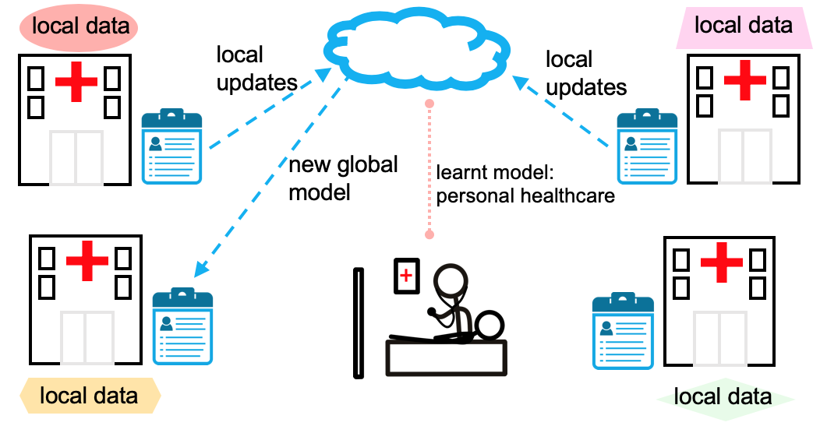
Preliminaries
2.1 Federated Learning
Horizontal Federated Learning
Notes:
分布式机器学习技术，在不泄露隐私的同时支持把用户数据作为样本进行模型训练。
医院都有自己的本地数据，想要共同训练一个医疗诊断模型，不能把本地数据简单聚合，只能通过联邦学习进行训练。
联邦学习中每个客户端都会维护一个本地训练模型，样本训练是在本地进行的。训练完以后，会将模型权重上传到中心模型。中心进行权重聚合，下发给客户端。完成模型之间的通讯。

Slide 9
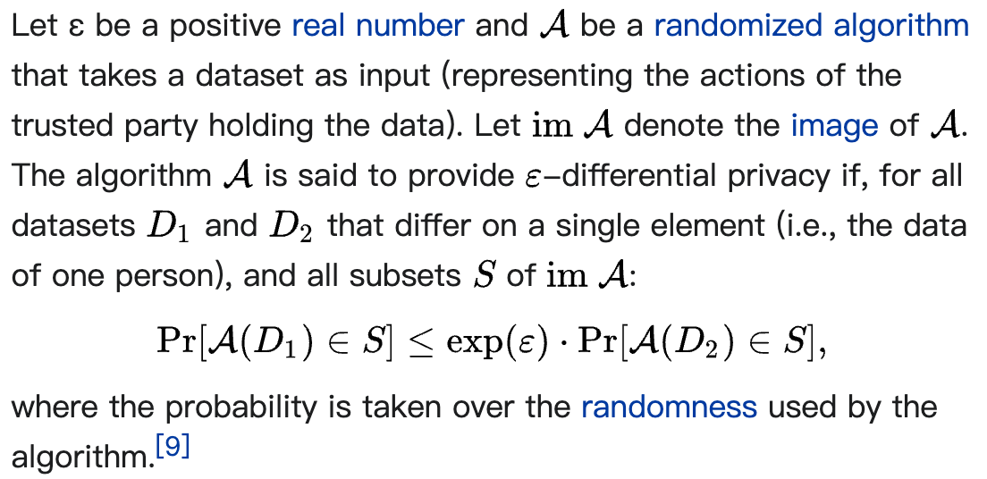
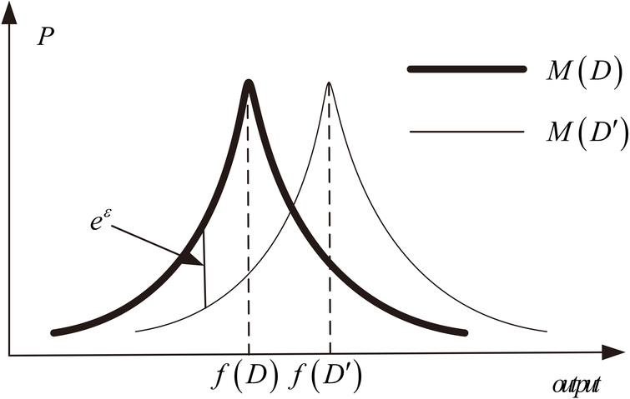
Preliminaries
2.2 Differential Privacy
Notes:
差分隐私机制像是隐私保护程度的一种定义，而不是实现手段。
把原始数据加噪声，导致原始数据分布进行偏移，偏移量就是eEpsilon，这样就满足差分隐私定义。
所谓随机化算法，是指对于特定输入，该算法的输出不是固定值，而是服从某一分布

Slide 10
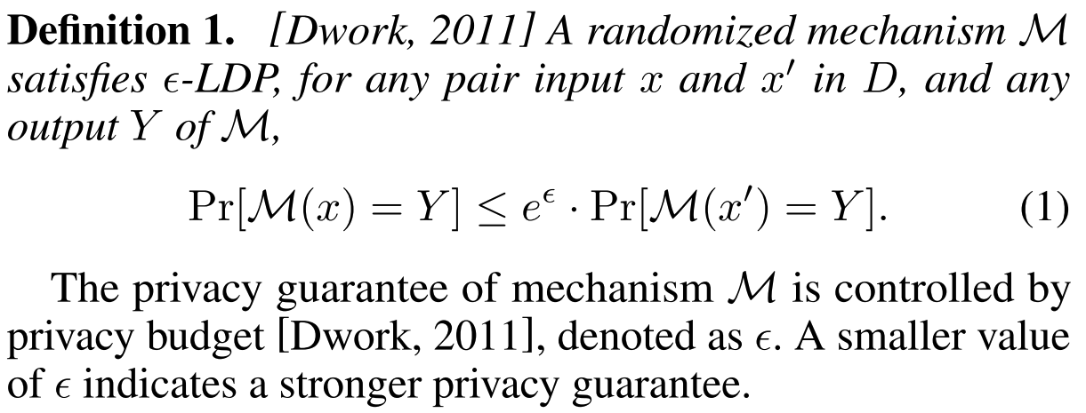
Preliminaries
2.3 Local Differential Privacy
[Dwork, 2011] Cynthia Dwork. Differential privacy. Encyclopedia of Cryptography and Security, 2011.
Notes:
本地差分隐私是基于分布式条件下的一种差分隐私方法，它是在本地进行数据扰动，再把扰动后数据上传至中心模型。
相对的其实还有中心化差分隐私，是将数据聚合后再做扰动。

Slide 11
03
Methodology
Notes:
这篇文章的实验部分分为三个部分
第一部分从pointnet的应用入手，第二部分着眼于pointnet结构设计，第三部分pointnet的鲁棒性测试。

Slide 12
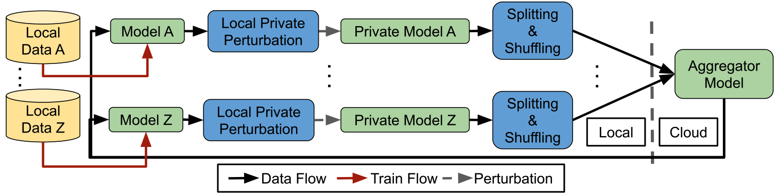
Methodology
3.1 Overview of LDP-FL
Figure 1: The overview of LDP-FL. Each client has a private dataset. After training their model locally, clients perturb their model weights with differentially private noise, and locally split and shufﬂe the weights to make them less likely to be linked together by the cloud. Finally, they send the weights to the cloud for aggregation.
Notes:
把本地差分隐私应用在联邦学习当中，去限制通过模型权重还原真实数据。
模型整体框架，数据流概览。
蓝色方块是文章中的隐私保护手段，满足差分隐私机制的扰动，（分割混洗）满足匿名性的一种乱序手段。

Slide 13
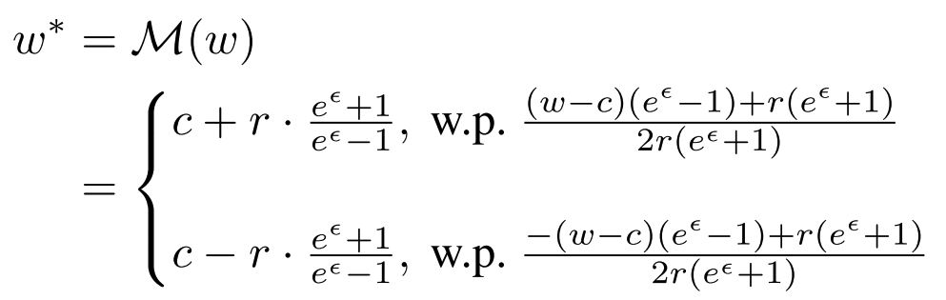
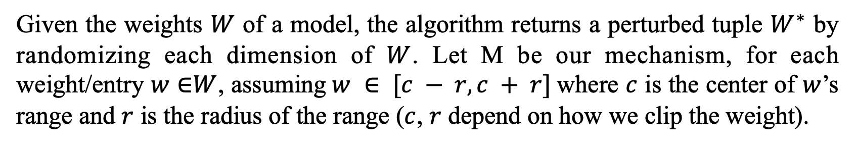
Methodology
3.2 Privacy-Preserving Mechanism
Data Perturbation with Adaptive Range
Given the weights $W$ of a model, the algorithm returns a perturbed tuple $W^{∗}$ by randomizing each dimension of $W$. Let M be our mechanism, for each weight/entry $w$ ∈$W$, assuming$w ∈ [c − r, c + r]$where $c$ is the center of $w$’s range and $r$ is the radius of the range ($c$, $r$ depend on how we clip the weight).
where w∗ is the reported noisy weight by our proposed LDP.
Notes:
通过自适应的范围进行数据扰动
单数值的扰动，c是一组权重当中的中心数值，r是这个数值范围的半径

Slide 14
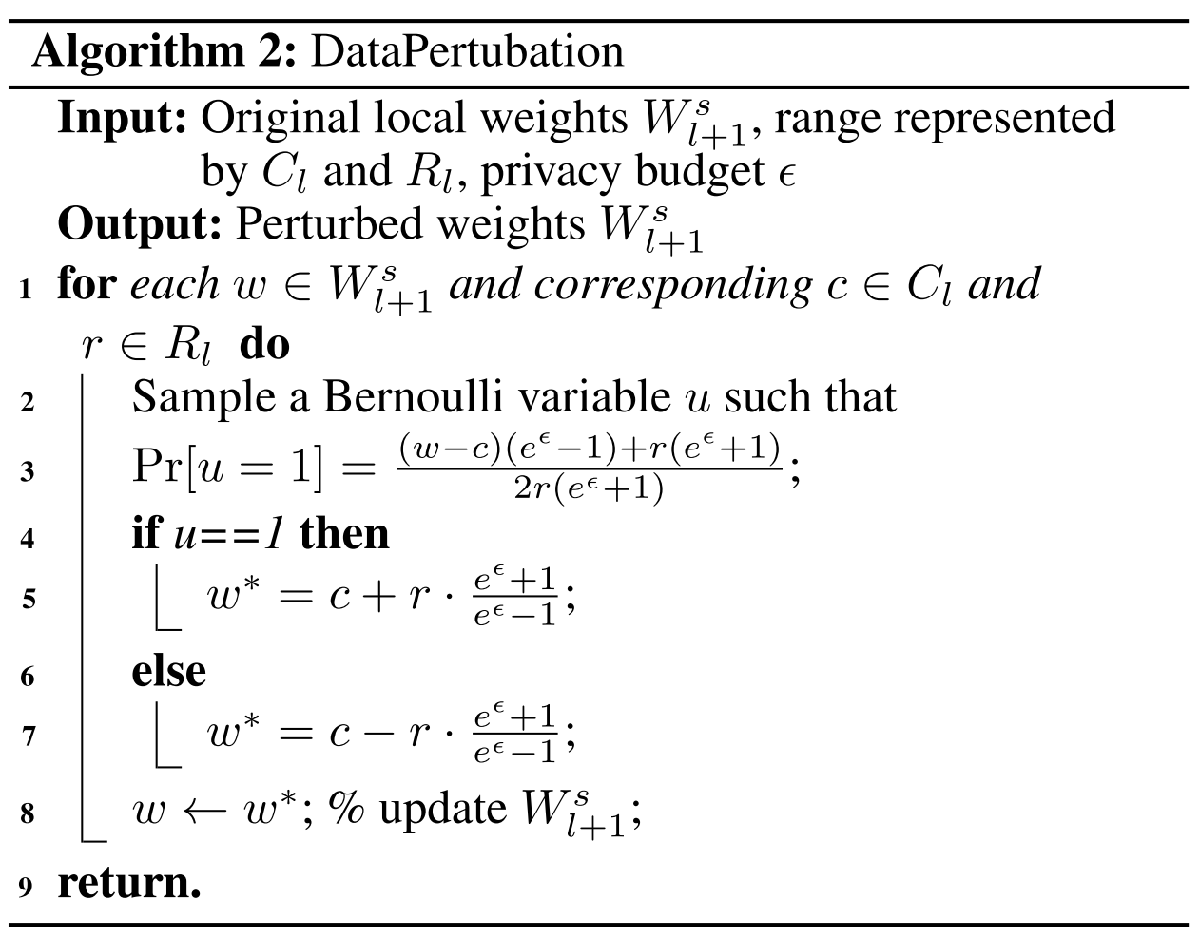
Methodology
3.2 Privacy-Preserving Mechanism
Data Perturbation with Adaptive Range – Algorithm
Notes:
数值扰动算法的伪代码
w是本地模型权重，下标l+1是指训练轮次，C是数值范围的中心，R是数值范围的半径，

Slide 15
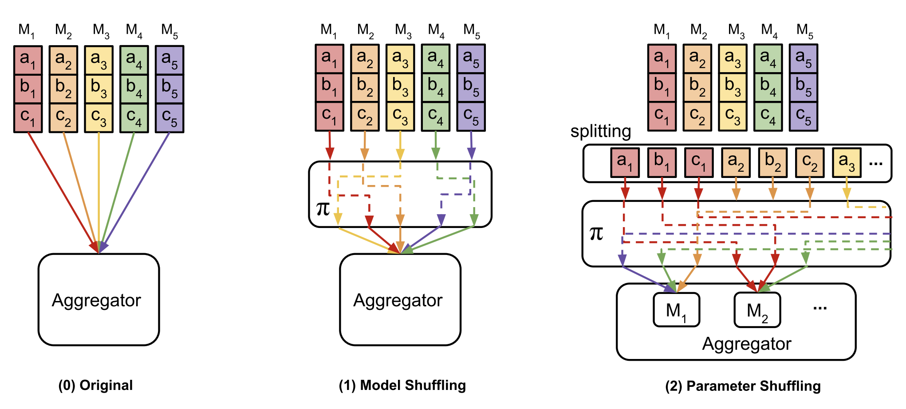
Methodology
3.2 Privacy-Preserving Mechanism
Parameter Shufﬂing
Figure 2: Example of parameter shufﬂing in LDP-FL. π is a random shufﬂing mechanism. Note that, the parameter shufﬂing is composed of parameter shufﬂing mechanisms. The cloud will aggregate all kinds of information from clients.
Notes:
通过可信第三方实现混洗策略
模型混洗使得云端无法分辨整体权重是由哪个客户端上传的，
参数混洗使得云端无法分辨单个权重的来源。

Slide 16
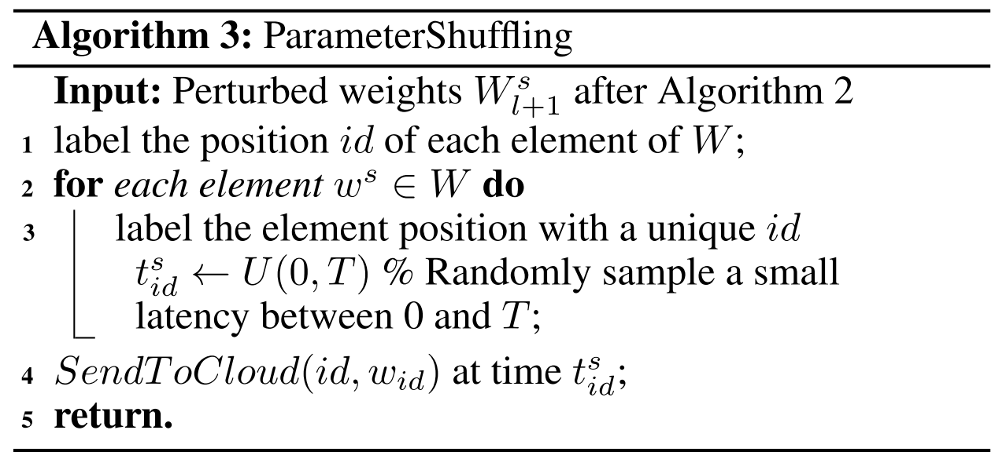
Methodology
3.2 Privacy-Preserving Mechanism
Parameter Shufﬂing – Algorithm
Notes:
参数混洗的算法实现
客户端是独立计算的，有可能有数据上传时间的差异。
这个算法还增加了发送时间的扰动，使得云端无法通过上传时间来进行权重来源的区分

Slide 17
04
Experiments

Slide 18
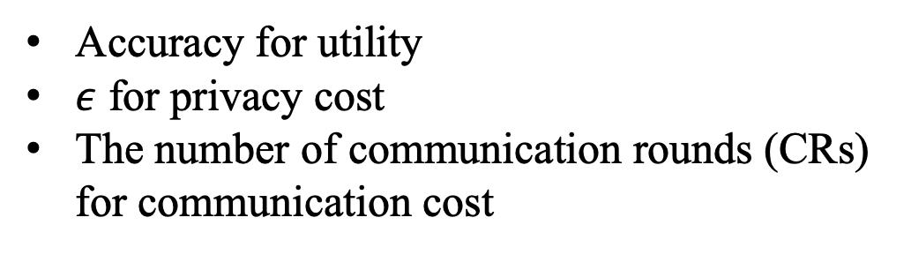
Experiments
4.1 Dataset:
CIFAR-10, MINST, Fashion-MINST
4.2 Evaluation metrics:
Accuracy for utility
$ε$ for privacy cost
The number of communication rounds (CRs) for communication cost
Notes:
模型进行图像识别的准确率
隐私预算的消耗值
通讯回合数

Slide 19
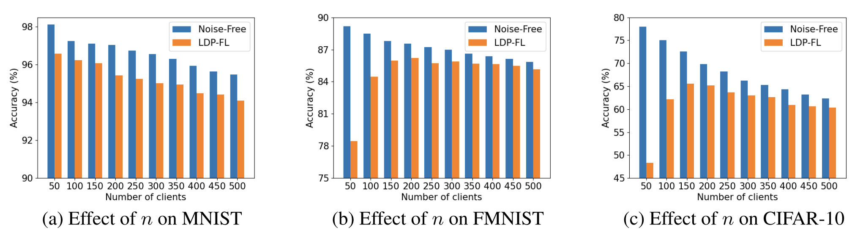
Experiments
4.3 Results
Figure 3: Effect of $n$ on the training accuracy.
Notes:
本文模型和无噪声模型在不同客户端数量上的识别准确率的对比。
MNIST，不随客户端数量改变模型之间的差异
FMNIST, CIFAR-10 客户端越多，结果就越接近无噪声模型

Slide 20
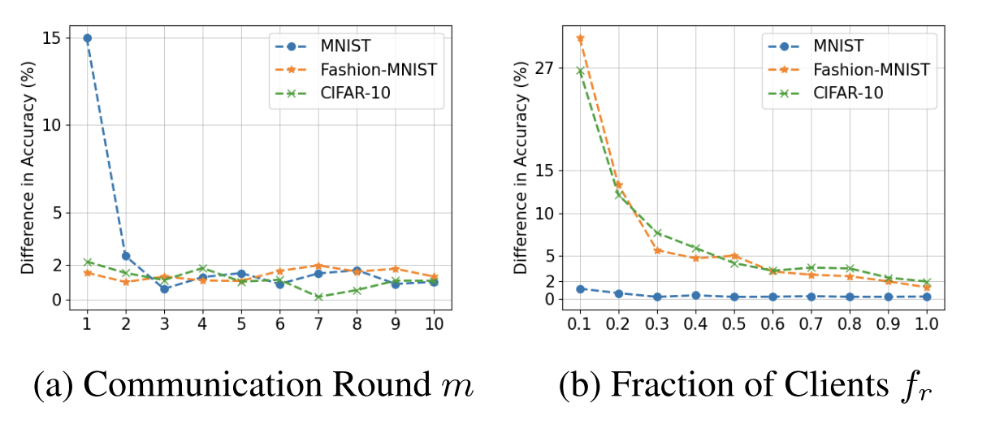
Experiments
4.3 Results
Figure 4: Parameter analysis on communication round and fraction of clients. For MNIST, FMNIST and CIFAR-10, we set the number of total clients as 100, 200, 500 respectively.
Notes:
4a 本文模型和无噪声模型的准确度差异会随通讯回合数逐渐降低。
4b Fr是指每一轮参与模型更新的客户端比例。参与模型更新的客户端比例越大，两个模型之间的差异就越小。

Slide 21
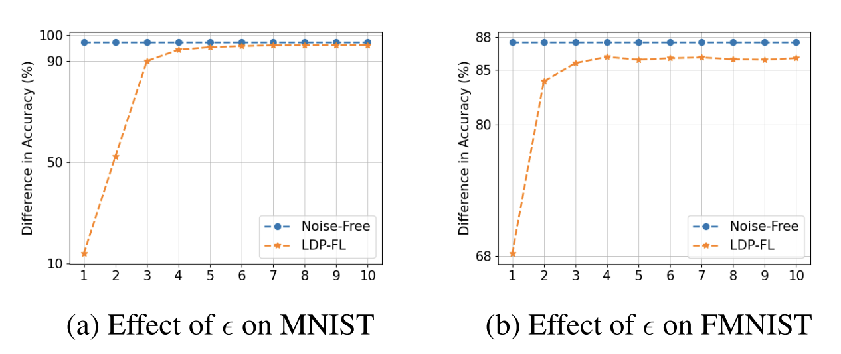
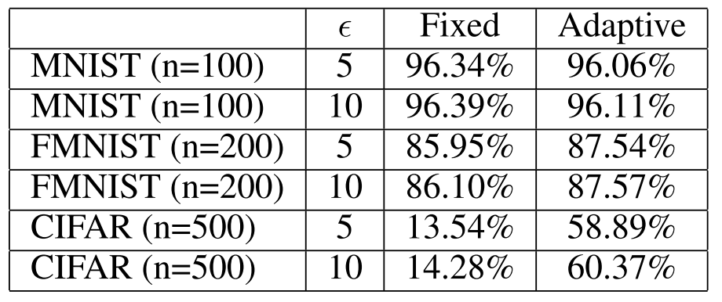
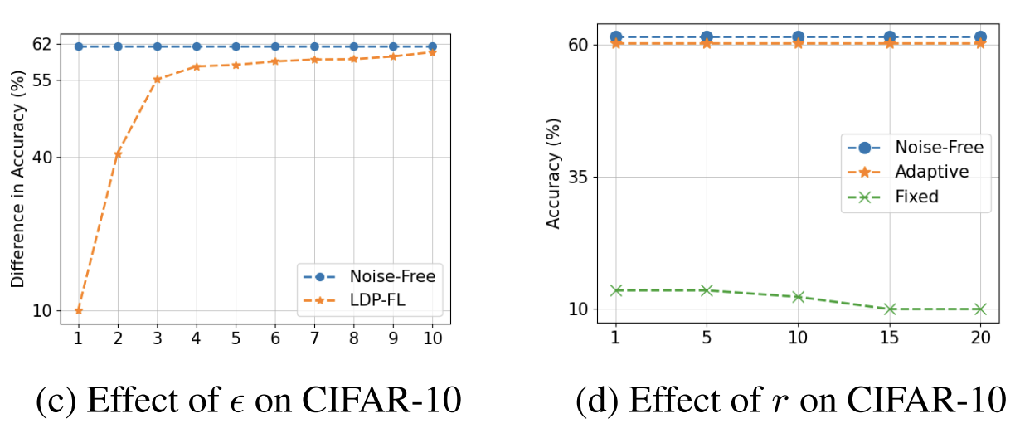
Experiments
4.3 Results
Table 1: Comparison of Adaptive and Fixed Weight Range Settings
Notes:
图5 a-c 隐私预算增大对于模型的影响，表明隐私预算越大越接近无噪声。纵坐标错误
d 权重数值半径的范围越大，那么以固定范围来扰动数据的模型方法，它的准确率就越低。
表1 自适应方法和固定取值的方法在不同隐私预算下的准确率。明显看到自适应范围的方法在整体的识别准确度上是较高的。

Slide 22
05
Conclusions

Slide 23
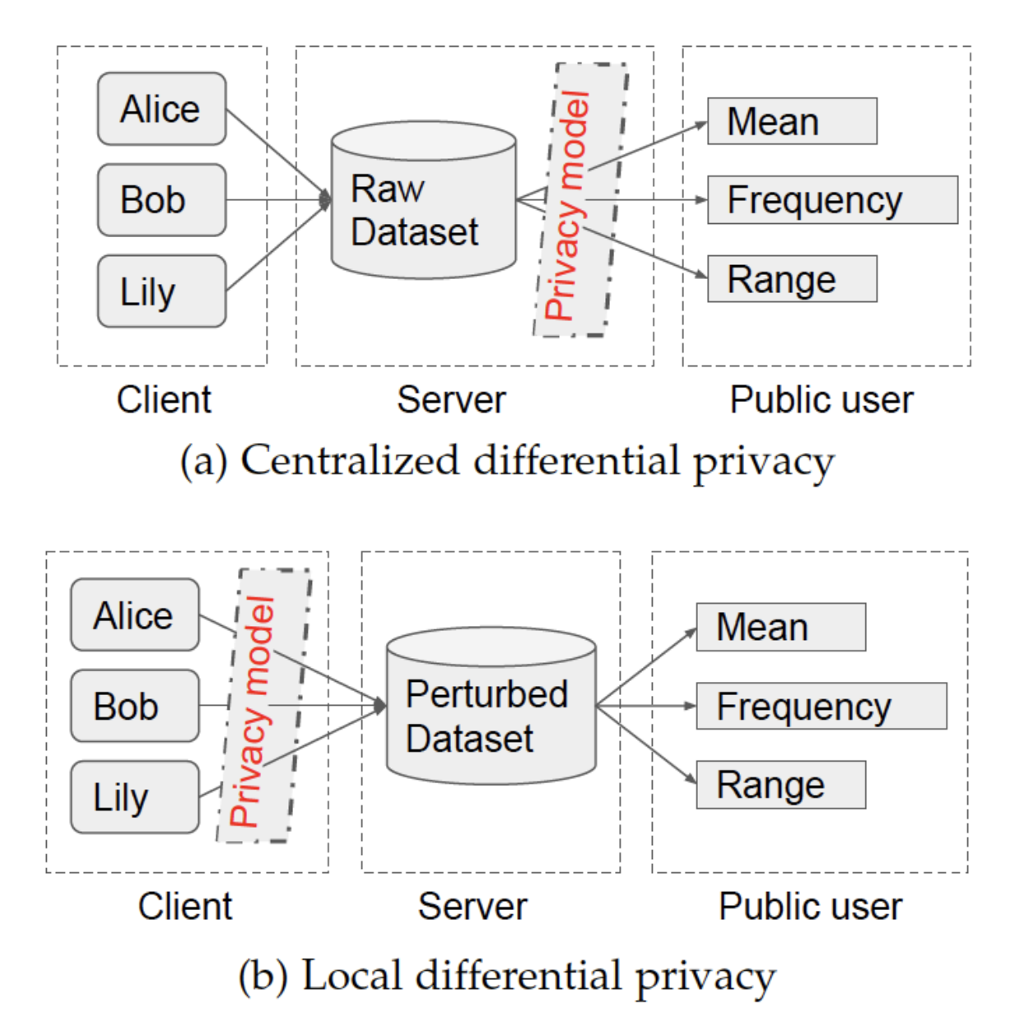
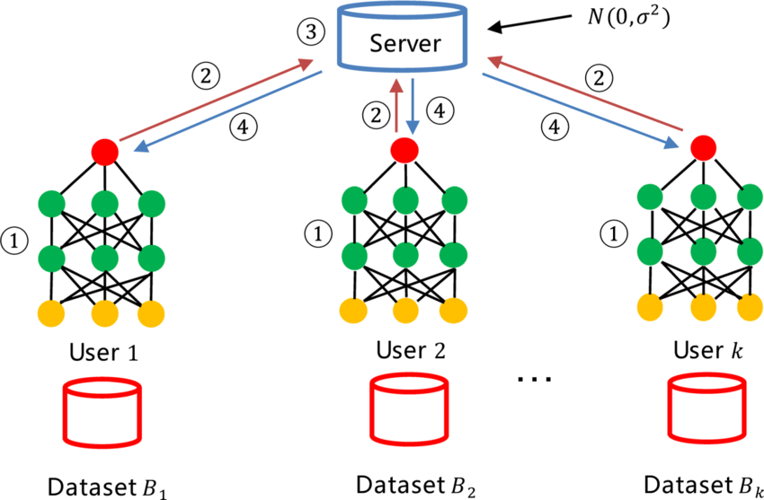
Conclusions
1 LDP 用来满足传输过程中的隐私安全
2 CDP 用来满足发布结果当中的隐私安全

Slide 24
汇报完毕
Thanks for listening

Slide 25
Preliminaries
2.1 Federated Learning
FL has been proposed and widely used in different approaches. The motivation is to share the model weights instead of the private data for better privacy protection. Each client, the owner of private training data, updates a model locally, and sends all gradients or weights information to the cloud. The cloud aggregates such information from clients, updates a new central model (e.g., averaging all clients’ weights), and then distributes it back to a fraction of clients for another round of model update. Such process is continued iteratively until a satisfying performance is achieved. Note that, to minimize communication, each client might take several mini-batch gradient descent steps in local model computation.

Slide 26
Introduction
1.3 轨迹生成模型及其隐私保护机制
以这种方式处理大规模轨迹数据,能够分别解决两种问题.
一是能够解决研究中缺乏真实轨迹样本的问题[].在许多研究领域中,收集相关的数据代价是较为昂贵的,然而收集足够的数据来进行正确地训练和验证模型又是必不可缺的.在这种情况下,生成与真实环境下相似的仿真轨迹数据以增加样本是一种高效的样本处理手段.
二是能够解决真实轨迹数据发布的隐私泄露问题[].合成的轨迹数据在与真实的轨迹数据相同的分布下生成,以较为合理的相似度对隐私敏感的轨迹数据进行组合或替换,从而能够为研究任务提供有价值的数据并且能够保护真实用户的轨迹隐私.

Slide 27
Introduction
1.3 大规模轨迹生成的相关方法和研究现状
Ouyang等人提出了一个去参数化的轨迹生成模型，通过网格化表示轨迹并用GAN学习其分布。（2018）
Rao等人提出了LSTM-TrajGAN方法，即将LSTM递归神经网络和GAN结构结合的深度学习模型，生成保持隐私的合成轨迹，用于轨迹数据发布[]。（2020）
Choi等人提出了一种GAIL框架（强化学习和GAN的结合）用于生成位置序列，其中每个位置被建模为一个动作结果，从而每个轨迹被部分可观察的马尔可夫决策过程建模[] 。（2021）
Wang等人提出了一种新的基于GAN和RNN的分步学习方法，分别对原始轨迹进行联合分配学习，进一步从地图图像中嵌入道路网络[]。（2021）
......
Notes:
Rao J, Gao S, Kang Y, et al. LSTM-TrajGAN: A deep learning approach to trajectory privacy protection[J]. arXiv preprint arXiv:2006.10521, 2020. Choi S, Kim J, Yeo H. TrajGAIL: Generating urban vehicle trajectories using generative adversarial imitation learning[J]. Transportation Research Part C: Emerging Technologies, 2021, 128: 103091.
Wang X, Liu X, Lu Z, et al. Large scale GPS trajectory generation using map based on two stage GAN[J]. Journal of Data Science, 2021, 19(1): 126-141
虽然这些最先进的模型在效用和隐私之间提供了合理的平衡，但隐私机制和效用度量的效力还没有得到充分的研究。

