Slide 1






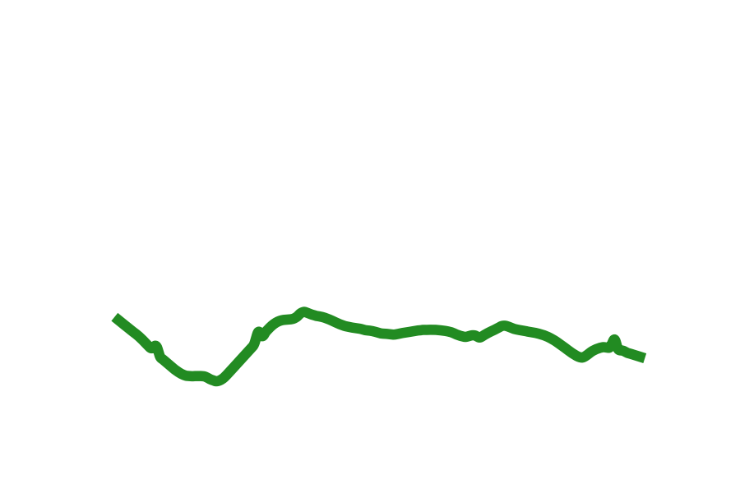
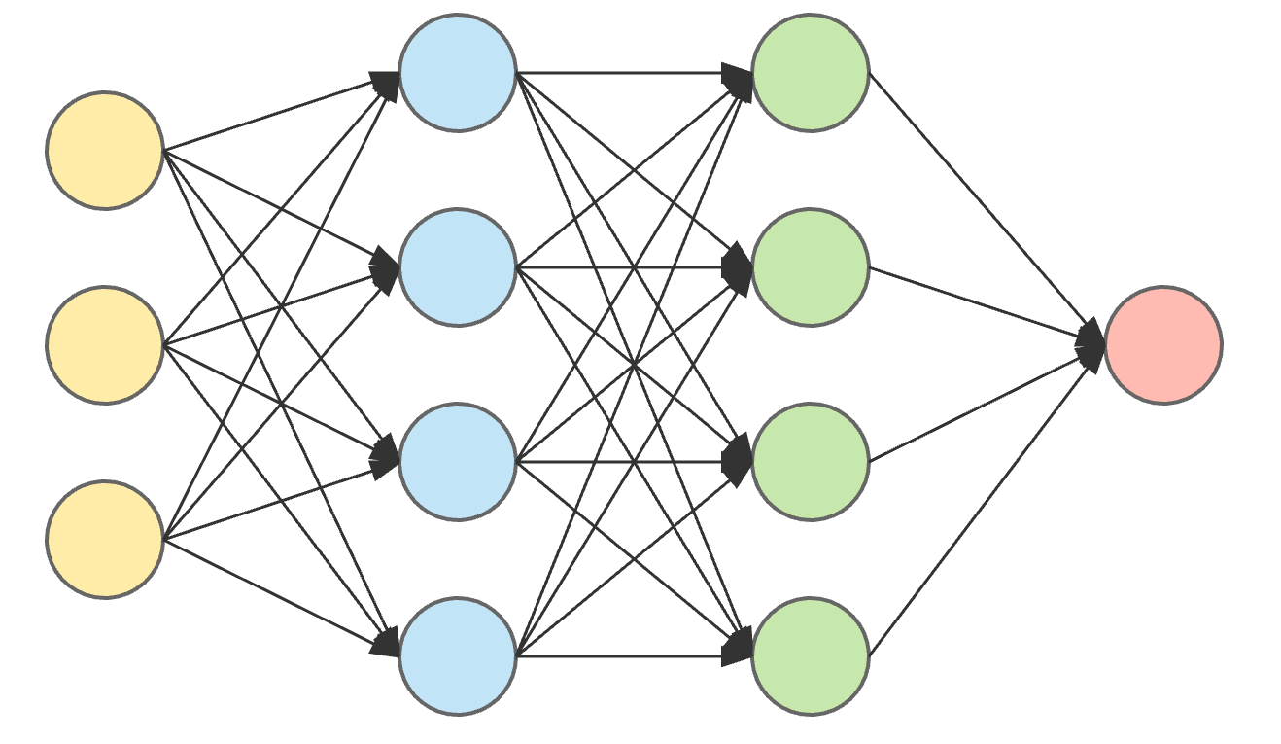



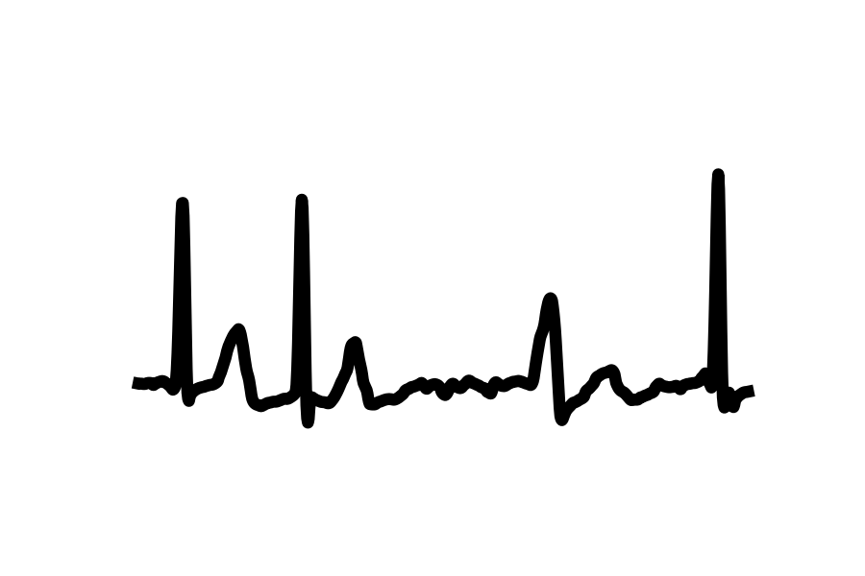


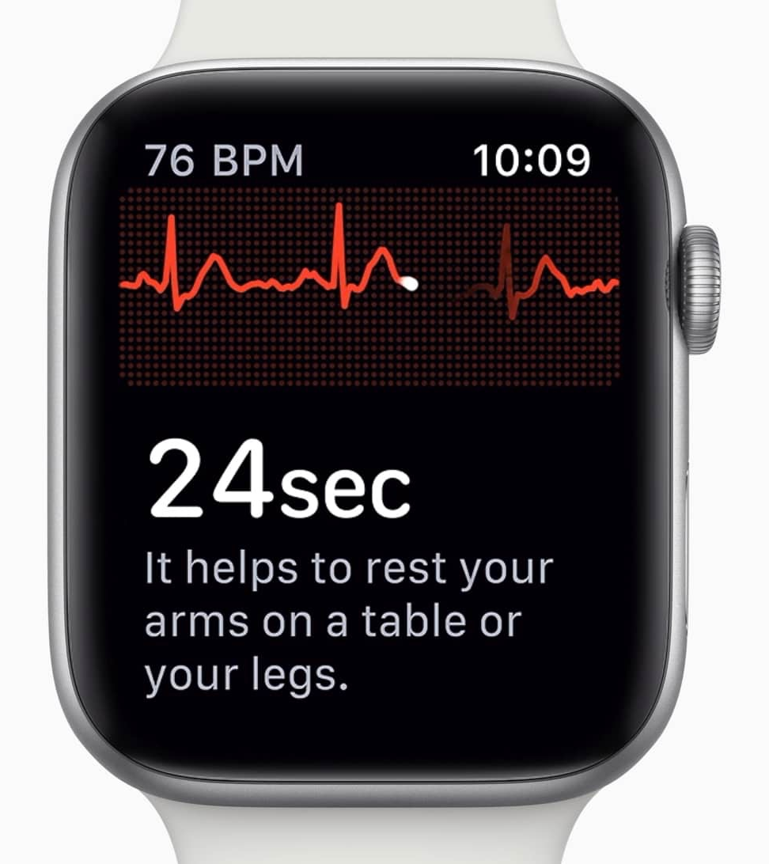


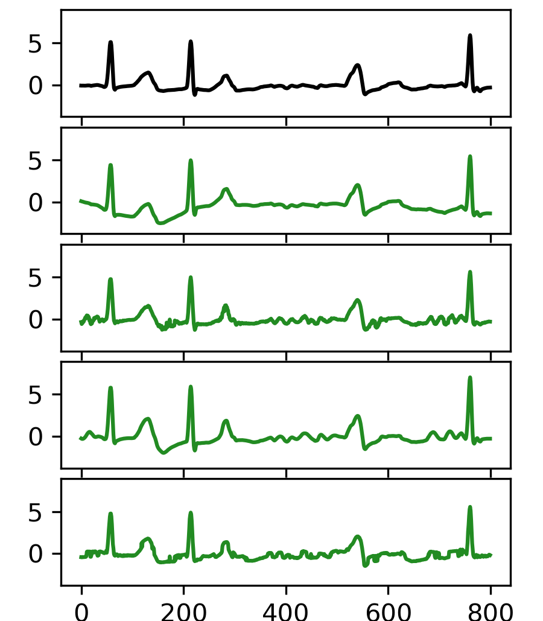
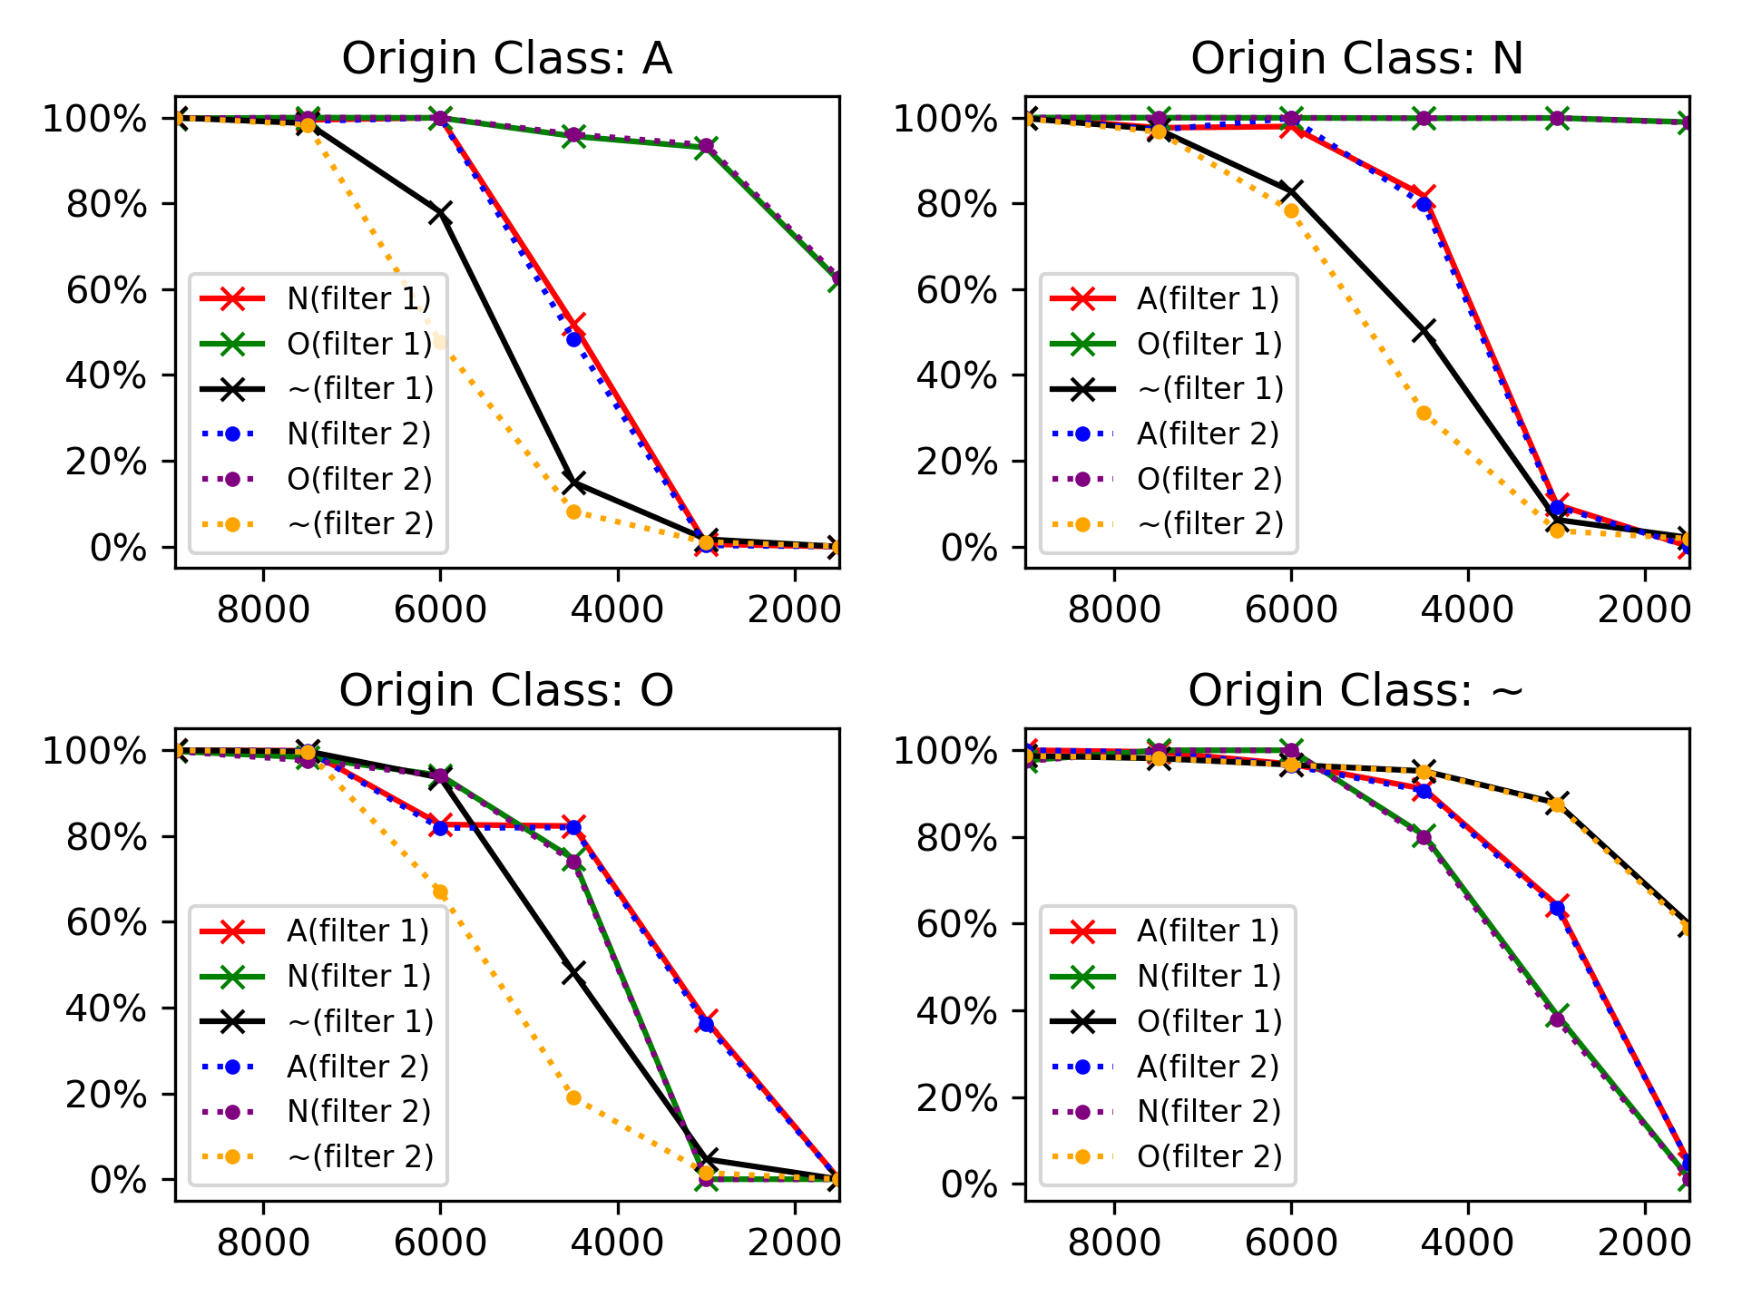
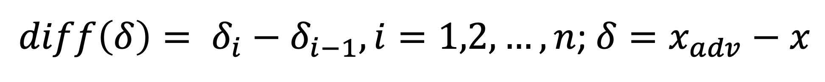
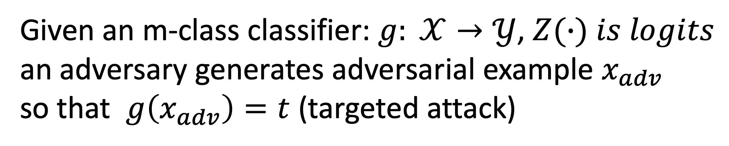
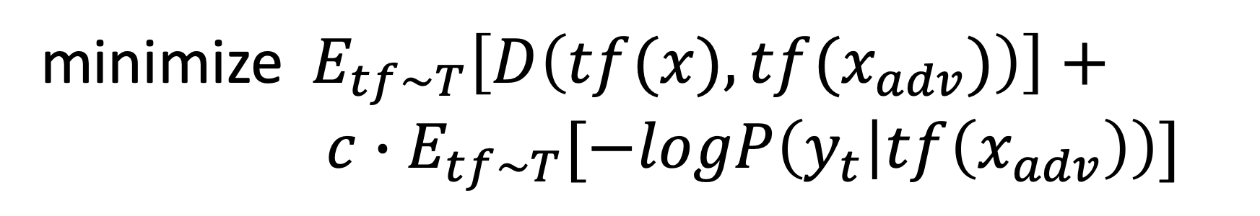
ECGadv: Generating Adversarial Electrocardiogram to
Misguide Arrhythmia Classiﬁcation System
Huangxun Chen^{1†}, Chenyu Huang^{1†}, Qianyi Huang² ¹, Qian Zhang¹ , Wei Wang³
¹The Hong Kong University of Science and Technology
²Southern University of Science and Technology, Peng Cheng Laboratory
³Huazhong University of Science and Technology
†Co-primary Authors
Injected Perturbation
Normal
WHAT
An ECG signal (Arrhythmia)
ECG patch
Cloud DNN model
Are DNN-based arrhythmia classifiers vulnerable to adversarial examples?
Normal
Arrhythmia
Injected Perturbation
Local DNN model
Attack goal
Main issues in Case II: Skewing, Filtering
Given an m-class classifier: $g: 𝒳→𝒴$, $Z(∙) is logits$
an adversary generates adversarial example $x_{adv}$
so that $g\left(x_{adv}\right)=t$ (targeted attack)
Attack strategy
1. Cooperate time domain skewing
Given a distribution $T$ of transformation function $tf$:
HOW
Main issue in Case I: Imperceptibility
minimize $E_{tf\sim T}\left[D\left(tf(x), {tf(x}_{adv})\right)\right]+$
$c∙E_{tf\sim T}[−logP\left(y_{t} | tf\left(x_{adv}\right)\right)]$
Attack strategy
2. Cooperate filtering
$$minimize D\left(x, x_{adv}\right)+c∙f_{g}(x_{adv})$$
$x_{adv}=x+h\left(x_{perturb}\right), h(∙)$ is a rectangular filter
$$f_{g}\left(x_{adv}\right)=(\max_{i≠t}(Z(x_{adv})_{i})−Z(x_{adv})_{t})^{+}$$
Similarity metric: Smoothness of perturbation $δ$
Dataset and Victim Model
$$D\left(x, x_{adv}\right)= d_{smooth}\left(δ\right)=var\left(diff\left(δ\right)\right)$$
Victim Model: 34-layer Residual Networks*
$diff\left(δ\right)= δ_{i}−δ_{i−1}, i=1,2,…, n$; $δ=x_{adv}−x$
*https://github.com/fernandoandreotti/cinc-challenge2017
Dataset: 6,081 ECG segments, 4 classes (normal rhythm(N), atrial ﬁbrillation(A), other rhythm(O) and noise(~) )
Case I: Human Perceptual Study
Case II: Success Rate and Attack Duration
Imperceptibility Test (57 AMT users)
Success attack rates with different attack duration
Which adversarial example is more similar to original signal?
Attack duration: the part of an ECG affected by perturbation
Filter 1: Rectangular ﬁlter
Filter 2: A high-pass Butterworth ﬁlter (0.05Hz cutoff) + Notch ﬁlters (50/60Hz)
Original signal
RESULT
Metric: Smoothness
Metric: L2-norm
Metric: Smoothness+L2-norm
Metric: Soft-DTW
A sample: Arrhythmia -> Normal
Contact: {hchenay, chuangak}@connect.ust.hk
Thirty-Fourth AAAI Conference on Artificial Intelligence (AAAI-20)

