Slide 1
SPRING: A Strategy-Proof and Privacy Preserving Spectrum Auction Mechanism
Qianyi Huang, Yixin Tao, and Fan Wu
Department of Computer Science and Engineering
Shanghai Jiao Tong University, China

Slide 2
Outline
Motivation
Preliminary
SPRING
SPRING with Multi-Channel Bids
Evaluation
Conclusion

Slide 3
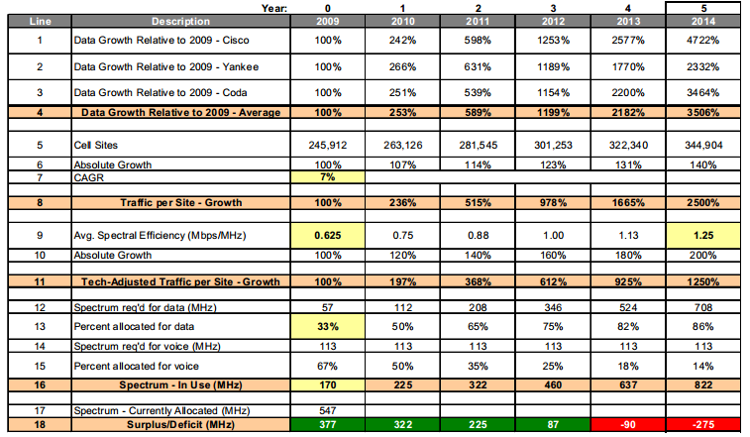
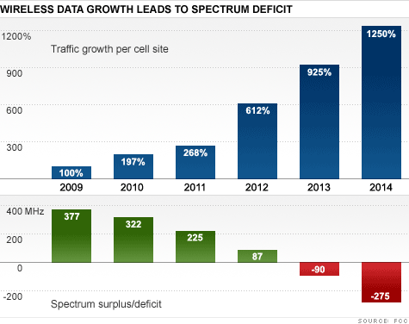
Spectrum Need Forecast ‐ Table of Results

Slide 4


Secondary Spectrum Market
Government: static long term licenses
Radio spectrum is not fully utilized
New wireless applications have to crowd into limited unlicensed bands
Need for Dynamic Spectrum Redistribution/ Auction

Slide 5


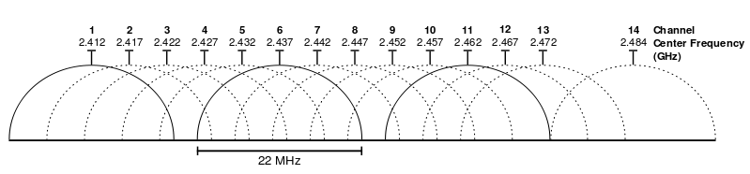
Traditional Spectrum Auctions
Auctioneer
Bidders
Channels
Spectrum auction mechanisms stimulate the bidders to truthfully reveal their valuations of spectrum/channels.
True valuations are sensitive information
Corrupt auctioneer

Slide 6
Motivation
Existing spectrum auction mechanisms fail to protect bidders’ privacy.
Existing privacy preserving auction mechanisms cannot be directly applied to spectrum auctions.
Channel 1
Channel 2

Slide 7


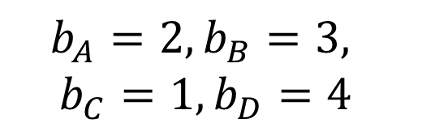

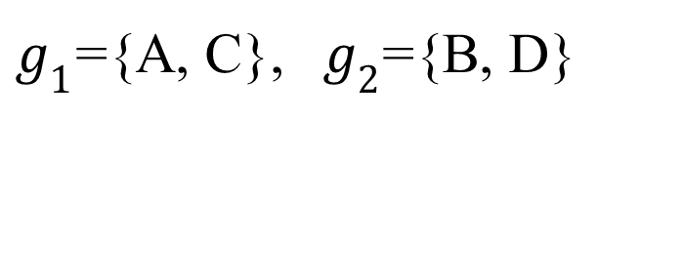
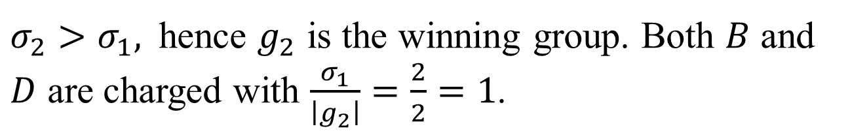
Generic Strategy-Proof Spectrum Auction
Four bidders are competing for one channel
B
$$b_{A}=2, b_{B}=3,$$
$$b_{C}=1, b_{D}=4$$
C
A
D
$g_{1}$={A, C},${ g}_{2}$={B, D}
$$σ_{1}=\left|g_{1}\right|×\min\left\{b_{A}, b_{C}\right\}=2×1=2$$
$$σ_{2}=\left|g_{2}\right|×\min\left\{b_{B}, b_{D}\right\}=2×3=6$$
$σ_{2}>σ_{1},$hence $g_{2}$ is the winning group. Both $B$ and $D$ are charged with $\frac{σ_{1}}{\left|g_{2}\right|}=\frac{2}{2}=1$.

Slide 8
Outline
Motivation
Preliminary
SPRING
SPRING with Multi-Channel Bids
Evaluation
Conclusion

Slide 9
Order Preserving Encryption
OPES encrypts numeric data while preserving the order. It enables any comparison operation to be directly applied on the encrypted data.
$$β=\left\{β_{1}，β_{2}，…,β_{z}\right\}, { β}_{1}<β_{2}<…<β_{z}$$
OPES
$$γ=\left\{γ_{1}，γ_{2}，…,γ_{z}\right\},γ_{1}<γ_{2}<…<γ_{z}$$

Slide 10



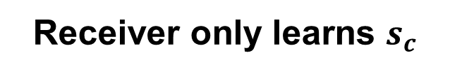


Oblivious Transfer
$$s_{1}, s_{2}, …, s_{z}$$
$$c∈\{1,2,…, z\}$$
Sender has z secrets
Receiver has choice c
Sender doesn’t know c
Receiver only learns $s_{c}$

Slide 11
Outline
Motivation
Preliminary
SPRING
SPRING with Multi-Channel Bids
Evaluation
Conclusion

Slide 12
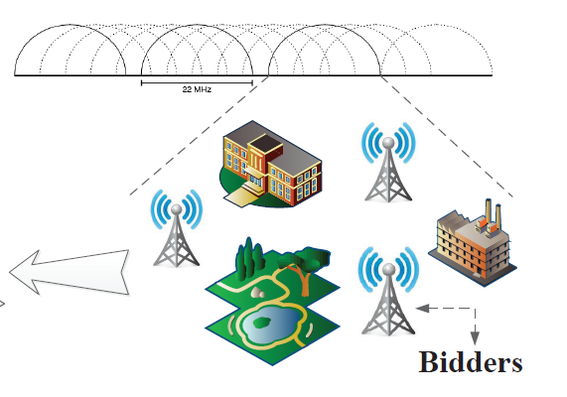


SPRING
End-to-end Asymmetric Encryption
Oblivious Transfer

Slide 13
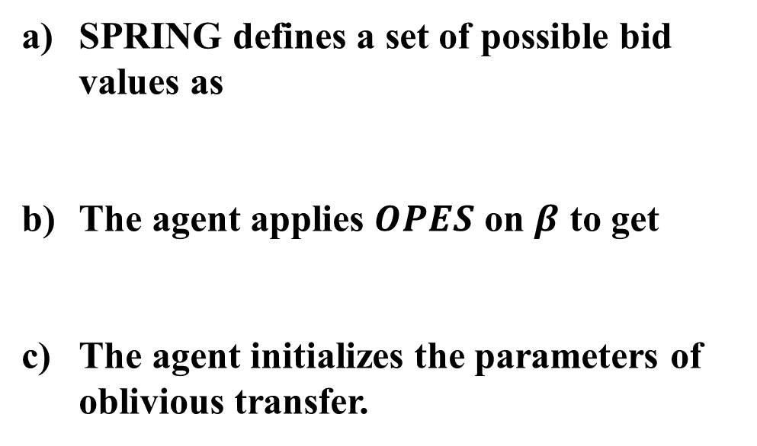

Design Details - Step 1: Initialization
SPRING defines a set of possible bid values as
The agent applies $OPES$ on $β$ to get
The agent initializes the parameters of oblivious transfer.
$$β=\left\{β_{1}，β_{2},…,β_{z}\right\}, { β}_{1}<β_{2}<…<β_{z}.$$
$$γ=\left\{γ_{1}，γ_{2},…,γ_{z}\right\},γ_{1}<γ_{2}<…<γ_{z}.$$

Slide 14
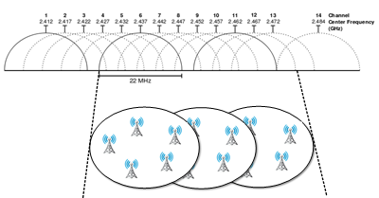
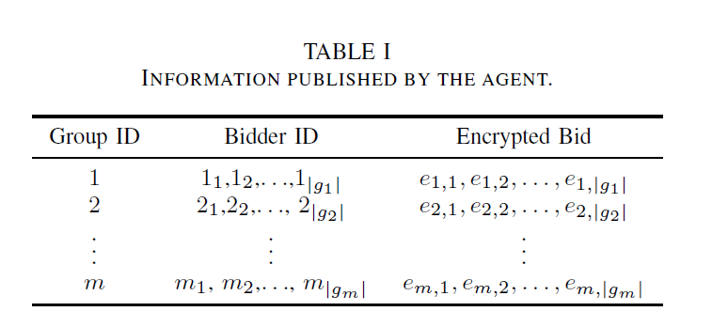
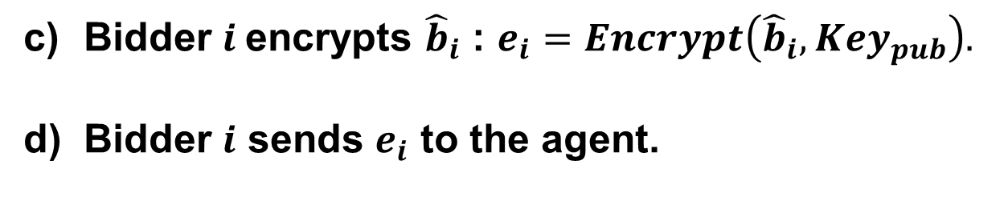
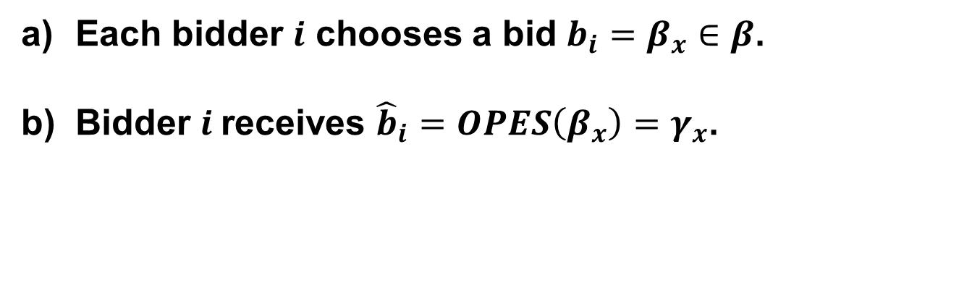
Design Details - Step 2: Bidding
1-out-of –z OT
Bidder $i$encrypts ${\hat{b}}_{i}$ : $e_{i}=Encrypt\left({\hat{b}}_{i},{Key}_{pub}\right).$
Bidder $i$ sends $e_{i}$ to the agent.
Each bidder $i$ chooses a bid $b_{i}=β_{x}∈β$.
Bidder $i$receives ${\hat{b}}_{i}=OPES\left(β_{x}\right)=γ_{x}$.
The agent collects bids, groups bidders in a bid-independent way, publishes the grouping results and encrypted bids.

Slide 15
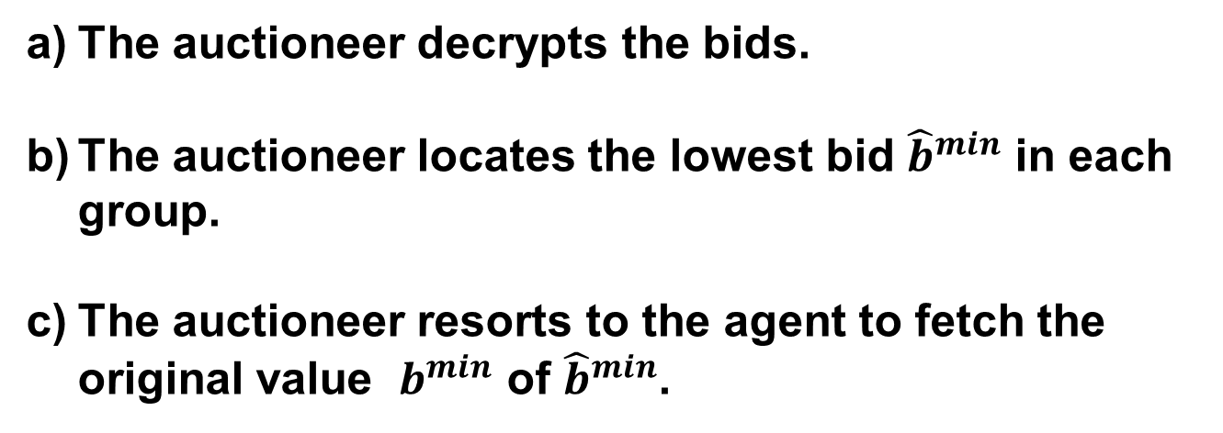
Design Details - Step 3: Opening
The auctioneer decrypts the bids.
The auctioneer locates the lowest bid ${\hat{b}}^{min}$ in each group.
The auctioneer resorts to the agent to fetch the original value $b^{min}$ of ${\hat{b}}^{min}$.
The auctioneer calculates group bids.
The auctioneer determines the winners and their charges.

Slide 16
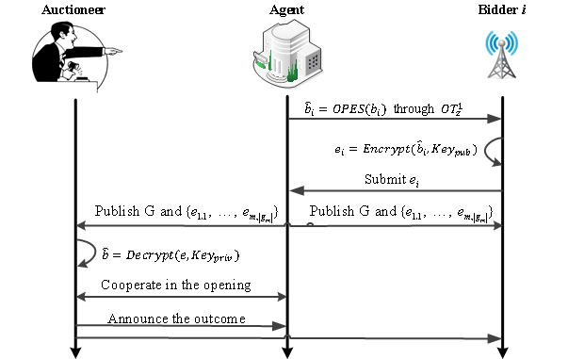
Message Flow in SPRING

Slide 17
Analysis
Theorem 1. SPRING is a strategy-proof spectrum auction mechanism.
We require that each bidder group must contain at least k bidders. Then we have
Theorem 2. SPRING guarantees k-anonymity.

Slide 18
Outline
Motivation
Preliminary
SPRING
SPRING with Multi-Channel Bids
Evaluation
Conclusion

Slide 19
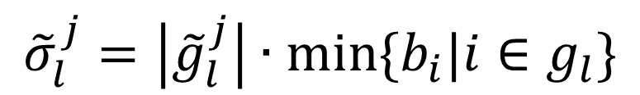
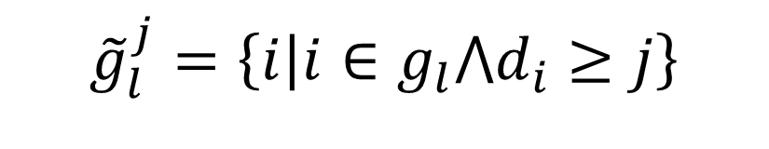
Virtual Group
$${\tilde{g}}_{l}^{j}=\left\{i | i∈g_{l}⋀d_{i}≥j\right\}$$
$${ \tilde{g}}_{l}^{3}$$
〖 𝑔 ̃〗_𝑙^3
$${\tilde{g}}_{l}^{2}$$
𝑔 ̃_𝑙^2
$${\tilde{g}}_{l}^{1}$$
𝑔 ̃_𝑙^1
$${\tilde{σ}}_{l}^{j}=\left|{\tilde{g}}_{l}^{j}\right|∙min⁡\{b_{i}|i∈g_{l}\}$$

Slide 20
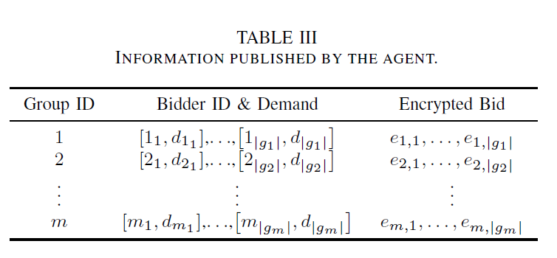
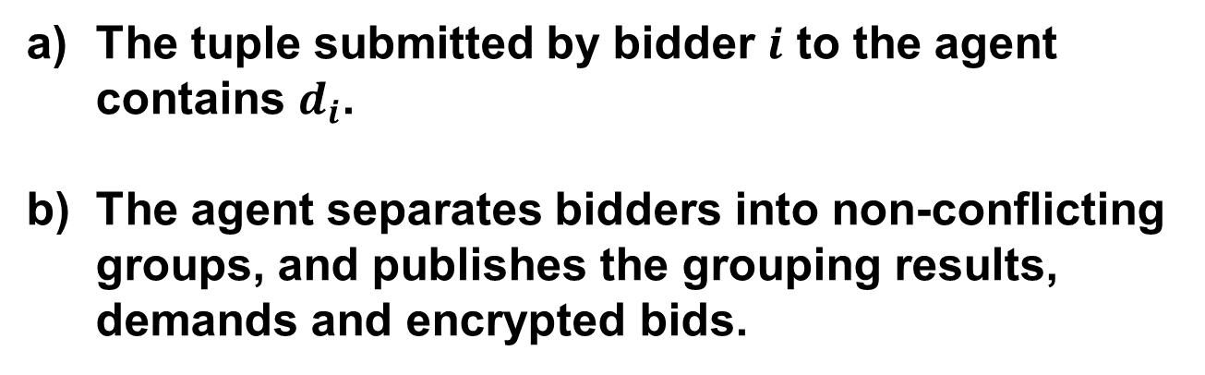
Extension Details – Step 2: Bidding
The tuple submitted by bidder $i$ to the agent contains $d_{i}$.
The agent separates bidders into non-conflicting groups, and publishes the grouping results, demands and encrypted bids.

Slide 21
Extension Details – Step 3: Opening
The auctioneer decrypts the encrypted bids.
The auctioneer cooperates with the agent to calculate the group bids.
The auctioneer determines the winners and charges winners with their critical values.

Slide 22
Outline
Motivation
Preliminary
SPRING
SPRING with Multi-Channel Bids
Evaluation
Conclusion

Slide 23
Evaluation Setup
We implement SPRING using JavaSE-1.7 with packages java.security and javax.crypto, use RSA to do encryption/decryption and digital signature/verification.
Efficiency
Channel Utilization
Satisfaction ratio
Overhead
Computation overhead
Communication overhead

Slide 24
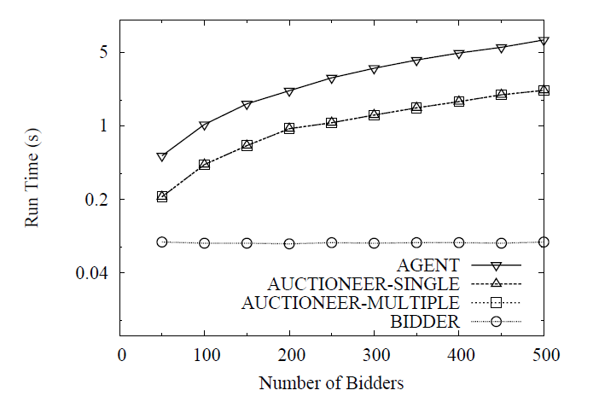
Computation Overhead
The running environment is Intel(R) Core(TM) i7 2.67GHz and Windows 7.
The computation overhead of each bidder is rather low.

Slide 25
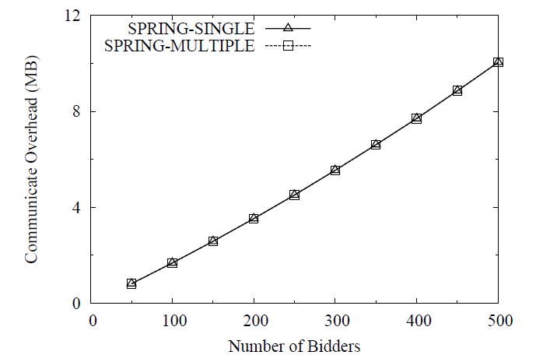
Communication Overhead
The communication overhead grows linearly with the number of bidders.

Slide 26
Outline
Motivation
Preliminary
SPRING
SPRING with Multi-Channel Bids
Evaluation
Conclusion

Slide 27
Conclusion
SPRING is the first strategy-proof and privacy preserving auction mechanism for spectrum redistribution.
SPRING guarantees k-anonymous privacy protection both in single channel and multi-channel auctions.
We have implemented SPRING and extensively evaluated its performance.

Slide 28
Thank You!

