Slide 1
Battery-free Sensing Platform for Wearable Devices: The Synergy Between Two Feet
Qianyi Huang, Yan Mei, Wei Wang and Qian Zhang
Department of Computer Science and Engineering
Hong Kong University of Science and Technology
Notes:
Thanks for the introduction. Good morning, everyone. I am PhD student from Hong Kong University of Science and Technology, under the supervision of Prof. Zhang Qian. Today, I will present our work on the battery-free sensing platform for wearable devices.

Slide 2
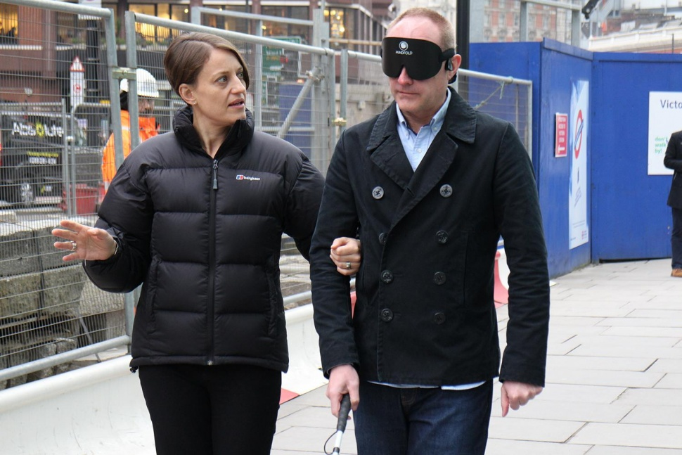
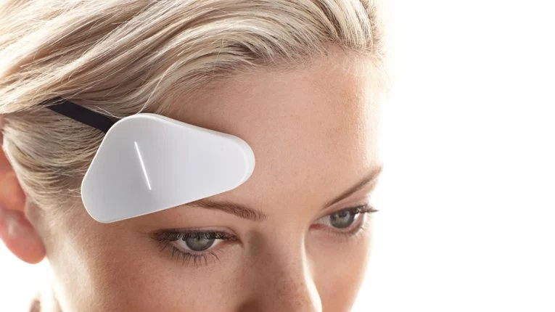
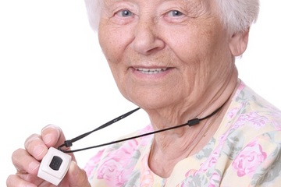
Life Changing Wearable Technology
Notes:
Wearable technology is changing our life from many aspects. Wearable devices provide health-care for the elderly people who are
living alone, and give out alerts to doctors or family members when detecting abnormal physiology. They may also provide assistance for those with disability to live a normal life.

Slide 3




Frequent Charging
Battery-free Wearable Devices
Notes:
The main constraint in wearable technology today is battery life. The majority of wearable devices require frequent charging. This is a challenging requirement in the above mentioned scenarios. Elderly people easily forget to recharge their health tracking devices. The situation is even more challenging for those in cognitive decline, who may be already suffering from memory loss. Thus, we envision the wearable devices to be completely battery-free, relieve the burden of recharging.

Slide 4
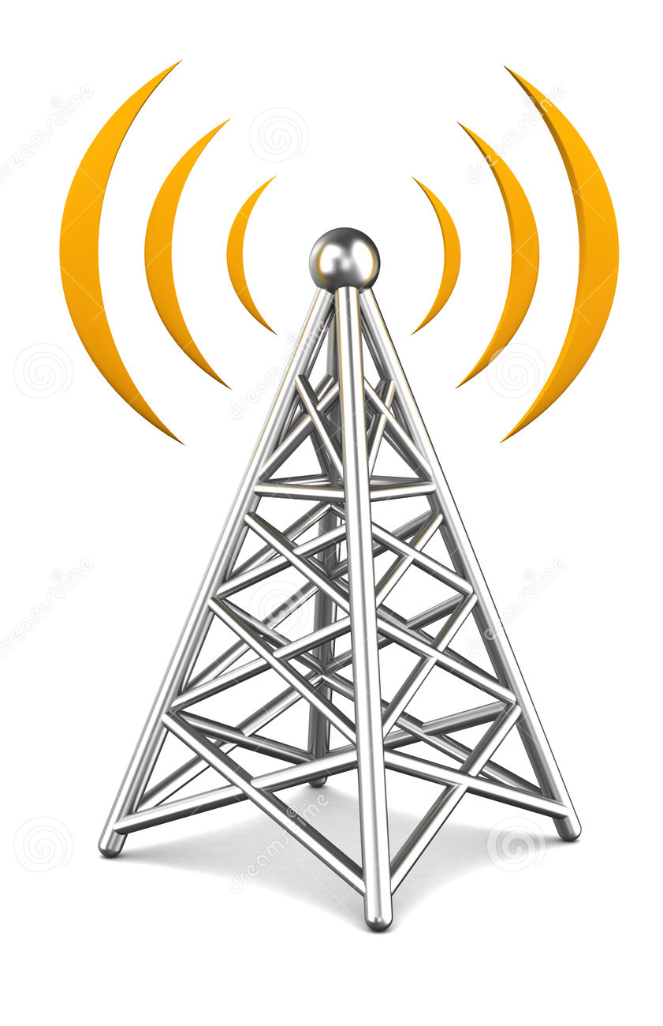
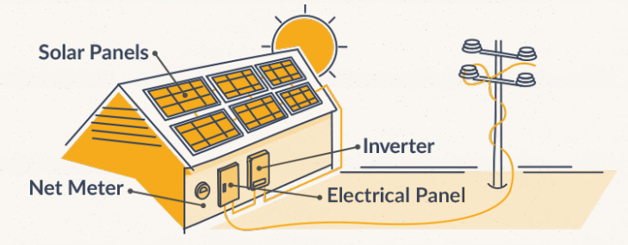
Battery-free Sensing Platform
These conditions can not be satisfied by wearable devices
Notes:
Existing battery-free devices harvest energy from different sources, such as solar energy, RF signals. They are limited to specific environments, which require sunlight or a powerful RF source. These conditions can not be satisfied by wearable devices, as
users may wear them and go around.

Slide 5
Energy harvesting from human body
Scenario | Power
Taking a book off a shelf | <10 μW
Writing with a pencil | 10-15 μW
Opening a drawer | 10-30 μW
Shaking an object | > 3000 μW
Wearable devices can be energy self-sufficiency, by harvesting energy from human body.
Gorlatova, Maria, et al. "Movers and shakers: Kinetic energy harvesting for the internet of things." SIGMETRICS '14.
Notes:
Different from wireless sensor nodes, wearable devices are worn by users for long periods of time. A measurement study from SIGMETRICS pointed out that when performing daily activity, our body generates substantial power. It brings the feasibility that wearable devices can harvest the energy from human body and no need to rely on battery.

Slide 6
Why We Favor Shoes
Energy source
Promising amount of kinetic energy available during walking or running
Existing works on energy harvesting shoes can generate about 1-2 mW
Ubiquitous
Shoes are worn by users for the majority of time
Smart shoes are gaining popularity
Pedestrian safety, navigation, fitness tracking
Notes:
Although there are many possible designs to harness energy from human body， we design the battery-free platform as a pair of shoes for three reasons. First, there is promising amount of kinetic energy available during walking or running. Existing works on energy harvesting shoes can generate about 1-2 MJ per step; Second, shoes are ubiquitous. We wear shoes for the majority of daily time, including the time spent in the office/school, going on a visit to a park or a supermarket; Last, smart shoes are gaining popularity. They play important roles in many aspects, such as assuring pedestrian safety, navigation and fitness tracking.

Slide 7
We Have Two Feet
Power transfer is infeasible
Notes:
Although there are a number of existing studies on energy harvesting shoes, they have one common problem. They only utilize the kinect energy from one foot. During walking or running, our two feet can generate almost equal amount of energy. Yet there is no existing feasible solution to combine these two parts of available energy to support a complete sensing system. The most straightforward solution is to transfer the energy from one foot to the other foot. Wireless power transfer needs a powerful source and works in short distance. Thus, it cannot work in our scenario. Since power transfer is infeasible, we come up with the idea of enabling a data channel between two feet to coordinate these two distributed parts. Traditional communication methods
(e.g., Bluetooth, WiFi) consume at least tens of milliwatts, which cannot be affordable by the energy harvesting platform. Instead, we use ambient backscatter as the communication channel between two feet.

Slide 8

Ambient Backscatter Can Bridge The Gap
Bob
Alice
Bob
Alice
Notes:
Ambient backscatter works by modulating existing RF (e.g., TV, WiFi) signals in the air. Assume that Alice want to transmit a string of ‘0’s and ‘1’s to Bob. She will switch her antenna between reflecting and nonreflecting states. In non-reflecting state, Bob will only see the ambient signals; in reflecting state, the additional reflected wave from the Alice will superimpose the original ambient signals and create changes in signal envelop. Thus, Bob can distinguish these two states to decode the information. As the transmitter does not actively generate radio signals, it consumes almost zero power.

Slide 9
The Synergy Between Two Feet
Notes:
In our design, we allocate separate tasks to each foot. One foot is equipped with sensing hardware (e.g., accelerometer, pulse sensor, temperature sensor). It senses user activity or ambient environment, and informs the other foot of the results by ambient backscatter. The other foot can transmit this
information wirelessly to users’ smartphone. In this way, we fully utilize the harvested energy on both feet.

Slide 10
Overview
Notes:
So, on each foot, we have an energy harvesting insole, which can convert the foot pressure into electrical current. The power management circuits are used to transfer the unstable and alternating voltage into stable DC voltage. On one feet, we got sensors; on the other foot, we have Bluetooth module. Two feet communicate by ambient backscatter. Next, I will introduce each component one by one.

Slide 11
Energy Harvesting Insole Design
Notes:
First is the energy havesting insole.

Slide 12
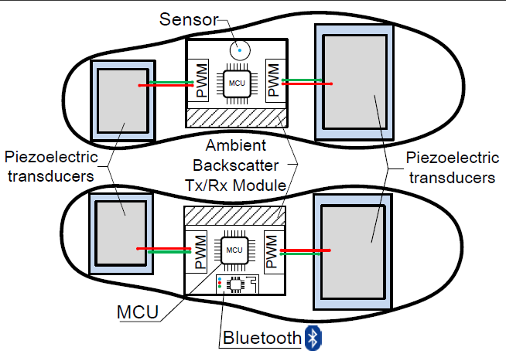
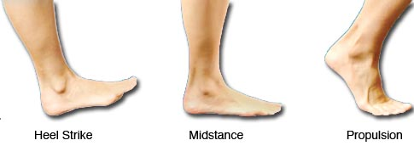
Insole Design
We can get 1 mJ per step per foot
Notes:
We observe that during walking, there are two phases when the insole is under high pressure. An obvious one is the contact phase when the heel hit the ground. The other one is the propulsive phase, when the heel is off the ground and body weight is on the forefoot area. Based on this observation, we we mount piezoelectric materials in these two areas, as shown in the right figure. Piezoelectric materials can convert pressure into electricity. In this way, we can get 1mJ per step per foot, which is comparable to the current state of art.

Slide 13
Power Management Circuit Design
Notes:
Next is the power management circuit.

Slide 14

Circuit Design
Notes:
As mentioned before, we have two piezoelectric transducers. They are connected in parallel, for we want more current instead of higher voltage. We use separate input capacitors and buck converters for micro-controller and sensors/Bluetooth. thus they can prevent some power-hungry sensors or Bluetooth from draining away the energy for micro-controllers. Thus, we can guarantee stable power supply for micro-controllers. The input capacitors are selected according to the load requirements. Here, the left hand side is the amount of energy required by loads. VIN is the voltage on the input capacitor and VTH is the shunt off voltage threshold for the buck converter. \eta is the
efficiency of buck converter. The input capacitor should store enough energy for the loads before the buck converter shunts off. We can select an appropriate capacity for the capacitors.

Slide 15
Ambient Backscatter Between Two Feet
Notes:
The last component is the ambient backscatter module.

Slide 16
Challenges
Bob
Alice
Bob
Alice
Notes:
As mentioned before, ambient backscatter works by modulating existing RF (e.g., TV, WiFi) signals in the air. The reflected wave may either constructively or destructively superimpose on the ambient signals, which depends on the relative position of the transmitter and the receiver. During walking, the distance and orientation between the two feet keep changing. For one instant, the reflecting state at the transmitter side may correspond to a large signal amplitude at the receiver side; for the next instant, it may correspond to a small signal amplitude. Thus, compared with static scenarios, packet error rate between a pair of moving transmitter and receiver is significantly higher.

Slide 17
Challenges
High error rate for moving Tx and Rx
Notes:
To get a basic idea, we do a measurement study. When the user is walking or running, the packet error rate is much higher than standing statically. Furthermore, the error rate is subject to many factors, such as the speed of walking, stride length and ambient environment. In the right figure, we can see that in the walking scenario, for the majority of times, it requires at most 5 times of duplicate
transmission. However, in the worst case, it requires more than 20 times of retransmissions. Traditional error control methods work by adding fixed ratio of redundancy in data transmission,
which is unsuitable in this case where the error rate fluctuates significantly.

Slide 18
Challenges
The error rate is unpredictable

Slide 19
Rateless Transmission
1
2
3
4
5
6
7
8
1
2
3
6
2
3
4
7
3
4
5
8
Rateless transmission can flexibly adapt to channel condition
Notes:
To jointly tackle these two challenges, we borrow the idea from rateless codes. We divide the whole packet into k blocks of equal size. At each transmission, instead of transmitting a complete packet, we transmit a short sub-packet which is a combination of some of the k blocks. The transmitter continuously transmits sub-packets until the receiver has received enough number of sub-packets for decoding.

Slide 20
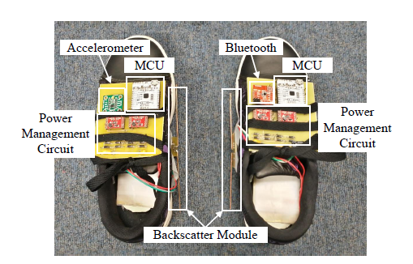
Implementation and Evaluation
We evaluate the system from three aspects
System start-up and brownout time
Bluetooth throughput
Performance on rateless transmission
Notes:
In evaluation, we demonstrate the system as a pedometer. We invite five volunteers to participate in the experiments. They are all college students and staff, including one female and four male. For each volunteer, we put the energy harvesting insoles into his/her own shoes, and also attach the circuits to the shoes. They are instructed to walk at their preferred walking speed. We evaluate the system from three aspect.

Slide 21
System Start-up and Brownout Time
Experiment Number | Start-up Time (sec) | Brownout Time (sec)
1 | 6.0 | 13.8
2 | 7.6 | 22.2
3 | 9.0 | 17.2
4 | 5.4 | 25.0
5 | 6.6 | 28.8
The system takes 5-9 seconds’ walking to wake up and can sustain for at least 13 seconds after the user rests
Notes:
From this table, we can learn that the system can start-up shortly after the user starts walking. In our experiments, it takes 5-9 seconds’ walking to wake up the system. We expect this period to be even shorter in practical use, for it is very likely that the input capacitors have some initial charge, which is the residual energy from the last walking period. The system can sustain for at least 13 seconds after the user rests, which can prevent the micro-controller from being powered off frequently when the user comes to a short pause, such as stops to open the door, or encounters a friend and pauses for a
short conversation.

Slide 22
Bluetooth Throughput
 | No. | Duration | Throughput | First Transmission
Walking | 1 | 10min | 489 bytes | 56sec
 | 2 | 10min | 426 bytes | 1min 40sec
 | 3 | 10min | 535 bytes | 1min 14sec
 | 4 | 11min | 492 bytes | 2min 0sec
 | 5 | 11min | 541 bytes | 1min 21sec
Jogging | 1 | 8min | 610 bytes | 38sec
 | 2 | 10min | 535 bytes | 1min 1sec
 | 3 | 10min | 856 bytes | 1min 44sec
 | 4 | 10min | 718 bytes | 1min 23sec
 | 5 | 10min | 901 bytes | 53sec
During walking, Bluetooth can transmit about
48-byte data per minute. During jogging, it can transmit about 60 bytes every 48 seconds.
Notes:
Bluetooth throughput measures how many and how frequently data can be transmitted from our shoes to users’ smartphone. On average, during walking, Bluetooth can transmit about 48-byte data per minute. The first transmission starts after 1.5 minutes’ walking. During jogging, it can transmit about 60 bytes every 48 seconds. The first transmission starts after 1 minute on average. The system is suitable for applications which do not require always-on Bluetooth connection and only need to update information periodically. For applications such as pedometer and heart rate monitor, it is sufficient to synchronize with the smartphone once per minute. 48-60-byte per minute throughput
is adequate for carrying information about timestamps and step counts/heart rate.

Slide 23
Performance on Rateless Transmission
The rateless transmission mechanism can improve the overall throughput
Notes:
Last, we show the evaluation results on rateless transmission. We compare our design with two other mechanisms: complete transmission and sequential transmission. Complete transmission directly transmits a complete packet with 64-byte data; sequential transmission divide the original packet into sub-packets and transmit the subpackets sequentially. In this evaluation, we vary the moving speed and stride length. From the figures, we can see that rateless transmission outperform the other twho especially when users are moving fast with large stride length.

Slide 24
Conclusion
We have designed a battery-free platform for wearable devices in the form-factor of shoes. It supports sensing, processing and wireless communication with smartphone.
We have achieved this goal by combining the harvestable energy from two feet. Each foot performs separate tasks and two feet are coordinated by ambient backscatter.
We have implemented a prototype to demonstrate the feasibility of our idea. Evaluation results show that our design is robust enough for practical use.

Slide 25
Thank you for your time Q &A

Slide 26
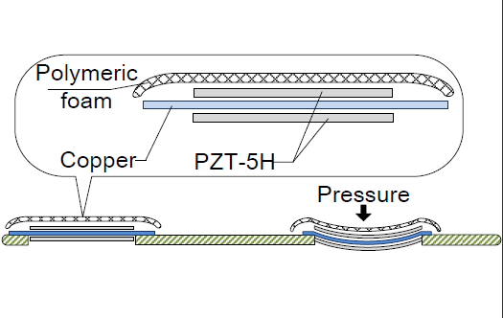
Energy Harvesting Insole

