Slide 1

Notes:
Source: user-uploaded videoplayback.mp4. Sarathi-Serve, OSDI 2024. Source slide 1. Capture at 30 seconds. https://www.usenix.org/conference/osdi24/presentation/agrawal

Slide 2
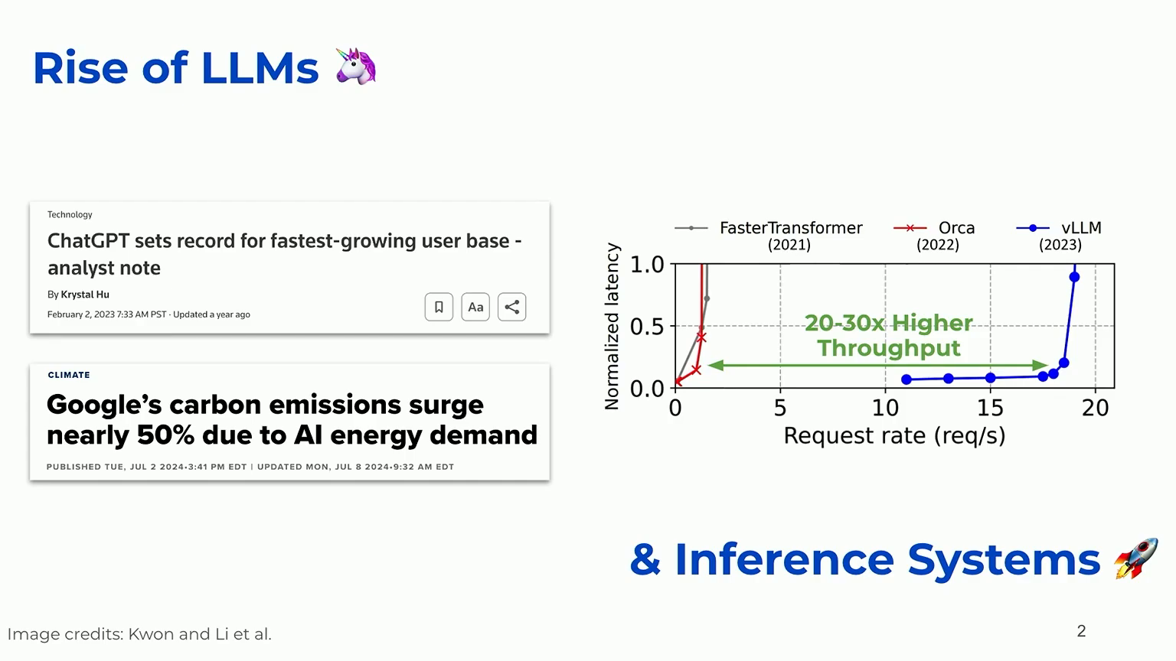
Notes:
Source: user-uploaded videoplayback.mp4. Sarathi-Serve, OSDI 2024. Source slide 2. Capture at 59 seconds. https://www.usenix.org/conference/osdi24/presentation/agrawal

Slide 3
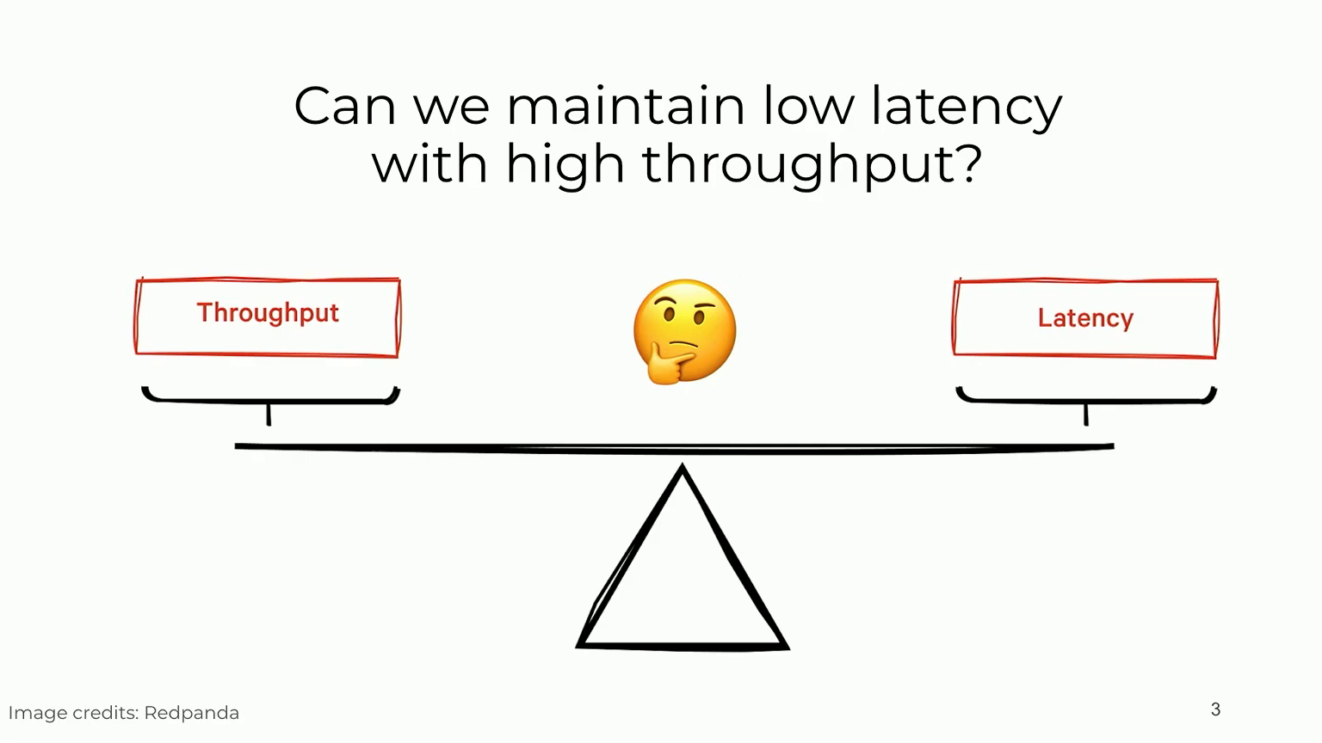
Notes:
Source: user-uploaded videoplayback.mp4. Sarathi-Serve, OSDI 2024. Source slide 3. Capture at 76 seconds. https://www.usenix.org/conference/osdi24/presentation/agrawal

Slide 4
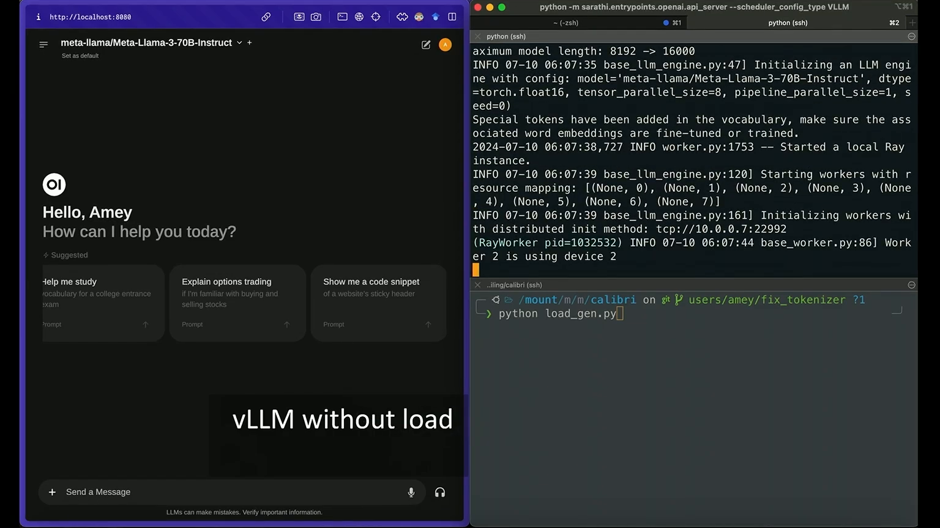
Notes:
Source: user-uploaded videoplayback.mp4. Sarathi-Serve, OSDI 2024. Source slide 4. Capture at 90 seconds. https://www.usenix.org/conference/osdi24/presentation/agrawal
Demo: 80–181.15 seconds in source recording. Click the video in slide-show mode to play. Source contains no audio.

Slide 5
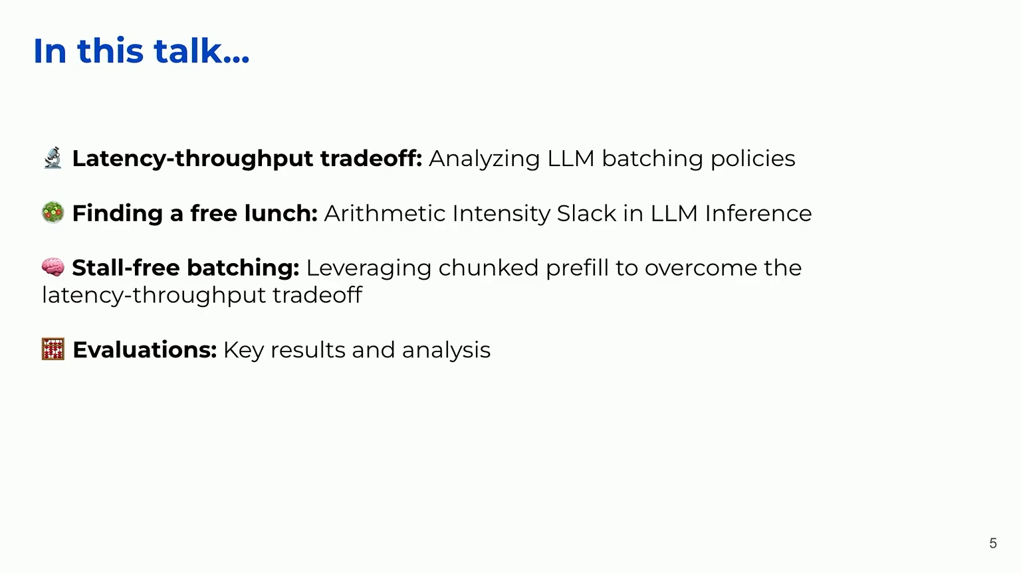
Notes:
Source: user-uploaded videoplayback.mp4. Sarathi-Serve, OSDI 2024. Source slide 5. Capture at 218 seconds. https://www.usenix.org/conference/osdi24/presentation/agrawal

Slide 6
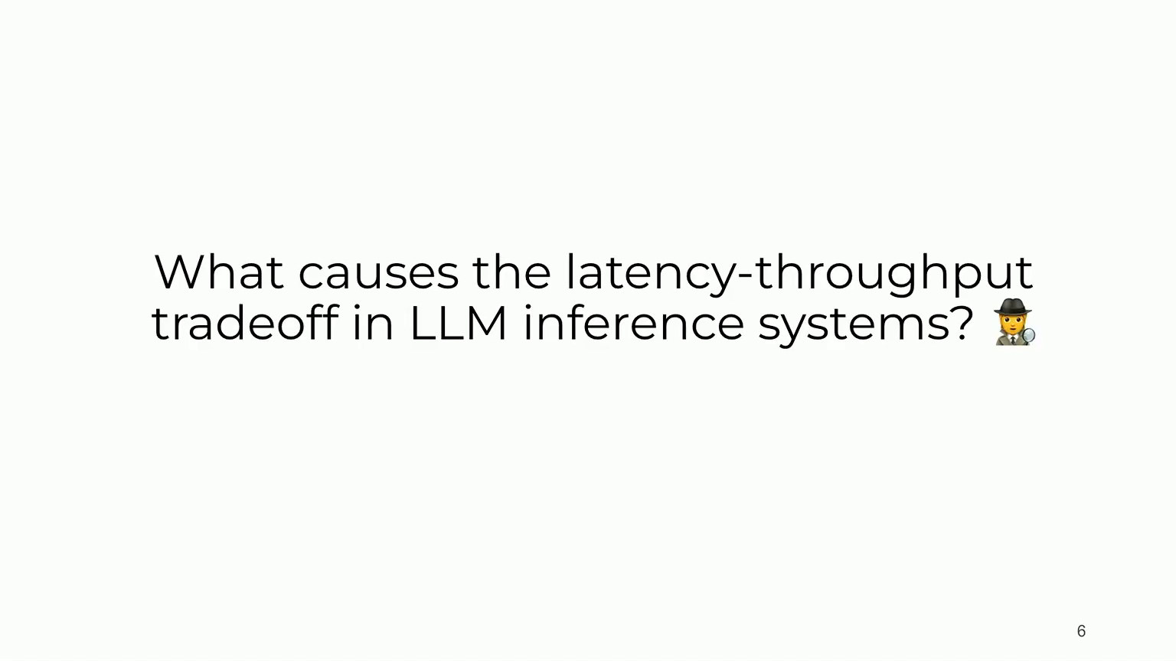
Notes:
Source: user-uploaded videoplayback.mp4. Sarathi-Serve, OSDI 2024. Source slide 6. Capture at 224 seconds. https://www.usenix.org/conference/osdi24/presentation/agrawal

Slide 7
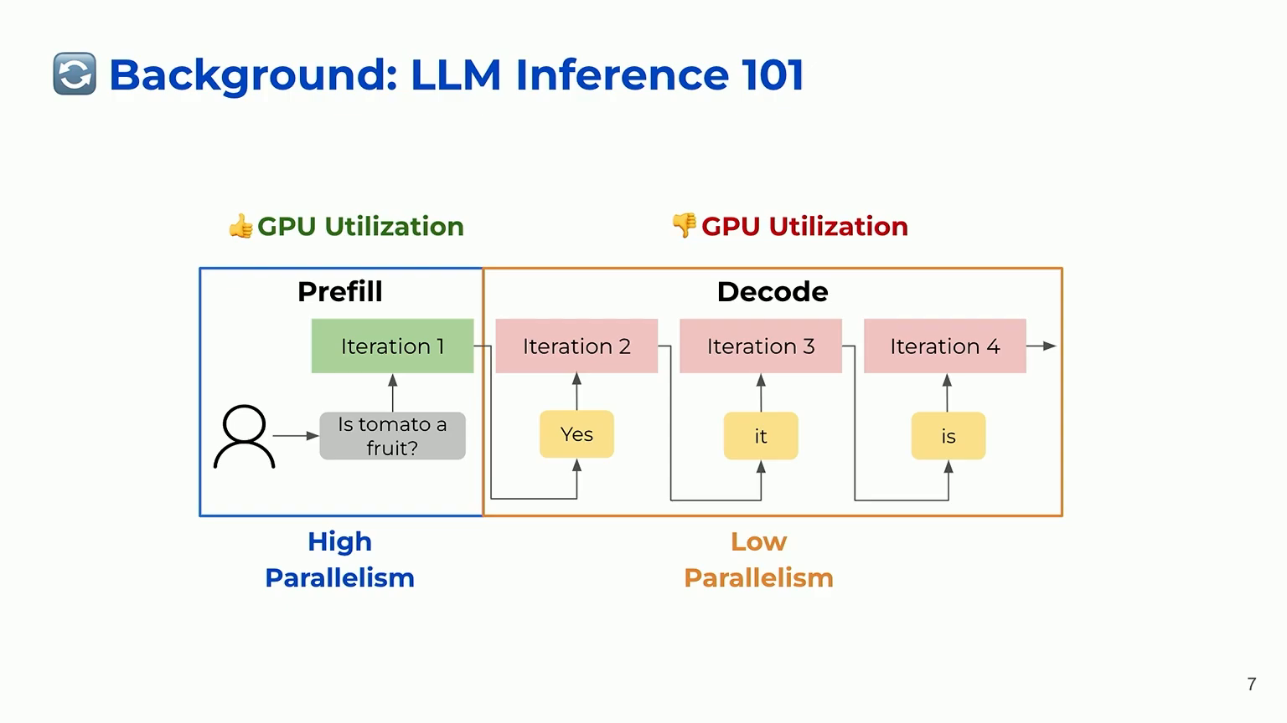
Notes:
Source: user-uploaded videoplayback.mp4. Sarathi-Serve, OSDI 2024. Source slide 7. Capture at 268 seconds. https://www.usenix.org/conference/osdi24/presentation/agrawal

Slide 8
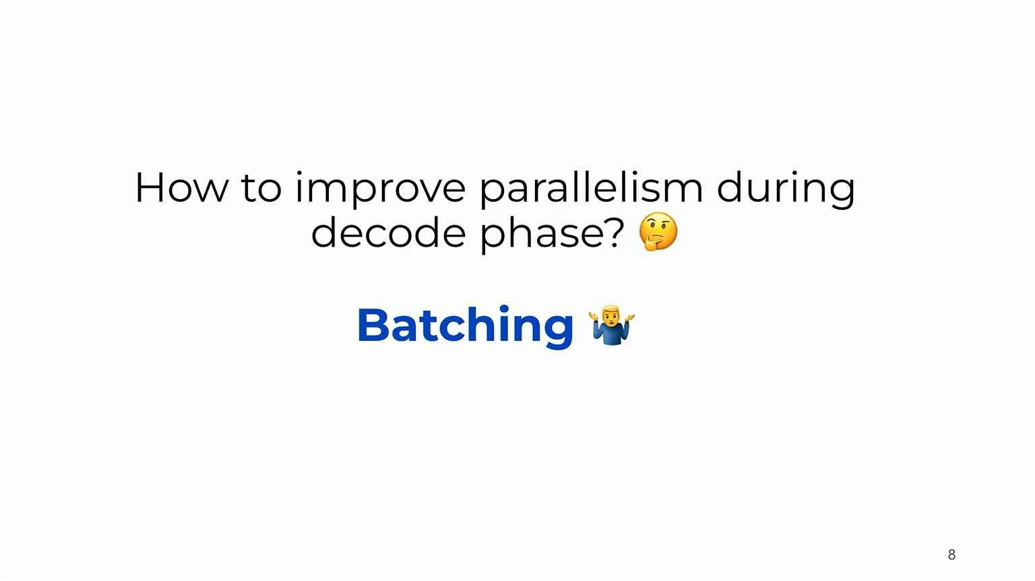
Notes:
Source: user-uploaded videoplayback.mp4. Sarathi-Serve, OSDI 2024. Source slide 8. Capture at 286 seconds. https://www.usenix.org/conference/osdi24/presentation/agrawal

Slide 9
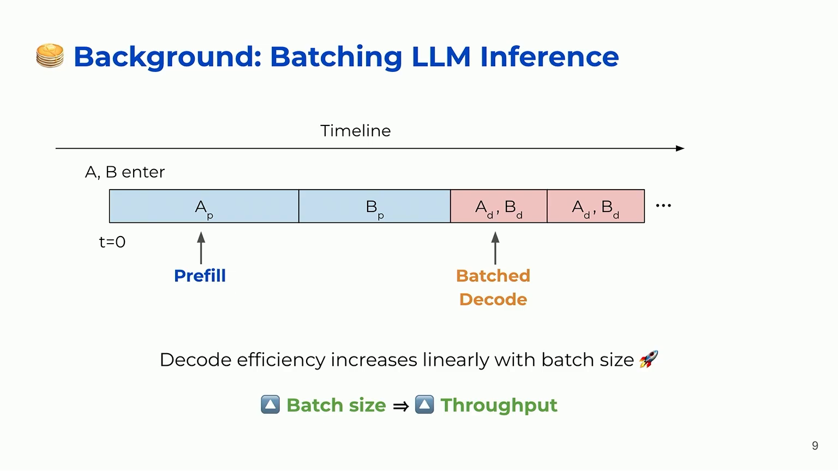
Notes:
Source: user-uploaded videoplayback.mp4. Sarathi-Serve, OSDI 2024. Source slide 9. Capture at 320 seconds. https://www.usenix.org/conference/osdi24/presentation/agrawal

Slide 10
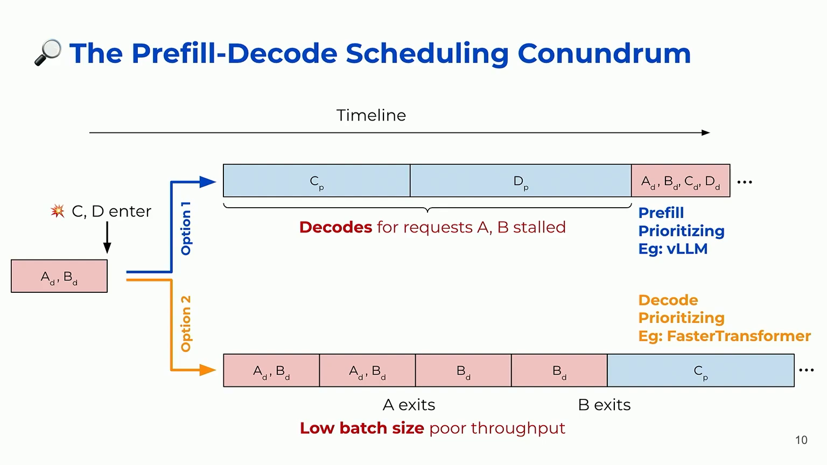
Notes:
Source: user-uploaded videoplayback.mp4. Sarathi-Serve, OSDI 2024. Source slide 10. Capture at 398 seconds. https://www.usenix.org/conference/osdi24/presentation/agrawal

Slide 11
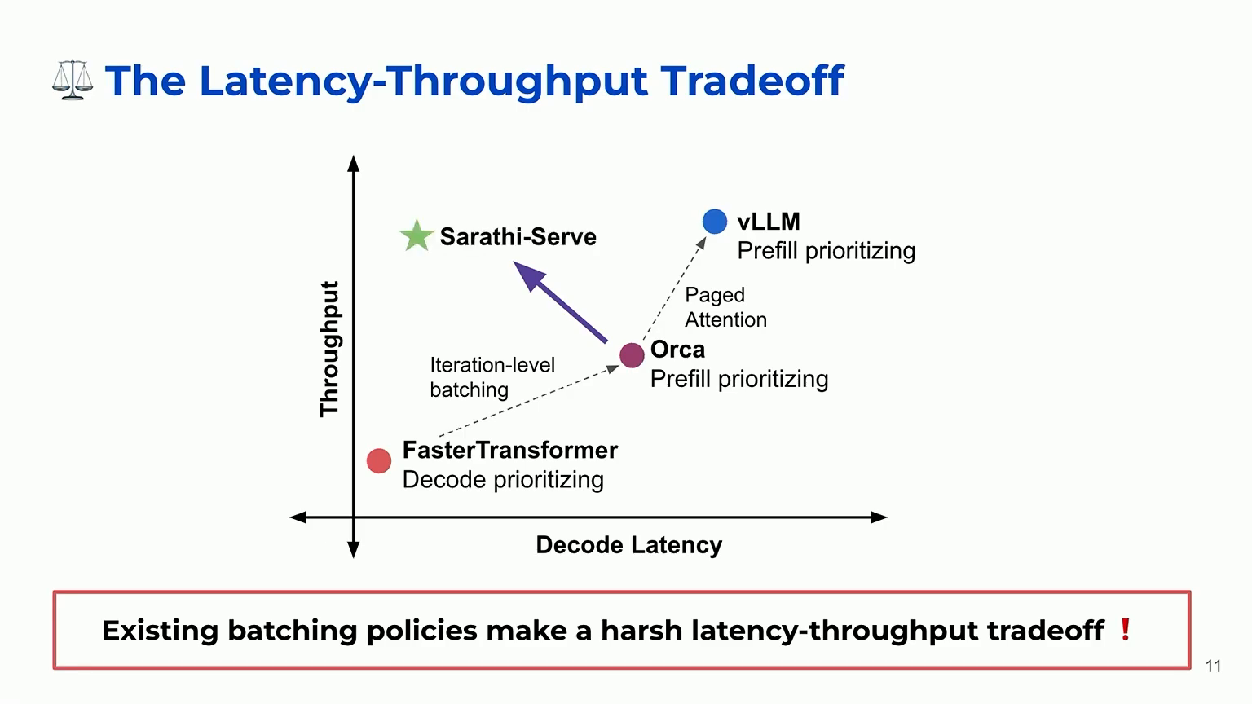
Notes:
Source: user-uploaded videoplayback.mp4. Sarathi-Serve, OSDI 2024. Source slide 11. Capture at 433 seconds. https://www.usenix.org/conference/osdi24/presentation/agrawal

Slide 12

Notes:
Source: user-uploaded videoplayback.mp4. Sarathi-Serve, OSDI 2024. Source slide 12. Capture at 438 seconds. https://www.usenix.org/conference/osdi24/presentation/agrawal

Slide 13
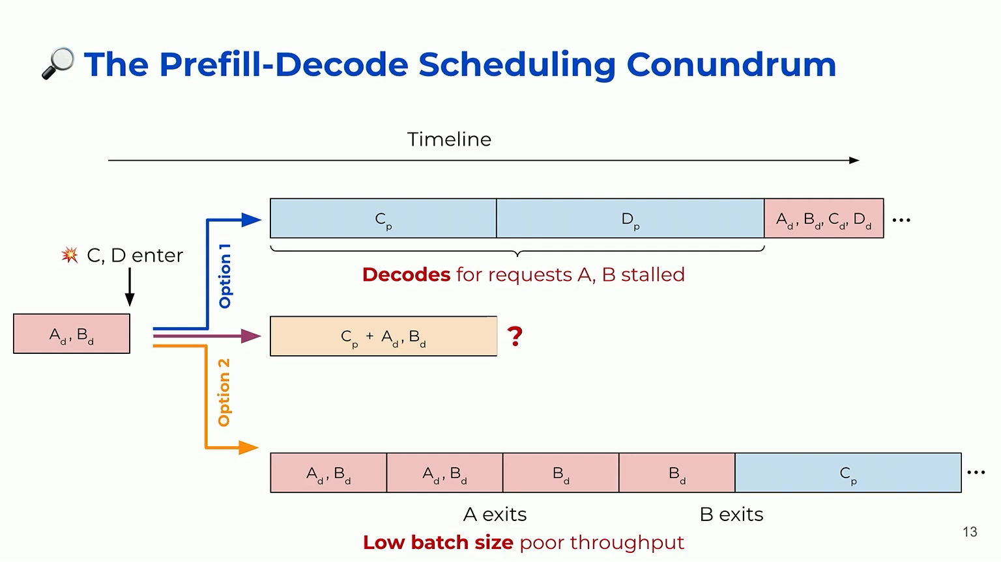
Notes:
Source: user-uploaded videoplayback.mp4. Sarathi-Serve, OSDI 2024. Source slide 13. Capture at 455 seconds. https://www.usenix.org/conference/osdi24/presentation/agrawal

Slide 14
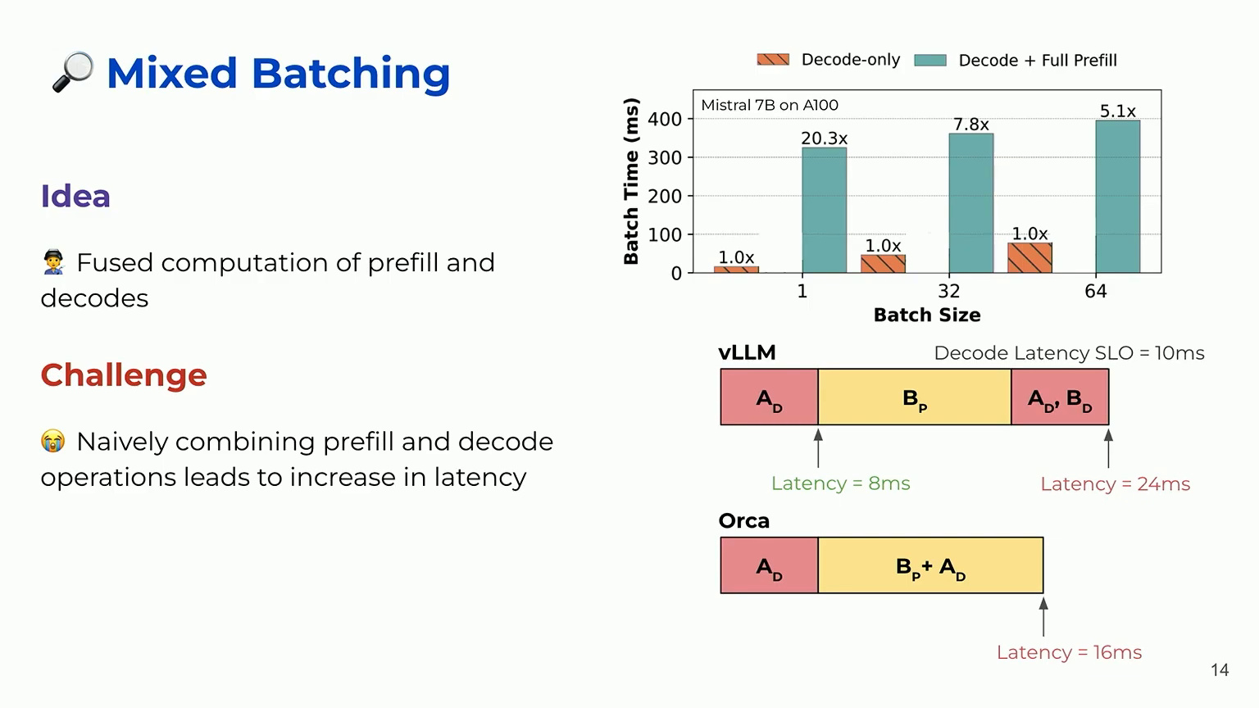
Notes:
Source: user-uploaded videoplayback.mp4. Sarathi-Serve, OSDI 2024. Source slide 14. Capture at 529 seconds. https://www.usenix.org/conference/osdi24/presentation/agrawal

Slide 15
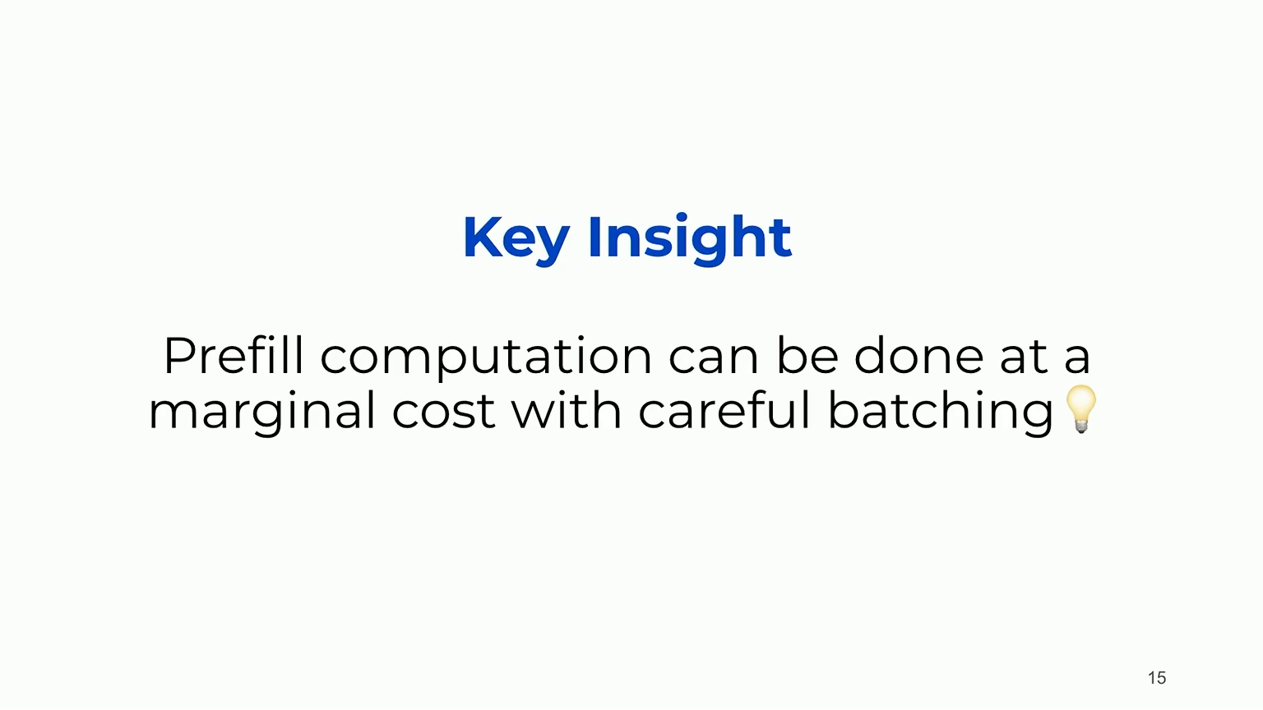
Notes:
Source: user-uploaded videoplayback.mp4. Sarathi-Serve, OSDI 2024. Source slide 15. Capture at 536 seconds. https://www.usenix.org/conference/osdi24/presentation/agrawal

Slide 16
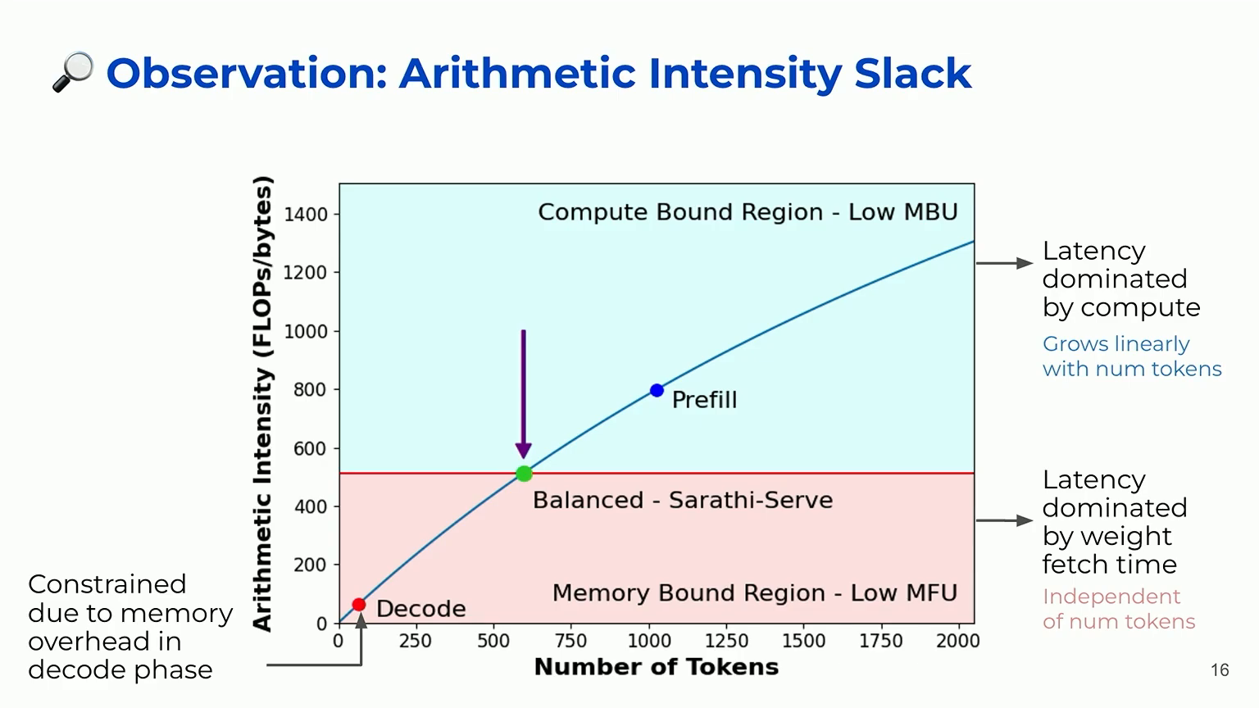
Notes:
Source: user-uploaded videoplayback.mp4. Sarathi-Serve, OSDI 2024. Source slide 16. Capture at 628 seconds. https://www.usenix.org/conference/osdi24/presentation/agrawal

Slide 17
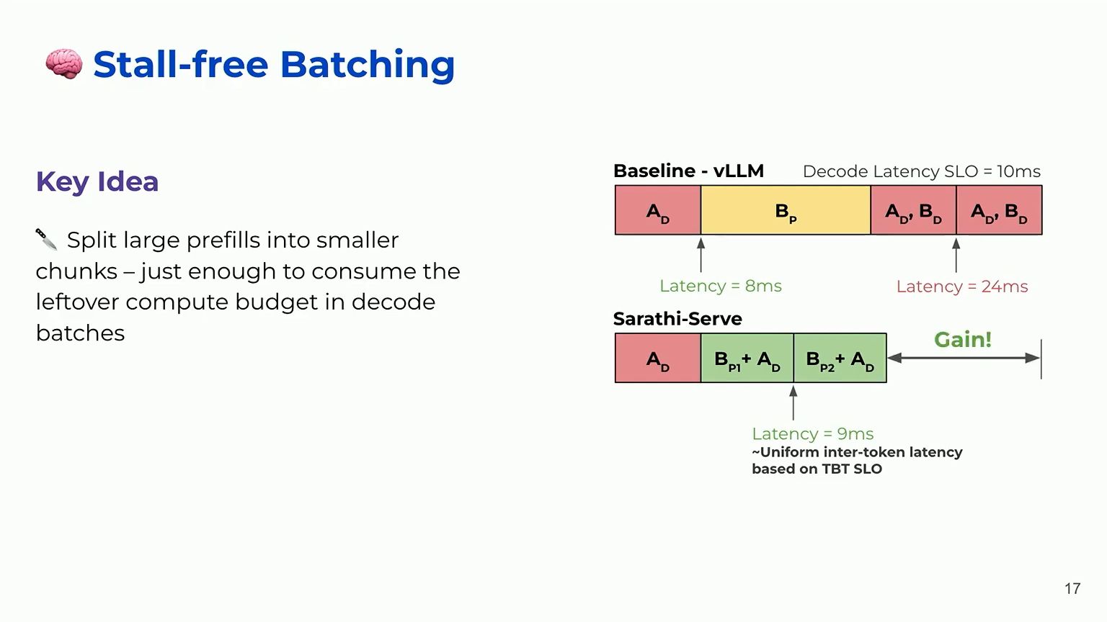
Notes:
Source: user-uploaded videoplayback.mp4. Sarathi-Serve, OSDI 2024. Source slide 17. Capture at 700 seconds. https://www.usenix.org/conference/osdi24/presentation/agrawal

Slide 18
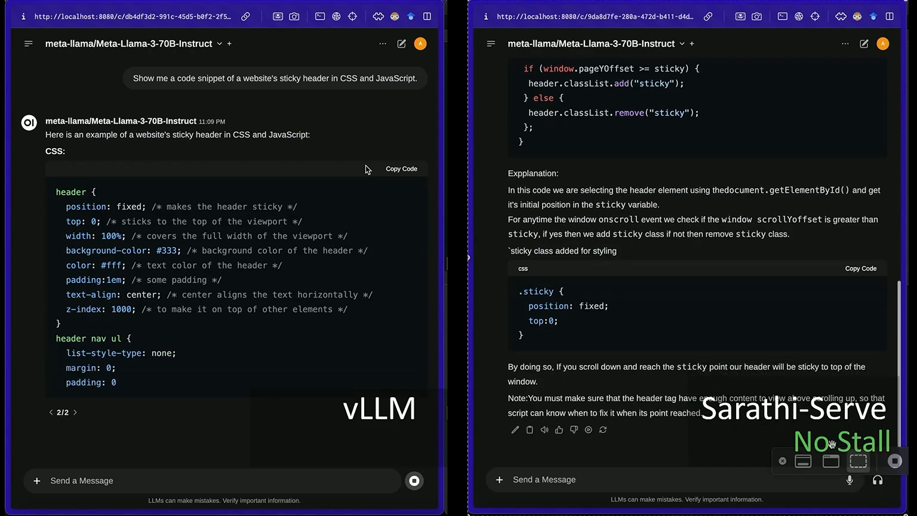
Notes:
Source: user-uploaded videoplayback.mp4. Sarathi-Serve, OSDI 2024. Source slide 18. Capture at 750 seconds. https://www.usenix.org/conference/osdi24/presentation/agrawal
Demo: 720–772.25 seconds in source recording. Click the video in slide-show mode to play. Source contains no audio.

Slide 19

Notes:
Source: user-uploaded videoplayback.mp4. Sarathi-Serve, OSDI 2024. Source slide 19. Capture at 781 seconds. https://www.usenix.org/conference/osdi24/presentation/agrawal

Slide 20
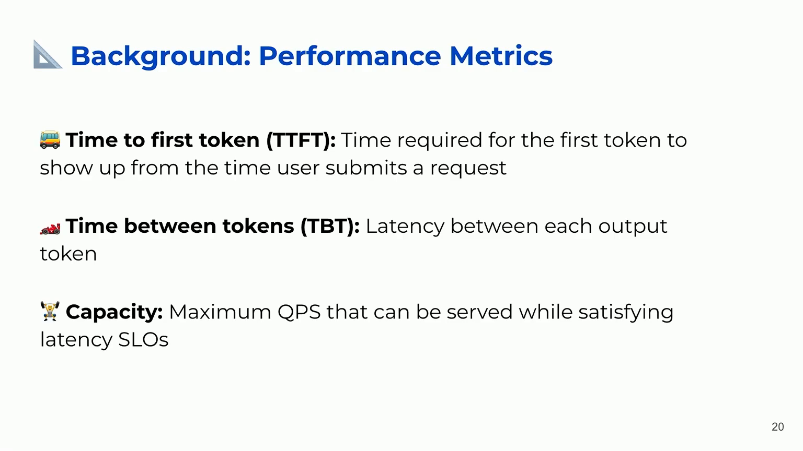
Notes:
Source: user-uploaded videoplayback.mp4. Sarathi-Serve, OSDI 2024. Source slide 20. Capture at 822 seconds. https://www.usenix.org/conference/osdi24/presentation/agrawal

Slide 21
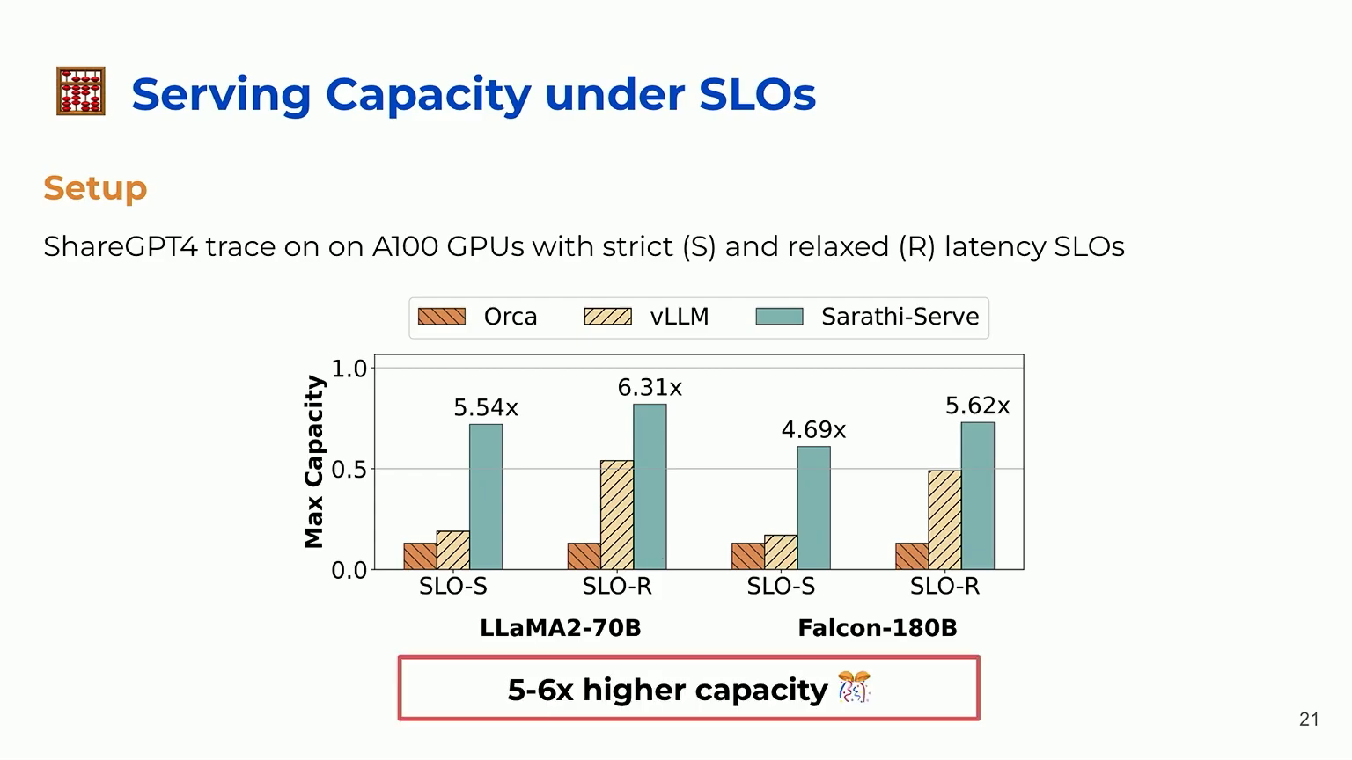
Notes:
Source: user-uploaded videoplayback.mp4. Sarathi-Serve, OSDI 2024. Source slide 21. Capture at 874 seconds. https://www.usenix.org/conference/osdi24/presentation/agrawal

Slide 22
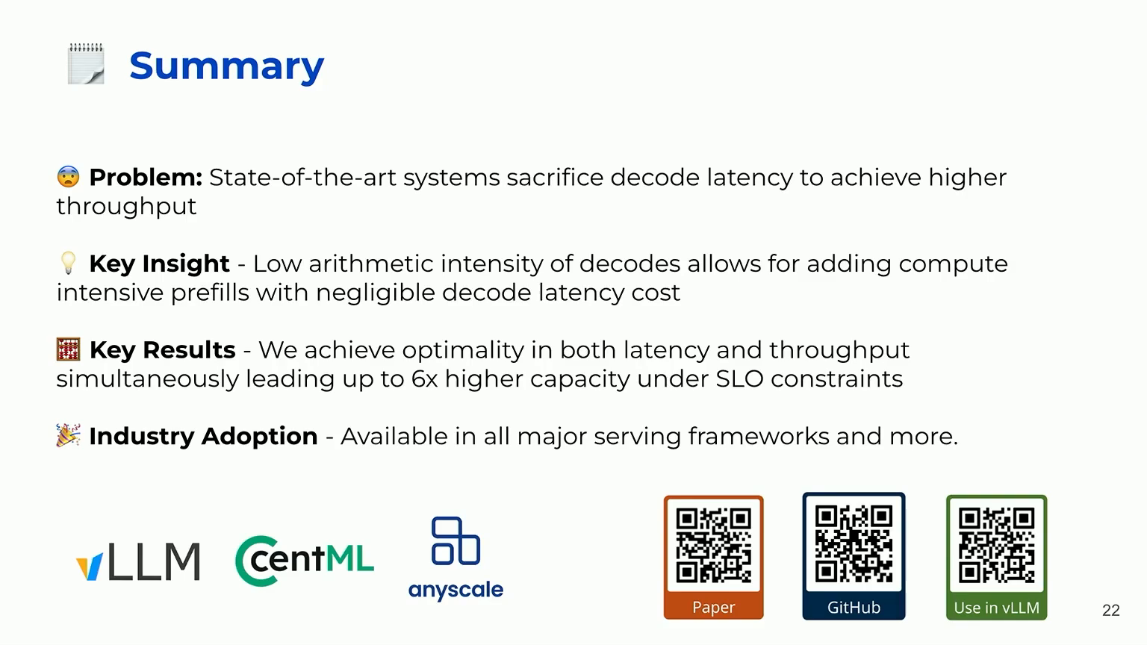
Notes:
Source: user-uploaded videoplayback.mp4. Sarathi-Serve, OSDI 2024. Source slide 22. Capture at 924 seconds. https://www.usenix.org/conference/osdi24/presentation/agrawal

