Slide 1
Computer Networks
Fall Semester, 2026

Slide 2

















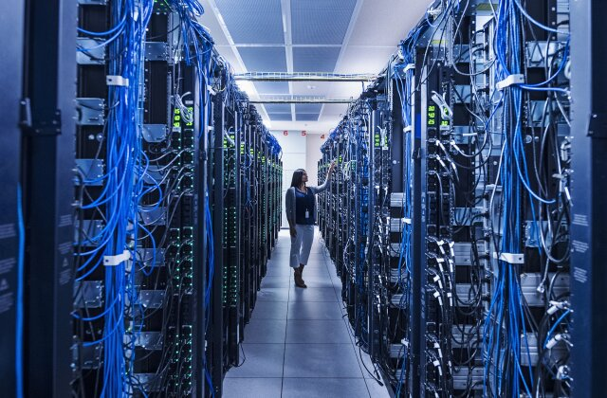





We are connected everyday and everywhere
mobile network
national or global ISP
local or regional ISP
home network
content
provider
network
datacenter
network
enterprise
network

Slide 3
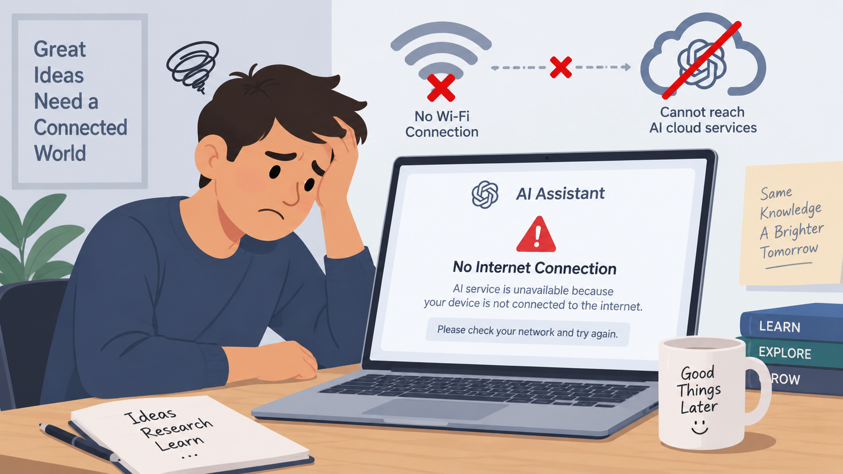
为什么要学习计算机网络—上网

Slide 4



为什么要学习计算机网络--考研

Slide 5
为什么要学习计算机网络—工作
华为
运营商 (移动/联通/电信)
百度/腾讯/阿里/字节
京东/拼多多
小米
Google/Amazon/Meta

Slide 6
Computer Networks
Instructor: Qianyi Huang (黄倩怡)
Affiliation: CSE of SYSU
Email: huangqy89@mail.sysu.edu.cn
Office: 529F, Guangzhou Supercomputing Center, East Campus
Office Hour: by appointment

Slide 7
Teaching Assistant
Zixian Que (阙紫娴)
quezx@mail2.sysu.edu.cn
Ling Wang (王灵)
wangling36@mail2.sysu.edu.cn
TA office: 529, Guangzhou Supercomputing Center, East Campus
They are responsible for homework grading, Q&A, etc

Slide 8
Course Website
https://huangqy89.github.io/cn-2026/
Lecture notes
Assignments & Solutions
Laboratory materials
Additional resources (reference books, online courses)

Slide 9


Textbook
Book
教材名称：计算机网络：自顶向下方法 (原书第8版)
作者：[美] James F.Kurose，Keith W.Ross 著，陈鸣 译
出版社：机械工业出版社

Slide 10
What Will We Learn?
Internet
Layered architecture
Application layer
Transport layer
Network layer
Link layer
Protocols, e.g., TCP/IP
We will cover up to Section 7.3

Slide 11
Challenges
A lot of terminologies
HTTP, SMTP, FTP, TCP, UDP, TLS, etc
Computer networks are quite complicated systems
Various configurations, a lot of details
This topic is evolving…

Slide 12
Additional Resources
Computer Networks: A Top-down approach, by Jim Kurose
https://gaia.cs.umass.edu/kurose_ross/index.php
Videos, Knowledge checks, Interactive End-of-Chapter Problems
中科大郑烇、杨坚全套《计算机网络（自顶向下方法 第7版，James F.Kurose，Keith W.Ross）》课程
https://www.bilibili.com/video/BV1JV411t7ow/?share_source=copy_web&vd_source=aa6451f6e14c3ab9b1d86b1c2c7e09ee

Slide 13
Schedule
Class Lecture:
Teaching Building: D402 (Monday, 8:00 – 9:40, Week 1-9)
Teaching Building: D402 (Thursday, 8:00 – 9:40, Week 1 to Week 17)
Lab Section
Thursday, 10:30-11:50, Week 1-17
Experimental Building D402

Slide 14
Grading Policy
Regular grades 40%
Homework: 35%
Quiz : 5%
Absence: -1 per time
Answer questions correctly: +1 per time
Final Exam (closed book) 60%

Slide 15
Suggestions
Do the reading carefully
Do all the homework carefully
Take full advantage of online resources
If you’re struggling, get help from the instructor & TAs

