Slide 1

Digital Fundamentals
Tenth Edition
Floyd
Boolean Algebra and Logic Simplification
© 2008 Pearson Education

Slide 2
In this Chapter…
Objectives:
Laws and Rules of Boolean Algebra
Standard Forms of Boolean Expression
Simplification by using algebra rules
Karnaugh map and logic simplification

Slide 3
Boolean variable
In Boolean algebra, a variable is a symbol used to represent an action, a condition, or data. A single variable can only have a value of 1 or 0.
The complement represents the inverse of a variable and is indicated with an overbar. Thus, the complement of A is A.
A literal is a variable or its complement.

Slide 4
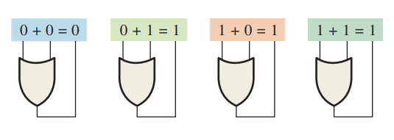
Boolean Addition
Addition is equivalent to the OR operation. The sum term is 1 if one or more if the literals are 1. The sum term is zero only if each literal is 0.
Example
Determine the values of A, B, and C that make the sum term of the expression A + B + C = 0?
Solution
Each literal must = 0; therefore A = 1, B = 0 and C = 1.

Slide 5
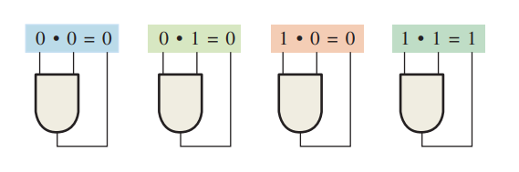
Boolean Multiplication
In Boolean algebra, multiplication is equivalent to the AND operation. The product of literals forms a product term. The product term will be 1 only if all of the literals are 1.
Example
What are the values of the A, B and C if the product term of A.B.C = 1?
Solution
Each literal must = 1; therefore A = 1, B = 0 and C = 0.

Slide 6
Commutative Laws (交换律)
The commutative laws are applied to addition and multiplication. For addition, the commutative law states
In terms of the result, the order in which variables are ORed makes no difference.
A + B = B + A
For multiplication, the commutative law states
In terms of the result, the order in which variables are ANDed makes no difference.
AB = BA

Slide 7
Associative Laws (结合律)
The associative laws are also applied to addition and multiplication. For addition, the associative law states
When ORing more than two variables, the result is the same regardless of the grouping of the variables.
A + (B +C) = (A + B) + C
For multiplication, the associative law states
When ANDing more than two variables, the result is the same regardless of the grouping of the variables.
A(BC) = (AB)C

Slide 8
Distributive Law (分配律）
The distributive law is the factoring law. A common variable can be factored from an expression just as in ordinary algebra. That is
AB + AC = A(B+ C)
The distributive law can be illustrated with equivalent circuits:
A(B+ C)
AB + AC

Slide 9
Rules of Boolean Algebra
1. A + 0 = A
7. A . A = A
2. A + 1 = 1
8. A . A = 0
=
3. A . 0 = 0
9. A = A
4. A . 1 = A
10. A + AB = A
5. A + A = A
11. A + AB = A + B
6. A + A = 1
12. (A + B)(A + C) = A + BC

Slide 10
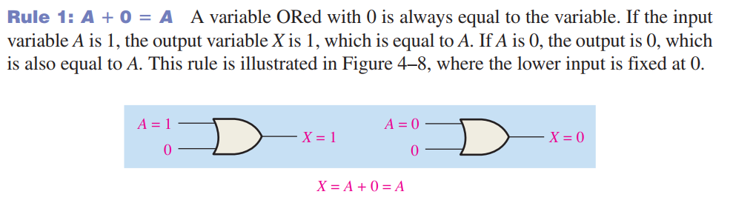
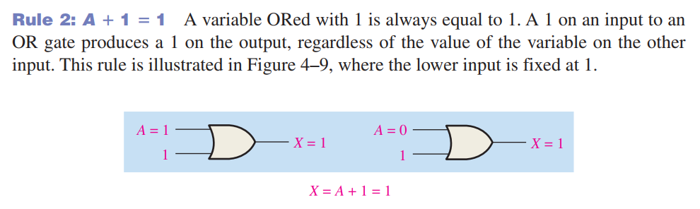

Slide 11
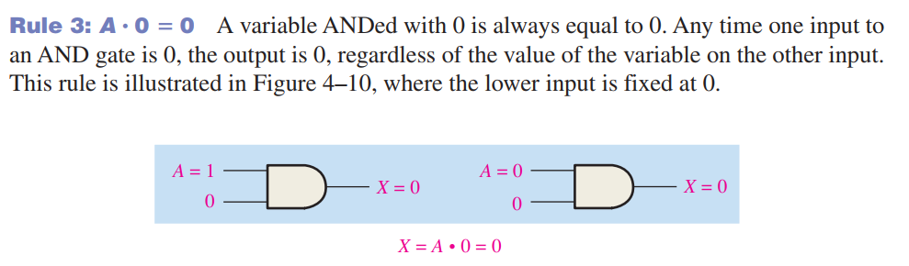
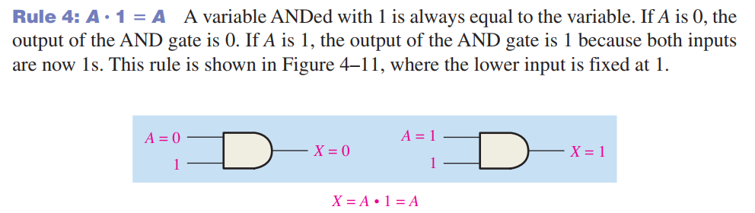

Slide 12
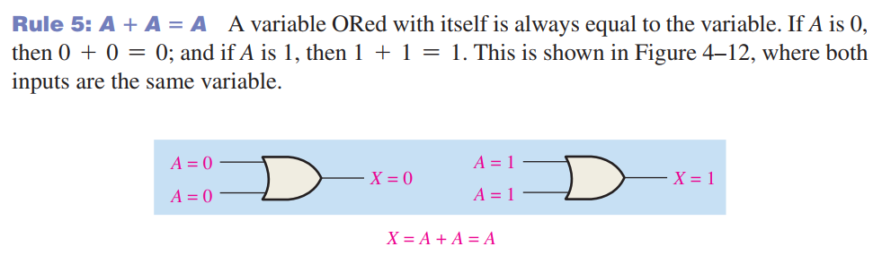
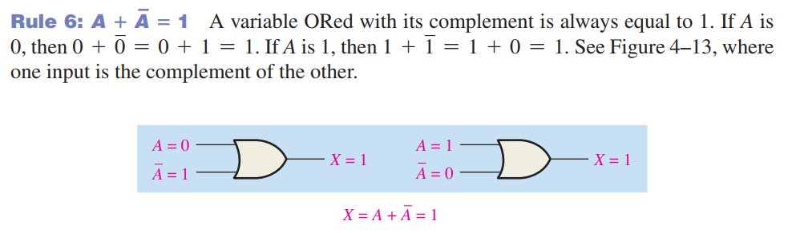

Slide 13
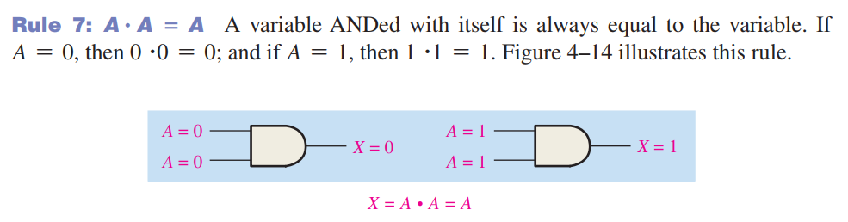
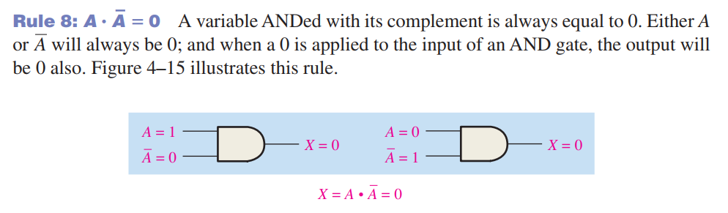

Slide 14
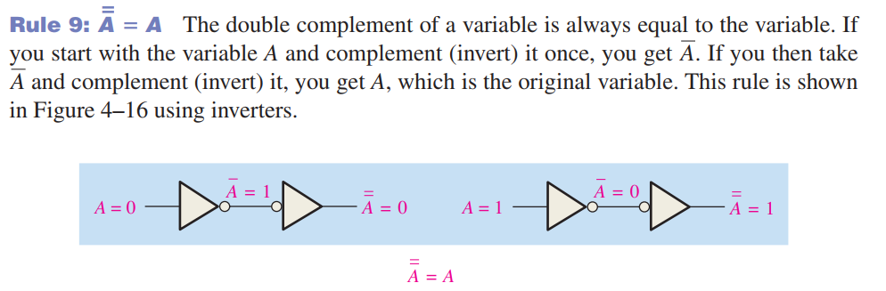

Slide 15
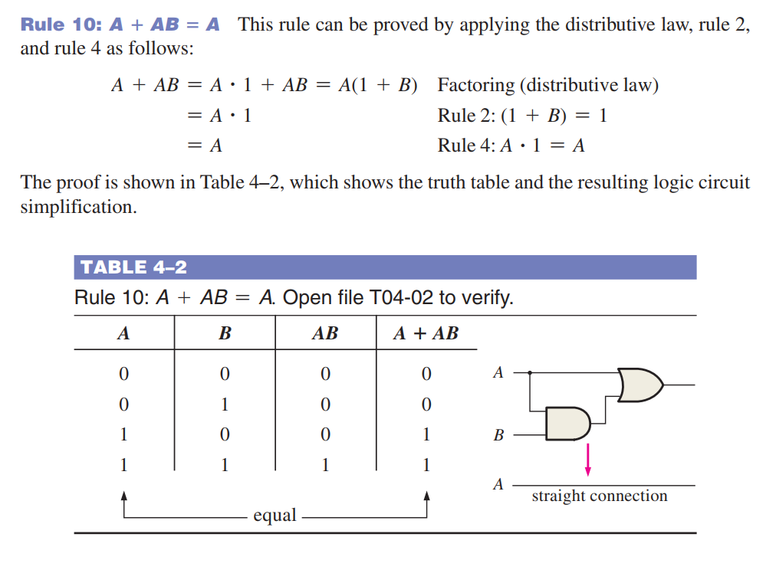

Slide 16
Rules of Boolean Algebra
Rules of Boolean algebra can be illustrated with Venn diagrams (文氏图). The variable A is shown as an area.
The rule A + AB = A can be illustrated easily with a diagram. Add an overlapping area to represent the variable B.
The overlap region between A and B represents AB.
=
The diagram visually shows that A + AB = A. Other rules can be illustrated with the diagrams as well.

Slide 17
Rules of Boolean Algebra
Illustrate the rule with a Venn diagram.
Example
A + AB = A + B
Solution
This time, A is represented by the blue area and B again by the red circle.
The intersection represents AB.
Notice that A + AB = A + B
A

Slide 18
Rules of Boolean Algebra
Rule 12, which states that (A + B)(A + C) = A + BC, can be proven by applying earlier rules as follows:
(A + B)(A + C) = AA + AC + AB + BC
= A + AC + AB + BC
= A(1 + C + B) + BC
= A . 1 + BC
= A + BC
This rule is a little more complicated, but it can also be shown with a Venn diagram, as given on the following slide…

Slide 19
Three areas represent the variables A, B, and C.
The area representing A + B is shown in yellow.
The area representing A + C is shown in red.
The overlap of red and yellow is shown in orange.
The overlapping area between B and C represents BC.
ORing with A gives the same area as before.
=
(A + B)(A + C)
A + BC

Slide 20
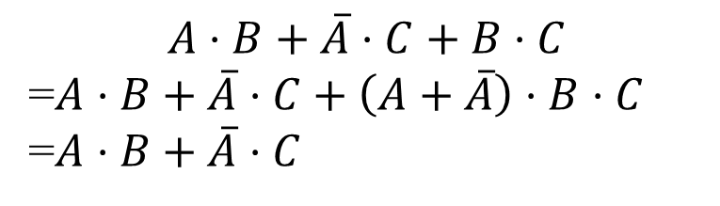
Rules of Boolean Algebra

Slide 21
DeMorgan’s Theorem (德·摩根定理)
DeMorgan’s 1st Theorem
The complement of a product of variables is equal to the sum of the complemented variables.
AB = A + B
Applying DeMorgan’s first theorem to gates:

Slide 22
DeMorgan’s Theorem
DeMorgan’s 2nd Theorem
The complement of a sum of variables is equal to the product of the complemented variables.
A + B = A . B
Applying DeMorgan’s second theorem to gates:

Slide 23
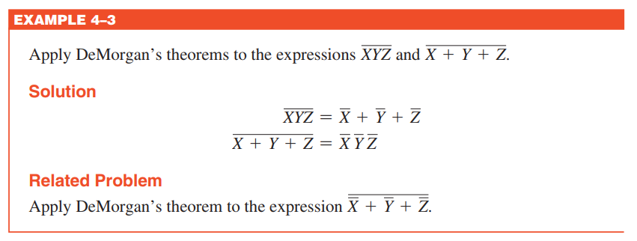

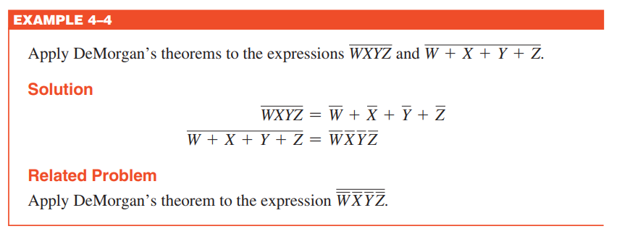
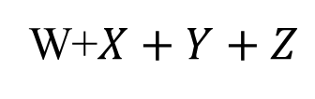

Slide 24
DeMorgan’s Theorem
Example
Apply DeMorgan’s theorem to remove the overbar covering both terms from the
expression X = C + D.
Solution
To apply DeMorgan’s theorem to the expression, you can break the overbar covering both terms and change the sign between the terms. This results in
X = C . D. Deleting the double bar gives X = C . D.
=

Slide 25
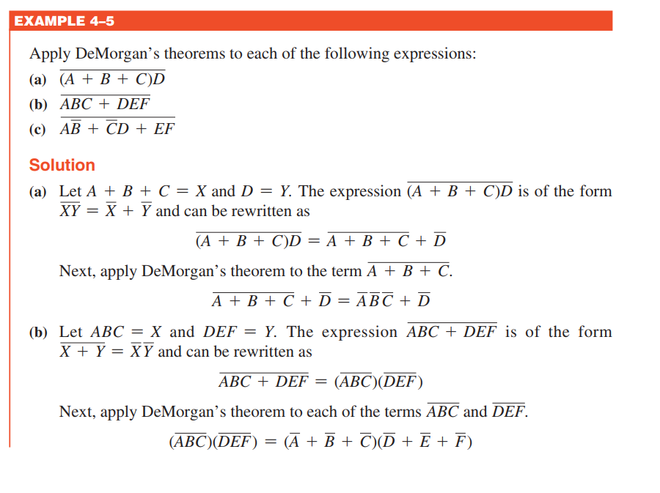

Slide 26
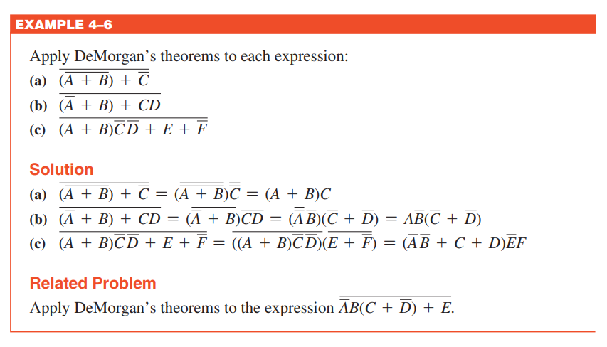

Slide 27
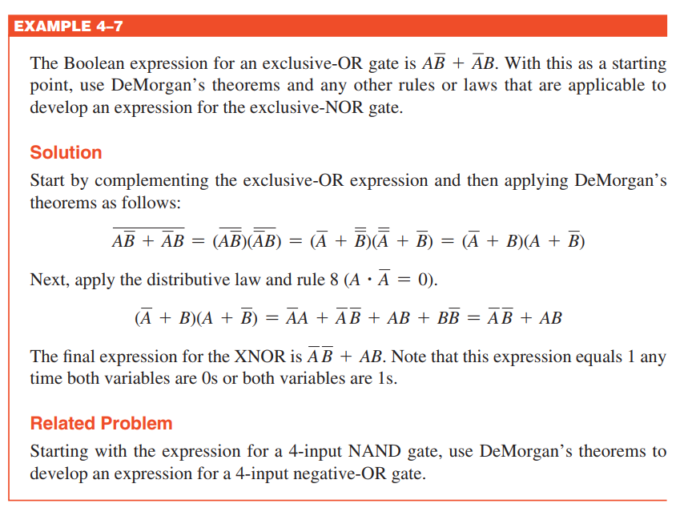

Slide 28
Boolean Analysis of Logic Circuits
Combinational logic circuits can be analyzed by writing the expression for each gate and combining the expressions according to the rules for Boolean algebra.
Example
Apply Boolean algebra to derive the expression for X.
Solution
Write the expression for each gate:
(A + B )
C (A + B )
= C (A + B )+ D
X
Applying DeMorgan’s theorem and the distribution law:
X = C (A B) + D = A B C + D

Slide 29
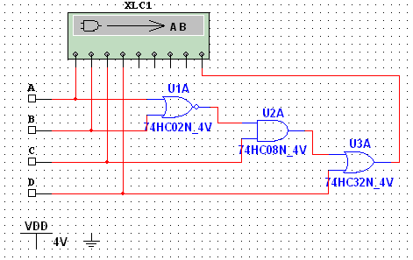
Boolean Analysis of Logic Circuits
Example
Use Multisim to generate the truth table for the circuit in the previous example.
Solution
Set up the circuit using the Logic Converter as shown. (Note that the logic converter has no “real-world” counterpart.)
Double-click the Logic Converter top open it. Then click on the conversion bar on the right side to see the truth table for the circuit (see next slide).

Slide 30
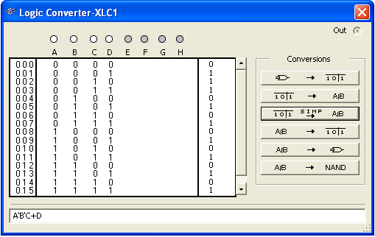
Boolean Analysis of Logic Circuits
The simplified logic expression can be viewed by clicking
Simplified expression

Slide 31
Logic Simplification
Why simplification?
In software design, simpler logic means less program branches and simpler codes
In hardware design, simpler logic means less gates, lower cost and less energy consumption
Ways to simplify logic functions
With rules in Boolean Algebra
With Karnaugh map

Slide 32
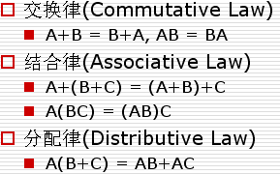
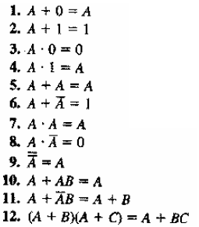
Logic Simplification
Example
Simplify the logic function below.
AB+A(B+C)+B(B+C)
Solution
AB+A(B+C)+B(B+C)
=AB+AB+AC+BB+BC
=AB+AC+B+BC
=B(A+1+C)+AC
=B+AC

Slide 33
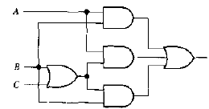

Logic Simplification
AB+A(B+C)+B(B+C)=B+AC

Slide 34
Logic Simplification
Example
Simplify the logic function below.
Solution

Slide 35
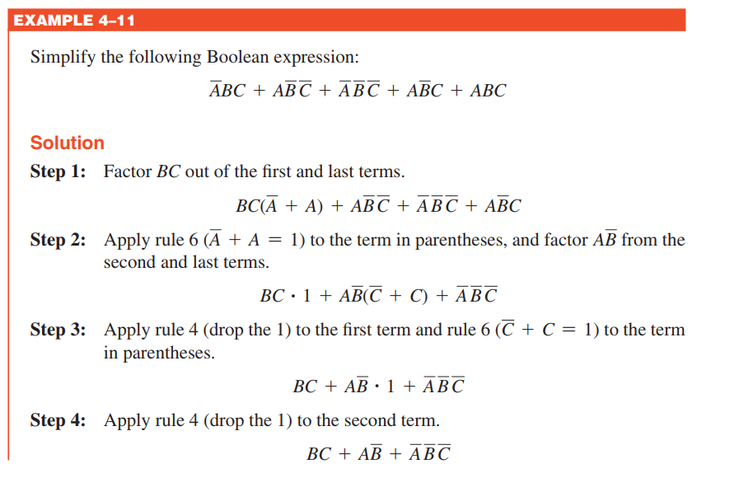
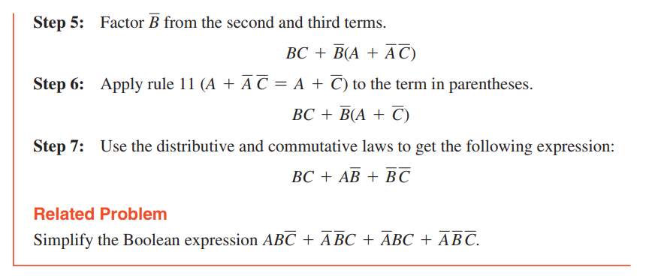

Slide 36
