Slide 1
Chapter 2 In this chapter…
Objectives
  Number systems (Decimal, Binary, Hexadecimal)
  Conversions
  Arithmetic
  BCD

Slide 2
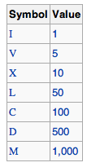
Place Value System
Decimal number system is a place value system (or weighted number system)
  The value of a digit depends not only on the digit itself, but also depends on its position
  5858.58
Non-Place value number systems
  Roman number system
MMXII =
2012

Slide 3
Decimal Numbers 十进制
The position of each digit in a weighted number system is assigned a weight based on the base (基) or radix.
The radix of decimal numbers is ten.
The weights of decimal numbers are powers of ten that increase from right to left beginning with 10⁰ =1:
…10⁵ 10⁴ 10³ 10² 10¹ 10⁰.
For fractional decimal numbers, the column weights are negative powers of ten that decrease from left to right:
10² 10¹ 10⁰. 10⁻¹ 10⁻² 10⁻³ 10⁻⁴ …

Slide 4

Decimal Numbers
Decimal numbers can be expressed as the sum of the products of each digit times the column value for that digit. Thus, the number 9240 can be expressed as
(9 x 10³) + (2 x 10²) + (4 x 10¹) + (0 x 10⁰)
or
9 x 1,000 + 2 x 100 + 4 x 10 + 0 x 1
Example
Express the number 480.52 as the sum of values of each digit.
Solution
480.52 = (4 x 10²) + (8 x 10¹) + (0 x 10⁰) + (5 x 10⁻¹) +(2 x 10⁻²)

Slide 5
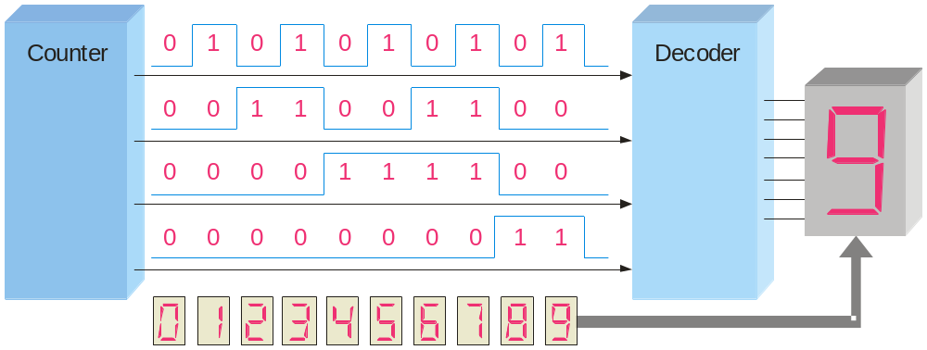
Decimal Number
Binary Number
Binary Numbers
0 0 0 0 0
1 0 0 0 1
2 0 0 1 0
3 0 0 1 1
4 0 1 0 0
5 0 1 0 1
6 0 1 1 0
7 0 1 1 1
8 1 0 0 0
9 1 0 0 1
10 1 0 1 0
11 1 0 1 1
12 1 1 0 0
13 1 1 0 1
14 1 1 1 0
15 1 1 1 1
A binary counting sequence for numbers from zero to fifteen is shown →
Notice the pattern of zeros and ones in each column.
Digital counters frequently have this same pattern of digits:

Slide 6
Binary Numbers 二进制
For digital systems, binary number system is used.
Binary has a radix of two and uses the digits 0 and 1 to represent quantities.
The column weights of binary numbers are powers of 2 that increase from right to left beginning with 2⁰ =1:
…2⁵ 2⁴ 2³ 2² 2¹ 2⁰.
For fractional binary numbers, the column weights are negative powers of two that decrease from left to right:
2² 2¹ 2⁰. 2⁻¹ 2⁻² 2⁻³ 2⁻⁴ …

Slide 7
Binary to Decimal Conversions
The decimal equivalent of a binary number is determined by:
Adding the column values of all of the “1” bits
Discarding all of the “0” bits
Example
Convert the binary number 100101.01 to decimal.
Solution
Start by writing the column weights; then add the weights that correspond to each 1 in the number.
2⁵ 2⁴ 2³ 2² 2¹ 2⁰. 2⁻¹ 2⁻²
32 16 8 4 2 1 . ½ ¼
1 0 0 1 0 1. 0 1
32 +4 +1 +¼ =
37¼

Slide 8
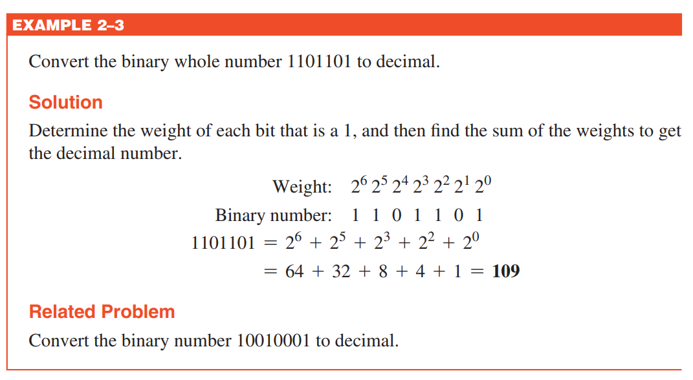

Slide 9
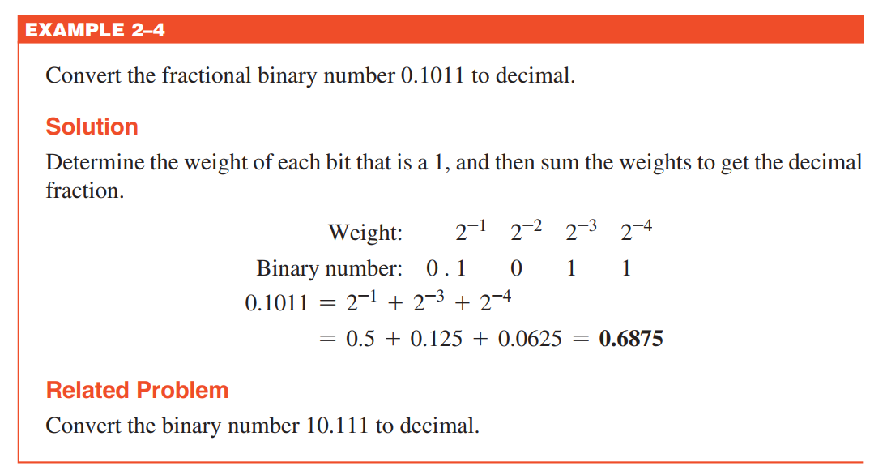

Slide 10
Decimal to Binary Conversions (Sum-of-Weights Method)
To convert decimal to binary:
Write the binary weight of each column
Place 1’s in the columns that sum to the decimal number
Example
Convert the decimal number 49 to binary.
Solution
The column weights double in each position to the right. Write down column weights until the last number is larger than the one you want to convert.
2⁶ 2⁵ 2⁴ 2³ 2² 2¹ 2⁰.
64 32 16 8 4 2 1.
(49)₁₀ = (110001)₂
0 1 1 0 0 0 1.

Slide 11
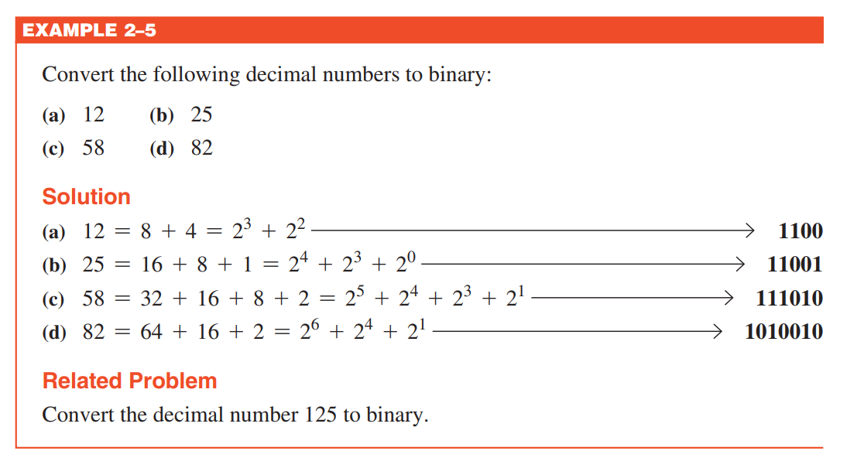

Slide 12
Decimal to Binary Conversions (Repeated Division-by-2 Method)
Example
Convert the decimal number 49 to binary by repeatedly dividing by 2.
remainder
2
49
Quotient
2
24
……..…1
LSB
Least Significant Bit
2
12
……..…0
2
6
……..…0
2
3
……..…0
2
1
……..…1
MSB
Most Significant Bit
0
……..…1

Slide 13
Binary Conversions
You can convert decimal to any other base by repeatedly dividing by the base. For binary, repeatedly divide by 2:
Example
Convert the decimal number 49 to binary by repeatedly dividing by 2.
Solution
You can do this by “reverse division” and the answer will read from left to right. Put quotients to the left and remainders on top.
Answer:
1
1
0
0
0
1
remainder
0
1
3
6
12
24
49 2
Continue until the last quotient is 0
Decimal number
base
Quotient

Slide 14
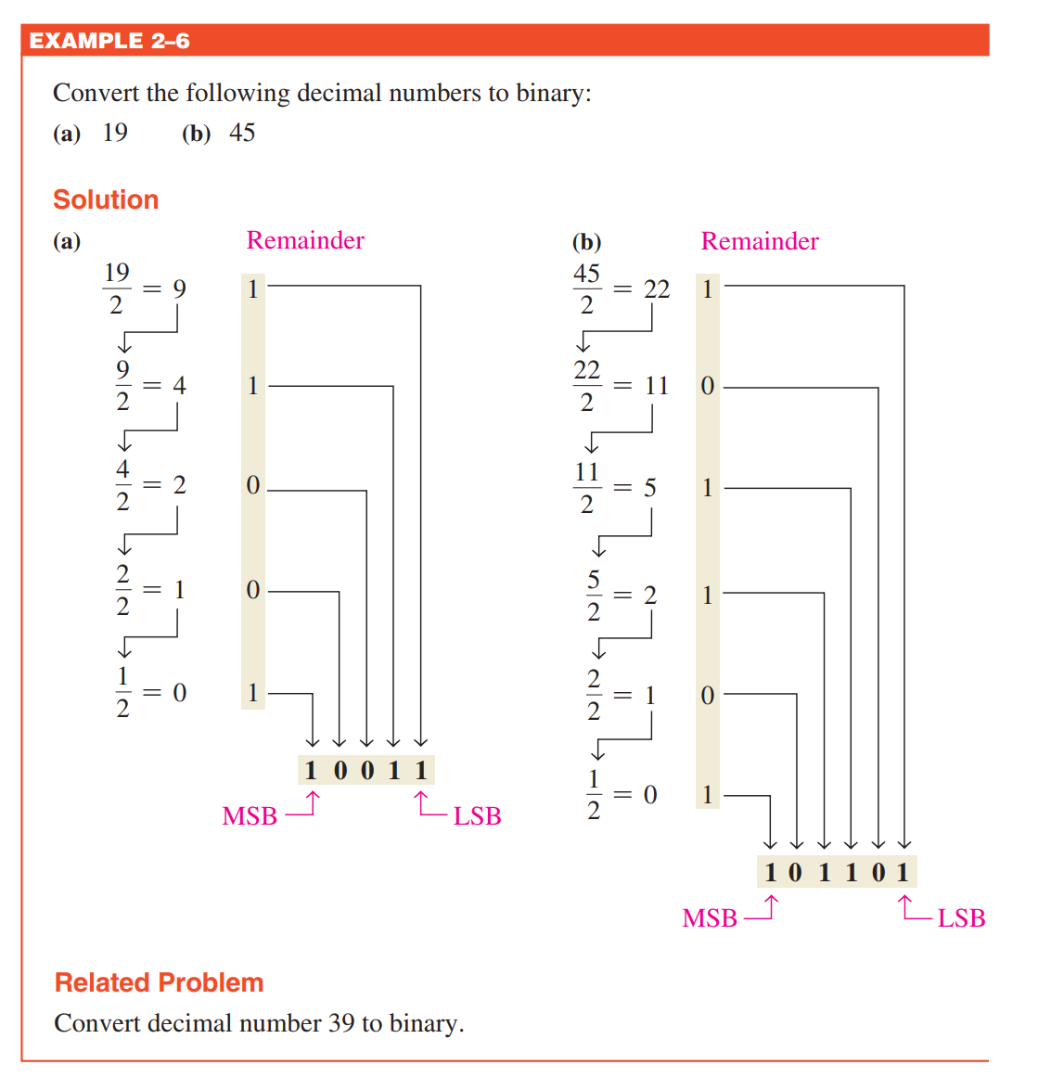

Slide 15
Decimal to Binary Conversions
Decimal fraction to binary conversion can be done by:
The sum-of-weights method can be applied to fractional decimal numbers, as shown in the following example
Example
Convert the decimal fraction 0.625 to binary by sum-of-weights method:
Solution
0.625 = 0.5 + 0.125 = 2⁻¹ + 2⁻³ = 0.101

Slide 16
Decimal to Binary Conversions
Decimal fraction to binary conversion can be done by:
Repeatedly multiplying the fractional results of successive multiplications by 2.
The carries form the binary number.
Example
Convert the decimal fraction 0.188 to binary by repeatedly multiplying the fractional results by 2.
Solution
0.188 x 2 = 0.376 carry = 0
MSB
0.376 x 2 = 0.752 carry = 0
0.752 x 2 = 1.504 carry = 1
0.504 x 2 = 1.008 carry = 1
0.008 x 2 = 0.016 carry = 0
Answer = .00110 (for five significant digits)

Slide 17
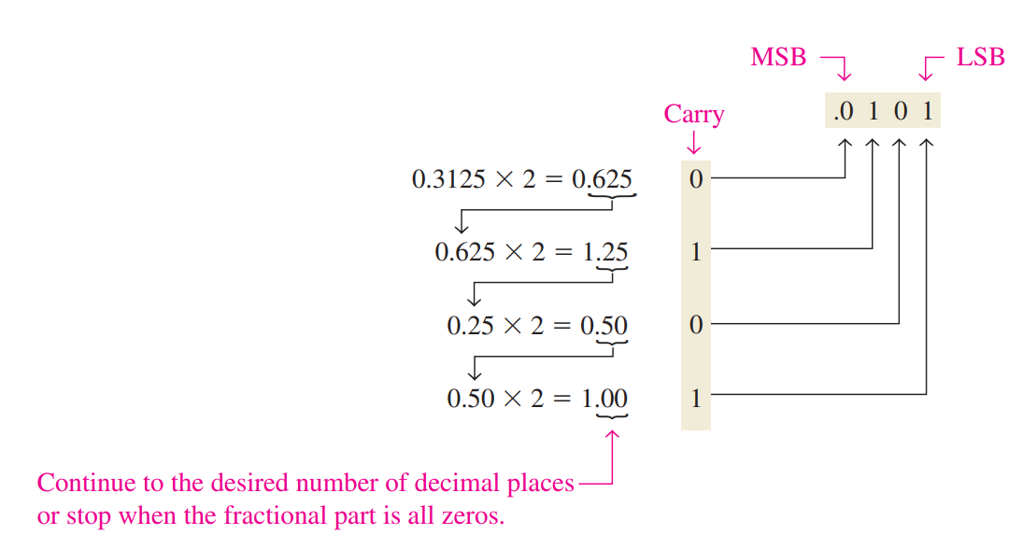
Example
Convert the decimal fraction 0.3125 to binary by repeatedly multiplying the fractional results by 2.
Solution

Slide 18
Binary Addition
The rules for binary addition are
0 + 0 = 0 Sum = 0, carry = 0
0 + 1 = 0 Sum = 1, carry = 0
1 + 0 = 0 Sum = 1, carry = 0
1 + 1 = 10 Sum = 0, carry = 1
When an input carry = 1 due to a previous result, the rules are
1 + 0 + 0 = 01 Sum = 1, carry = 0
1 + 0 + 1 = 10 Sum = 0, carry = 1
1 + 1 + 0 = 10 Sum = 0, carry = 1
1 + 1 + 1 = 11 Sum = 1, carry = 1

Slide 19
Binary Addition
Example
Add the binary numbers 00111 and 10101 and show the equivalent decimal addition.
Solution
0
1
1
1
00111 7
10101 21
1
1
1
0
0
=
28

Slide 20
Binary Subtraction
The rules for binary subtraction are
0 − 0 = 0
1 − 1 = 0
1 − 0 = 1
10 − 1 = 1 with a borrow of 1
Example
Subtract the binary number 00111 from 10101 and show the equivalent decimal subtraction.
Solution
/¹
/¹
/¹
10101 21
00111 7
0
1
1
1
0
=
14

Slide 21
Binary Multiplication
The rules for binary multiplication are
0 × 0 = 0
0 × 1 = 0
1 × 0 = 0
1 × 1 = 1

Slide 22
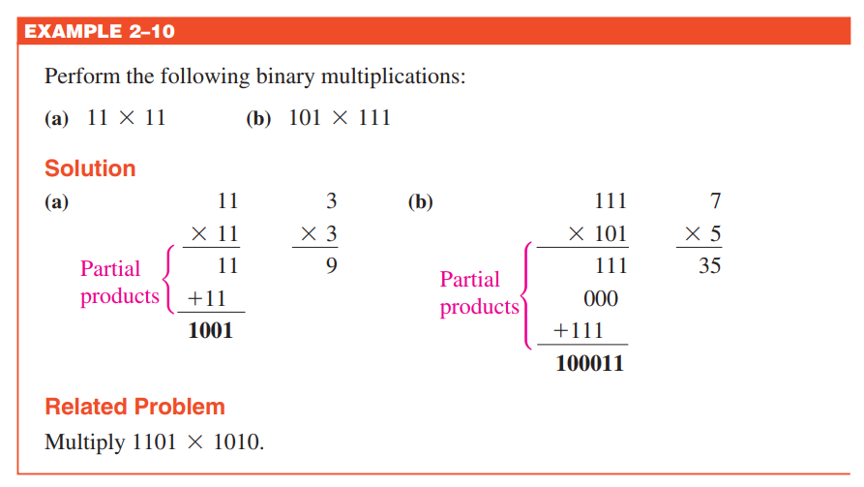

Slide 23
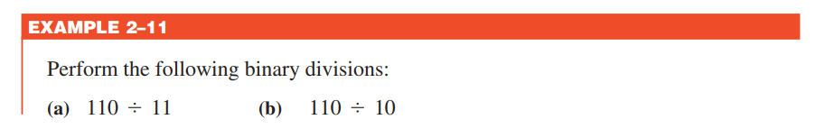
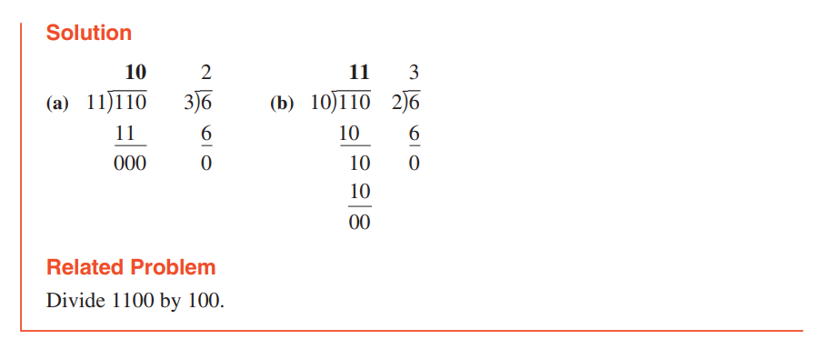
Binary Division
Division in binary follows the same procedure as division in decimal

Slide 24
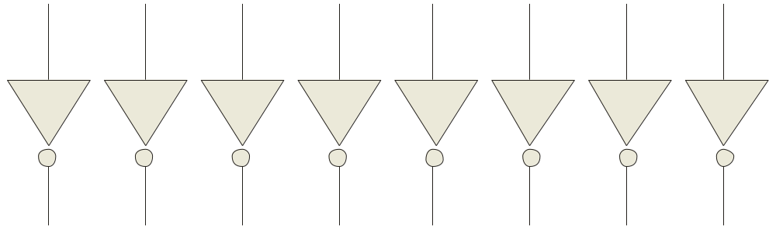
1’s Complement (1的补码/反码)
The 1’s complement of a binary number is just the inverse of the digits. To form the 1’s complement, change all 0’s to 1’s and all 1’s to 0’s.
For example, the 1’s complement of 11001010 is
00110101
In digital circuits, the 1’s complement is formed by using inverters:
1 1 0 0 1 0 1 0
0 0 1 1 0 1 0 1

Slide 25
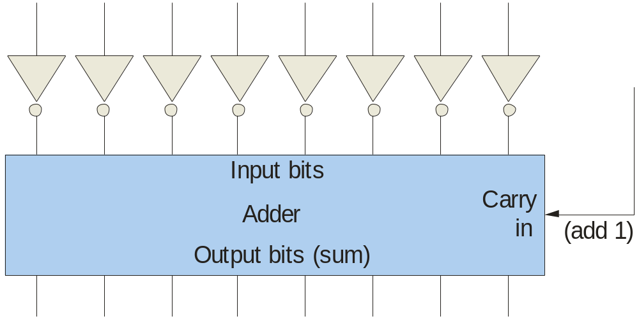
2’s Complement (2的补码/补码)
The 2’s complement of a binary number is found by adding 1 to the LSB of the 1’s complement.
Recall that the 1’s complement of 11001010 is
00110101 (1’s complement)
To form the 2’s complement, add 1:
+1
00110110 (2’s complement)
1 1 0 0 1 0 1 0
1
0 0 1 1 0 1 0 1
0 0 1 1 0 1 1 0

Slide 26
Why 1’s Complement/2’s Complement?
11001010
1’s Complement
+
00110101
11111111
11001010
2’s Complement
+
00110110
100000000
=2^{N}

Slide 27

Signed Binary Numbers
There are several ways to represent signed binary numbers. In all cases, the MSB in a signed number is the sign bit, that tells you if the number is positive or negative.
Sign-Magnitude Form (符号数值形式）
00011001₂ = 25₁₀
10011001₂ = -25₁₀

Slide 28
Signed Binary Numbers
1’s Complement Form (反码形式)
Positive numbers are represented the same way as the positive sign-magnitude numbers
A negative number is the 1’s complement of the corresponding positive number
00011001₂=25₁₀
11100110₂=-25₁₀
1’s complement

Slide 29
Signed Binary Numbers
2’s Complement Form (补码形式)
Computers use a modified 2’s complement for signed numbers.
Positive numbers are stored in true form (with a 0 for the sign bit)
Negative numbers are stored in complement form (with a “1” for the sign bit).
For example, the positive number 58 is written using 8-bits as 00111010 (true form).
Sign bit
Magnitude bits

Slide 30
Signed Binary Numbers
Negative numbers are written as the 2’s complement of the corresponding positive number.
The negative number −58 is written as:
−58 = 11000110 (complement form)
Sign bit
Magnitude bits
An easy way to read a signed number that uses this notation is to assign the sign bit a column weight of −128 (for an 8-bit number). Then add the column weights for the 1’s.
Example
Assuming that the sign bit = −128, show that 11000110 = −58 as a 2’s complement signed number:
Solution
Column weights: −128 64 32 16 8 4 2 1.
1 1 0 0 0 1 1 0
−128 +64 +4 +2 = −58

Slide 31
Range of Signed Integer Numbers
For n-bit 2’s complement signed numbers,
the maximum is
0111…111
the minimum is
1000…000
Range = -(2^{n-1}) to +(2^{n-1} - 1)

Slide 32
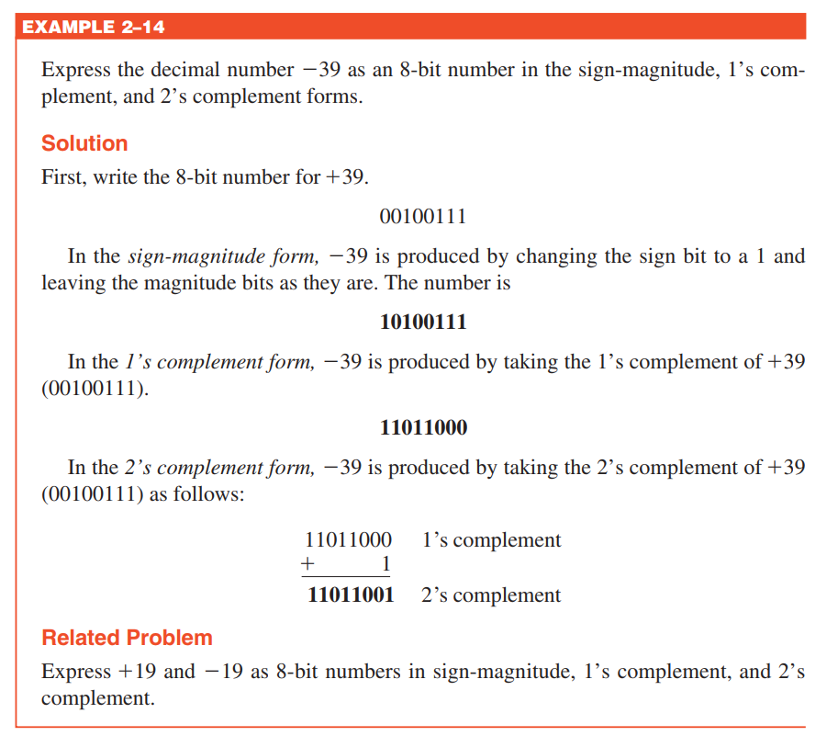

Slide 33
Arithmetic Operations with Signed Numbers
Using the signed number notation with negative numbers in 2’s complement form simplifies addition and subtraction of signed numbers.
Rules for addition: Add the two signed numbers. Discard any final carries. The result is in signed form.
Examples:
00011110 = +30
00001111 = +15
00001110 = +14
11101111 = −17
11111111 = −1
11111000 = −8
00101101
= +45
11111101
= −3
1
11110111
= −9
Discard carry

Slide 34
Arithmetic Operations with Signed Numbers
Note that if the number of bits required for the answer is exceeded, overflow will occur. This occurs only if both numbers have the same sign. The overflow will be indicated by an incorrect sign bit.
Two examples are:
01111101 = +125
01111011 = +123
10000001 = −127
10000001 = −127
11111000
= −16
Discard carry
100000010
= +2
Wrong! The answer is incorrect and the sign bit has changed.

Slide 35
Arithmetic Operations with Signed Numbers
Rules for subtraction: 2’s complement the subtrahend and add the numbers. Discard any final carries. The result is in signed form.
Repeat the examples done previously, but subtract:
00011110
00001111
(+30)
–(+15)
00001110
11101111
11111111
11111000
(+14)
–(−17)
(−1)
–(−8)
−
−
−
2’s complement subtrahend and add:
00011110 = +30
11110001 = −15
00001110 = +14
00010001 = +17
11111111 = −1
00001000 = +8
1
00001111
= +15
00011111
= +31
1
00000111
= +7
Discard carry
Discard carry

Slide 36
Floating Point Numbers
Floating point notation is capable of representing very large or small numbers by using a form of scientific notation. A 32-bit single precision number is illustrated.
S E (8 bits) F (23 bits)
Sign bit
Biased exponent (+127)
Magnitude with MSB dropped
Example
Express the speed of light, c, in single precision floating point notation. (c = 0.2998 x 10⁹)
Solution
In binary, c = 0001 0001 1101 1110 1001 0101 1100 0000₂.
In scientific notation, c = 1.0001 1101 1110 1001 0101 1100 0000 x 2²⁸.
S = 0 because the number is positive. E = 28 + 127 = 155₁₀ = 1001 1011₂. F is the next 23 bits after the first 1 is dropped.
In floating point notation, c =
0 10011011 0001 1101 1110 1001 0101 1100

Slide 37



Floating Point Numbers
Example
Solution

Slide 38

Decimal
Hexadecimal
Binary
Hexadecimal Numbers
0 1 2 3 4 5 6 7 8 9
0 1 2 3 4 5 6 7 8 9 A B C D E F
0000 0001 0010 0011 0100 0101 0110 0111 1000 1001 1010 1011 1100 1101 1110 1111
Hexadecimal uses sixteen characters to represent numbers: the numbers 0 through 9 and the alphabetic characters A through F.
Large binary number can easily be converted to hexadecimal by grouping bits 4 at a time and writing the equivalent hexadecimal character.
10
11
12
13
14
15
Example
Express 1001 0110 0000 1110₂ in hexadecimal:
Solution
Group the binary number by 4-bits starting from the right. Thus, 960E

Slide 39
Decimal
Hexadecimal
Binary
Hexadecimal Numbers
0 1 2 3 4 5 6 7 8 9
0 1 2 3 4 5 6 7 8 9 A B C D E F
0000 0001 0010 0011 0100 0101 0110 0111 1000 1001 1010 1011 1100 1101 1110 1111
Hexadecimal is a weighted number system. The column weights are powers of 16, which increase from right to left.
{
16³ 16² 16¹ 16⁰
.
Column weights
4096 256 16 1
.
10
11
12
13
14
15
Example
Express 1A2F₁₆ in decimal.
Solution
Start by writing the column weights:
4096 256 16 1
1 A 2 F₁₆
1(4096) + 10(256) +2(16) +15(1) =
6703₁₀

Slide 40
Decimal
Octal
Binary
Octal Numbers
0 1 2 3 4 5 6 7 8 9
0 1 2 3 4 5 6 7
0000 0001 0010 0011 0100 0101 0110 0111 1000 1001 1010 1011 1100 1101 1110 1111
Octal uses eight characters the numbers 0 through 7 to represent numbers. There is no 8 or 9 character in octal.
Binary number can easily be converted to octal by grouping bits 3 at a time and writing the equivalent octal character for each group.
10 11 12 13 14 15 16 17
10
11
12
13
14
15
Example
Express 1 001 011 000 001 110₂ in octal:
Solution
Group the binary number by 3-bits starting from the right. Thus, 113016₈

Slide 41
Decimal
Octal
Binary
Octal Numbers
0 1 2 3 4 5 6 7 8 9
0 1 2 3 4 5 6 7
0000 0001 0010 0011 0100 0101 0110 0111 1000 1001 1010 1011 1100 1101 1110 1111
Octal is also a weighted number system. The column weights are powers of 8, which increase from right to left.
{
8³ 8² 8¹ 8⁰
.
Column weights
512 64 8 1
.
10 11 12 13 14 15 16 17
Example
Express 3702₈ in decimal.
10
11
12
13
14
15
Solution
Start by writing the column weights:
512 64 8 1
3 7 0 2₈
3(512) + 7(64) +0(8) +2(1) =
1986₁₀

Slide 42
Decimal
Binary
BCD
BCD
0 1 2 3 4 5 6 7 8 9
0000 0001 0010 0011 0100 0101 0110 0111 1000 1001 1010 1011 1100 1101 1110 1111
0000 0001 0010 0011 0100 0101 0110 0111 1000 1001 0000 0001 0010 0011 0100 0101
Binary coded decimal (BCD) is a weighted code that is commonly used in digital systems when it is necessary to show decimal numbers such as in clock displays.
The table illustrates the difference between straight binary and BCD. BCD represents each decimal digit with a 4-bit code. Notice that the codes 1010 through 1111 are not used in BCD.
10
11
12
13
14
15
0001 0001 0001 0001 0001 0001

Slide 43
BCD
You can think of BCD in terms of column weights in groups of four bits. For an 8-bit BCD number, the column weights are: 80 40 20 10 8 4 2 1.
Question:
What are the column weights for the BCD number 1000 0011 0101 1001?
Answer:
8000 4000 2000 1000 800 400 200 100 80 40 20 10 8 4 2 1
Note that you could add the column weights where there is a 1 to obtain the decimal number. For this case:
8000 + 200 +100 + 40 + 10 + 8 +1 = 8359₁₀

Slide 44
Decimal
Binary
Gray code
Gray code (格雷码）
0 1 2 3 4 5 6 7 8 9
0000 0001 0010 0011 0100 0101 0110 0111 1000 1001 1010 1011 1100 1101 1110 1111
0000 0001 0011 0010 0110 0111 0101 0100 1100 1101 1111 1110 1010 1011 1001 1000
Gray code is an unweighted code that has a single bit change between one code word and the next in a sequence. Gray code is used to avoid problems in systems where an error can occur if more than one bit changes at a time.
10
11
12
13
14
15

Slide 45
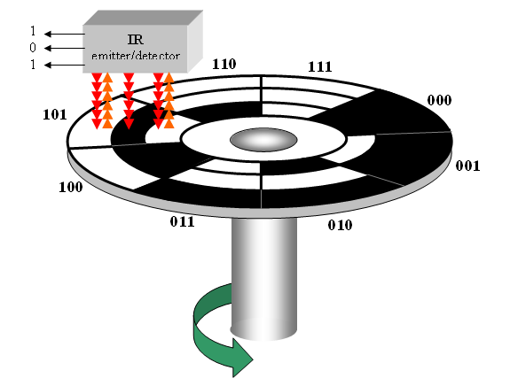
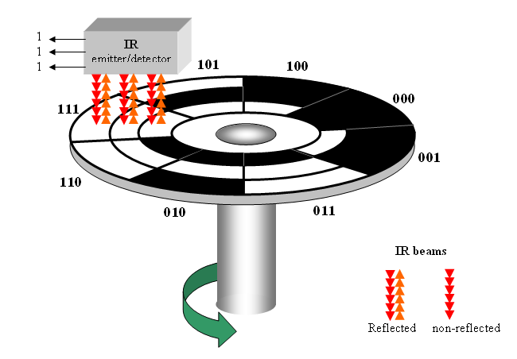
Gray code
A shaft encoder is a typical application. Three IR emitter/detectors are used to encode the position of the shaft. The encoder on the left uses binary and can have three bits change together, creating a potential error. The encoder on the right uses gray code and only 1-bit changes, eliminating potential errors.
Binary sequence
Gray code sequence

Slide 46
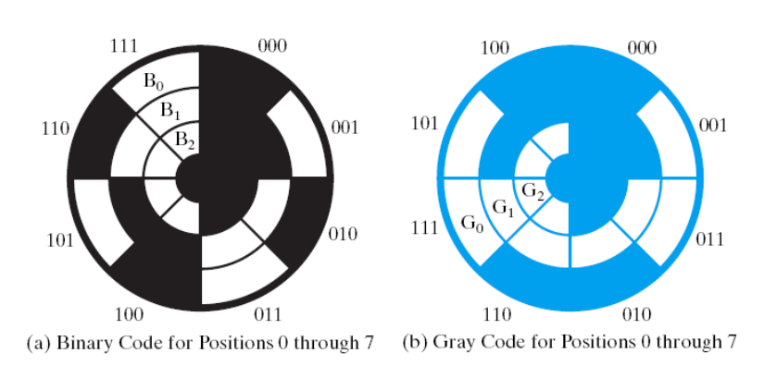

Slide 47
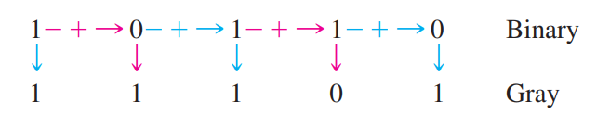
Binary-to-Gray code Conversion
1. The most significant bit (left-most) in the Gray code is the same as the corresponding MSB in the binary number.
2. Going from left to right, add each adjacent pair of binary code bits to get the next Gray code bit. Discard carries.
Example
Convert 10110 (binary) to Gray code
Solution

Slide 48
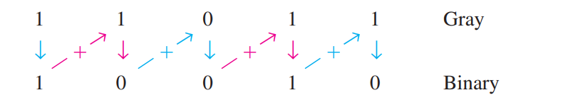
Gray-to-Binary code Conversion
The most significant bit (left-most) in the binary code is the same as the corresponding bit in the Gray code.
Add each binary code bit generated to the Gray code bit in the next adjacent position. Discard carries
Example
Convert 11011 (Gray code) to binary
Solution

Slide 49
ASCII
ASCII is a code for alphanumeric characters and control characters. In its original form, ASCII encoded 128 characters and symbols using 7-bits. The first 32 characters are control characters, that are based on obsolete teletype requirements, so these characters are generally assigned to other functions in modern usage.
In 1981, IBM introduced extended ASCII, which is an 8-bit code and increased the character set to 256. Other extended sets (such as Unicode) have been introduced to handle characters in languages other than English.

Slide 50
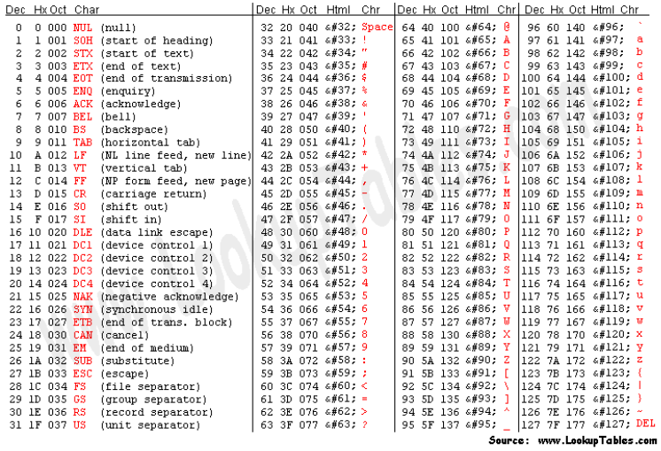

Slide 51
Parity Method
The parity method is a method of error detection for simple transmission errors involving one bit (or an odd number of bits). A parity bit is an “extra” bit attached to a group of bits to force the number of 1’s to be either even (even parity) or odd (odd parity).
Example
The ASCII character for “a” is 1100001 and for “A” is 1000001. What is the correct bit to append to make both of these have odd parity?
Solution
The ASCII “a” has an odd number of bits that are equal to 1; therefore the parity bit is 0. The ASCII “A” has an even number of bits that are equal to 1; therefore the parity bit is 1.

Slide 52
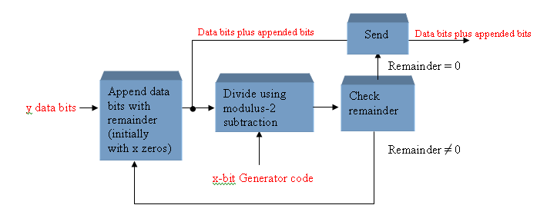
Cyclic Redundancy Check
The cyclic redundancy check (CRC) is an error detection method that can detect multiple errors in larger blocks of data. At the sending end, a checksum is appended to a block of data. At the receiving end, the check sum is generated and compared to the sent checksum. If the check sums are the same, no error is detected.

Slide 53

Quiz
1. For the binary number 1000, the weight of the column with the 1 is
a. 4
b. 6
c. 8
d. 10
© 2008 Pearson Education

Slide 54
Quiz
2. The 2’s complement of 1000 is
a. 0111
b. 1000
c. 1001
d. 1010
© 2008 Pearson Education

Slide 55
Quiz
3. The fractional binary number 0.11 has a decimal value of
a. ¼
b. ½
c. ¾
d. none of the above
© 2008 Pearson Education

Slide 56
Quiz
4. The hexadecimal number 2C has a decimal equivalent value of
a. 14
b. 44
c. 64
d. none of the above
© 2008 Pearson Education

Slide 57
Quiz
5. Assume that a floating point number is represented in binary. If the sign bit is 1, the
a. number is negative
b. number is positive
c. exponent is negative
d. exponent is positive
© 2008 Pearson Education

Slide 58
Quiz
6. When two positive signed numbers are added, the result may be larger that the size of the original numbers, creating overflow. This condition is indicated by
a. a change in the sign bit
b. a carry out of the sign position
c. a zero result
d. smoke
© 2008 Pearson Education

Slide 59
Quiz
7. The number 1010 in BCD is
a. equal to decimal eight
b. equal to decimal ten
c. equal to decimal twelve
d. invalid
© 2008 Pearson Education

Slide 60
Quiz
8. An example of an unweighted code is
a. binary
b. decimal
c. BCD
d. Gray code
© 2008 Pearson Education

Slide 61
Quiz
9. An example of an alphanumeric code is
a. hexadecimal
b. ASCII
c. BCD
d. CRC
© 2008 Pearson Education

Slide 62
Quiz
10. An example of an error detection method for transmitted data is the
a. parity check
b. CRC
c. both of the above
d. none of the above
© 2008 Pearson Education

