Slide 1

Digital Fundamentals
Tenth Edition
Floyd
Combinational Logic Analysis
© 2008 Pearson Education

Slide 2
In this chapter
Objectives
Analysis of combinational logic
Implementation of combinational logic
NAND/NOR universal gates and applications

Slide 3
Combinational Logic Circuits
In Sum-of-Products (SOP) form, basic combinational circuits can be directly implemented with AND-OR combinations if the necessary complement terms are available.

Slide 4
Combinational Logic Circuits
An example of an SOP implementation is shown. The SOP expression is an AND-OR combination of the input variables and the appropriate complements.
A
B
ABC
C
X = ABC
+ DE
SOP
D
E
DE

Slide 5
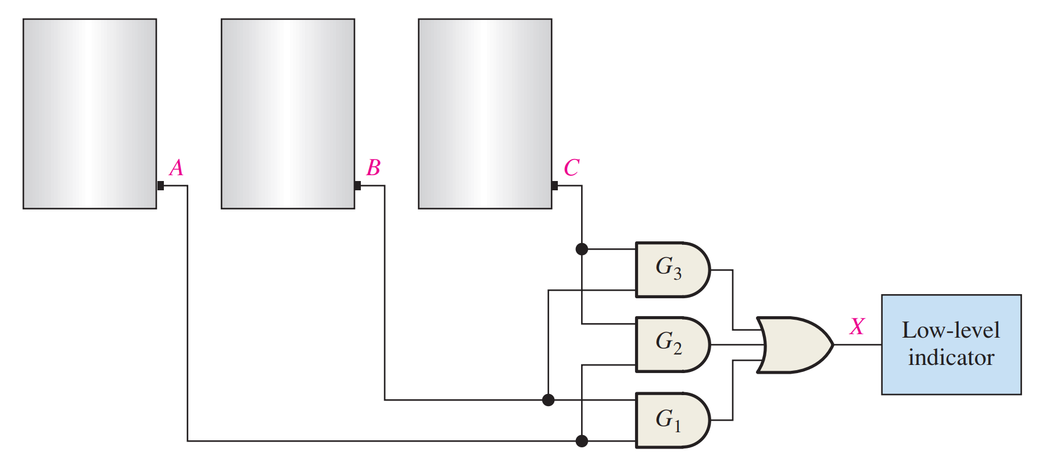
Example
In a certain chemical-processing plant, a liquid chemical is used in a manufacturing process. The chemical is stored in three different tanks. A level sensor in each tank produces a HIGH voltage when the level of chemical in the tank drops below a specified point. Design a circuit that monitors the chemical level in each tank and indicates when the level in any two of the tanks drops below the specified point.

Slide 6
Combinational Logic Circuits
When the output of a SOP form is inverted, the circuit is called an AND-OR-Invert circuit. The AOI configuration lends itself to product-of-sums (POS) implementation.
An example of an AOI implementation is shown. The output expression can be changed to a POS expression by applying DeMorgan’s theorem twice.
A
B
ABC
C
X = ABC
+ DE
X = ABC
+ DE
AOI
D
X = (ABC)(DE)
DeMorgan
E
DE
X = (A + B + C)(D + E)
POS

Slide 7
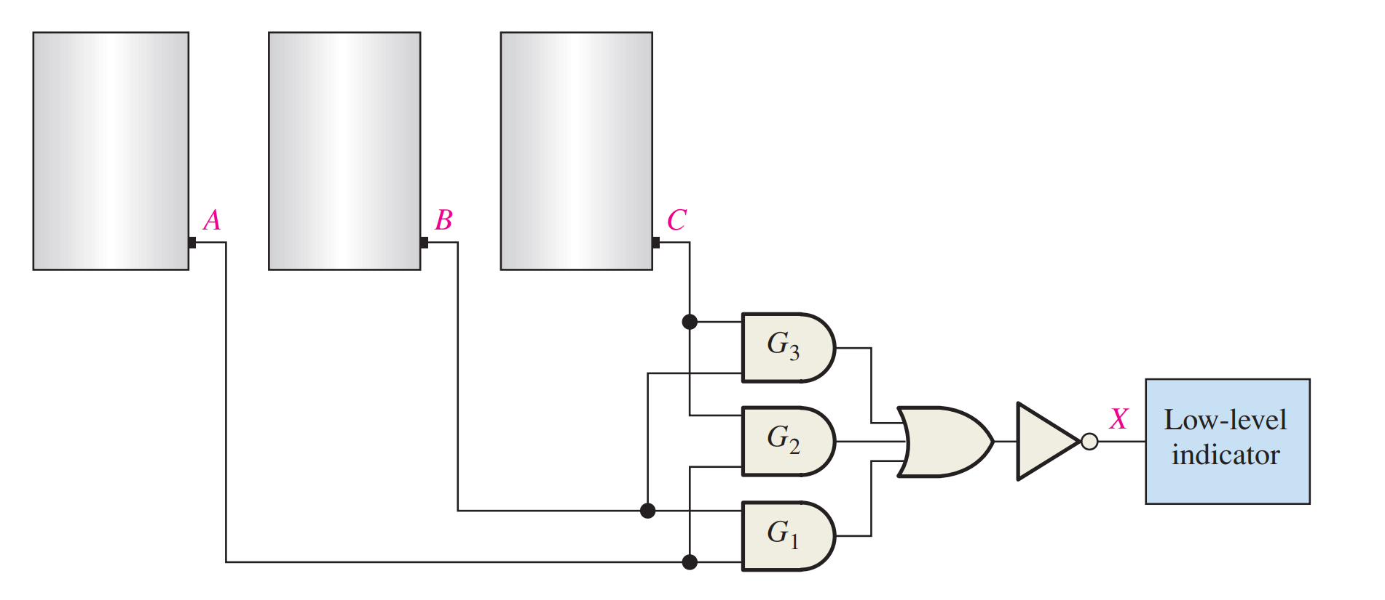
Example
The sensors in the chemical tanks are being replaced by a new model that produces a LOW voltage instead of a HIGH voltage when the level of the chemical in the tank drops below a critical point. Modify the circuit to operate with the different input levels and still produce a HIGH output to activate the indicator when the level in any two of the tanks drops below the critical point. Show the logic diagram

Slide 8
Exclusive-OR Logic
The truth table for an exclusive-OR gate is
Notice that the output is HIGH whenever A and B disagree.
The Boolean expression is
X = AB + AB
The circuit can be drawn as
A
Symbols:
X
Distinctive shape Rectangular outline
B

Slide 9
Exclusive-NOR Logic
The truth table for an exclusive-NOR gate is
Notice that the output is HIGH whenever A and B agree.
The Boolean expression is
X = AB + AB
The circuit can be drawn as
A
Symbols:
X
B
Distinctive shape Rectangular outline

Slide 10
Example
For each circuit, determine if the LED should be on or off.
(a) (b) (c)
Solution
Circuit (a): XOR, inputs agree, output is LOW, LED is ON.
Circuit (b): XNOR, inputs disagree, output is LOW, LED is ON.
Circuit (c): XOR, inputs disagree, output is HIGH, LED is OFF.

Slide 11
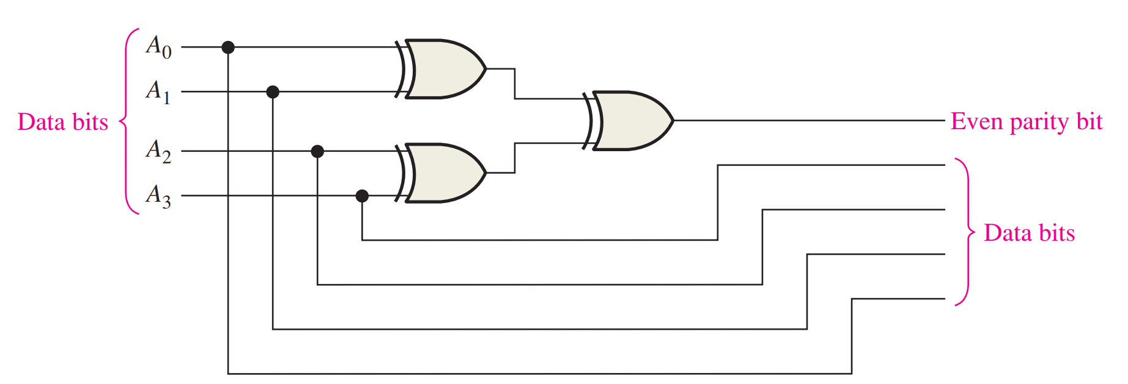
Example
Use exclusive-OR gates to implement an even-parity code generator for an original 4-bit code.

Slide 12
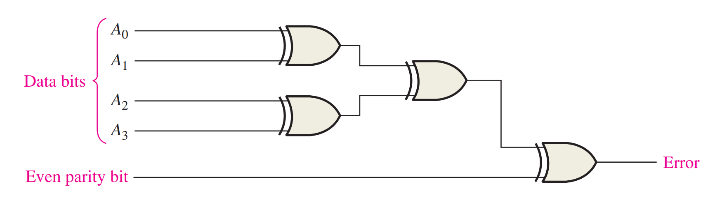
Example
Use exclusive-OR gates to implement an even-parity checker for the 5-bit code generated by the circuit in the previous slides.

Slide 13
Implementing Combinational Logic
Implementing a SOP expression is done by first forming the AND terms; then the terms are ORed together.
Example
Show the circuit that will implement the Boolean expression X = ABC + ABD + BDE. (Assume that the variables and their complements are available.)
Solution
Start by forming the terms using three 3-input AND gates.
Then combine the three terms using a 3-input OR gate.
A
B
C
A
X = ABC + ABD + BDE
B
D
B
D
E

Slide 14
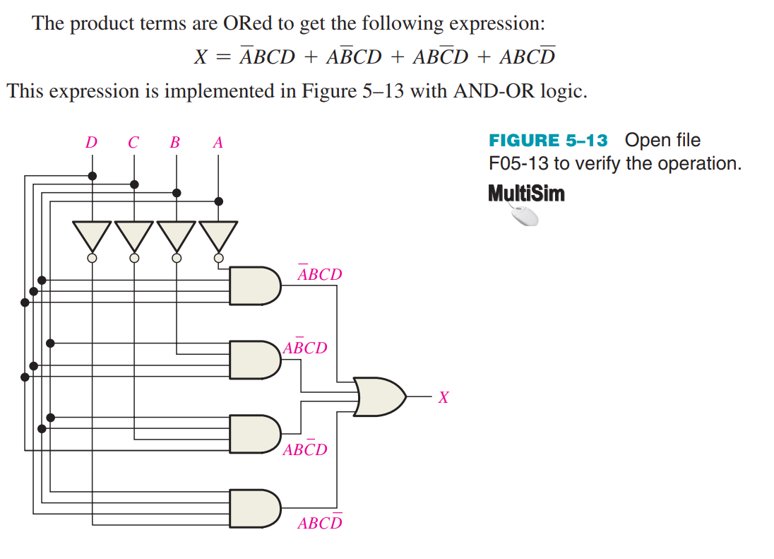
Example
Develop a logic circuit with four input variables that will only produce a 1 output when exactly three input variables are 1s

Slide 15
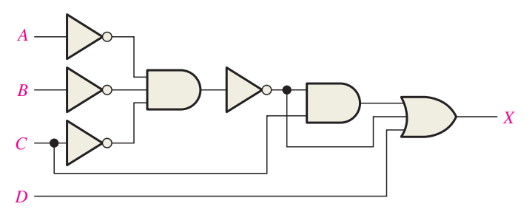
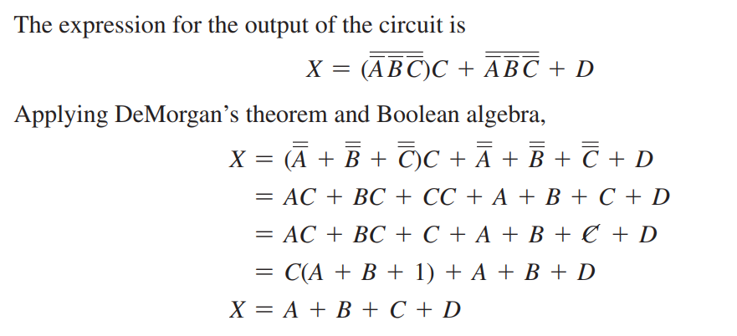
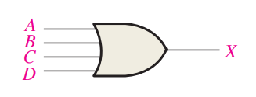
Example
Reduce the combinational logic circuit to a minimum form
Solution

Slide 16
Karnaugh Map Implementation
For basic combinational logic circuits, the Karnaugh map can be read and the circuit drawn as a minimum SOP.
Example
A Karnaugh map is drawn from a truth table. Read the minimum SOP expression and draw the circuit.
Solution
1. Group the 1’s into two overlapping groups as indicated.
Read each group by eliminating any variable that changes across a boundary.
B changes across this boundary
The vertical group is read A C.
C changes across this boundary
The horizontal group is read AB.
The circuit is on the next slide:

Slide 17
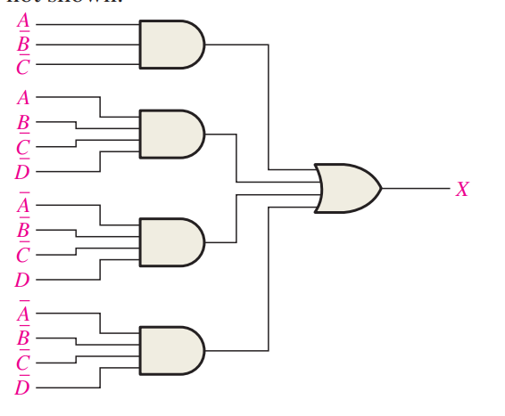
Example
Minimize the combinational logic circuit. Inverters for the complemented variables are not shown.

Slide 18
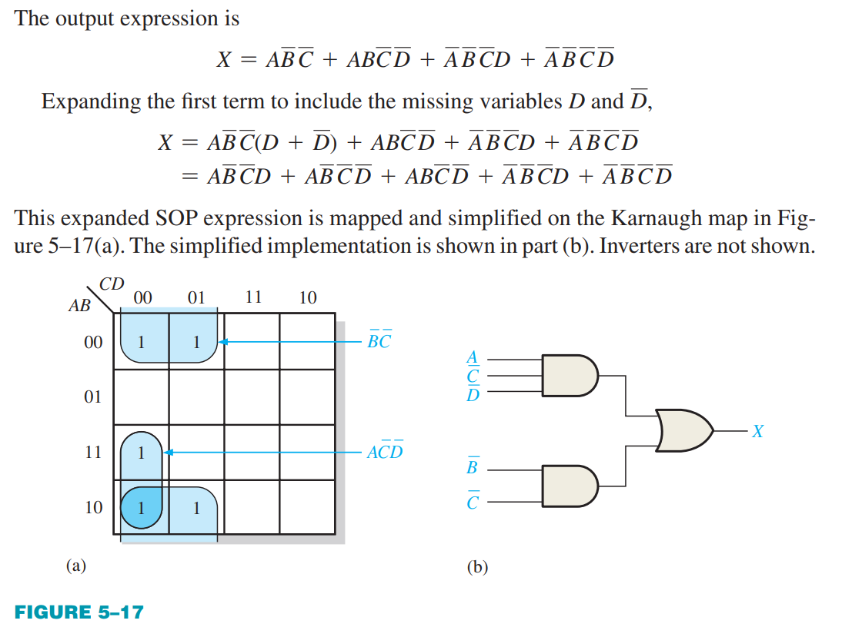
Solution

Slide 19
Solution
continued…
Circuit:
A
C
X =
A
C
+
A
B
A
B
The result is shown as a sum of products.
It is a simple matter to implement this form using only NAND gates as shown in the text and following example.

Slide 20
A
C
X =
A
C
+
A
B
NAND Logic
A
B
Example
Convert the circuit in the previous example to one that uses only NAND gates.
Solution
Recall from Boolean algebra that double inversion cancels. By adding inverting bubbles to above circuit, it is easily converted to NAND gates:
A
C
X =
A
C
+
A
B
A
B

Slide 21
NAND Logic
Recall from DeMorgan’s theorem that AB = A + B. By using equivalent symbols, it is simpler to read the logic of SOP forms. The earlier example shows the idea:
A
C
X =
A
C
+
A
B
A
B
The logic is easy to read if you (mentally) cancel the two connected bubbles on a line.

Slide 22
Universal Gates
NAND gates are sometimes called universal gates because they can be used to produce the other basic Boolean functions.
A
A
A
AB
B
Inverter
AND gate
A
A
A + B
A + B
B
B
OR gate
NOR gate

Slide 23
NOR Logic
Alternatively, DeMorgan’s theorem can be written as A + B = A B. By using equivalent symbols, it is simpler to read the logic of POS forms. For example,
A
B
X =
(A + B)(A + C)
A
C
Again, the logic is easy to read if you cancel the two connected bubbles on a line.

Slide 24
Universal Gates
NOR gates are also universal gates and can form all of the basic gates.
A
A
A
A + B
B
Inverter
OR gate
A
A
AB
AB
B
B
AND gate
NAND gate

Slide 25
5.4 Combinational Logic Using NAND and NOR Gates
How can NAND and NOR gates be used to implement a logic function?

Slide 26
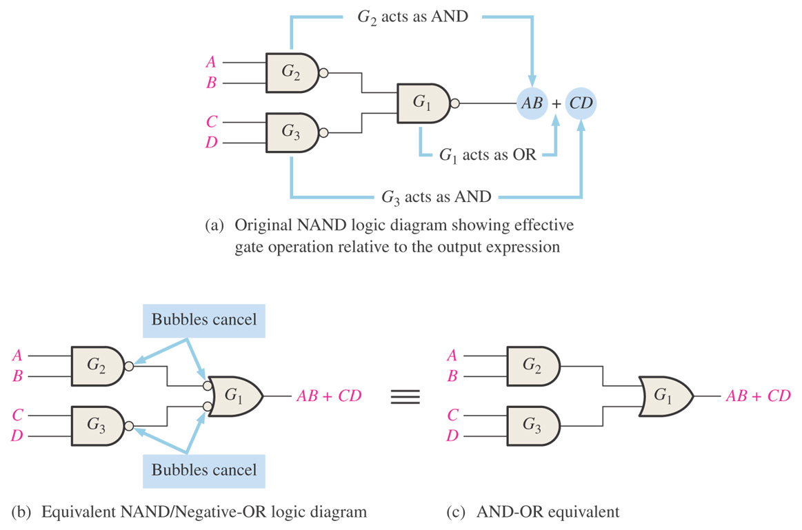
Figure 5–19 Development of the AND-OR equivalent of the circuit in Figure 5–18.

Slide 27
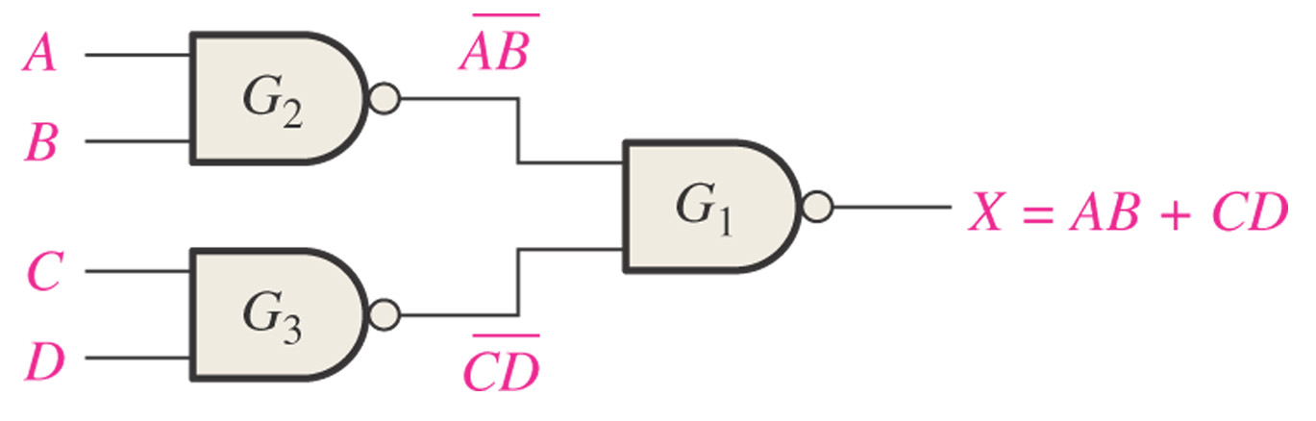
Figure 5–18 NAND logic for X = AB + CD.

Slide 28
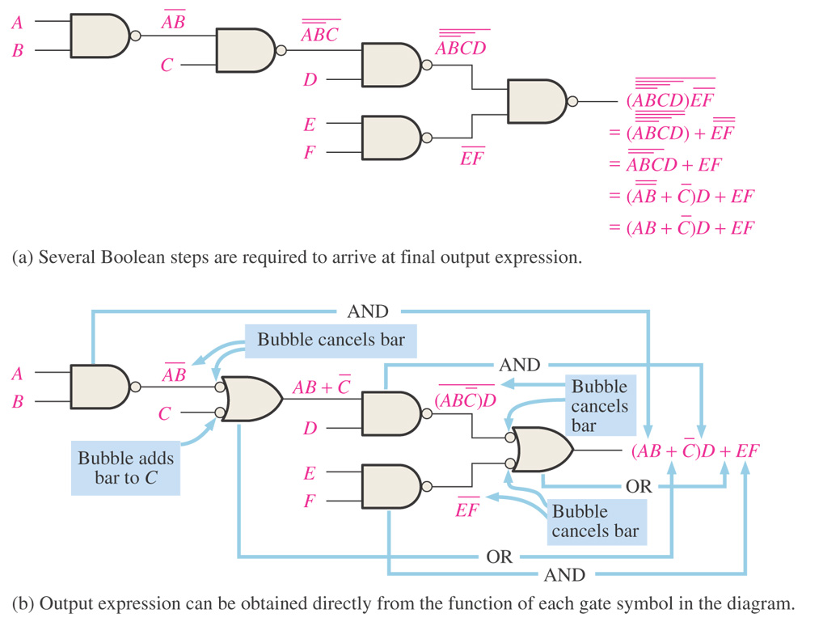
Figure 5–20 Illustration of the use of the appropriate dual symbols in a NAND logic diagram.

Slide 29
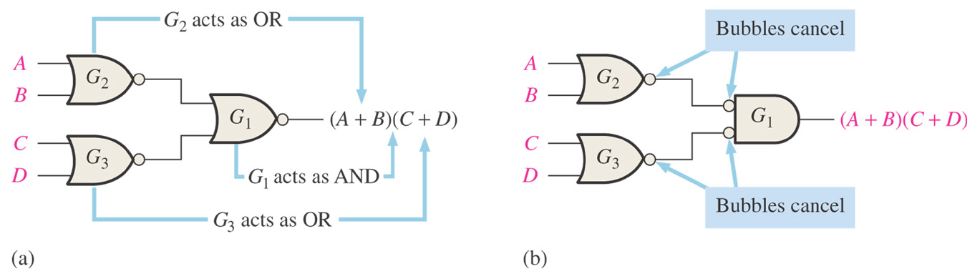
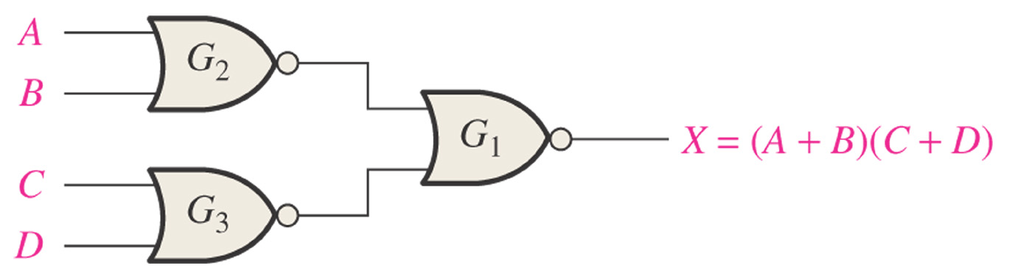
Figure 5–24 NOR logic for X = (A + B)(C + D).

Slide 30
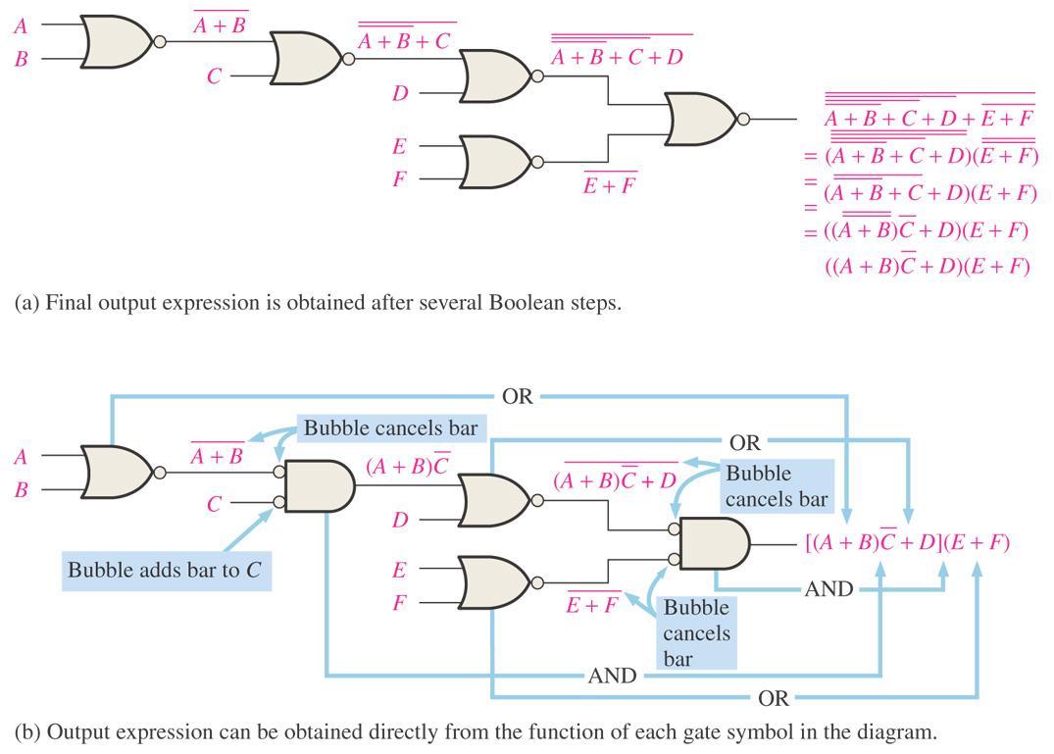
Example: Illustration of the use of the appropriate dual symbols in a NOR logic diagram.

Slide 31
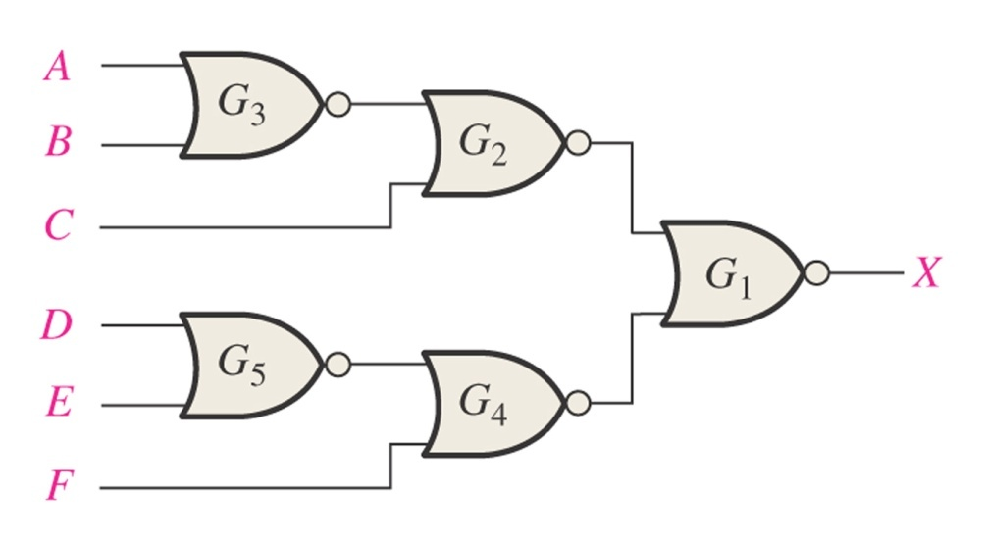
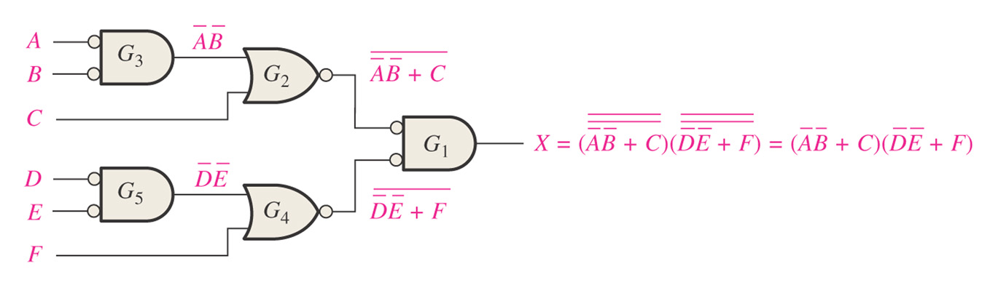
Example: Using appropriate dual symbols, redraw the logic diagram and develop the output expression for the circuit in the following figure.

Slide 32
5.5 Logic Circuit Operation with Pulse Waveform Inputs
The output of an AND gate is HIGH only when all inputs are HIGH at the same time;
The output of an OR gate is HIGH only when at least one of its inputs is HIGH;
The output of a NAND gate is LOW only when all inputs are HIGH at the same time;
The output of a NOR gate is LOW only when at least one of its inputs is HIGH.

Slide 33
Pulsed Waveforms
For combinational circuits with pulsed inputs, the output can be predicted by developing intermediate outputs and combining the result. For example, the circuit shown can be analyzed at the outputs of the OR gates:
A
A
G₁
B
B
G₃
C
C
D
G₂
D
G₁
G₂
G₃

Slide 34
Pulsed Waveforms
Inputs
Output
Alternatively, you can develop the truth table for the circuit and enter 0’s and 1’s on the waveforms. Then read the output from the table.
A B C D
X
0 0 0 0
0
0 0 0 1
1
A
0 0 1 0
1
G₁
0 0 1 1
1
B
0 1 0 0
0
G₃
C
0 1 0 1
1
G₂
0 1 1 0
1
D
0 1 1 1
1
1 0 0 0
0
A
0 1 0 1 0 1 0 1 0 1
1 0 0 1
0
0 1 1 0 0 1 1 0 0 0
1 0 1 0
0
B
1 0 1 1
0
C
0 0 0 1 1 1 1 0 0 0
1 1 0 0
0
1 1 0 1
1
D
0 0 0 0 0 0 0 1 1 0
1 1 1 0
1
G₃
0 0 0 0 1 1 1 0 1 0
1 1 1 1
1

Slide 35
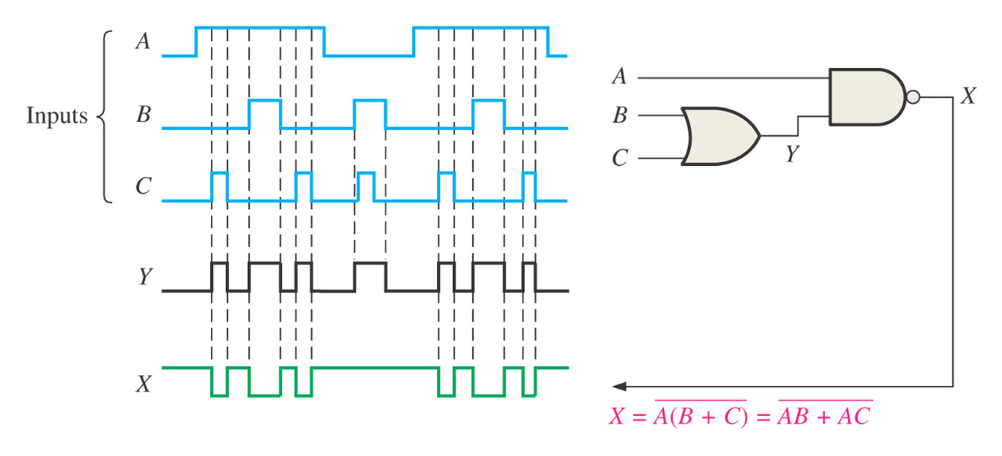
Example: Determine the final output waveform X for the circuit in the following figure, with input waveforms A, B, and C as shown.

Slide 36
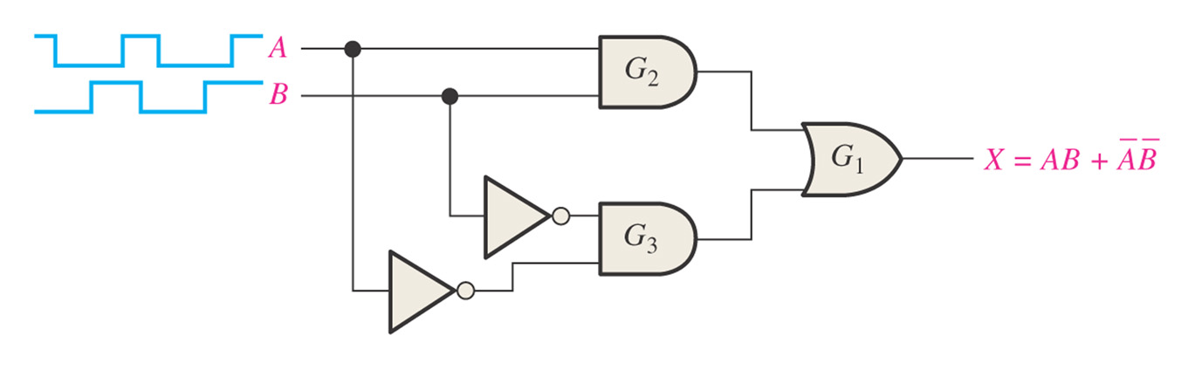
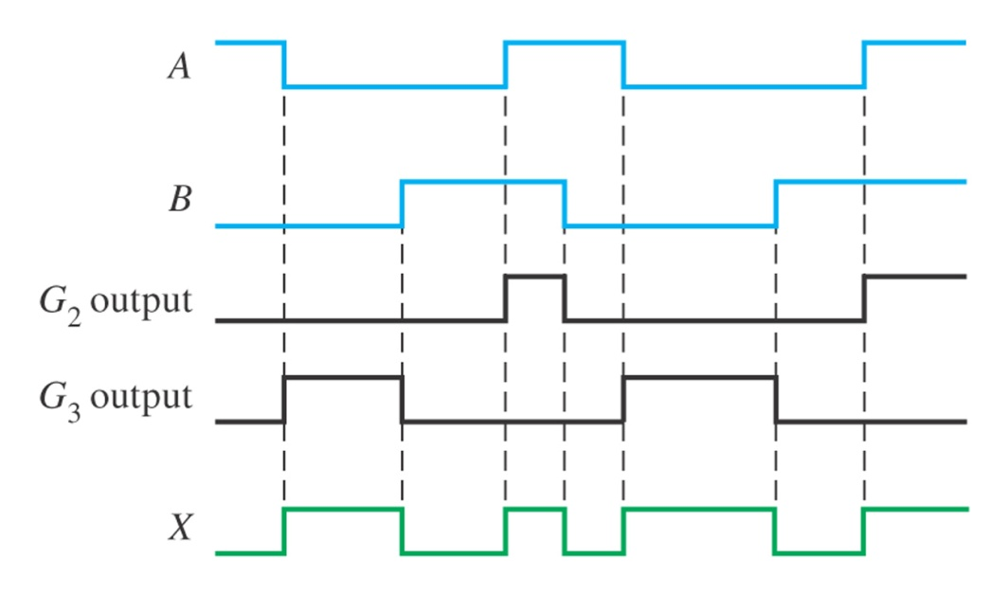
Example: Determine the final output waveform X for the circuit in the following figure, with input waveforms A, B, and C as shown.

Slide 37
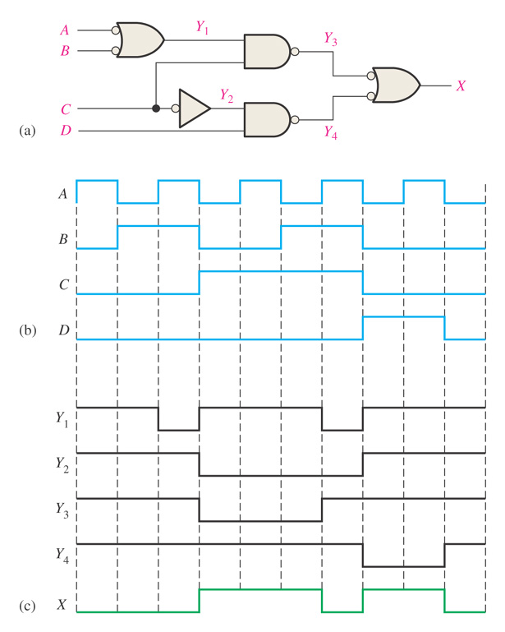
Example: Determine the final output waveform X for the circuit in the following figure, with input waveforms A, B, and C as shown.

Slide 38
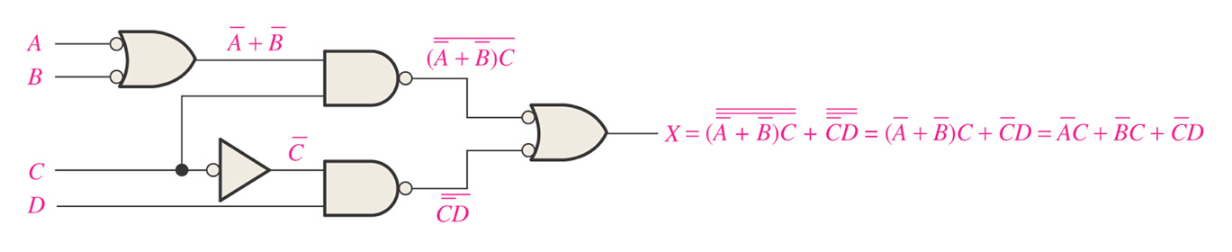
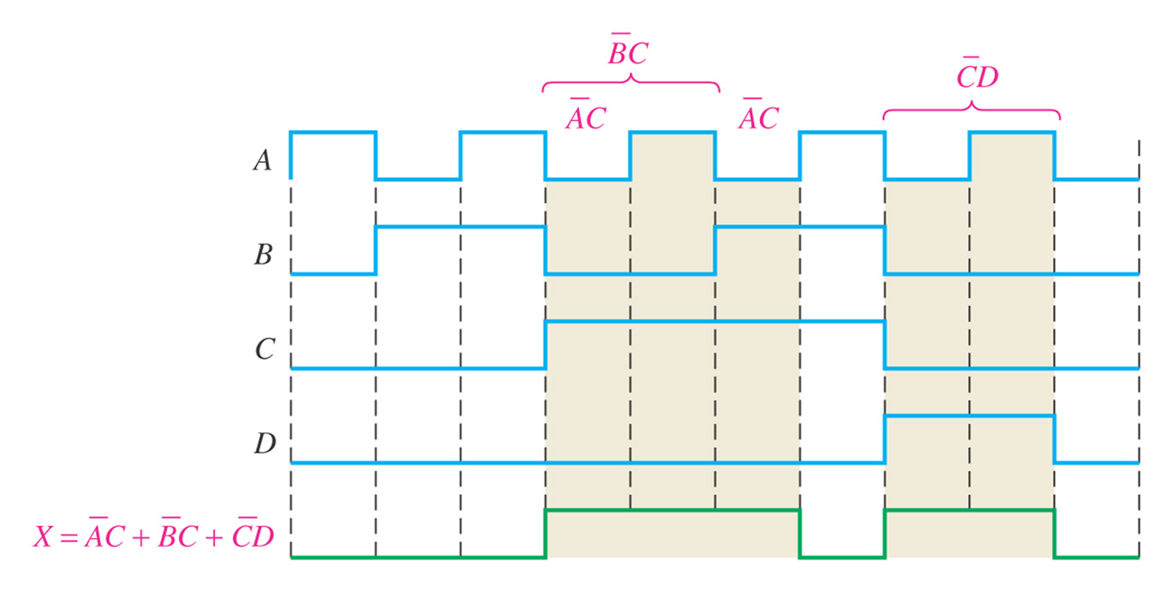
Example: Determine the final output waveform X for the circuit in the following figure, with input waveforms A, B, and C as shown.

Slide 39

Quiz
1. Assume an AOI expression is AB + CD. The equivalent POS expression is
a. (A + B)(C + D)
b. (A + B)(C + D)
c. (A + B)(C + D)
d. none of the above
© 2008 Pearson Education

Slide 40
Quiz
2. The truth table shown is for
a. a NAND gate
b. a NOR gate
c. an exclusive-OR gate
d. an exclusive-NOR gate
© 2008 Pearson Education

Slide 41
Quiz
3. An LED that should be ON is
a. LED-1
b. LED-2
c. neither
d. both
© 2008 Pearson Education

Slide 42
Quiz
4. To implement the SOP expression , the type of gate that is needed is a
a. 3-input AND gate
b. 3-input NAND gate
c. 3-input OR gate
d. 3-input NOR gate
X = ABC + ABD + BDE
A
B
C
A
B
D
B
D
E
© 2008 Pearson Education

Slide 43
Quiz
5. Reading the Karnaugh map, the logic expression is
a. A C + A B
b. A B + A C
c. A B + B C
d. A B + A C
© 2008 Pearson Education

Slide 44
Quiz
6. The circuit shown will have identical logic out if all gates are changed to
a. AND gates
b. OR gates
c. NAND gates
d. NOR gates
A
B
C
D
© 2008 Pearson Education

Slide 45
Quiz
7. The two types of gates which are called universal gates are
a. AND/OR
b. NAND/NOR
c. AND/NAND
d. OR/NOR
© 2008 Pearson Education

Slide 46
Quiz
10. During the first three intervals for the pulsed circuit shown, the output of
a. G₁ is LOW and G₂ is LOW
b. G₁ is LOW and G₂ is HIGH
c. G₁ is HIGH and G₂ is LOW
d. G₁ is HIGH and G₂ is HIGH
A
A
G₁
B
B
G₃
C
C
D
G₂
D
© 2008 Pearson Education

