Slide 1


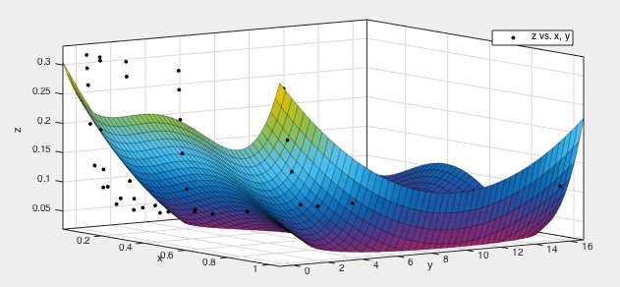
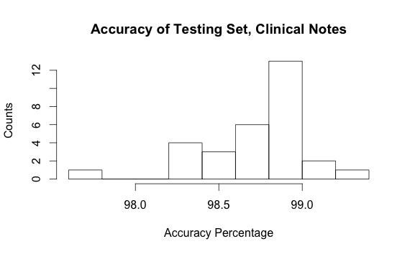
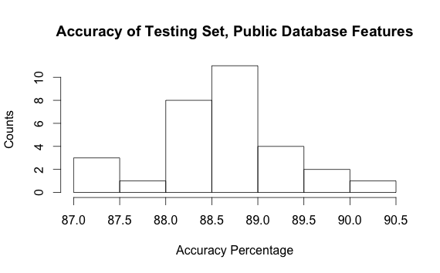
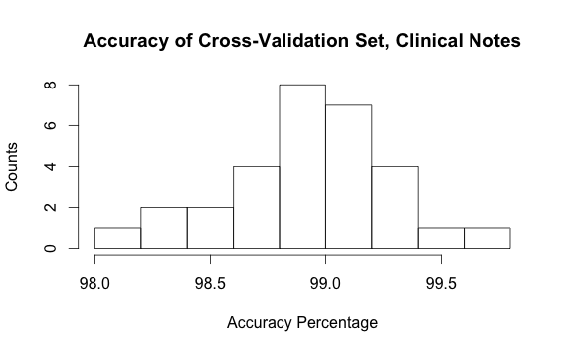
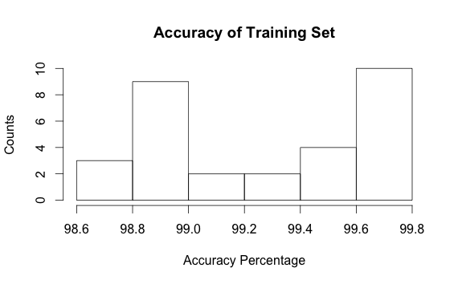
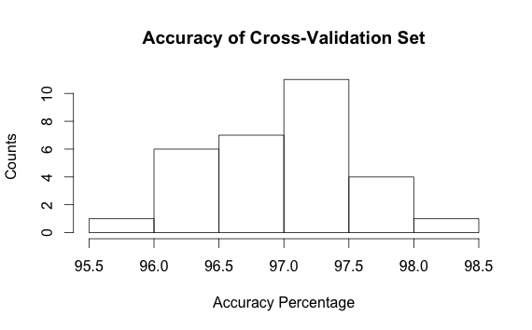
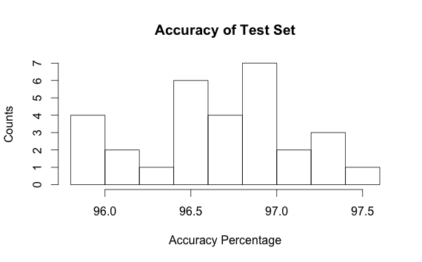
Constructing a Predictor to Identify Drug and Adverse Event Pairs
Shah Lab
Rick Huang, Bell Wang, Elsie Gyang MSc, Nigam Shah PhD
Stanford School of Medicine, Stanford, CA
Abstract
Introduction (cont.)
Methods & Materials (cont.)
Results
The FDA drug approval process aims to ensure that medications are safe for use. Even so, adverse, or undesired, events can still result. Given the severity of drug adverse events, it is imperative to develop ways of identifying potential adverse events to raise potential safety concerns. While public databases have already been used to build predictive models to identify drug-adverse event (AE) pairs, we show that clinical notes are also a strong source for predicting drug-AE pairs.
From known usages in Medi-Span Drug Indications Database, we are able to construct a "gold standard" of known positive and negative drug-AE pairs. Using the National Medi-Span and Drugbank databases, we compute sixteen features including the cosine and Jaccard similarity index between related drugs, diseases, pathways, and categories. We compute this by considering a matrix of drugs with boolean indications of whether or not they are associated with a certain disease, pathway, or category. In addition, we extract nine features from clinical notes extracted from the Stanford Translational Research Integrated Database Environment (STRIDE), containing more than 2 million patients for a total of twenty-five features.
We train a support vector machine model using the radial basis function kernel on the gold standard to predict positive or negative drug-AE pairs based on all features, only clinical note features, and only database features.
While our predictor on all features achieved an accuracy of 96% in predicting positive and negative drug-AE pairs, we compared the performance from using clinical note features compared with database features to find that our model significantly improved by including the clinical note features.
Overall, our hypothesis was supported, as the results show that using clinical note features in addition to public database features builds a stronger model to predict drug-AE pairs.
As a result, it becomes essential to create a model to accurately predict positive or negative drug-AE pairs. To create such a model, we must extract certain features from reliable databases that allow us to accurately classify drug-AE pairs as positive or negative. Using private clinical notes, we hope to extract features that significantly increases our predictor’s performance in addition to public database features.
Figure 4. Histograms of accuracy of model trained on only clinical note-based features and only public database-based features. Difference significance p << 0.01.
Hypothesis
Figure 1. C (y-axis) and sigma (x-axis) are mapped against the fraction error (z-axis) for the SVM model on the cross-validation set. We optimize based on overall accuracy, so we minimize the error.
We hypothesize that it is possible to construct an accurate model to predict whether a certain drug-AE pair is positive or negative based on its features, with features extracted from clinical notes strengthening the prediction..
The final accuracy resulted from running the optimal model on the testing set.
A two pairs test was performed to measure differences between the cross-validation accuracy and the testing accuracy.
Another two pairs test was performed to measure differences between the accuracy of models using the clinical features and without clinical features.
Methods & Materials
Figure 5. Histograms of accuracy of model on cross-validation set and testing set for only clinical note-based features. Difference significance p < 0.01.
The Medi-Span Drug Indication Database included mappings of known drug-AE pairs, which formed our “gold standard.”
We construct features for our gold standard using empirical features such as mention count from the STRIDE5 database. We also include 16 other features such as similarity factors included from Medi-Span and DrugBank.²
Using MatLab, the “gold standard” features were all normalized using z-scores. We normalize unavailable features to the mean.
This “gold standard” was then randomly split into a training set, a cross-validation set, and a testing set.
An SVM using the RBF kernel from “kernlab” in R was run on the train set to create a model, and the model was run on the cross-validation set to determine initial accuracy.
Constants C and sigma for the RBF kernel were varied to maximize this initial accuracy on the cross-validation set.
Results
Conclusions and Future Work
Our hypothesis is supported in that we created an accurate model based on clinical note and public database features to identify positive drug-disease pairs. Features from clinical notes strengthen the prediction more than public database features.
However, the features from clinical notes alone trained a model that overfit cross-validation data more than combining clinical note features and public database features to train a model.
We next analyze general trends appearing between drugs and predicted AEs to determine potentially threatening AEs, and create a function dependent on correlation strength to give direction to research specific relations more in-depth.
Figure 2. Histogram of accuracy of n=30 simulations on each split set. Mean accuracy of model is 96.64%. p>0.01 but p<0.05 for difference between cross-validation and test sets.
Introduction
While 21% of drug prescriptions are off-label prescriptions, only 27% of off-label drug use have evidence of being safe. Usage of off-label drugs can result in an AE. Roughly 30% of hospital stays include a patient suffering from an ADE, with around 2 million patients suffering from an AE reaction, and up to a hundred thousand patients succumb to AEs. In addition, over 75 billion dollars are spent treating AEs.¹ _x0018_
Dataset Used | Average Accuracy of Clinical and Database Features | Average Accuracy of Clinical Features Only | Average Accuracy of Database Features Only
Training Dataset | 99.4515% | 99.6157% | 93.3449%
Cross-Val. Dataset | 97.2444% | 98.9058% | 88.6475%
Testing Dataset | 97.1113% | 98.6901% | 88.6182%
Selected References
¹Ahmad SR. Adverse drug event monitoring at the Food and Drug Administration: your report can make a difference. J Gen Intern Med. 2003;18(1):57–60.
²Jung K, LePendu P, Chen WS, Iyer SV, Readhead B, et al. (2014) Automated Detection of Off-Label Drug Use. PLoS ONE 9(2): e89324. doi:10.1371/journal.pone.0089324
Acknowledgements
Figure 3. Averages over 30 trials of training data for different sets of features. Testing data is the measure for overall accuracy of the data.
The authors would like to thank the Stanford Institutes of Medical Research Summer Research Program and the members of the Shah lab for continued support and aid in this research. The author would also like to thank the Stanford Medical Hospital for providing information on patients from clinical notes.

